Slide 1
Increasing Happiness in Learning and Life
Dr. Marsha Fralick and Dr. Seth Batiste
Notes:
Tamara
Welcome to our presentation today. We’re happy you could join us.

Slide 2
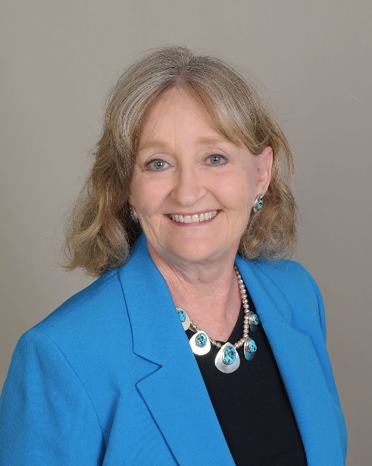
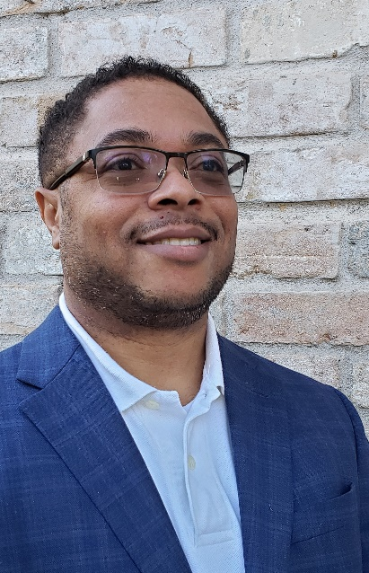
Introduction
Dr. Marsha Fralick
Dr. Seth Batiste
Notes:
Dr. Marsha Fralick is currently Professor Emeritus at Cuyamaca Community College, in the San Diego area. She has been recognized as an Outstanding First-Year Student Advocate by the National Resource Center for the First-Year Experience and Students in Transition for excellence in counseling, teaching, curriculum development, and leadership over the last 43 years. She has brought together research in psychology, education, neuroscience, health, and career development to provide students with strategies for college, career, and lifelong success. She is the author of several first- year experience and career textbooks including Native American, Hawaiian, and Pacific Islander versions. Her materials include positive psychology and information about achieving happiness in life.
Dr. Seth Batiste is currently the FOUNDER and Chief Strategist of Batiste Consulting, LLC, specializing in curriculum and subject-matter resources that include college writing, study skills, and student success strategies. He is the co-author of College and Career Success with Dr. Marsha Fralick. He has over 25 years experience in teaching and administration in K-12 and higher education. While working as an administrator at the Lone Star Community College District in Houston, Texas, he was instrumental in developing the Best Start Quality Enhancement Program that eventually became the cornerstone for the Educational Frameworks courses addressing student success, which he managed and also taught in the program. He also believes that it is important to help student attain mental health and happiness in life.

Slide 3
Resources
www.collegesuccess1.com
Training Notes
collegesuccess1.com/TrainingNotes.htm
Notes:
Marsha
Show website and resources.

Slide 4
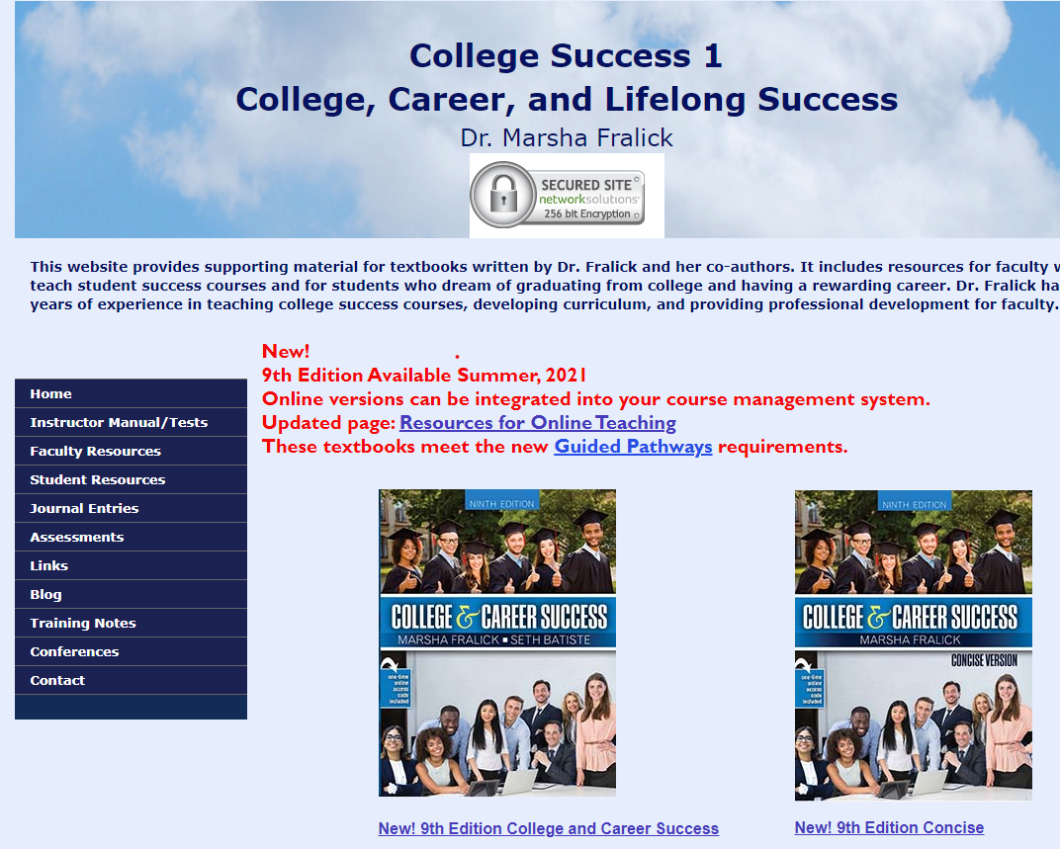
Notes:
Marsha
Here is my website. Click on Training Notes

Slide 5
Key Ideas
How will we achieve happiness in a post pandemic world?
What ideas can you use to achieve happiness?
As we go through this presentation make a list of ideas you can use to improve happiness.
We will share ideas along the way.
Notes:
Seth:
Here are some key ideas for our presentation today.
Alternate

Slide 6
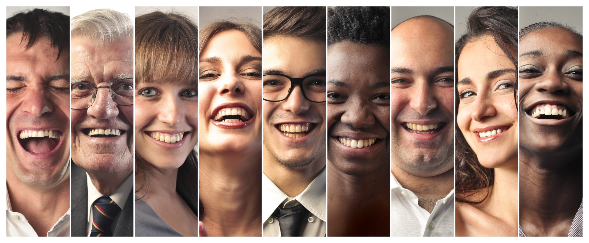
Why is happiness important?
Happy people:
Live longer
Have better mental health
Enjoy their jobs more
Have rich and fulfilling social lives
Notes:
Seth
Read slide

Slide 7
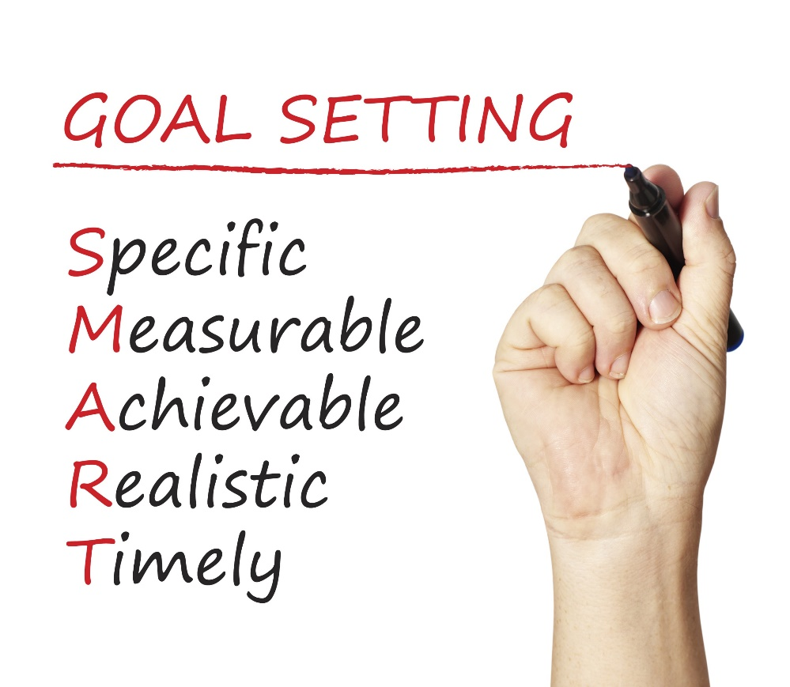
Happiness is a common goal.
Notes:
Marsha
In working with my students over the years, I found out that happiness was commonly mentioned as an important goal.
However, we know that goals should be
Specific
Measurable
Achievable
Realistic
Timely
How do these ideas apply to happiness?

Slide 8
Happiness is not a goal!
Achieving our goals is one of the ways to achieve happiness.
Notes:
Seth
Positive psychologists who study happiness tell us that happiness is not a goal!
Achieving goals is one of the ways to achieve happiness.
How can we help students achieve happiness?

Slide 9
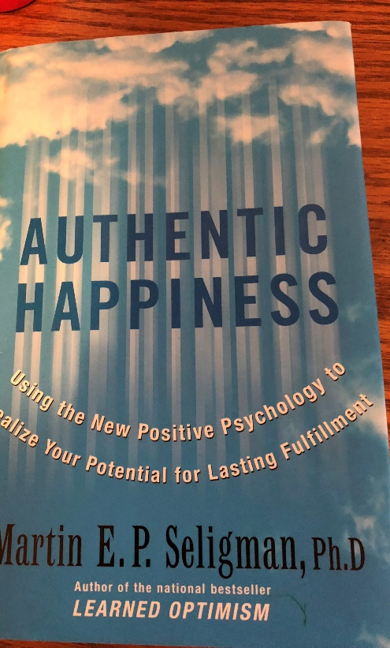
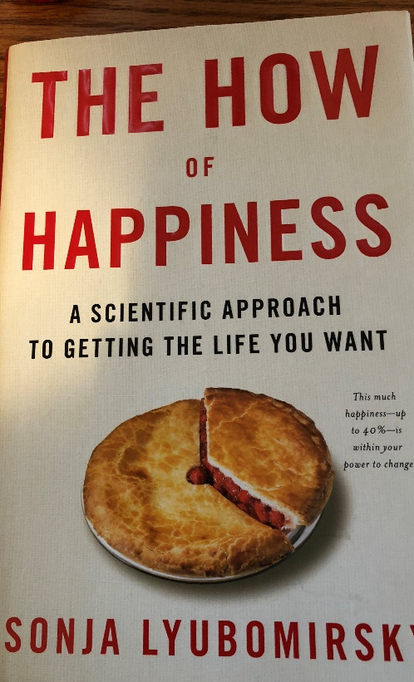
Martin Seligman Sonja Lyubomirsky
Positive psychologists who have done research on how to achieve happiness in your life. See the references on the handout.
Notes:
Marsha
Here are two of my favorite books on happiness.

Slide 10
Seligman: Happiness or Hedonism?
Hedonist
The hedonist wants as many good moments and as few bad moments as possible.
Why doesn’t it work?
Hedonistic Adaptation
The more material possessions we have, the greater our expectations, and we no longer appreciate what we have.
Notes:
Marsha
Positive psychologists such as Martin Seligman describe the difference between happiness and hedonism, and it is important to understand this difference.
Read Slide
Provide Example
Buying a TV or car

Slide 11
Expressing gratitude
Being optimistic
Being employed
Having positive self-esteem
Enjoying leisure activities
Having good health
Enjoying friendships
Notes:
Seth
Psychologists remind us to choose happiness over hedonism. What does this mean?
Choosing happiness means . . . (Read slide)

Slide 12
Sonya Lyubomirsky The How of Happiness 12 Happiness Activities Which ones can you use?
Notes:
Marsha
Today we will focus on some ideas from Sonya Lyubomirsky’s (Lubomirskey) book on the How of Happiness.
She suggests 12 happiness activities which we will review today.
Can you use some of these ideas? Make a note of some ideas you would like to use more often.

Slide 13
1. Express Gratitude
One of the most powerful happiness techniques
Notes:
Seth
The first activity is expressing gratitude. It is one of the most powerful happiness techniques.

Slide 14
What is gratitude?
“A felt sense of wonder, thankfulness, and appreciation for life.” –
Robert Emmons
Notes:
Seth
Read slide

Slide 15
Why Is Gratitude Important?
Savoring positive life experiences
Increasing self-esteem
Coping with stress and trauma
Encouraging moral behavior
You are more likely to help others
Building social bonds
Diminishing negative emotions
such as anger, bitterness, and greed
Appreciating what you have
Avoiding hedonistic adaptation.
Notes:
Marsha
Why is gratitude important?
Alternate reading boxes. Begin with Marsha.

Slide 16
Gratitude Exercise
What are 5 things in life for which you are grateful or thankful? Share your ideas.
Keep a gratitude journal. Each week list at least five things for which you’re grateful or simply take some time to contemplate why you are grateful.
Make it a Thanksgiving tradition.
Notes:
Marsha
Lead group in exercise
While participants are thinking, Marsha and Seth provide examples of being grateful for what we have in life.
Marsha:
I am grateful for my good health and my family.
I am grateful for a husband that makes me laugh every day.
Seth?

Slide 17
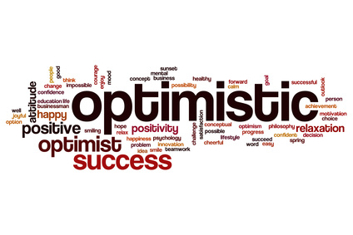
2. Cultivate Optimism
Notes:
Marsha
Another way to increase happiness is to cultivate optimism.

Slide 18
Cultivate optimism with mindset.
Notes:
Seth
One of the ways you can cultivate optimism is being aware of your mindset.
If you are interested, Carol Dweck has a book on this topic.

Slide 19
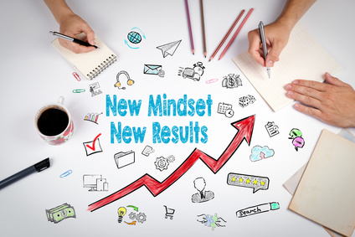
Positive Thinking and Mindset
Negative Thinking: Fixed Mindset
Positive Thinking: Growth Mindset
Intelligence is fixed at birth.
Increased effort does not lead to success.
Roadblocks are an excuse to be absent.
Intelligence is increased as you acquire new knowledge.
Through practice and effort, skills can be improved.
Failure is an opportunity to learn.
Notes:
Marsha
Here are just a few key ideas from the psychology of mindset:
Negative Thinking: Fixed Mindset
Seth
Positive Thinking: Growth Mindset

Slide 20
What Went Well Exercise
Student Exercise
We tend to focus on what does not go well and not enough on what goes right in our lives.
What are three things that went well last week? Share your ideas.
Challenge: For two weeks, at the end of each day, set aside 10 minutes to think or write about what went well during the day.
Notes:
Marsha introduces exercise
While group members are thinking, Seth and Marsha provide examples of what went well recently.
Marsha: What went well
Family dinner to celebrate birthday
Finished new curriculum on financial literacy
Seth?

Slide 21
3. Avoid Overthinking and Social Comparison
“Overthinking is thinking too much, needlessly, passively, endlessly, and excessively pondering the meaning, causes, and consequences of your character, your feelings, and your problems.” – Sonja Lyubomirsky
Negative Consequences:
Increases sadness
Fosters negative thinking
Impairs the ability to solve problems
Decreases motivation
Interferes with concentration
Notes:
Seth
Read slide

Slide 22
Social Comparison
Social media results in comparison:
Noticing our friends, coworkers, family members, and even fictional characters
On social media, they are smarter, richer, healthier, funnier, or more attractive than we are
Dealing with overthinking and social comparison:
Become aware of the impacts of social media.
Yell stop!
Don’t sweat the small stuff.
Will it matter in a year? If so, begin taking small steps to resolve the issue.
Notes:
Marsha
Read slide

Slide 23
4. Practice Acts of Kindness
Why does it work?
View others more positively
Connect with others
Appreciate your own good fortune
Leads to positive social consequences
Feel good about yourself
Chain of kindness
Notes:
Seth
Another way to increase happiness is through random acts of kindness. Read slide.
(Provide examples on next slide.)

Slide 24
Kindness Exercise
Seligman states that this exercise is the “single most reliable momentary increase in well-being of any exercise he has tested.”
Practice an act of kindness.
Examples?
Notes:
Seth and Marsha provide examples while group thinks of examples to possibly add in the chat window.
Marsha
Letting a car in the line of traffic.
Pulling weeds in my neighbor’s yard.
Seth?
Ask audience for participation.

Slide 25
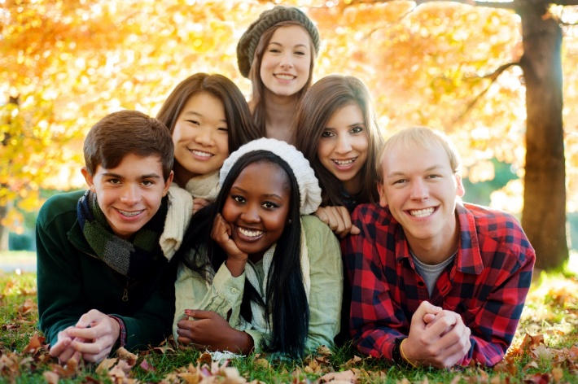
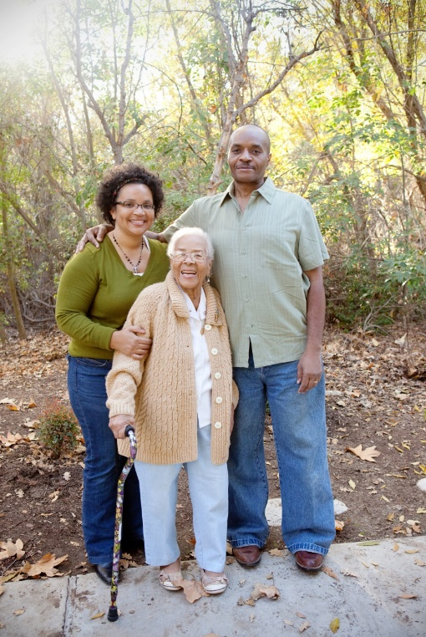
5. Nurture Social Relationships
Make time for others.
Express admiration and appreciation.
Be supportive and loyal.
Notes:
Marsha
Read slide and provide examples.
Marsha
Friends and museum
Seth add an example

Slide 26
6. Develop Strategies for Coping
We all know about these strategies. Can you increase some of them?
Meditation
Mindfulness
Breathing
Exercise
Sleep
Notes:
Seth
Read Slide
(Examples next page)

Slide 27
What is mindfulness?
It is taking the time to notice your environment. It provides distraction from worry.
Examples?
Notes:
Marsha
This is my personal favorite idea. Examples of how I use it each day.
Walking through a Eucalyptus grove in the fog. Noticing the smell.
Noticing my neighbors yard with purple Mexican sage and a yellow palo verde tree.

Slide 28
Grit is a powerful strategy for coping.
Grit = Passion and Perseverance
Notes:
Marsha

Slide 29
Grit: Key Ideas
Those who are gritty keep going after challenges or failure.
Grit is simply a “never give up” attitude.
What we accomplish may depend more on our passion and perseverance than our innate talent.
Talent is how quickly your skills improve when you invest effort.
Without effort, your talent is nothing more than your unmet potential.
Effortful training is more important than natural talent. It takes 10,000+ hours to become an expert.
Those with a growth mindset are grittier.
Notes:
Seth
Alternate

Slide 30
7. Learn to Forgive
Notes:
Seth
Read slide

Slide 31
8. Increase Flow Activities
Flow is the state of intense absorption and involvement with the present moment.
Flow is one of the characteristics of the happy life.
The key to creating flow is to establish a balance between skills and challenges.
To maintain flow, we must test ourselves in challenging situations.
Notes:
Marsha
Read slide
Provide example and connect to career development as well as relaxation.

Slide 32
9. Savor Life’s Joys
The ability to savor positive experiences in life is one of the most important ingredients of happiness.
Relish ordinary experiences
Savor and reminisce with family and friends.
Transport yourself.
Replay happy days.
Celebrate good news.
Be open to beauty and excellence.
Be mindful.
Brainstorm: Life’s Joys
Notes:
Seth
Read Slide
Marsha Examples
Noticing the hummingbirds outside my window
All my plants are blooming.
The smell of jasmine on my fence
Seth
Provide examples
Ask for audience participation in brainstorming if time.

Slide 33
10. Commit to Your Goals
“An aim in life is the only fortune worth finding.” -Robert Louis Stevenson
“Find a happy person and you will find a project.” -Sonja Lyubomirsky
Working toward a goal is as important to well-being as it’s attainment.
Goals provide structure and meaning to our lives.
Goals help us to master our time.
Accomplish goals with grit.
Notes:
Seth
Read slide
Provide examples of goals. Marsha add goals.
Marsha
Maintain my level of fitness to live a long and healthy life.
Improve my mental health by taking time to relax and savor life’s joys.

Slide 34
11. Practice Religion and/or Spirituality
Provides social support and a sense of identity
Helps people deal with trauma
Helps people find meaning and purpose in life
Provides hope
Promotes forgiveness
Notes:
Seth
Read slide
Marsha
Talk about spirituality

Slide 35
12. Take Care of Your Body
Can you add any of these ideas to your list of things to improve?
Exercise increases self-esteem.
It provides opportunities for flow.
Spend more time outside
Learn the basics of good nutrition
Get enough sleep
Notes:
Seth
Read slide
Marsha
At the end, we will ask for you to share some ideas you find useful.

Slide 36
Intention Statements
Express Gratitude
Cultivate Optimism
Avoid Over-thinking and Social Comparison
Practice Random Acts of Kindness
Nurture Social Relationships
Develop Coping Strategies
Learn to Forgive
Increase Flow Activities
Savor Life’s Joys
Commit to Your Goals
Practice Religion/Spirituality
Take Care of Your Body
Make a list of at least five things you can do to improve your happiness.
Review these ideas.
Share some of your ideas
Notes:
Marsha
Introduce exercise.
While group participants are thinking:
Seth, what are some of your intention statements?
Marsha share intention statements also.
I intend to savor life’s joys at the end of each day.
I intend to take care of my body by learning more about nutrition.
I intend to increase flow activities by spending more time on my art projects.

Slide 37
The new 9th Edition of College and Career Success includes positive psychology and finding happiness in life.
Contact:
marsha@marshafralick.com for a complimentary copy or demo of the interactive online version.
Notes:
Marsha
The new edition of College and Career Success includes positive psychology, including happiness in learning and in life. It can be customized to match your student learning outcomes.
It is available as a print or interactive online version.
Contact me if you would like a complimentary copy or a demo of how I use the interactive digital version with my students.

Slide 38
Contact the Authors
Dr. Marsha Fralick
Dr. Seth Batiste
marsha@marshafralick.com
www.collegesuccess1.com
Training Notes
sethbatiste@yahoo.com
Notes:
Marsha
Read contact information.
Seth
Read contact information.

Slide 39
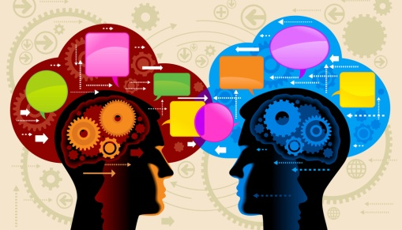
Discussion Questions
seth@batisteconsulting.us
marsha@marshafralick.com
Notes:
Seth
It would be great to hear any comments or questions you may have.
Marsha
Thanks for attending and hope you have some ideas that can increase happiness in your life.

