Slide 1
Hawaii and Pacific Islands College and Career Success

Slide 2
Agenda
Build excitement for the coming semester.
Describe some unique features of the textbook.
Share some of my key ideas for working with students.
List some tips for success.
Some practical tasks
Providing feedback on the journal entries
Understanding the assessments
Kau’ionalani Meade will join us around 10:00

Slide 3
Chapters
Cultural Identity and Success
Understanding Motivation
Choosing Your Major
Managing Time and Money
Using Brain Science to Improve Memory
Using Brain Science to Improve Study Skills
Taking Notes, Writing, and Speaking
Test Taking
Thinking Positively about the Future

Slide 4
Resources
www.collegesuccess1.com
Training Notes
Instructor Manual
Exercises
Handouts
PowerPoint
Video Suggestions

Slide 5
Cultural Content for Hawai’i and the Pacific Islands
While the text is designed for Native students, all student who live in Hawai’i and the Pacific Islands can benefit from increasing knowledge and appreciation of the culture of the people where they live.

Slide 6
Taking Pride in Your Culture
This textbook is based on the premise that students are more successful if they take pride in themselves and their culture.
Having pride in yourself is the foundation for good self-esteem and the foundation for good mental health and success in life.

Slide 7
Success in Education
Taking pride in your culture is important because it serves as a foundation for learning.
You are more likely to be successful if you approach learning with an understanding of your self which includes a sense of belonging to your family and an understanding and appreciation of your culture.

Slide 8
Hawaiian Values
Values are passed down throughout the generations.
Aloha is the root of all other values that lead to success in life.
Aloha can be used to be successful in college and careers.

Slide 9
To have aloha is to know how to treat others with love and to show respect. It begins with loving yourself and spreading this love to others.
Hawaiians have aloha for the:
Land: ‘aina
Family: ‘ohana
People: kanaka
Culture: mo’omeheu

Slide 10
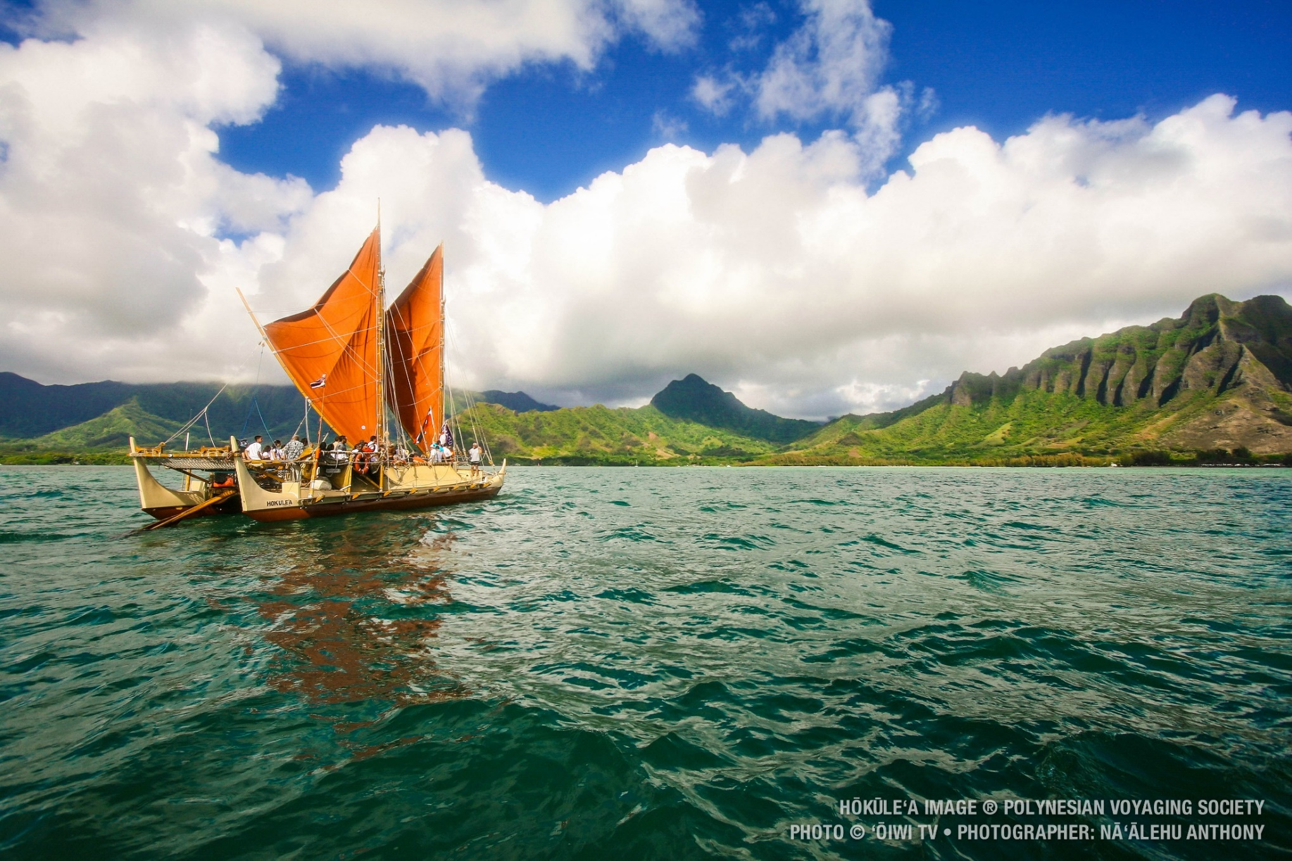
Revival of Pride in Hawaiian and Pacific Island Culture: The Hokule’a

Slide 11
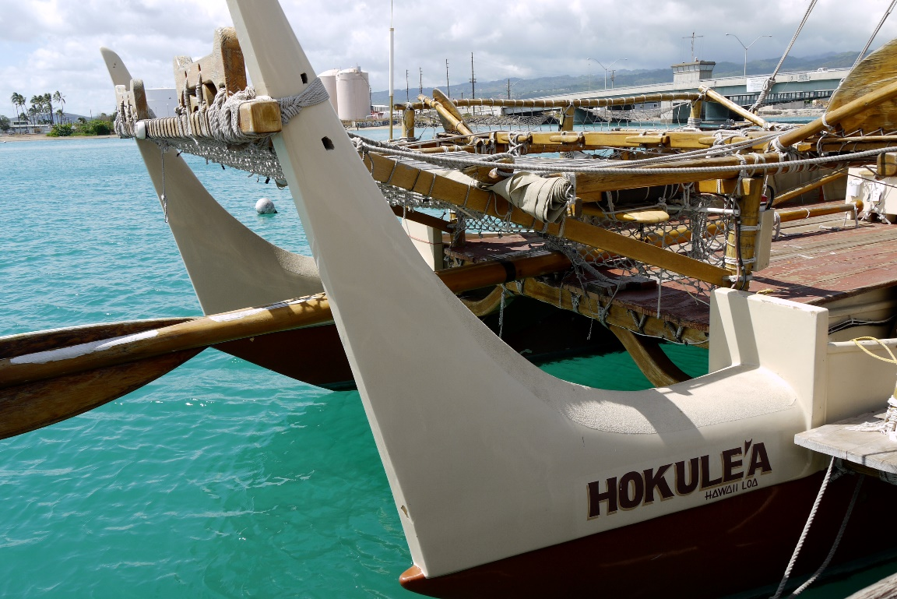
The Hokule’a
This project is helping students around the world take pride in their culture, inspiring beach clean-ups, school beautification, and discouraging pollution and littering.

Slide 12
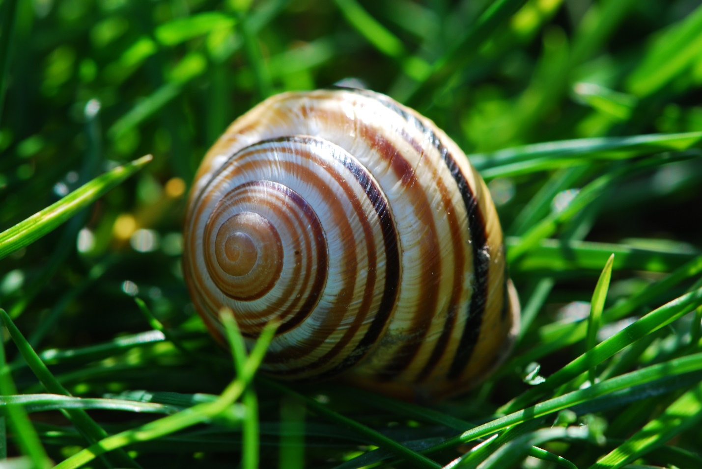
Appreciating Island Cultures: The Story of the Kahuli Shells
Read the story and discuss in class.

Slide 13
Help students understand their reason for attending college. What is your reason for attending college?
Write your answer in the chat window.

Slide 14
Career Emphasis
Career assessments help students to:
Focus on personal strengths
Connect them to a major and career
Students are empowered when they have a vision of the future, including their future career.
Important: Each personality type has different strengths. No personality type is better than any other.

Slide 15
Positive Psychology Provides the Foundation
Interacting with students
Providing feedback
Helping students understand their personal strengths using the career assessments.

Slide 16
What is Positive Psychology?

Slide 17
From Dr. Shamini Dias

Slide 18
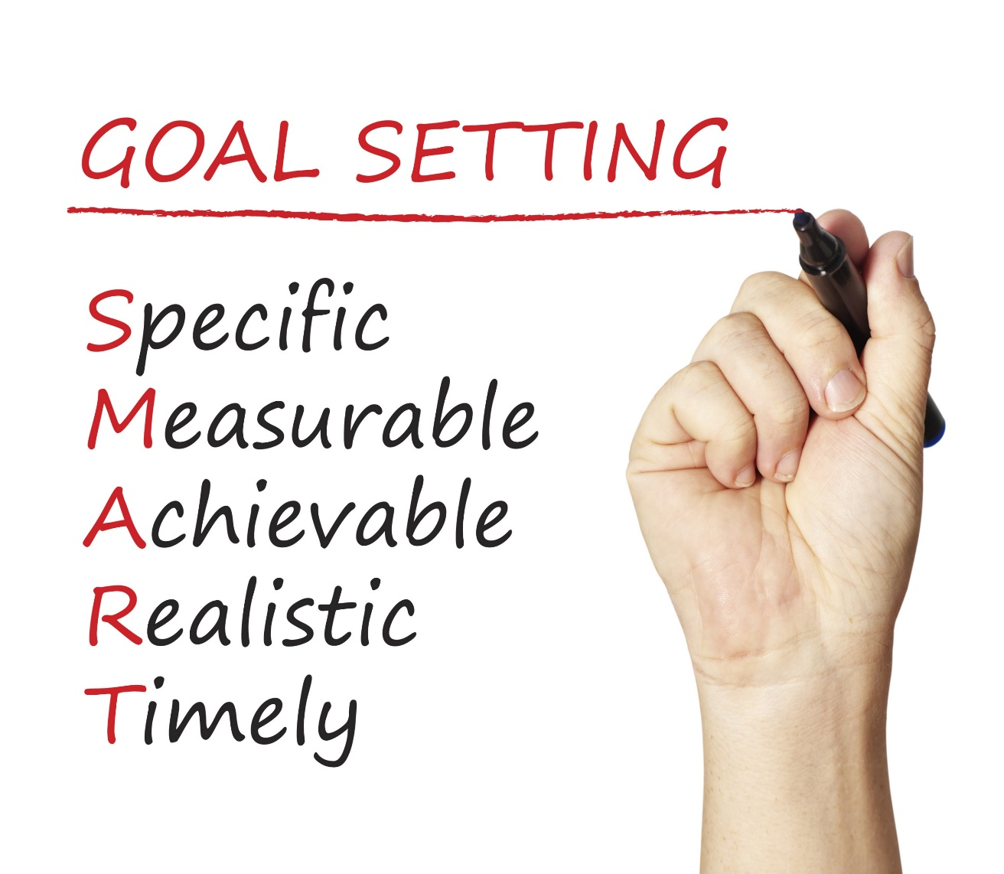
Happiness is a common goal.
How does it fit with SMART Goals?

Slide 19
Happiness is not a goal!
Achieving our goals is one of the ways to achieve happiness.

Slide 20
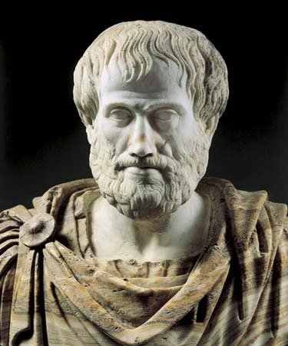
True happiness comes from a life of meaning, of doing what is worth doing. -Aristotle

Slide 21
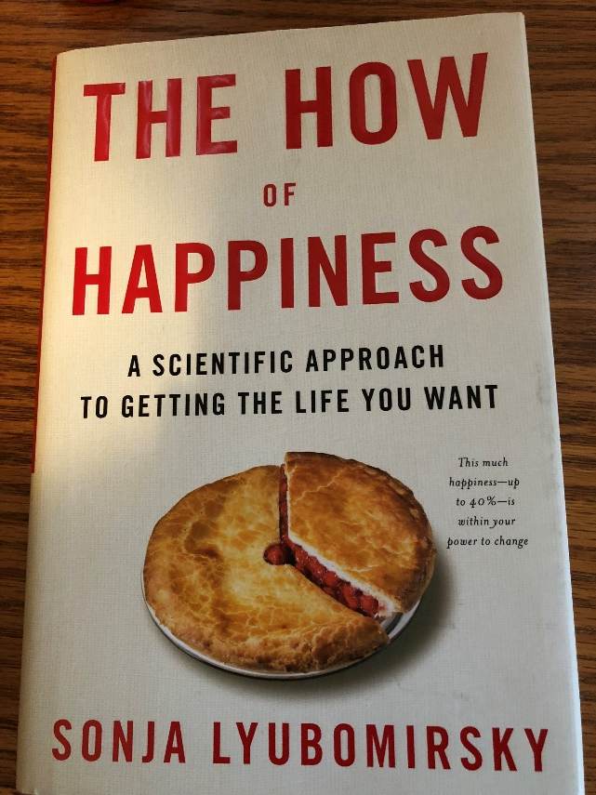
Martin Seligman Sonja Lyubomirsky
Positive psychologists who have done research on how to achieve happiness in your life. See the references on the handout.

Slide 22
Happiness or Hedonism?
Hedonist
The hedonist wants as many good moments and as few bad moments as possible.
Why doesn’t it work?
Hedonistic Adaptation
The more material possessions we have, the greater our expectations, and we no longer appreciate what we have.

Slide 23
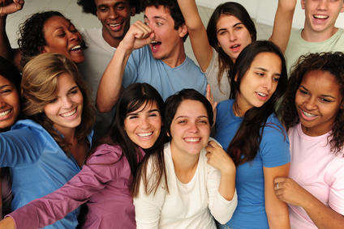
Research on happy people:
Live longer and have fewer disabilities.
Enjoy their jobs more.
Have rich and fulfilling social lives.

Slide 24
The last chapter has ideas on how to achieve happiness.
Secrets to happiness:
The past does not determine your future. The future is open to possibilities.
Be grateful.
Forgive and forget.
Increase optimism and hope for the future.
Engage in activities that make you happy.
Take the time to savor the happy times.
Take the time to enjoy the present moment.
Build more flow into your life. Flow is the state of gratification we feel when totally absorbed in an activity that matches our strengths.

Slide 25
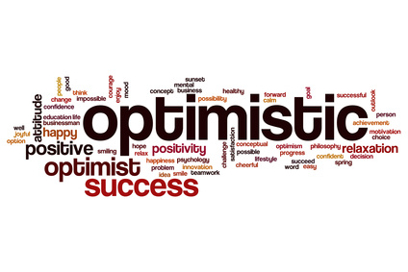
Optimism is a central theme.

Slide 26
Cultivate optimism with mindset.

Slide 27
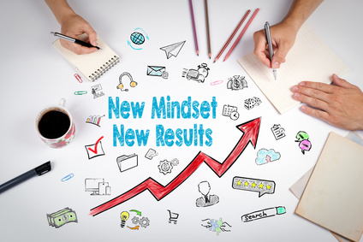
Positive Thinking and Mindset
Growth Mindset
Fixed Mindset
Intelligence is increased as you acquire new knowledge.
Through practice and effort, skills can be improved.
Failure is an opportunity to learn.
Intelligence is fixed at birth.
Increased effort does not lead to success.
Roadblocks are an excuse to be absent.

Slide 28
What Went Well Exercise for Students
Have students write down daily 3 good things that happened to them.
Write about one of the following:
Why did this good thing happen?
What does this mean to you?
How can you have more of this good thing in the future?

Slide 29
Grit is a powerful strategy for coping.
Grit = Passion and Perseverance

Slide 30
Grit: Key Ideas
Those who are gritty keep going after challenges or failure.
Grit is simply a “never give up” attitude.
What we accomplish may depend more on our passion and perseverance than our innate talent.
Talent is how quickly your skills improve when you invest effort.
Without effort, your talent is nothing more than your unmet potential.
Effortful training is more important than natural talent. It takes 10,000 hours to become an expert.
Those with a growth mindset are grittier.

Slide 31
Increase Flow Activities
Flow is the state of intense absorption and involvement with the present moment.
Flow is one of the characteristics of the happy life.
The key to creating flow is to establish a balance between skills and challenges.
To maintain flow, we must test ourselves in challenging situations.

Slide 32
Flow and grit are related.
To increase grit (passion and perseverance):
Begin with interest
Next comes practice. Practice increases interest.
Then comes purpose. We become passionate when we are convinced that our work matters and has meaning.
Finally comes hope for a better future.

Slide 33
Commit to Your Goals
“An aim in life is the only fortune worth finding.” -Robert Louis Stevenson
“Find a happy person and you will find a project.” -Sonja Lyubomirsky
Working toward a goal is as important to well-being as it’s attainment.
Goals provide structure and meaning to our lives.
Goals help us to master our time.
Accomplish goals with grit.

Slide 34
Take Care of Your Body
Exercise increases self-esteem.
It provides opportunities for flow.
Learn the basics of good nutrition

Slide 35
Intention Statements
Make a list of at least five things you can do to improve your happiness.
Make a list of at least five ways you can help your students to improve their happiness. Review the above lists.

Slide 36
Tips for Success
Celebrate your culture and values.
Your ohana is the source of strength, support, identity, and confidence.
Be open to learn about other cultures.
Appreciate different perspectives.
Learn to network with other people.
Be an advocate for Malama, protecting and caring for the earth, to improve the lives and futures of all earth’s inhabitants.

Slide 37
Applying Positive Psychology
Grading the journal entries.
Understanding the career assessments.

