Slide 1
The Moon Will Smile at Your Courage: Managing Time and Money
Chapter 4

Slide 2

Living in Harmony
Native peoples know that it is important to live in harmony with the earth and the universe. Building an awareness of new skills and the changes you are encountering will help you to remember that you are part of the universe, and your community will grow with you.

Slide 3

The Native Concept of Time
The Native concept of time is described as circular.
Circular time describes the natural world, including the seasons and the cyclical passing of the moon and sun.

Slide 4
Native Poet Sondra Ball
“More and more, I am convinced that Indian time is just ‘human time.’ Humans were not meant to keep exact times. We were meant to live within the confines of seasons, light and dark, and our own body’s rhythms, which are not the same from day to day or from year to year.”

Slide 5

Right Action
Because the events of the past have an influence on the present and future, the idea of circular time includes the obligation to care for the land and the natural environment.
Present behavior will affect the future.

Slide 6

Western Concept of Time: The Arrow of Time
It is linear and sequential, like an arrow approaching a target.
It is orderly, sequential, and chronological.
It is being on time and meeting deadlines

Slide 7
Balancing Native and Western Time: Learn to Walk in Both Worlds
Important for success in schools, colleges, and workplaces.
Learn different approaches to time as defined by home, work, or college.

Slide 8
What is the longest and yet the shortest thing in the world?
The swiftest and yet the slowest,
The most divisible and the most extended
The least valued and the most regretted,
Without which nothing can be done
Which devours everything, however small,
And yet opens the life and spirit,
To every object, however great?

Slide 9
Time
Time

Slide 10
Time Management is Not:
Restriction and control
Someone else’s agenda

Slide 11
Time Management Is:
Accomplishing your personal goals
Having fun with your life
Friends and family
A successful career

Slide 12

Manage time and money to reach your goals.

Slide 13
What are your lifetime goals?

Slide 14

Successful Goal Setting
Is it achievable?
Is it realistic?
Is it specific and measureable?
Do you want to do it?
Are you motivated to achieve it?
Does the goal match your values?
What steps will you take to begin?
When will you finish this goal?

Slide 15

Smart Goals

Slide 16
Knowing your goals is the key to time management.

Slide 17
Class Exercise:
My Lifetime Goals

Slide 18

Rules for Brainstorming
Generate as many ideas as possible
No censorship
Choose the best ideas later
Set a time limit
Establish a goal or quota

Slide 19

In 5 minutes, list your lifetime goals. Write anything that comes to mind. Can you list at least 10?

Slide 20

Look over your list and highlight or mark the most important goals.

Slide 21

In 5 minutes, list what you would like to accomplish in the next 5 years. Include your educational and career goals. See if you can come up with 10 items.

Slide 22
Again, highlight or mark your best answers.

Slide 23
What goals would you like to accomplish in the next year?
Consider these goals:
  Education
  Work
  Leisure
  Family
  Social

Slide 24
Highlight your best ideas.
Share with the class one of your most important ideas from this question.

Slide 25
Assignment:
Finish My Lifetime Goals

Slide 26
What is the difference between a goal and a fantasy?

Slide 27

Is this car a goal or a fantasy?

Slide 28
A Goal Requires
ACTION

Slide 29
Turn Your Dreams Into Reality
Dream or visualize
Convert the dream into goals
Convert your goals into tasks
Convert your tasks into steps
Take your first step and then the next

Slide 30
Activity: Make a quick list of what you have done today and what you plan to do until you go to bed tonight.

Slide 31

Priorities are the key to effective time management.
What are priorities?

Slide 32



Prioritize your list
Related to Lifetime Goals
Important--Have to Do
Could Postpone

Slide 33
Beware: “C” Fever
The tendency to do “C” activities first
  They are easier
  We can see the results
  Doesn’t take too much effort or creativity
  Little thought required

Slide 34
Work Your “A’s” Off
Make sure to accomplish what is most important
Work toward your lifetime goals

Slide 35

Technology Addiction?
How much time do you spend on it?
Does technology interfere with accomplishing your lifetime goals?
Use technology as a reward for accomplishing your priorities.

Slide 36
Schedule Your Success

Slide 37

What Is Your Chronotype?
Chronotype refers to different time preferences
Larks get up early
Owls stay up late
Hummingbirds are combination types

Slide 38

Owls Often Have Lower GPA’s
They are sleep deprived
Loss of sleep interferes with attention, memory, mathematical skills, logical reasoning and manual dexterity

Slide 39

Night Owls
Avoid:
Staying up late
Alcohol, nicotine, and food late in the evening
Do this:
Relax before bedtime
Develop a regular pattern of sleep
Get some exercise so you feel tired at night

Slide 40
Balancing Work and Study Time
You need 2 hours of study time for each hour in class.
Research on college success has shown that you should work no more than 20 hours a week to be successful in college.
Working 20 hours a week provides valuable work experience.

Slide 41
Full Time College Schedule
15 Hours Attending Class
30 Hours in Reading and Studying
45 Hours Total
This is like having a full time job.

Slide 42
College and Work Schedule
12 Hours Attending Class
24 Hours of Reading and Studying
20 Hours Work
56 Hours Total
This is like having a full-time job
and a part time job.

Slide 43
The Impossible Schedule
12 Hours Attending Class
24 Hours Reading and Studying
40 Hours Work
76 Hours Total
This is like having
two full time jobs!

Slide 44
Part Time Student Schedule
6 Hours Attending Class
12 Hours Reading and Studying
40 Hours Work
58 Hours Total

Slide 45

Schedule Your Success
Create a Master Schedule
  Class Times
  Work Time
  Scheduled Activities

Slide 46
Tips for Scheduling
Write in study times on your Master Schedule
Use the daylight hours for studying
Use your prime time for important tasks
Allow time for sleep and meals
Use priorities
Leave some unscheduled time for the unexpected
Leave time for recreation

Slide 47
Benefits of Using a Schedule
Gets you started
Helps avoid procrastination
Relieves pressure
Frees the mind of details
Helps find time to study
Helps avoid panic
Find time for recreation and exercise

Slide 48
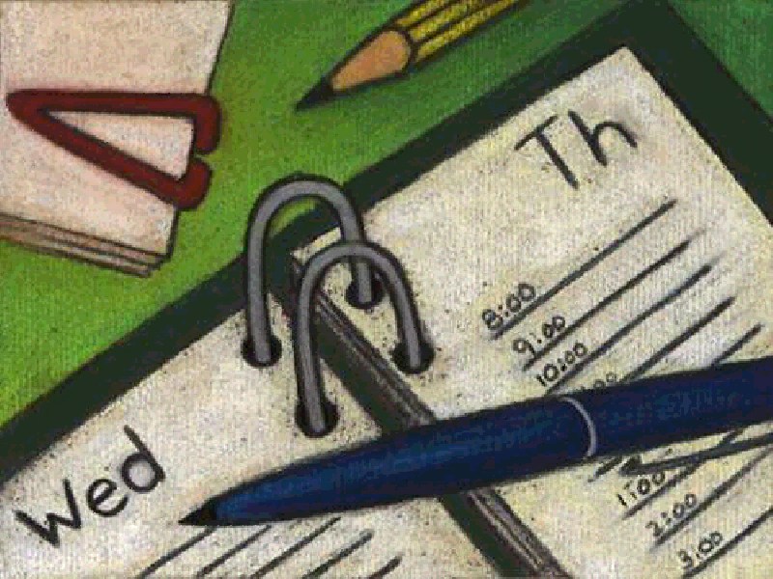
Types of Schedules
Weekly
Daily
Monthly
Yearly

Slide 49
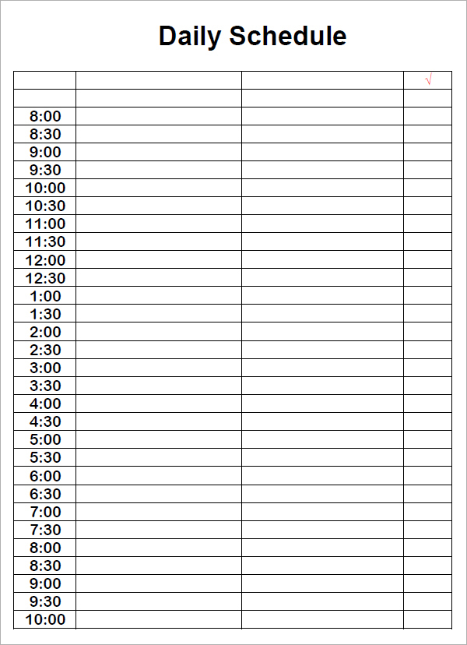
Daily Schedule

Slide 50
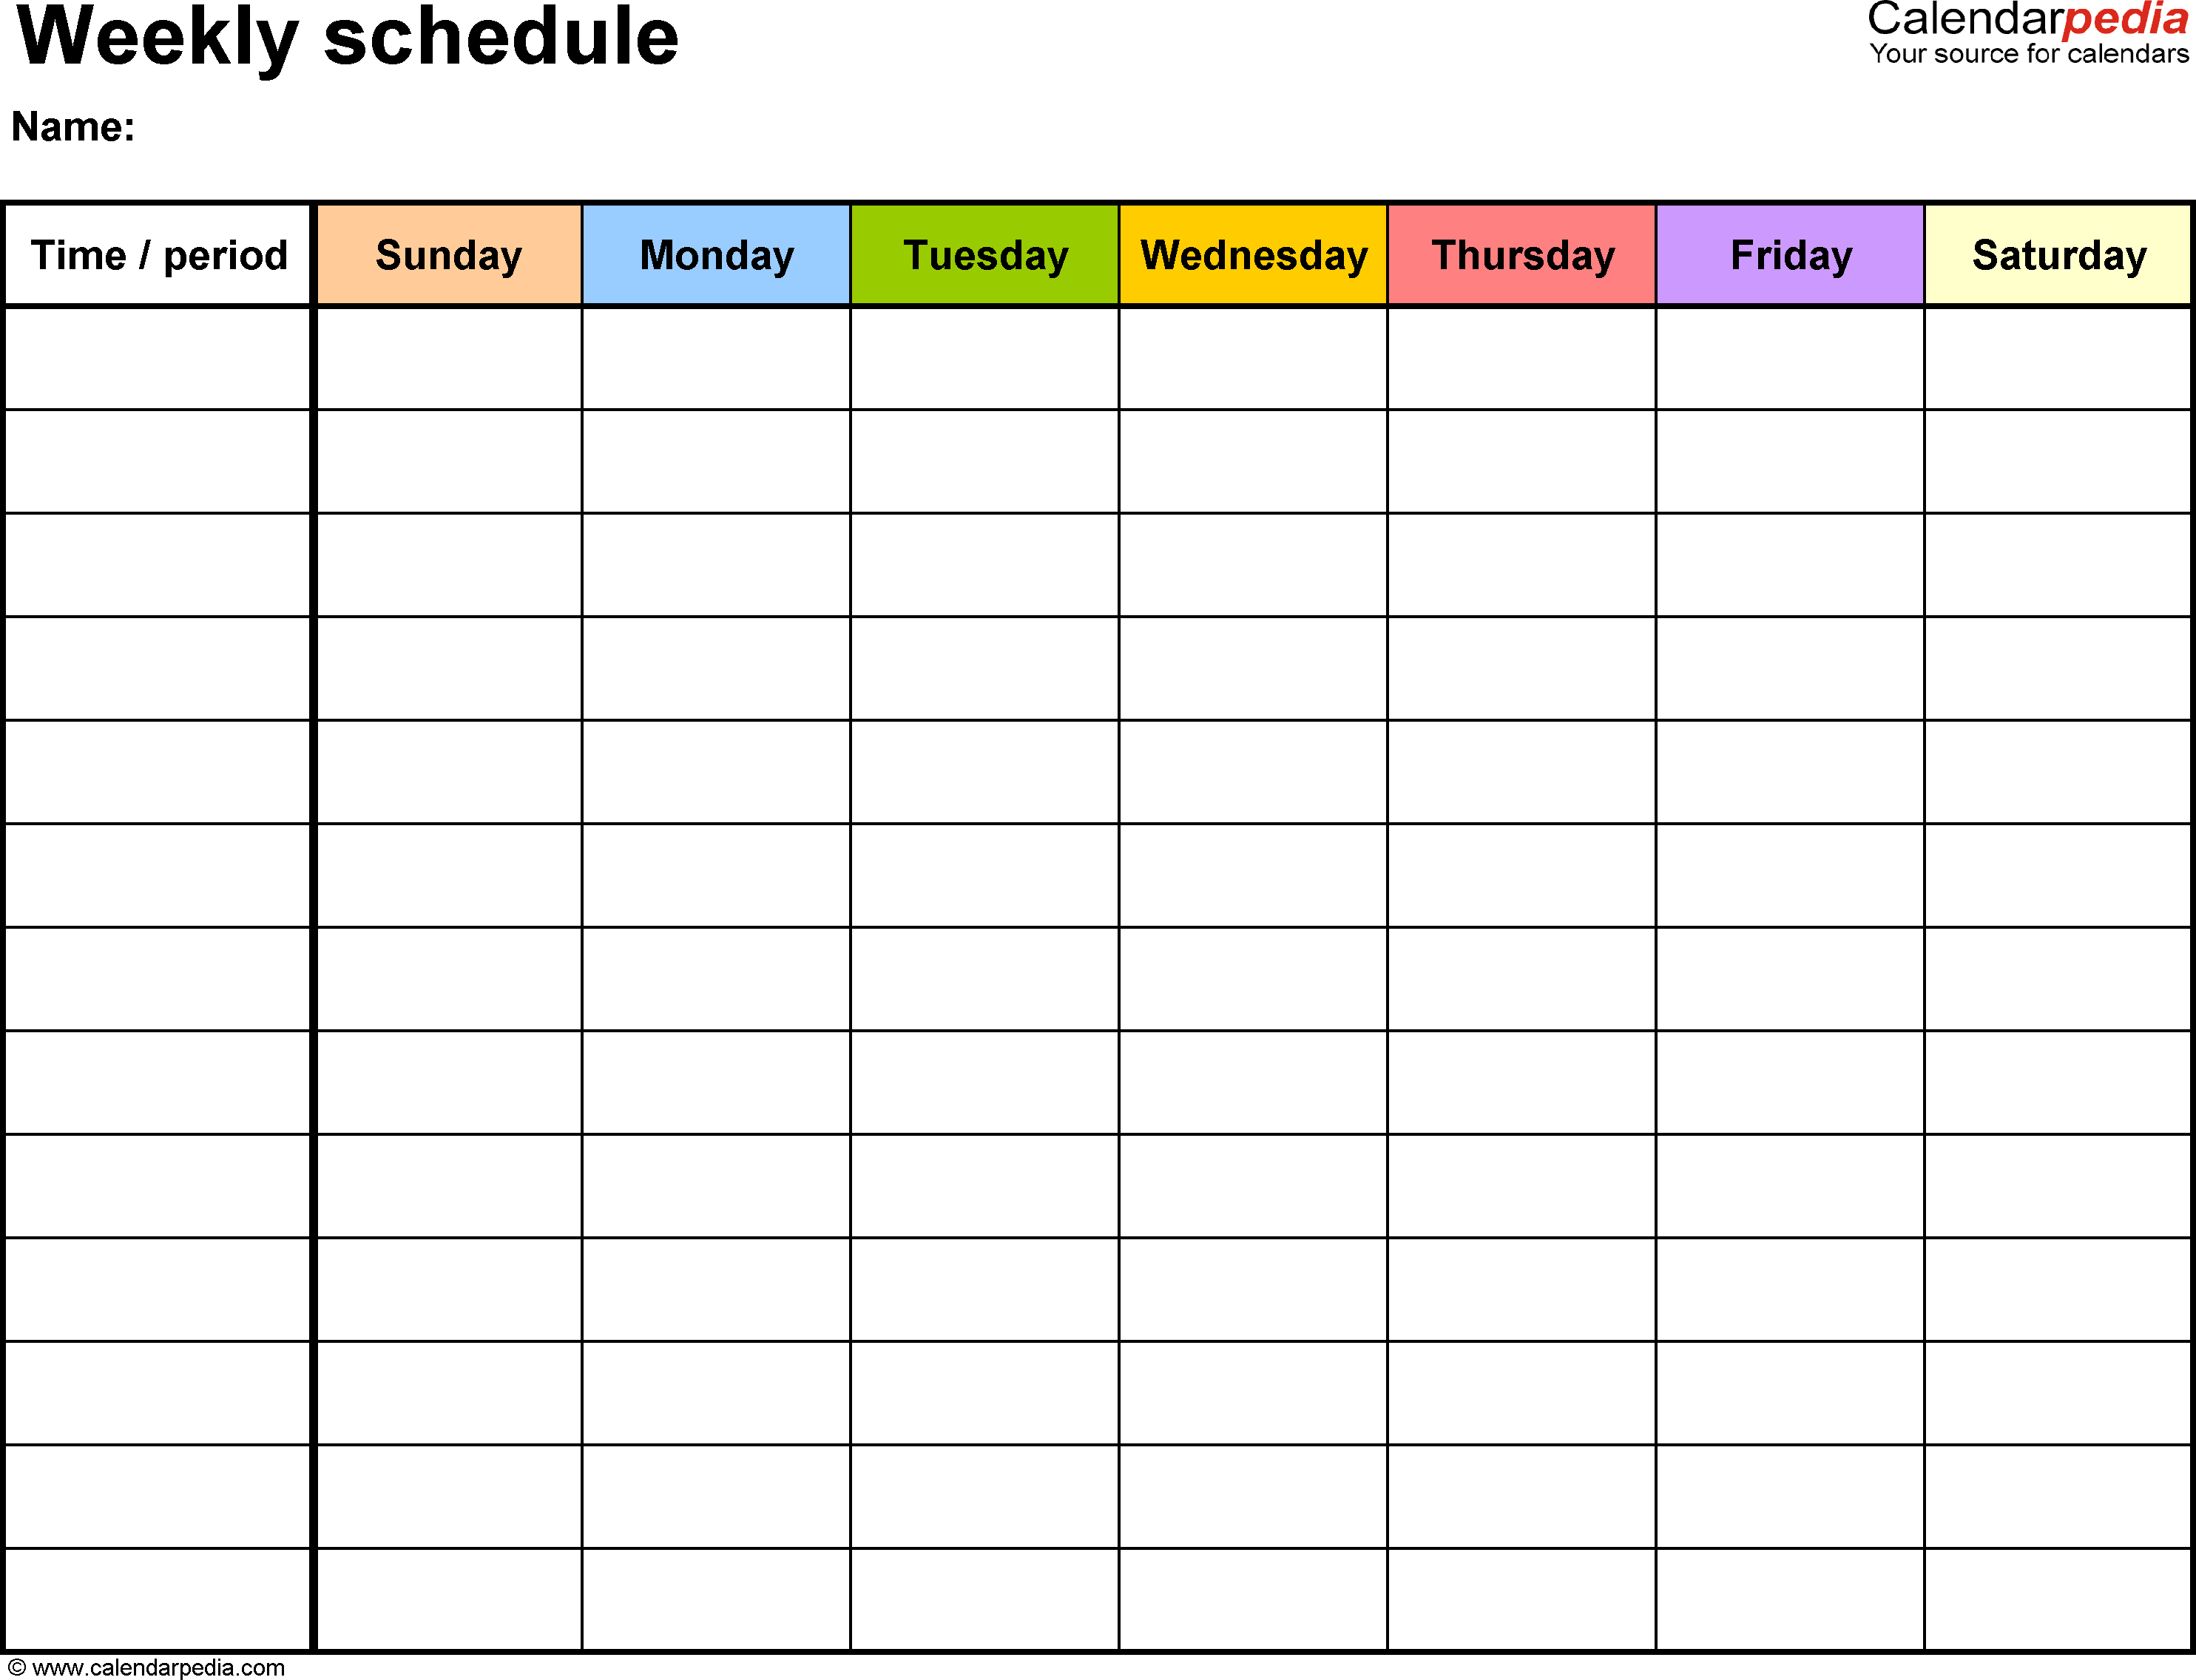
Weekly Schedule

Slide 51
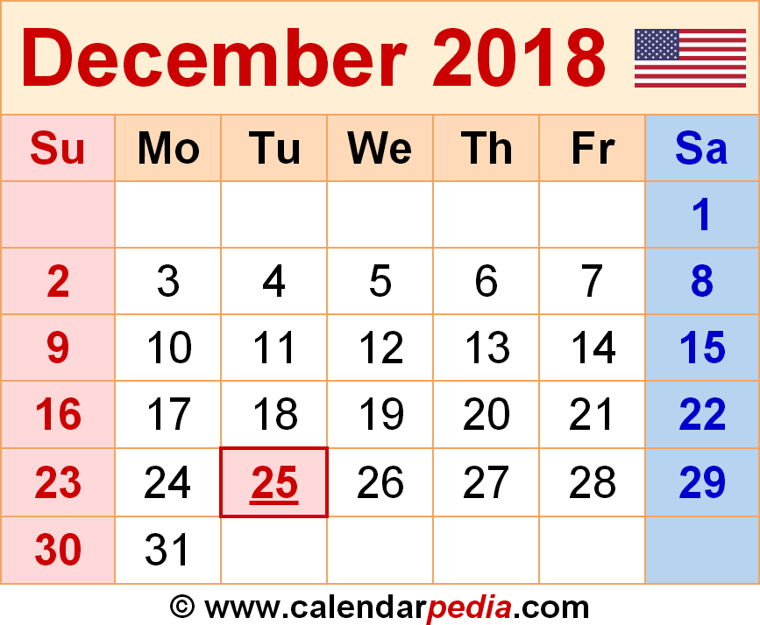
Monthly Schedule

Slide 52
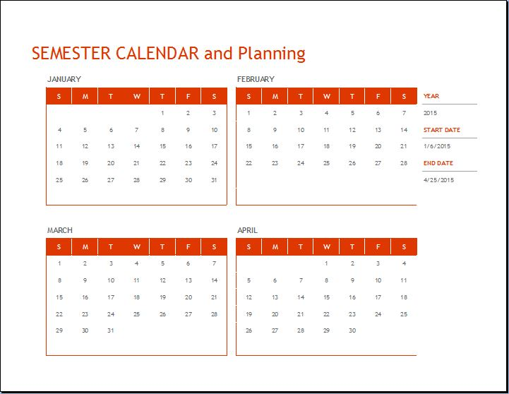
Semester Calendar

Slide 53
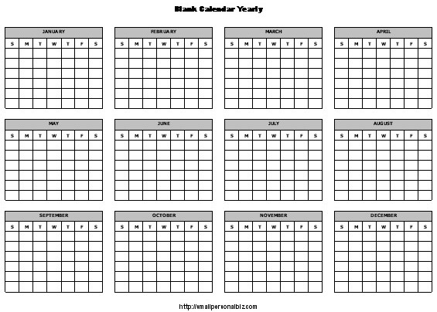
Yearly Schedule

Slide 54

Dislike schedules?
Use a “To Do List” with priorities
Use a calendar to write important due dates
Lakein’s Question: What is the best use of my time right now?
Reminders and sticky notes
Other ideas?

Slide 55
TO DO List
1. Batteries for watch
B 2. Grocery store
A 3. Dr. appointment
4. Clean house
A 5. Dinner with family
B 6. Gas in car
A 7. Prepare for class
8. Balance checkbook
9. Watch TV
10. Wash car

Slide 56
Assignment:
Monitor your time for a week. Turn it in next Tuesday along with analysis sheet.

Slide 57
Time Management Tricks

Slide 58
Divide and Conquer

Slide 59
Do the First Small Step

Slide 60
80/20 Rule
80% of the value comes from 20% of the items on a list.

Slide 61
80/20 Examples
We only wear 20% of our clothes
80% of file usage is in 20% of files
80% of dinners repeat 20% of recipes
80% of the dirt is on 20% of the floors
Can you think of others?

Slide 62

Aim for Excellence,
Not Perfection
Is perfection necessary?
Maybe “it ain’t no piano”

Slide 63
Make Learning Fun
By Finding a Reward

Slide 64

Just Take a Break

Slide 65

Study in the Library
Everyone else is studying there
It is difficult to do something else in the library

Slide 66
Learn to Just Say No
no

Slide 67

What are your time bandits?

Slide 68

Dealing with Time Bandits
Schedule time for other people
Use some of them as rewards
Use prime time wisely
Remind yourself of your priorities
Use a schedule
What is the payoff?

Slide 69
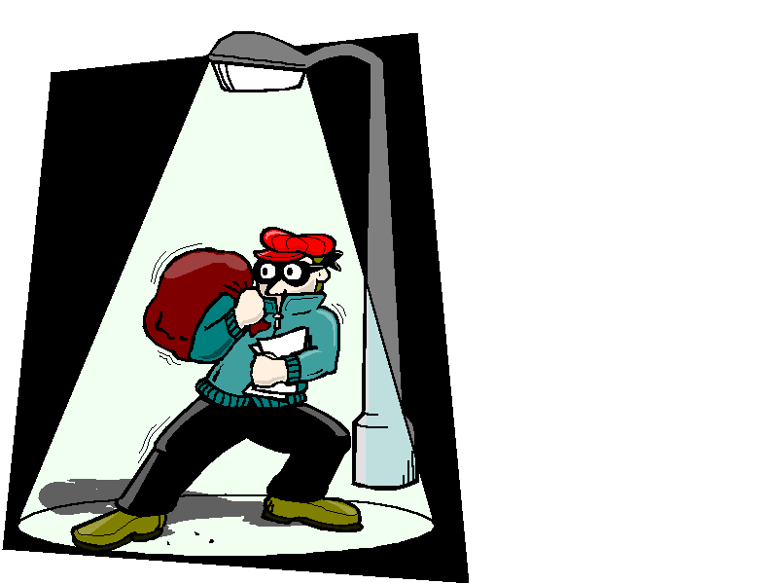
How to Deal With People Who Are Time Bandits
Communicate your goals
Spend quality time
Schedule
Keep your word
Tell them they are important
Be assertive if necessary

Slide 70
Think
Pair
Share
How can you avoid procrastination? For example, you have an assignment due and you are having a difficult time getting started. How do you motivate yourself to get started?

Slide 71

Dealing With Procrastination

Slide 72

Why do we procrastinate?

Slide 73

Reasons for Procrastination
Fear of failure
Fear of success
Perfectionism
Need for excitement
Excellence without effort
Loss of control

Slide 74

How can you avoid procrastination?

Slide 75

Avoiding Procrastination
You have a term paper due next week, but you are procrastinating getting started on this project.
How can you find the to get started?
Lets hear some answers!

Slide 76
Avoiding Procrastination
Select a goal.
Visualize your progress.
Be careful not to sabotage yourself.
Stick to a time limit.
Don’t wait until you feel like it.
Follow through.
Reward yourself.

Slide 77
Avoiding Procrastination
Re-evaluate your goals if you are procrastinating.
Are they dreams or goals?
Are your goals realistic?
Are your goals achievable?
And remember, you do not have to be perfect.

Slide 78
Managing Your Money

Slide 79

Save money to accomplish your goals.

Slide 80
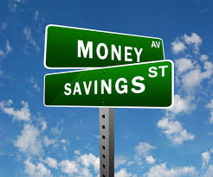
As a college student, how can you spend your money wisely and begin a savings habit?

Slide 81
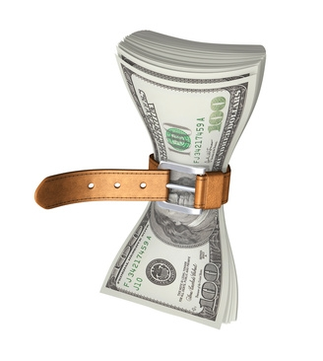
Group Exercise:
The College Student Tightwad Gazette

Slide 82

Budgeting is the Key to Money Management.

Slide 83
Start with a Money Monitor.

Slide 84
Try it on your own!
Budgeting for College

Slide 85
Need More Money?

Slide 86
Apply for Financial Aid
Loans
Grants
Work Study

Slide 87
The College Success Web site has links for getting information and applying for Financial Aid online. www.collegesuccess1.com

Slide 88

Apply for a Scholarship

Slide 89
How to Apply for a Scholarship
Research
  The College Success Web Site
  Library
  Scholarship Office

Slide 90
How to Apply for a Scholarship
Establish a scholarship file
  3 letters of recommendation
  Statement of personal goals
  Statement of financial need
  Copies of your transcripts
  Copies of other scholarship applications

Slide 91

Best Ideas for Financial Security
Use a budget
Have a financial plan
Save 10% of your income
Don’t take on too much debt. Beware of credit cards.
Learn about investments.
Don’t procrastinate. The earlier you take these steps the better.

Slide 92
Willpower, restriction and self-control may not work.

Slide 93

The trick is not to manage our time or money, but to manage ourselves.

Slide 94
Manage Yourself
Know your values.
Set goals.
Visualize the actions you will take.
Make decisions based on your values.

Slide 95
Keys to Success:
Do What Is Important First

Slide 96
Put First Things First.
--Steven Covey
Author of Seven Habits of Highly Effective People

Slide 97

Stories from the Elders
How the Navajo Learned to Weave
What lessons can you learn from this story?

