Slide 1
Native American College and Career Success

Slide 2
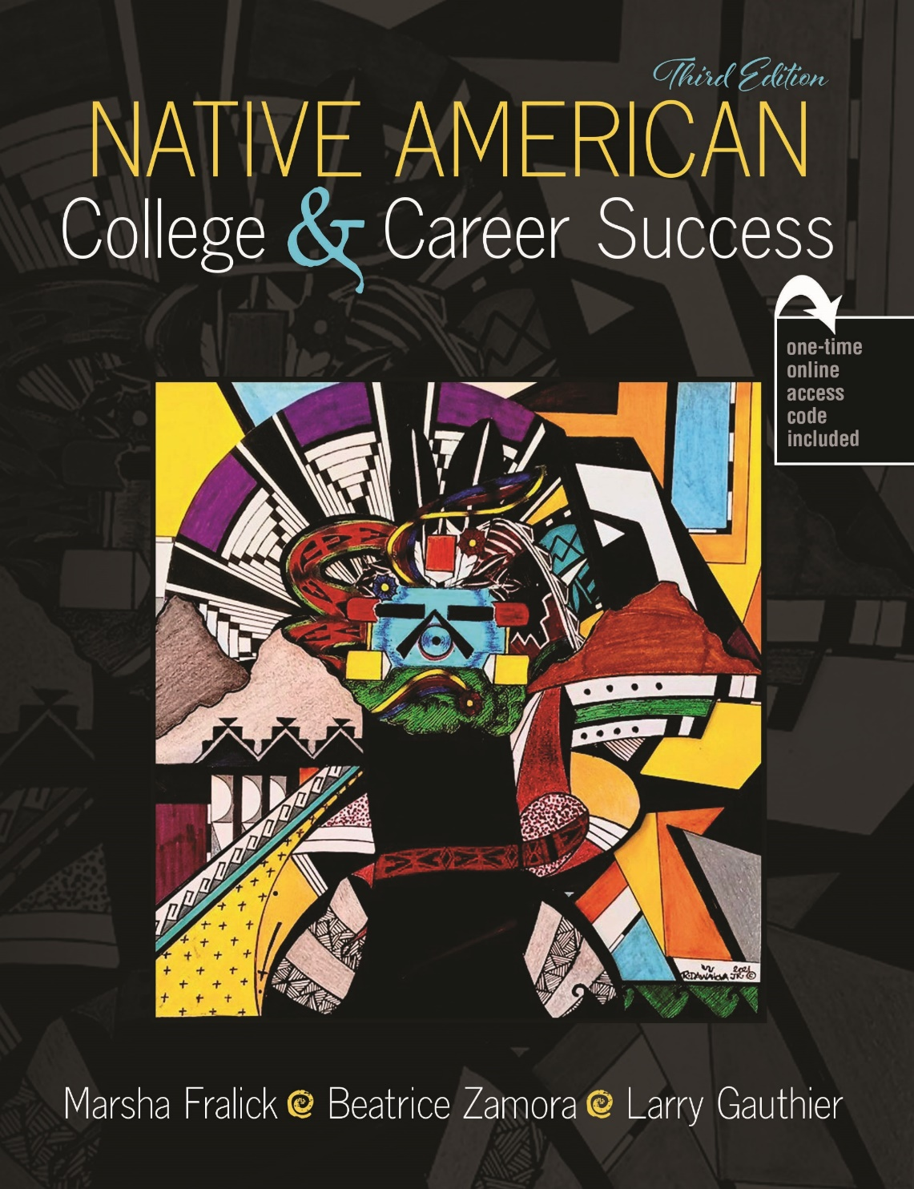
This textbook is based on the premise that students are more successful if they take pride in themselves and their culture.

Slide 3
The Spirit Essence of All We Do: Cultural Identity and Success
Chapter 1

Slide 4
Spirit Essence
Most Native peoples believe that there is a spirit essence in all things that we do and in all things in nature.
Remembering your spirit essence will help you to connect to your past and your present.
This focus will allow you to honor your family and community while also honoring your college education.

Slide 5
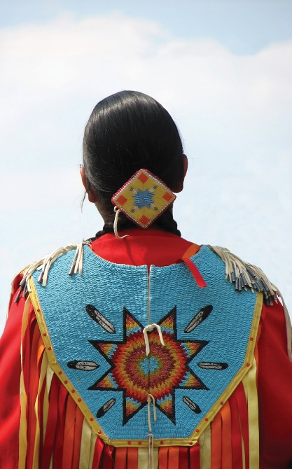
Think Pair Share What cultural or tribal name do you use to describe yourself?

Slide 6
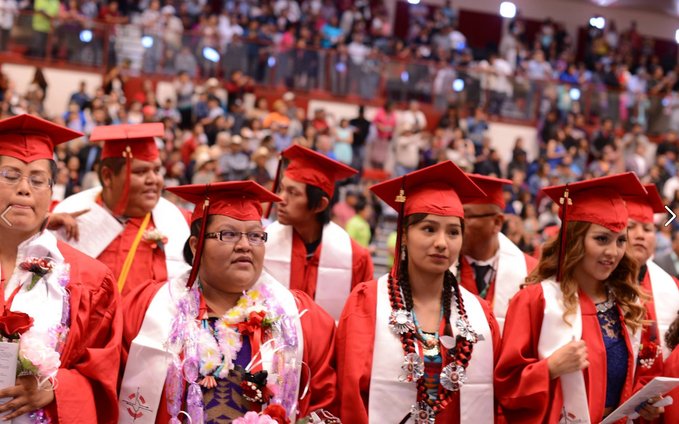
Native students need to improve their college graduation rates.

Slide 7
One Minute Paper
For one minute, write about this question:
What can you do to improve your chances of graduating from college?
After one minute, underline your best idea.
Share your best idea with other students in this class.

Slide 8
Unfortunate History
Early education and boarding schools tried to eliminate Native culture and language.
The goal was assimilation into the dominant culture.
This resulted in cultural disintegration and loss of identity resulting in lower educational achievement.

Slide 9
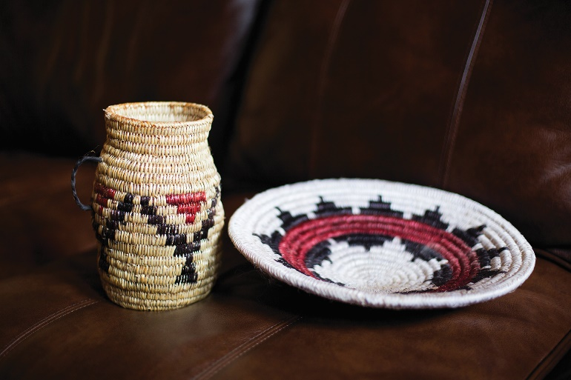
Rebirth of Education and Cultural Identity
In the 1960’s there was the realization that Western education was not working for Native students.
We are living in a new era of self-determination and resiliency.
Newer education involves appreciating diversity and incorporating Native values and culture.

Slide 10
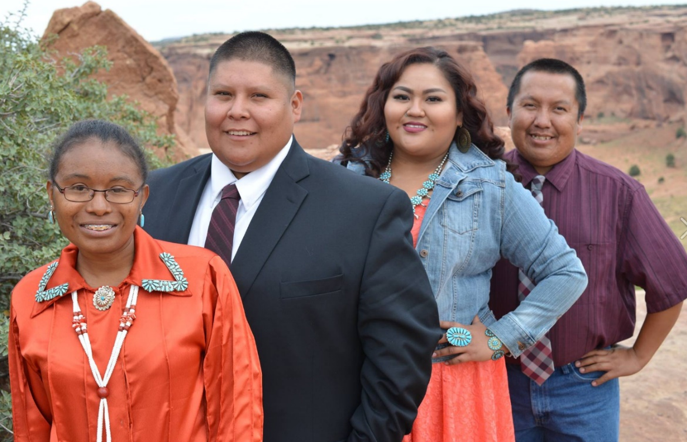
The Importance of Family and Home
Family and home are valued.
Gain support from your family

Slide 11
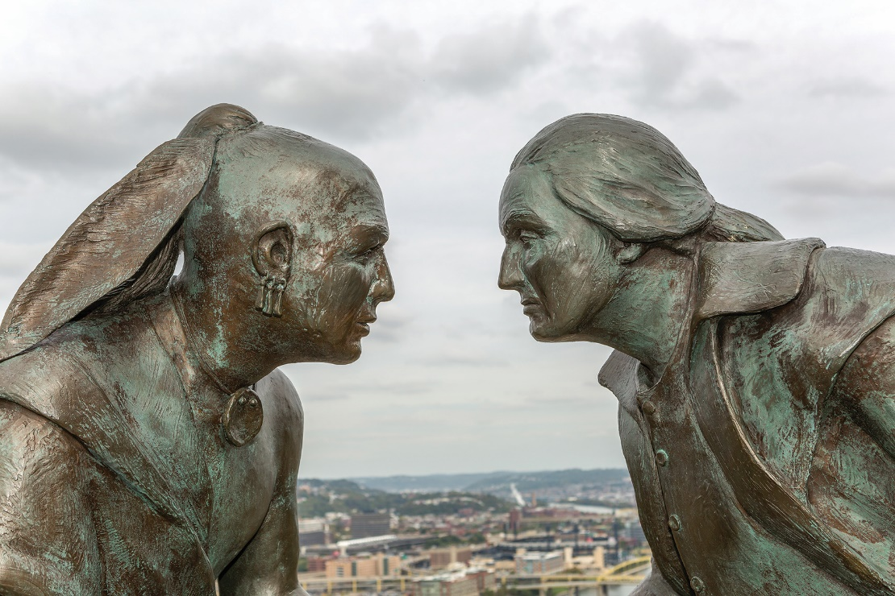
Cultural Differences
Higher education is competitive and based on the individual. Native cultures often value family and cooperation.

Slide 12
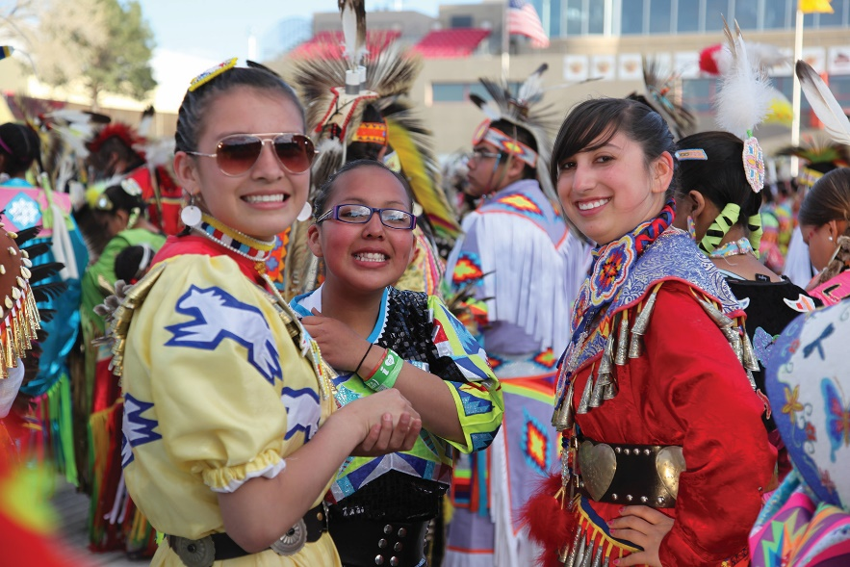
What are some other cultural differences?
Discussion:
How is the view of time different?
How is communication different?
What other cultural differences have you observed?

Slide 13
Personal Empowerment through Culture
Taking pride in your culture is the foundation for learning.

Slide 14
Empowerment through education

Slide 15
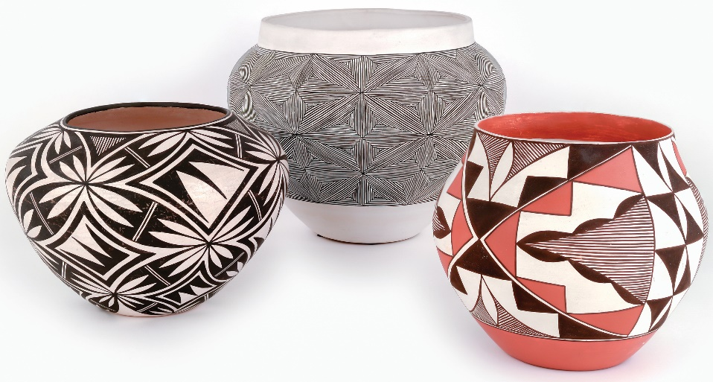
Some Native Beliefs
Understanding of the natural world
Knowledge of plants and animals.
Knowledge of astronomy and complex astronomical cycles

Slide 16
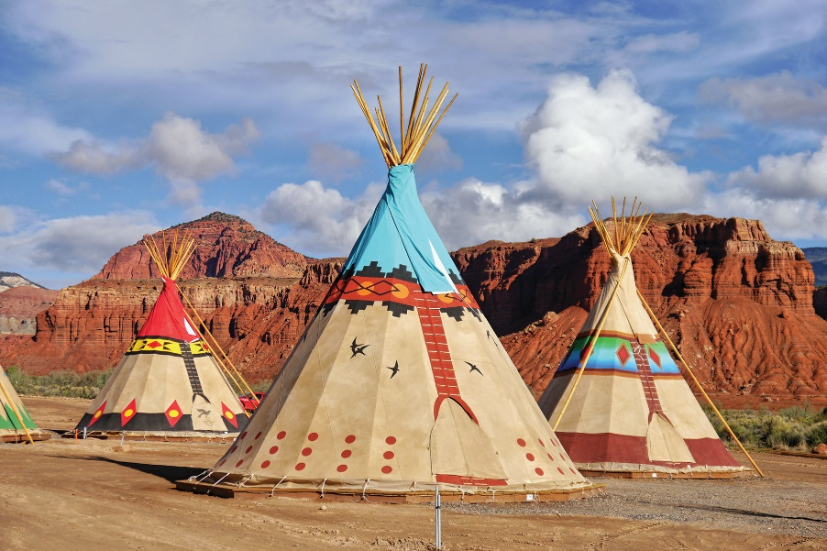
Value Systems
Some Native Values (Cree, Dakota, Blackfoot, Ojibwa)
Respect
Obedience
Humility
These values represented by the three center poles of their home or teepee.

Slide 17
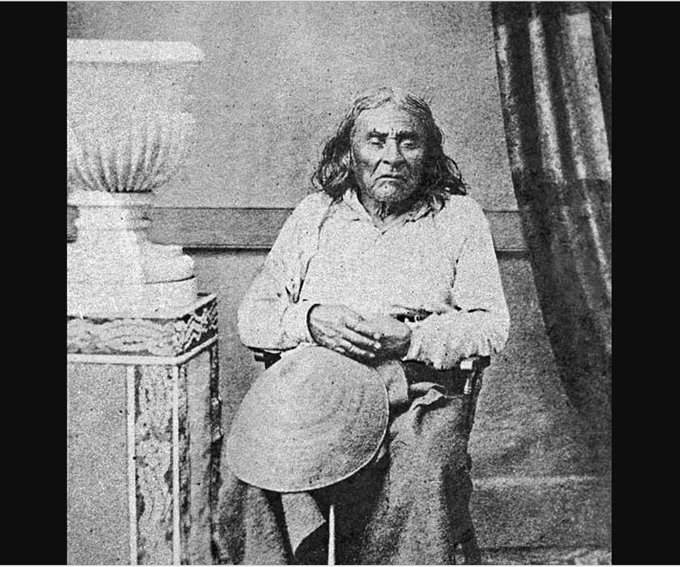
Environmentalists
“We are all related. Whatever befalls the earth, befalls man.”
Duwamish Chief Seattle

Slide 18
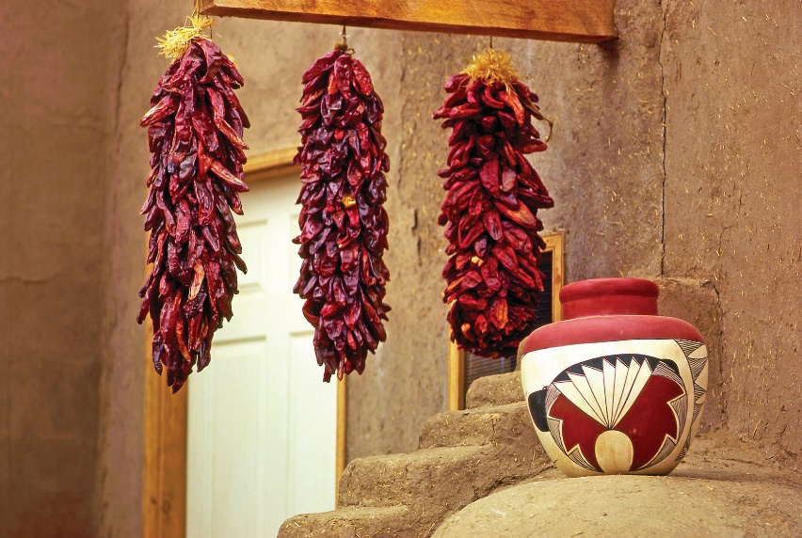
Think Pair Share What other values are important in your culture?

Slide 19
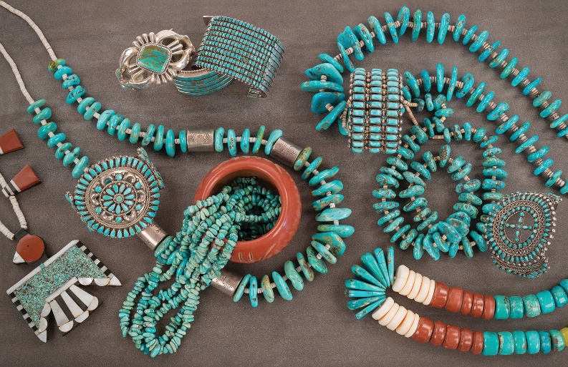
“American culture can be revived and rejuvenated by recognizing and appreciating a Native American school of thought.” -Lakota Chief Luther Standing Bear

Slide 20
Cree Prophecy
When all the trees have been cut down, when all the animals have been hunted, when all the waters are polluted, when all the air is unsafe to breathe, only then will you discover that you can’t eat money.
Video: You Can’t Eat Money

Slide 21
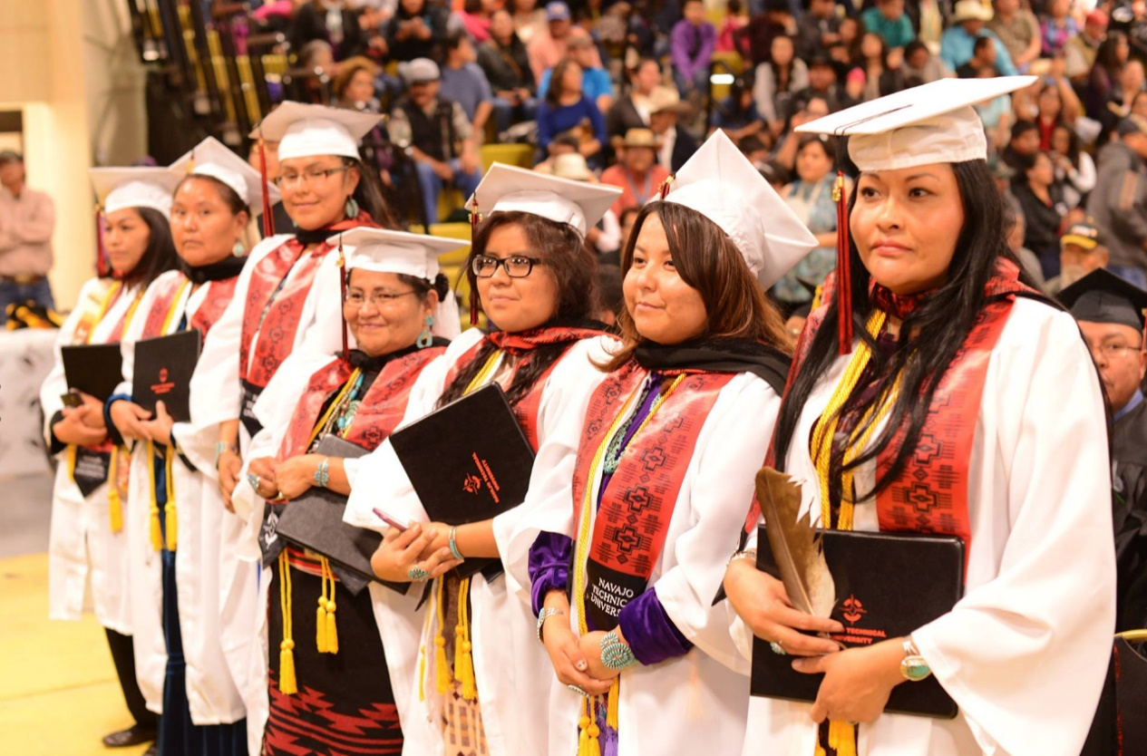
Cultural Traditionalism
How closely one adheres to traditional culture.
Are there differences among Native students?
How is being aware of culture a strength?

Slide 22
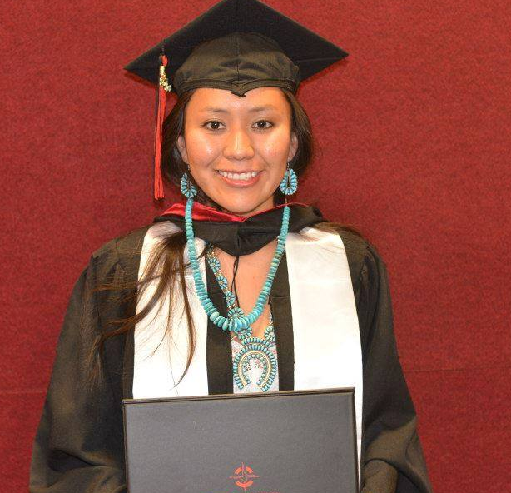
Finding a Safe Place
First space
Where you live or where you have come from
Second Space
Where you must learn to negotiate (college)
Third Space
A safe space
Learning to adapt between both worlds
How can you find your safe space?

Slide 23
Health and Well-Being
Good health has four components:
Spiritual
Emotional
Physical
Mental

Slide 24
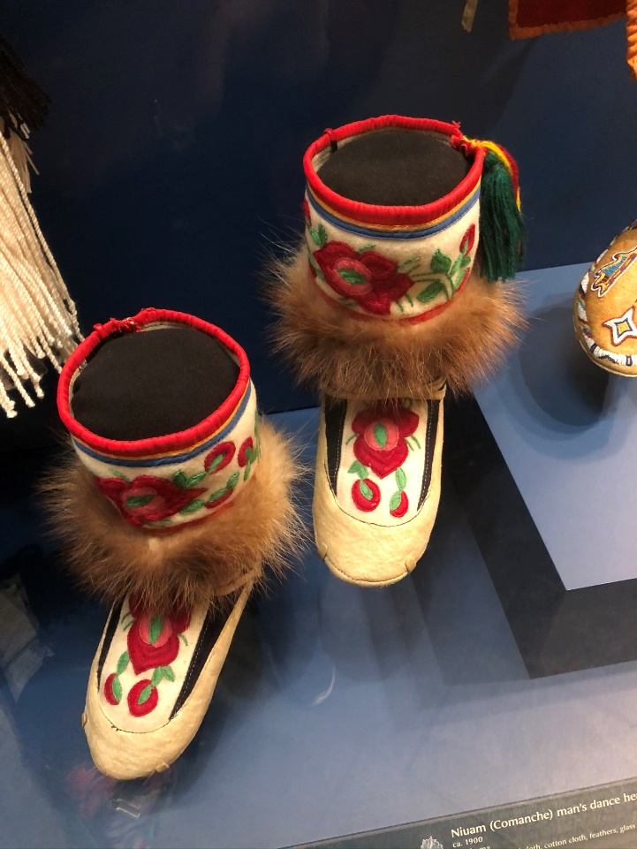
Student Success includes Good Health
Tribal practices have a positive impact on well-being and include:
Physical activity, traditional foods, and healthy living practices
Increased knowledge and sharing of tribal history and cultural practices
Increased sense of belonging to tribe, connection to culture, and intergenerational interactions

Slide 25
Successful Learning from the Native Perspective
Engage all the senses including visual, auditory, touch, movement, smell, and taste
Build on your experience. How does the material you are learning relate to your personal experience?
Every human being has a desire to succeed. Invest your time in learning and build on your success.
Think about how you can use your education in both the traditional and modern world.

Slide 26
Stories from the Elders
This textbook includes stories and interviews from the elders. The talking circle exercises are an opportunity to apply traditional knowledge to your success.
The elders often say, “Think with your heart.” All people need significance, competence, power, and virtue.

Slide 27
Stories from the Elders: Wesakechak and Crane
How does this story relate to your success in college and in life?

