Slide 1

Understanding Motivation
Chapter 2

Slide 2
What are the behaviors and attitudes of an “A” student?
List three important behaviors that an “A” student would have.
Get in a group of three students and compare lists
Report

Slide 3

What Do I Want from College?

Slide 4
Exercise:
What Do I Want from
College?
Share your most important reason with the class.

Slide 5

Value of a College Education

Slide 6

Education Increases Earnings

Slide 7
Yearly Income
HIGH SCHOOL $38,792
SOME COLLEGE $43,316
ASSOCIATE $46,124
BACHELORS $64,896
PROFESSIONAL $96,772

Slide 8

Lifetime Income
HIGH SCHOOL $1,163,750
SOME COLLEGE $1,299,480
ASSOCIATE $1,383,720
BACHELORS $1,946,880
PROFESSIONAL $2,903,160

Slide 9
What is the Value of a College Degree?
$1,946,880 College Graduate
$1,163,760 High School Graduate
$783,120 Value of College
Degree

Slide 10
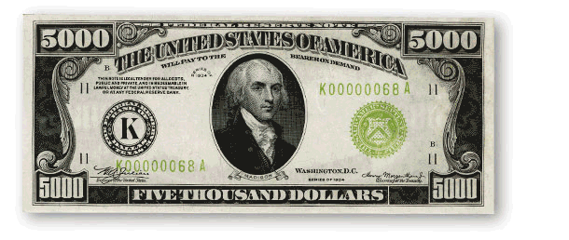
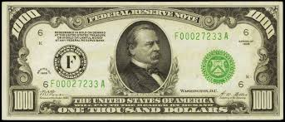
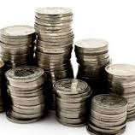
How much is each college class worth?
$19,578
and some

Slide 11
$19,578 per 3-unit class
($783,1200 divided by 40 classes for a BA or BS)

Slide 12

What is
of a college class worth?

Slide 13
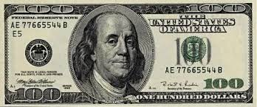
$408 per hour in class ($19,578 divided by 48 hours in class)

Slide 14

Would you attend class today and be prepared if I paid you $377?

Slide 15
Of course, these payments are over a working lifetime of 30 years.

Slide 16

Choosing Your Major
Making a good choice of a major helps increase your motivation for success.

Slide 17

How to Choose a Major
What is my personality type? What are my personal strengths?
What are my multiple intelligences?
What are my interests?
What are my values?
How can I match my personal strengths to the world of work?

Slide 18
How do you motivate yourself?
What if you don’t feel like coming to class or doing your homework. How do you motivate yourself to do it anyway?
      Think
      Discuss with the person next to you
      Share ideas

Slide 19

How to Be Motivated

Slide 20

There are many ways to be motivated. Let’s see if any are useful to you.
Your mindset makes a difference
Grit is a powerful tool for success
Think positively about the future
Look for something interesting
Avoid multi-tasking
Intrinsic or extrinsic motivation
Locus of control
Achievement motivation
Use a reward

Slide 21
Your Mindset
Makes a Difference
Growth Mindset:
Intelligence is increased as you learn new knowledge
Through practice and effort, skills can be improved
Failure is an opportunity to learn
Fixed Mindset:
Intelligence is fixed at birth
Hard work is unpleasant
The amount of work needed to be successful is underestimated
Roadblocks are an excuse to be absent

Slide 22

Grit

Slide 23
What is grit?
Grit is a combination of perseverance and passion.
It is a “never give up” attitude.

Slide 24
How do famous people achieve excellence?
NBA superstar
Pro football player
Gold medalist gymnast
Famous violinist

Slide 25
The key is effortful training
Practice until the performance becomes a habit.
It takes 10,000 hours to learn a complex skill.

Slide 26

How to develop grit
Find interest.
Invest your time in practice.
Find your purpose.

Slide 27

Positive Thinking

Slide 28

Think Positively about the Future
If you believe that your chances of graduating from college are good, you can increase motivation and take the steps needed to be successful.
If you believe that your chances of graduating from college are poor, it is difficult to motivate yourself to continue.

Slide 29
No pessimist ever discovered the secrets of the stars, or sailed to an uncharted land, or opened a new doorway for the human spirit.
Helen Keller

Slide 30
Benefits of Positive Thinking
Good health
Longevity
Happiness
Perseverance
Improved problem solving
Enhances ability to learn

Slide 31

If you are optimistic and believe that a goal is achievable, you are more likely to take the steps necessary to accomplish it.

Slide 32

Optimism Vs. Pessimism
How does it apply to college?

Slide 33

Find something interesting in your studies.
Exercise: Textbook Skimming

Slide 34

Avoid Multi-tasking
A person who is interrupted takes 50% longer to complete a task
The interruptions results in 50% more errors.
Avoid distractions from cell phones and other electronics.

Slide 35

Two types of Motivation

Slide 36

Motivation
Intrinsic motivation comes from within.
  Look for ways to enjoy college and find some personal meaning in it.

Slide 37

Motivation
Extrinsic motivation comes as a result of an external reward.
What is the payoff for attending college?
Higher earnings
Having a satisfying career
Buying a car or home

Slide 38

Which is the more powerful motivator?
Intrinsic or extrinsic motivation?

Slide 39
Intrinsic motivation is the most powerful.

Slide 40

Taking Control of Your Life
Where do you place the responsibility for control over your life?

Slide 41

Life is what I make happen.

Slide 42
What is Locus of Control?
Where you place responsibility for control over your life.

Slide 43
Locus of Control
Internal
External
Believe you are in control of your life.
Be self-motivated.
Learn from mistakes.
Think positively.
Rely on yourself.
Life is a result of luck or fate.
Rely on others for motivation.
Look for someone to blame.
Think negatively.
Rely on others.

Slide 44
Intrinsic Vs. Extrinsic Motivation
As a college student you are looking for what kind of Motivation?
Intrinsic Motivation
What kind of locus of control?
Internal locus of control

Slide 45
Exercise: Locus of Control
CSI Activity

Slide 46

More Types of Motivation

Slide 47

Affiliation Motivation

Slide 48
How can you use affiliation motivation to be successful in college?

Slide 49
Affiliation Motivation
Study Groups
Friends
Athletics
Clubs
Activities

Slide 50

Achievement Motivation

Slide 51
Are you motivated by achievement?
Competition for grades
Winning the game
Earning money
Recognition for achievement

Slide 52

Find a reward to increase desirable behavior.

Slide 53


1. Do not involve alcohol or drugs
Good Rewards

Slide 54

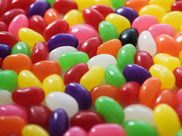
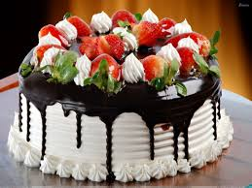
1. Do not involve alcohol or drugs
2. Do not have too many calories
Good Rewards

Slide 55

1. Do not involve alcohol or drugs
2. Do not have too many calories
3. Do not cost too much money
Good Rewards

Slide 56

What are some good rewards for studying?

Slide 57
Success is a HABIT

Slide 58
Success is a Habit
We establish habits by taking small actions each day.
You can establish habits for success.

Slide 59
Exercise:
I am successful when I:

Slide 60

Group Exercise
Describe a class where you were not motivated to learn. Why?
Think of a class where you were very motivated to learn. What made the class motivating?

Slide 61
Exercise:
I am successful when I:
Behaviors which interfere with my success.:

Slide 62
Exercise:
I am successful when I:
Behaviors which interfere with my success:
I would like to:

Slide 63
A PRACTICAL EXAMPLE

Slide 64
Step 1.
State the problem.
I have a chocolate chip
cookie eating habit.

Slide 65
Cookie

Slide 66
Step 2
Choose one small behavior at a time
Make it small.

Slide 67

Changing one small behavior is like making a ripple on a lake.

Slide 68
Change one small behavior and you can change your life.

Slide 69
I will eat a healthy snack.
NOT
I will lose weight. or
I will never eat cookies.

Slide 70
Step 3:
State in a positive way the behavior you wish to accomplish.

Slide 71

EXAMPLE
I will eat a healthy snack instead of eating cookies.

Slide 72
Write an intention statement.
I intend to eat a healthy
snack.

Slide 73
Step 4
Count the behavior
How many cookies do I
eat each day?

Slide 74
Many Cookies

Slide 75
Step 5:
Picture in your mind the actions you will take. Visualize your success.

Slide 76
Step 6
Practice
10 days
Keep a Log

Slide 77
Step 7
Find a reward for your behavior.

Slide 78
Step 6:
What reward will you use?

Slide 79
10 Habits of Successful College Students
Attend class.
Read the textbook.
Have an educational plan.
Use college services.
Get to know the faculty.

Slide 80
10 Habits of Successful College Students
Limit outside employment to 20 hours a week for a full-time student.
Take one step at a time.
Have a goal for the future.
Visualize your success.
Ask questions.

Slide 81

Assignment
How to Change a Habit
Keep a log for 10 days

Slide 82
Keys to Success: Persistence

Slide 83
Persistence Will Get You Almost
Anything Eventually
When is this true?
When is it not true?

Slide 84
90% of success is showing up!
(You also have to do some work when you get there.)

Slide 85
Make a commitment to reach your dreams.

Slide 86

Getting a college degree can be like climbing Mt. Everest.

Slide 87

How to Climb Mt. Everest
A small step at a time

Slide 88


College Success
How do you achieve College success?
One step at a time

Slide 89

Success all depends on the second letter

Slide 90
Succeed in college one step at a time.
Get started.
Attend the first class.
Read the first chapter.
Start a new study habit.

Slide 91
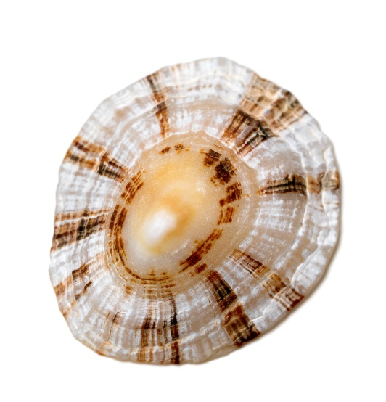
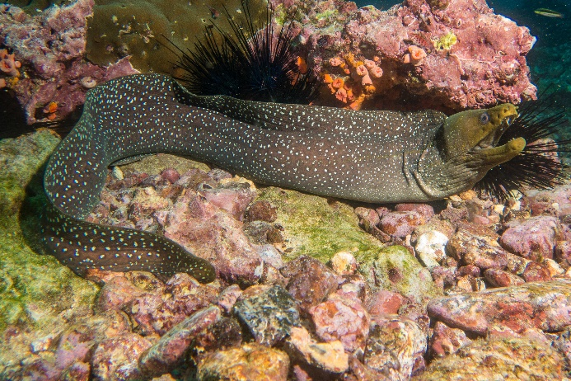
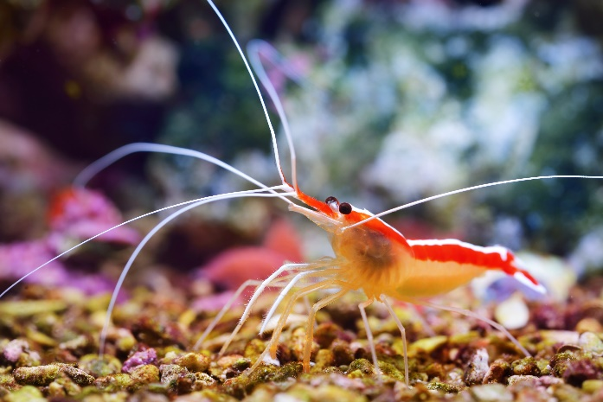
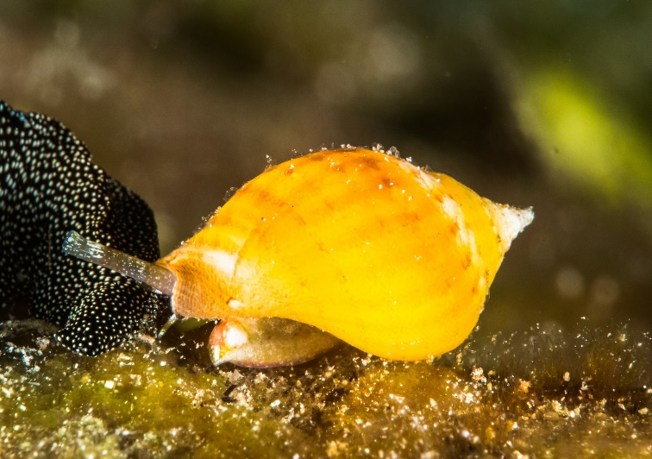
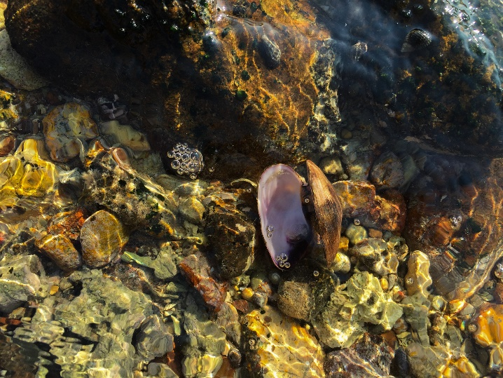

Appreciating Island Cultures: ‘Opae E
Read and discuss
in class.

Slide 92

Assignment
Measure Your Success

Slide 93
Next week take the TruTalent Personality Assessment at the beginning of Chapter 2

Slide 94
Job Jar Activity
Introducing the assessments

Slide 95

What is Personality Type?

Slide 96
Personality Type
We are born with certain preferences that we develop over a lifetime.
Each person is different and unique just like fingerprints or snowflakes.
Knowing your personal strengths will increase self-understanding and help you make a good choice of a major.

Slide 97
Personality Assessment
Use your access code to set up an online portfolio and take this assessment.
Your results are linked to matching careers.

Slide 98
Directions:
Personality assessment
Find a time when you are not tired or rushed.
There are no right or wrong answers.
Answer quickly giving your first impression. Do not over analyze.
You will have a chance to look at your profile and change it if you think it is not correct.

Slide 99
Directions
Answer
Answer the questions honestly to get the best results.
Answer
Answer the questions how you usually are when you are not stressed.
Do not answer
Do not answer the questions:
How you want to be
How you have to be at home, work or school
How others want you to be

Slide 100
Important
There are no good or bad types. Each type has personal strengths that can be used in the workplace.
Answer the questions honestly to get the best results. If you don’t answer the questions honestly, the career suggestions will not be a good match for you.

Slide 101
Directions
The test does not measure:
Intelligence
Psychological or emotional health
It assesses your personal strengths and matches them to possible careers.

