Slide 1
Hawaii and Pacific Islands College and Career Success
Chapter 1

Slide 2
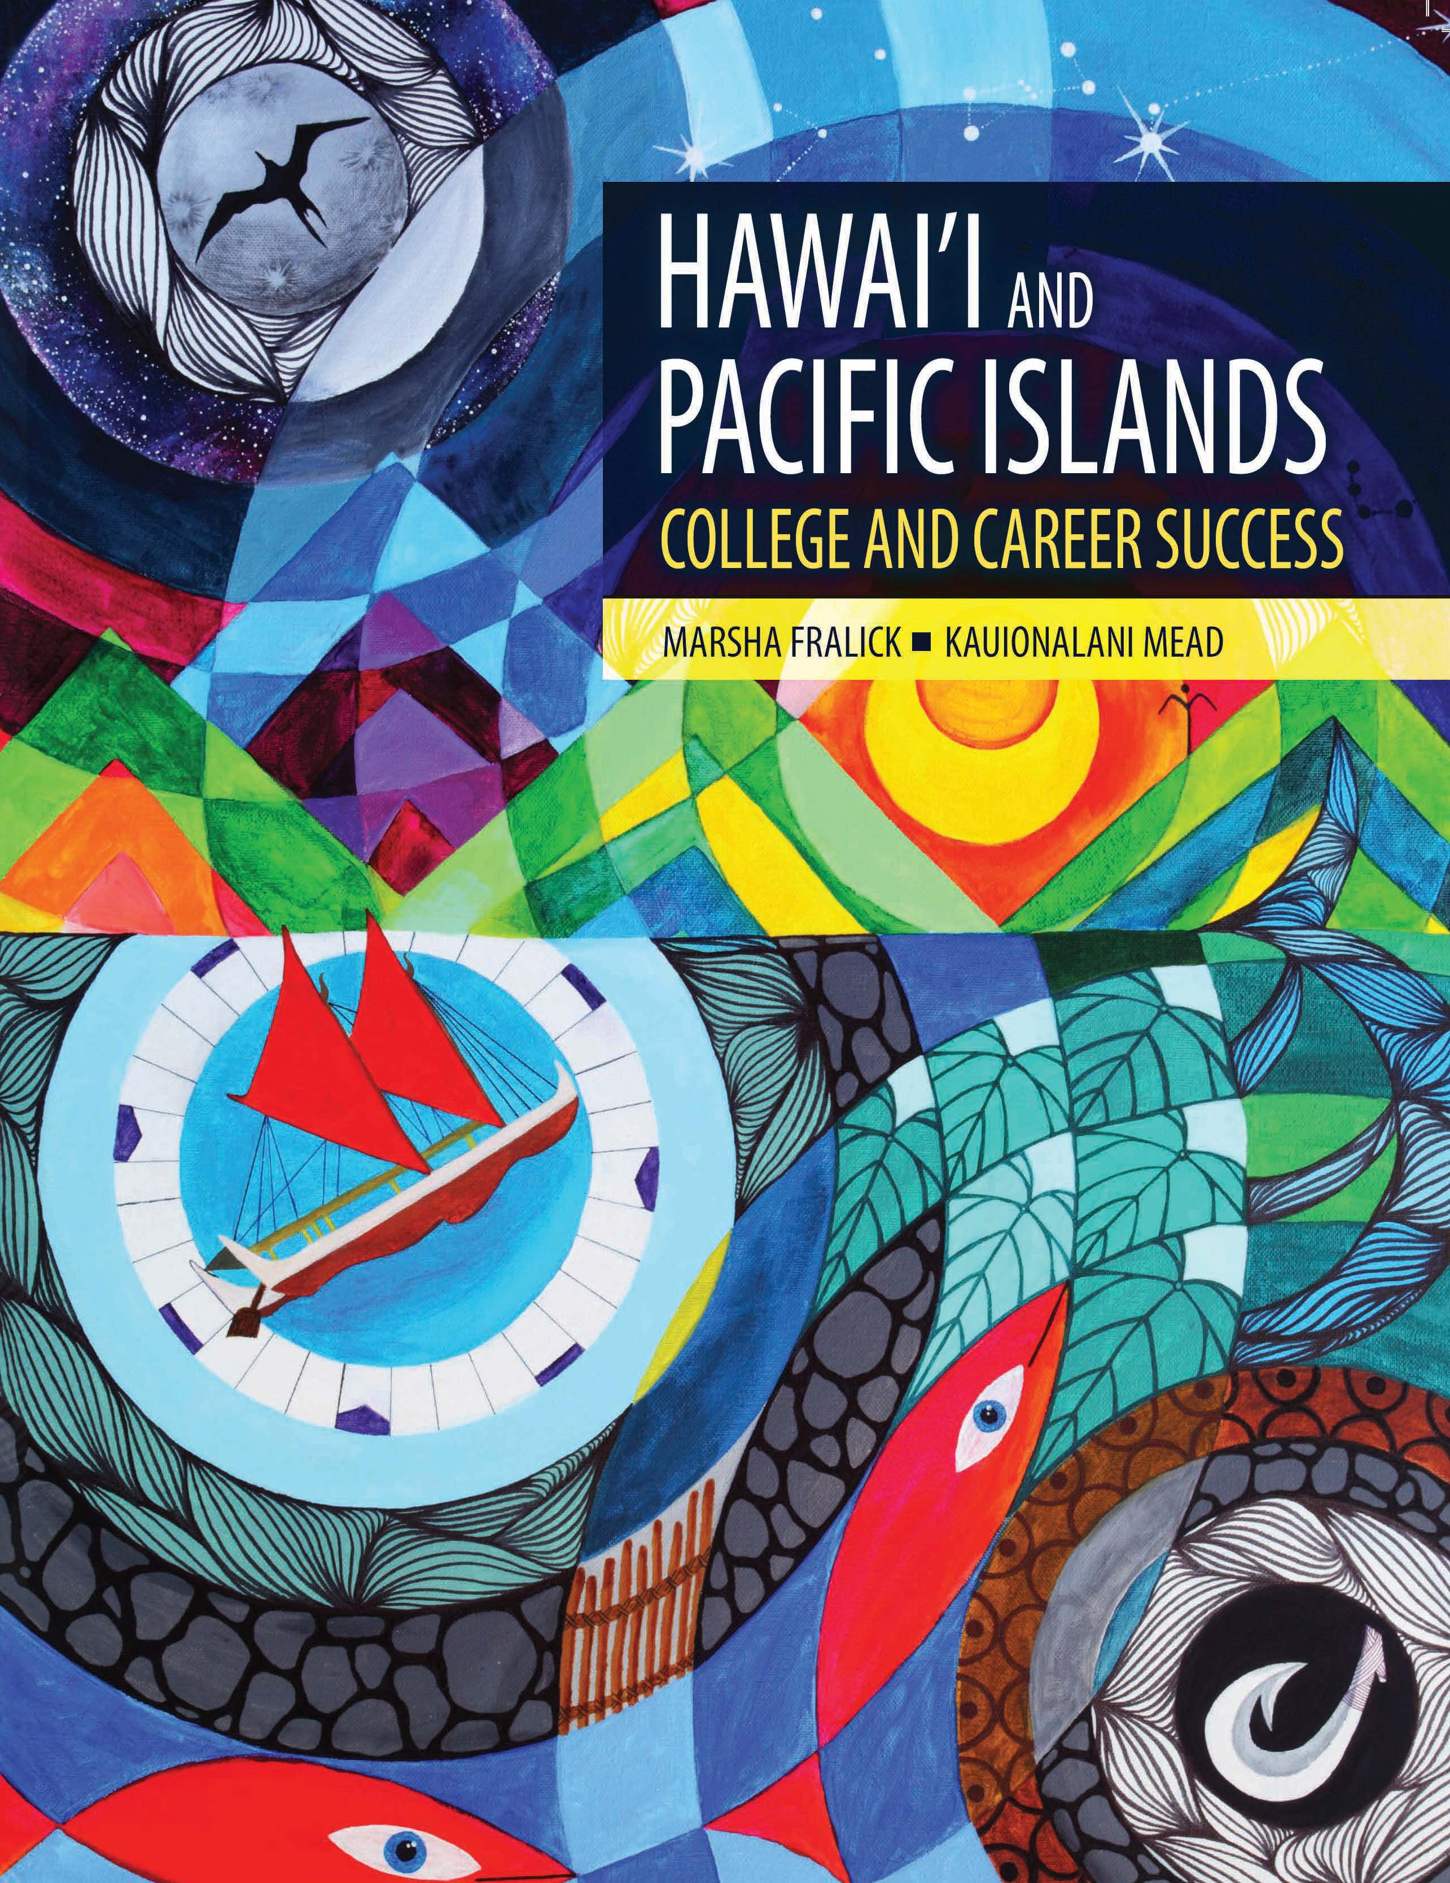
Cultural Content for
Hawai’i and the
Pacific Islands
While the text is designed for Native students, all student who live in Hawai’i and the Pacific Islands can benefit from increasing knowledge and appreciation of the culture of the people where they live.

Slide 3
Chapters
Cultural Identity and Success
Understanding Motivation
Exploring your Personality and Major
Managing Time and Money
Using Brain Science to Improve Memory
Using Brain Science to Improve Study Skills
Taking Notes, Writing, and Speaking
Thinking Positively about the Future

Slide 4
Taking Pride in Your Culture
This textbook is based on the premise that students are more successful if they take pride in themselves and their culture.
Having pride in yourself is the foundation for good self-esteem and the foundation for good mental health and success in life.

Slide 5
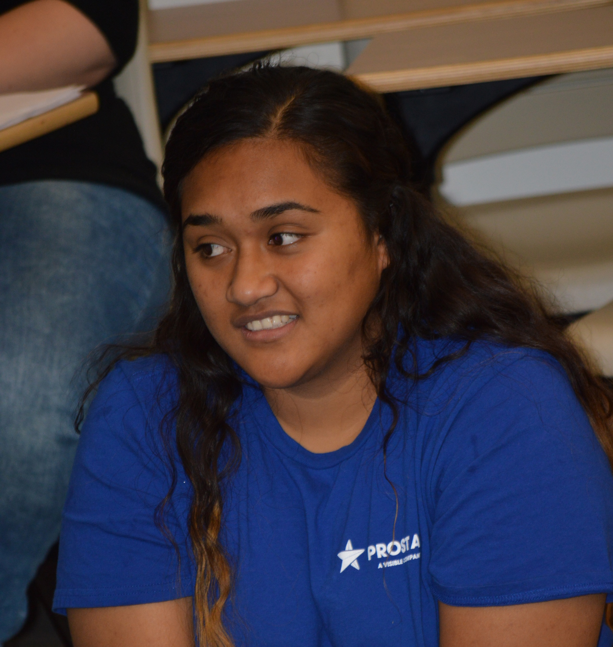
Who are the Pacific Islanders?
The Pacific Islands are home to the most diverse group of Indigenous people in the world.
Polynesia
Melanesia
Micronesia

Slide 6
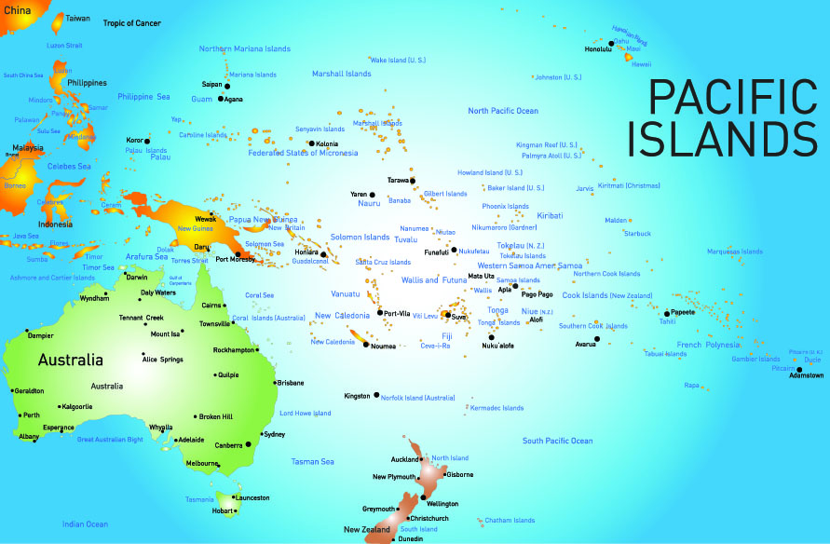

Slide 7
Educational Attainment
About 28% of the general population of the U.S. has a bachelor’s degree while only 15% of Native Hawaiians and Pacific Islanders have a bachelor’s degree.
About 18% of Native Hawaiian and Pacific Islanders live below the poverty rate as compared to 12% for the total population.
There is a need for increased college enrollment and completion.

Slide 8

Hawaiian Values
Values are passed down throughout the generations.
Aloha is the root of all other values that lead to success in life.
Aloha can be used to be successful in college and careers.

Slide 9

To have aloha is to know how to treat others with love and to show respect. It begins with loving yourself and spreading this love to others.
Hawaiians have aloha for the:
Land: ‘aina
Family: ‘ohana
People: kanaka
Culture: mo’omeheu

Slide 10
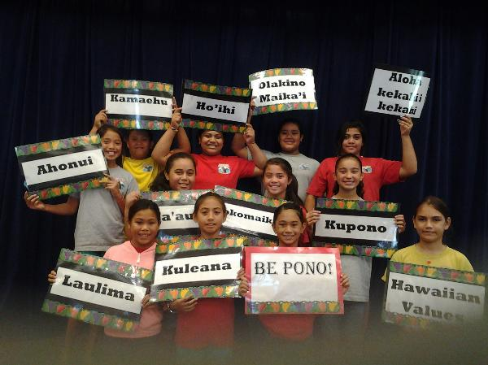
Hawaiian Values
How can they increase your success?

Slide 11
Ma kahanaka ‘ike
By working, you learn.

Slide 12
‘ImiNa’auao
This is the value of seeking wisdom.

Slide 13
Aloha Kekahi I Kekahi
This is the value of love, from one to another. Love includes respect.

Slide 14
Kulia I Ka Nu’u
This is the value of striving for excellence.

Slide 15
Kuleana
This is the value of responsibility.
Our kuleana is to care for the land, our people, culture, language, and the values of our people.

Slide 16
Lokahi
This is the value of unity which is the state of being one. We are at one with our creator, the creation, and with one another.

Slide 17
Malama
This term means to care for, tend, preserve, save, and honor.

Slide 18
‘A ‘ohe pau ka ‘ike I ka halau ho’okahi
Not all knowledge is taught in one school. There are many sources of knowledge and each are different, yet valuable. Learning and gathering our own information makes us successful.

Slide 19
Ahupua’a
This term refers to land divisions usually extending from the uplands to the sea containing all the resources needed for that particular community.
Ahu= altar
Pua= pig
Ahupua’a is the altar upon which the pig was laid as payment to the chief for the use of the land.

Slide 20
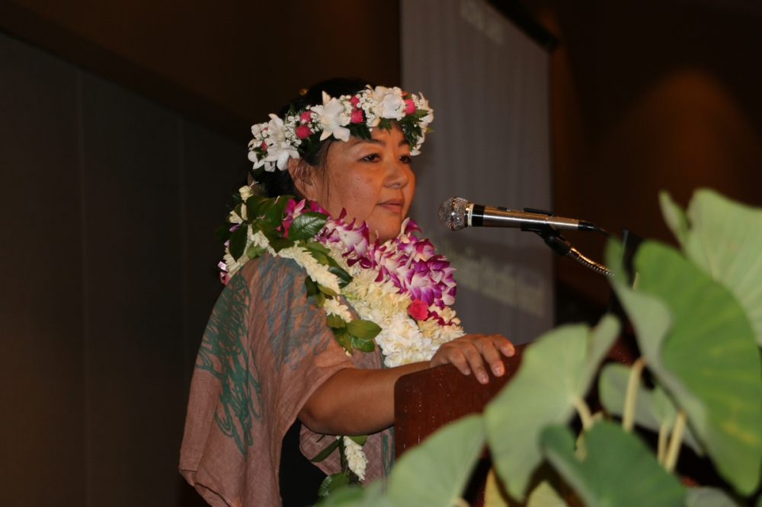
Are there other values taught by your family or culture?

Slide 21
Success in Education
Taking pride in your culture is important because it serves as a foundation for learning.
You are more likely to be successful if you approach learning with an understanding of your self which includes a sense of belonging to your family and an understanding and appreciation of your culture.

Slide 22
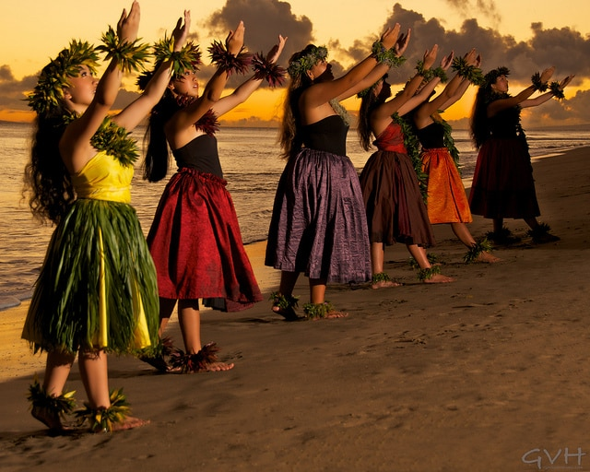
Early Hawaiian Education
There was no written language. Children learned from observing family and community members. Education was through:
Stories
Legends
Chants
Songs
Poems
Dance

Slide 23
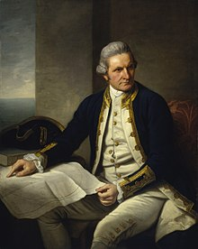
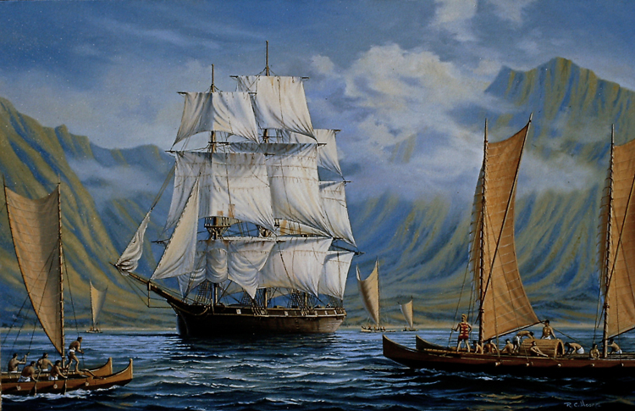
Captain Cook: Dramatic Change
Arrived in 1778
The Native population was decimated by diseases brought by the Europeans.
Population decreased by 80%!

Slide 24
Missionaries Arrive 1820
Introduced Christianity
Considered the hula dance immoral
Converted the Hawaiian language to a written language
Missionary schools taught Hawaiians to “abandon their culture for ‘civilized’ Western ways.”
The Hawaiian language was banned in 1896.

Slide 25
1901 Home Rule Party
Rules promoting:
The growth of taro
Use of the Hawaiian language
Honoring the deposed queen, Lili’uokalani

Slide 26
1960 Revival
During the 1960’s there was a revival of Hawaiian language and culture.
In 1978, the Hawai’i State Constitution was amended to include “the study of Hawaiian culture, history, and language.”

Slide 27
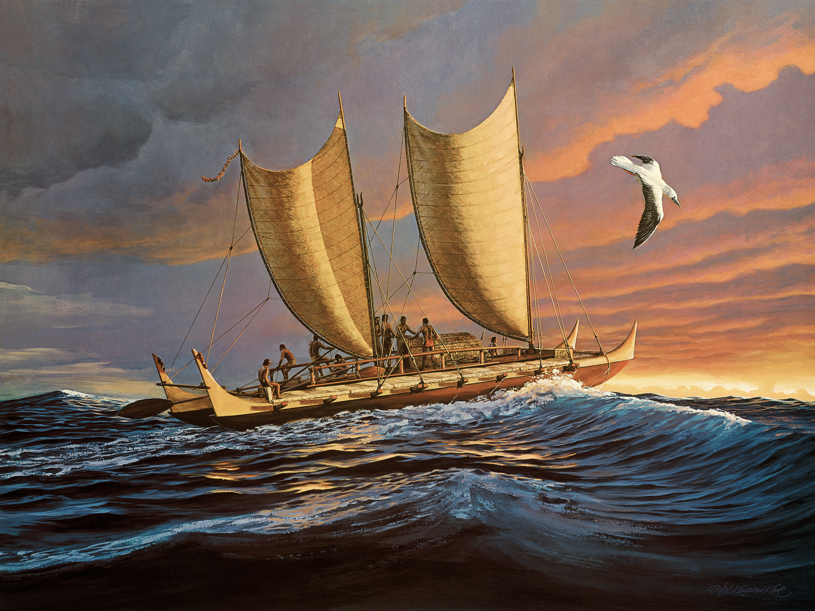
Revival of Pride in Hawaiian and Pacific Island Culture: The Hokule’a

Slide 28
The Hokule’a is the double hulled Hawaiian canoe that has been traveling the world.
It has become a symbol of hope for the revival of Pacific Island and Hawaiian culture.

Slide 29
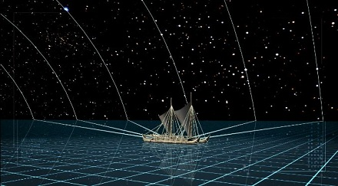
Early Explorers
Were able to travel great distances using wayfinding, a method of navigation using the stars and being aware of nature and the ocean environment.
They can be compared to modern day astronauts.

Slide 30
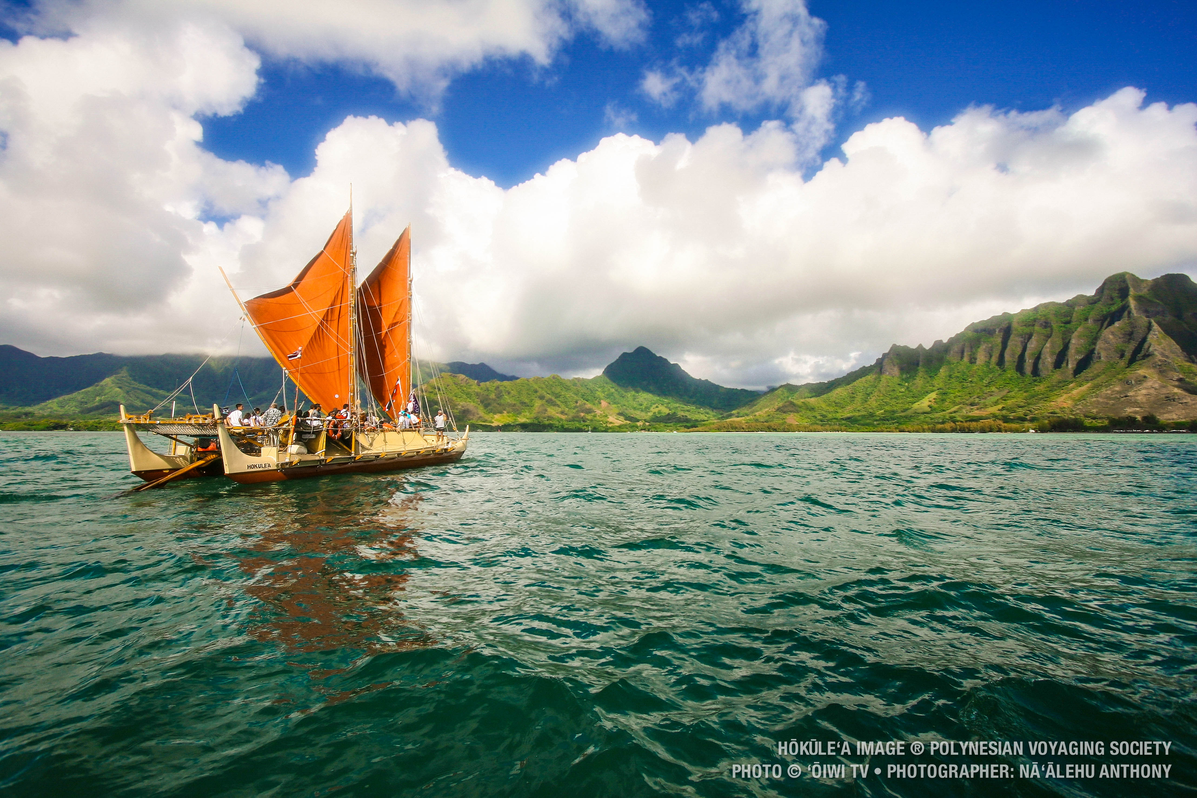
Hokule’a 1976 to the Present Time

Slide 31
The Hokule’a
Since 1976, there have been 25 voyages around the world including the South Pacific, Indonesia, the Indian Ocean, and The Cape of Good Hope in South Africa.
Voyages continue to spread the message about what the world can learn from island people about how to live sustainable and care for the ocean.

Slide 32
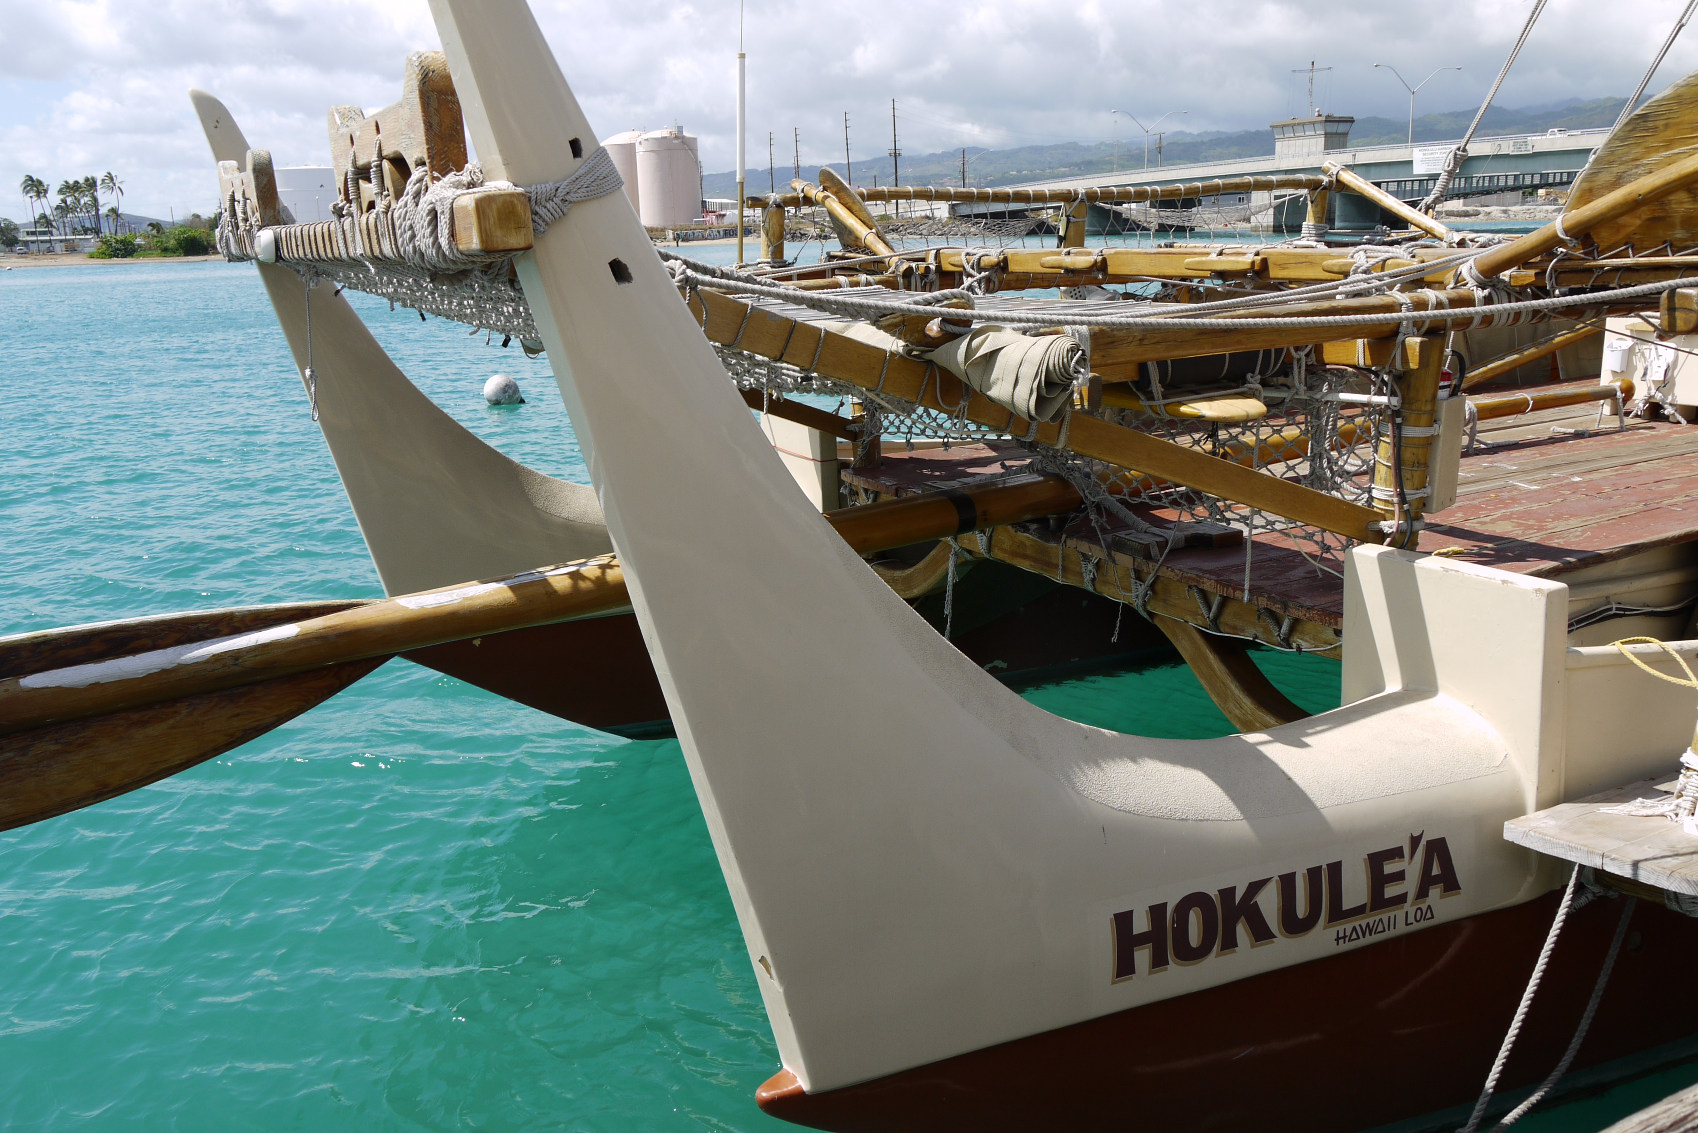
The Hokule’a
This project is helping students around the world take pride in their culture, inspiring beach clean-ups, school beautification, and discouraging pollution and littering.

Slide 33
Navigating Different Cultures
Balance “fitting in” and maintaining your culture.
Transculturation: Adapting to a different culture without sacrificing individual cultural identity.

Slide 34
The Third Space
First space: where you live and your culture
Second space: where you need to learn about, such as college
Third space: where you feel safe
Learning to adapt between the spaces is challenging.

Slide 35
The Safe Space
How can you establish your own safe place?
Trust in your culture and gain strength from knowing who you are.

Slide 36
Tips for Success
Celebrate your culture and values.
Your ohana is the source of strength, support, identity, and confidence.
Be open to learn about other cultures.
Appreciate different perspectives.
Learn to network with other people.
Be an advocate for Malama, protecting and caring for the earth, to improve the lives and futures of all earth’s inhabitants.

Slide 37
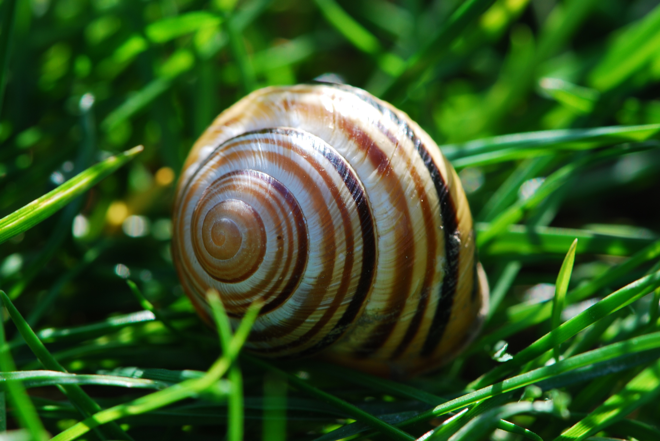
Appreciating Island Cultures:
The Story of the Kahuli Shells
Read the story and discuss in class.

