Slide 1
Unit 8: Understanding Banking

Slide 2
Think, Pair, Share
Why use a bank?

Slide 3
Reasons to Use a Bank
Money is protected from loss, theft, and fire.
It is easy to access the money in your bank account.
Cashing a check is less expensive.
Money in a bank is insured by the federal government.

Slide 4
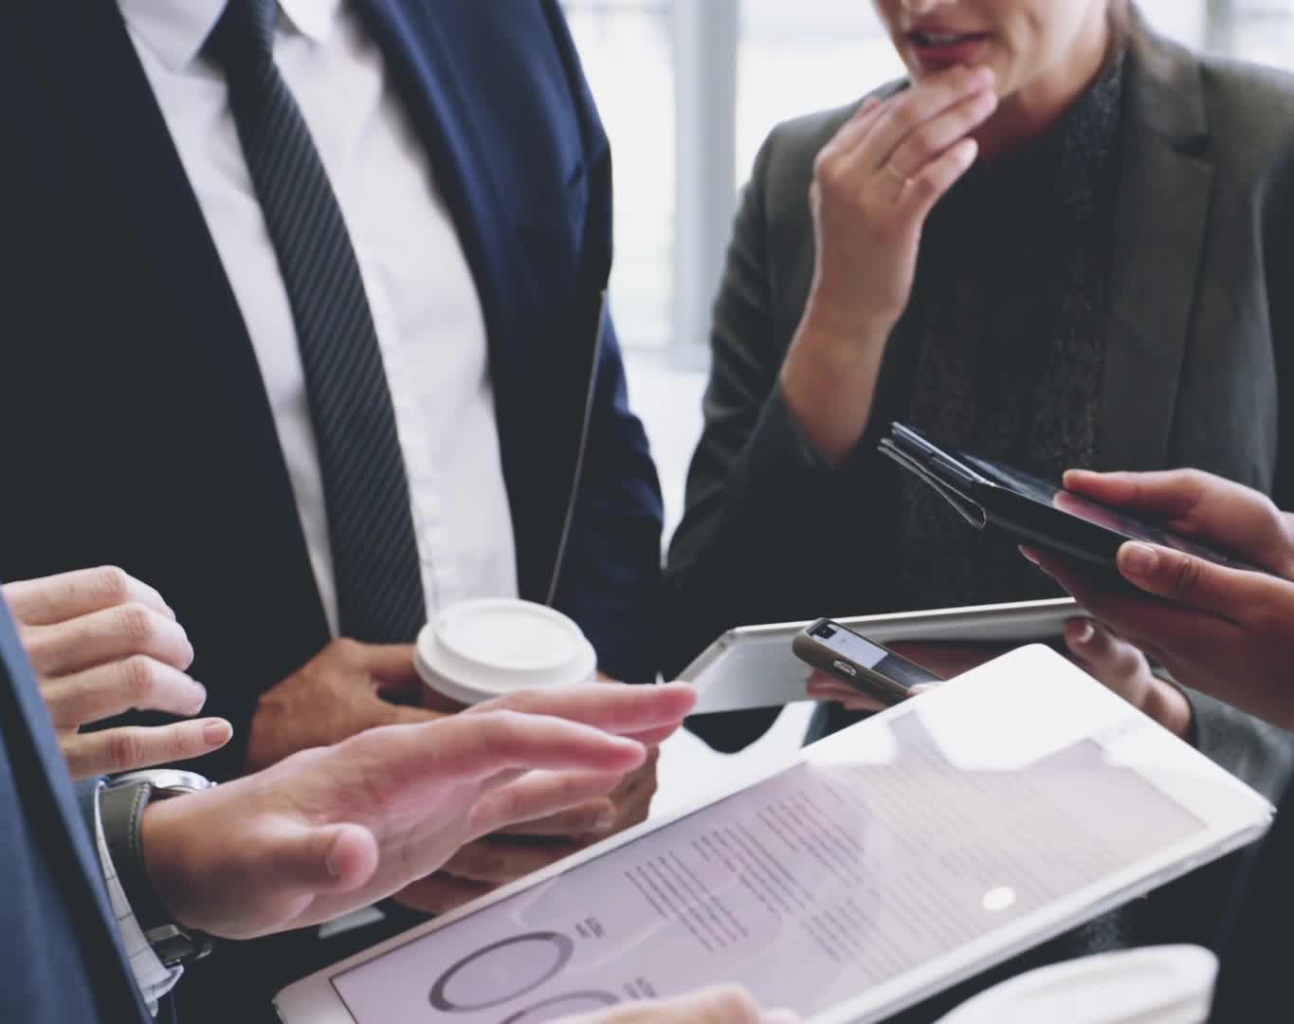
Preview the Topic
What do you know about banking?

Slide 5
Financial Literacy: Banking 101

Slide 6
Banking Services

Slide 7
Deposits and Transactions
Checking accounts
Easy access
Savings accounts
Longer term, interest
Money market accounts
Longer term, higher interest
Certificates of deposit
Higher interest, fixed term

Slide 8
The Different Types of Bank Accounts Explained

Slide 9
Loans and Credit Services
Consumer loans
Business loans

Slide 10
Other Banking Services
Safe deposit boxes
Individual Retirement Accounts (IRA’s)
Money grows tax free until retirement

Slide 11
Opening a Bank Account
Verify your identity:
Driver’s License
Identity Card
Green Card
Passport

Slide 12
Withdrawing Money
Electronic transfers
Debit (ATM) cards
Checks

Slide 13
How to Write a Check

Slide 14
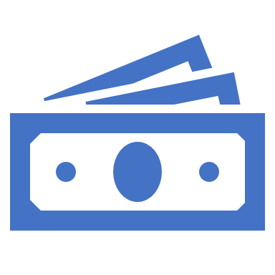
Managing Your Account
How much money do you have?
How much money have you spent?

Slide 15
Expenses
ATM withdrawals
Checks
Automatic payments
Bank fees

Slide 16
Tracking Expenses
Checkbook register
Excel spreadsheet
Money management software

Slide 17
Group Discussion
What are some ideas for managing your bank account so that it is not overdrawn?

Slide 18
How to Organize Your Money and Balance Your Bank Account

Slide 19
7 Habits for Organizing Your Money
Know how much you have and how much you have spent.
Set up online accounts with alerts.
Check your balance every time you use your debit card.
Print or save bank statements.
Maintain a checking account budget.
Keep a list of automatic transactions.
Be a record keeper. Keep your receipts to monitor income and expenses.

Slide 20
Intentions for the Future
In 5 minutes, write 5 intention statements for the future about using banking and managing your account.
I intend to:

