Slide 1
College Success Online
Dr. Marsha Fralick

Slide 2
Ice Breaker
Introduce yourself
Where are you from?
What should I see if I visit your city?

Slide 3

Take a Harbor Cruise in San Diego

Slide 4

Visit La Jolla Shores

Slide 5
Overview
Why teach online?
Advantages/disadvantages?
What are some best practices?
Engaging students online
An overview of my class
Share your ideas

Slide 6
PowerPoint and related documents posted online at:
www.collegesuccess1.com
Click on Conferences
Also Instructor Manual
Faculty Resources

Slide 7

Online Education is Increasing
One third of all college students took an online course last year.
Online education grew 10% last year as compared to 2% for traditional education.
Online education grew 22% in community colleges.
Not enough online courses available to meet the demand.

Slide 8
Why teach online?
Think, Pair, Share

Slide 9
Why teach online?
Access
  Working students
  Veterans
  Parents
  Disabled
  Distance
Convenience
Opportunities provided by technology

Slide 10
Researcher Arthur Levine
Undergraduate education would be improved:
78% Classes made greater use of technology
78% If professors made greater use of technology
52% If more blended courses were offered
33% If more courses were offered completely online

Slide 11
Are there some disadvantages of online education?
  Think
  Pair
  Share

Slide 12
Online education is improving
For community colleges
  72% complete their online courses.
  76% complete their F2F courses.
We know what works.

Slide 13
Foundations for Best Practice
Vocal
  Visible
  Organized
  Compassionate
  Analytical
  Lead by example
  From: “Best Practices in Online Teaching Strategies,” Hanover Research Council

Slide 14
Visibility
Class schedule
Website
Blog
Announcements
E-mail
Text messages

Slide 15


Visibility begins with the class schedule. It connects students to my website.

Slide 16
Website
www.collegesuccess1.com

Slide 17
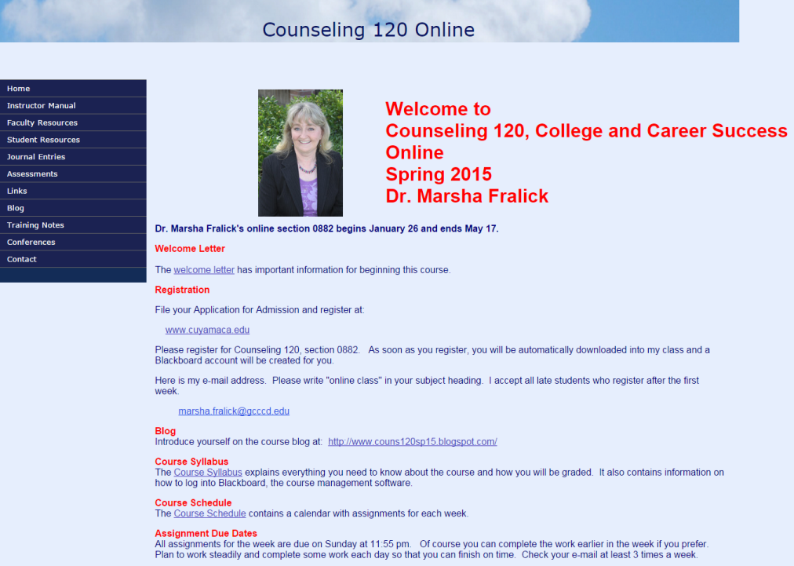

Slide 18
The Blog
Visibility and interaction start before the class begins.
Meet the professor.
Introduce yourself.
Describe your educational journey.
Make a personal connection.

Slide 19
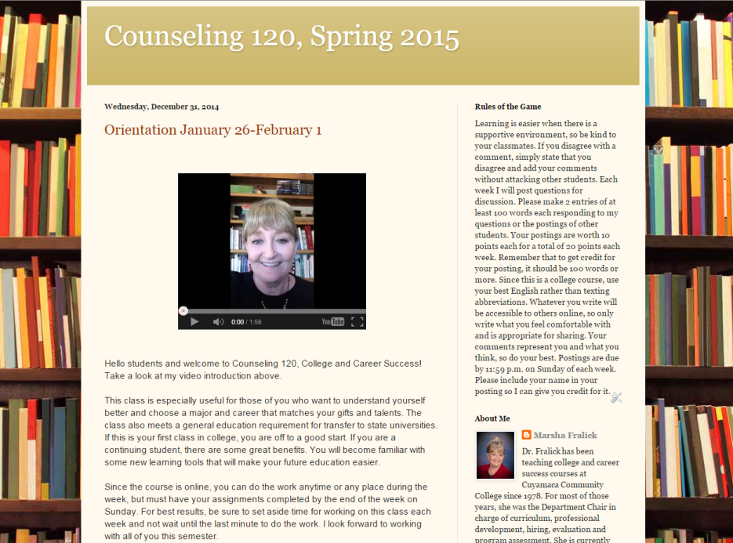

Slide 20
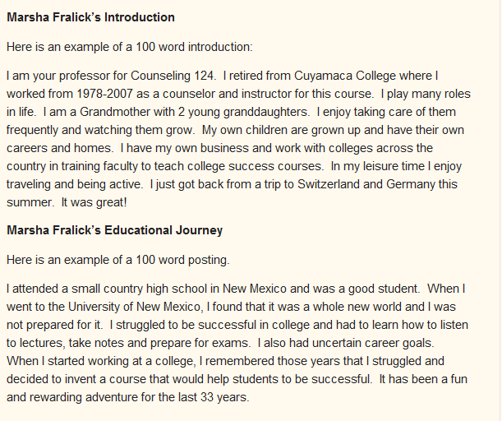

Slide 21
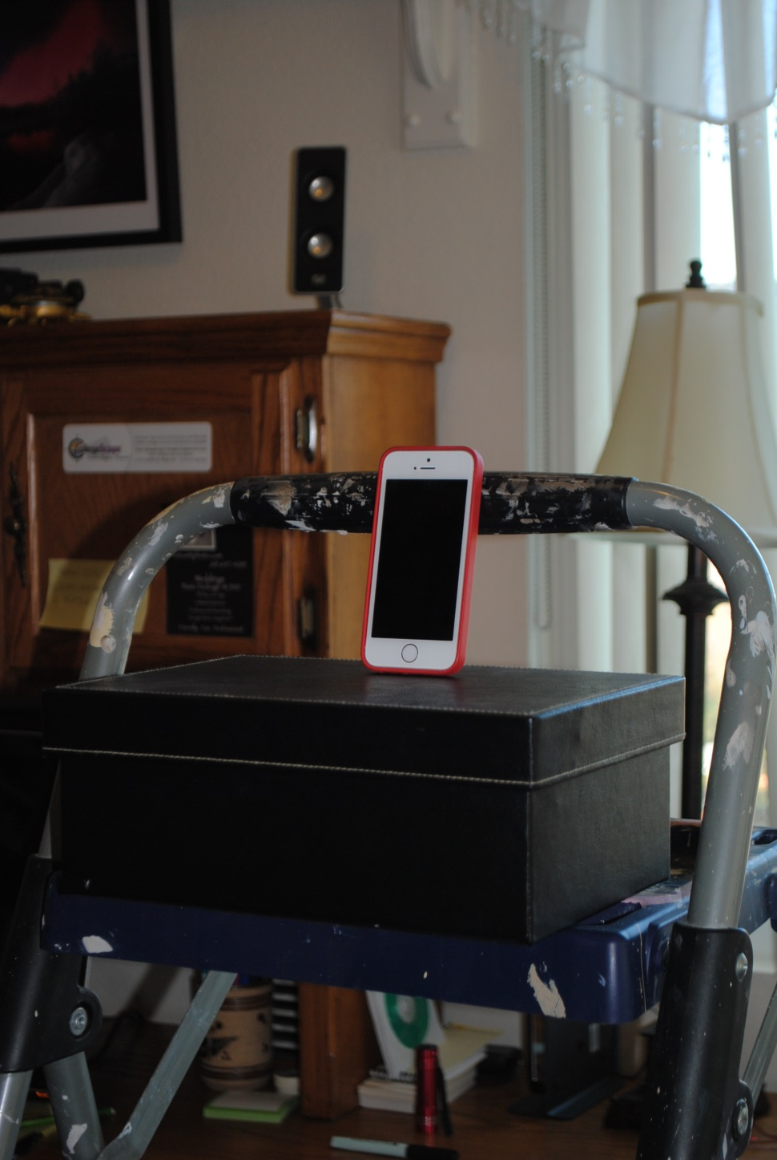
My Recording Studio

Slide 22
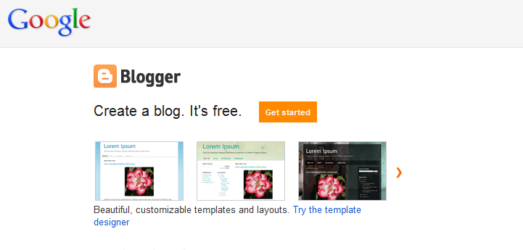
www.blogger.com

Slide 23
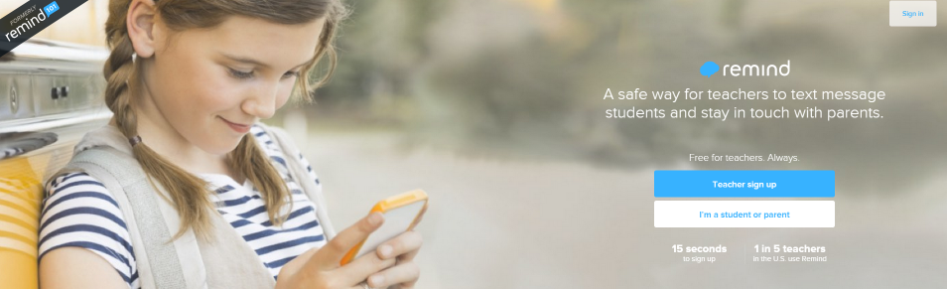
Use remind.com to send text messages

Slide 24
Organization
Welcome letter
Calendar
Syllabus
Course Management System
(such as Blackboard)

Slide 25
The Welcome Letter
What is the course about?
Why should you take it?
What are the benefits?
Myths about online courses
Time commitment required
Being an independent online learner
Begin the first week
How you begin the class sets the stage for student involvement and success.
A copy is provided at www.collegesuccess1.com

Slide 26
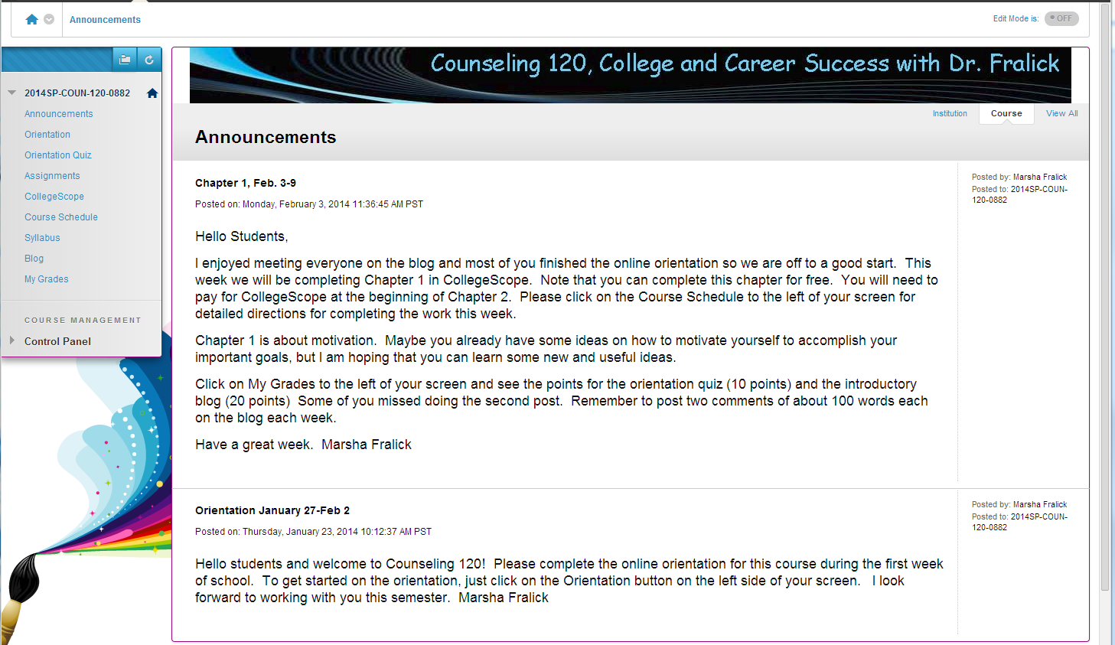

Slide 27
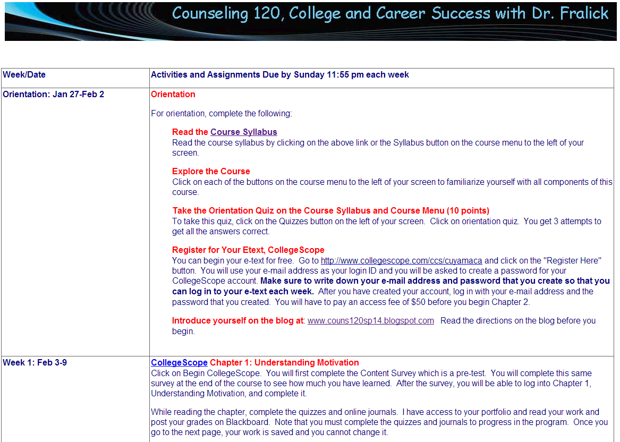

Slide 28
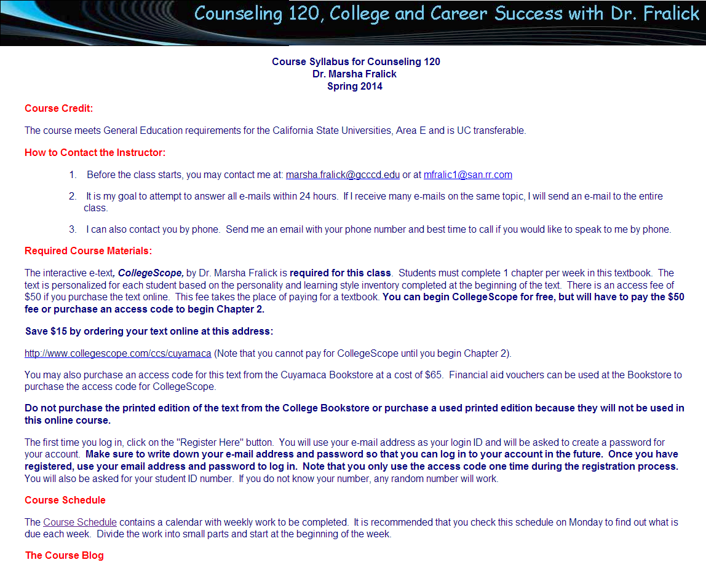

Slide 29
Compassion
The first 2 weeks are critical
Help students get to know one another.
Rules for conduct; be kind to others.
Get to know your students and their individual situations.
Follow up on any missing work.

Slide 30
Deadlines Vs. Milestones
Students are not given credit for late work
Allow adult learners some flexibility on the rate of learning.
Set milestones.
Reward accomplishment.
Late form

Slide 31
Analytical
Assignments that encourage creative and critical thinking
Clear expectations
Timely grading of assignments and posting grades
Current grade in course available each week

Slide 32
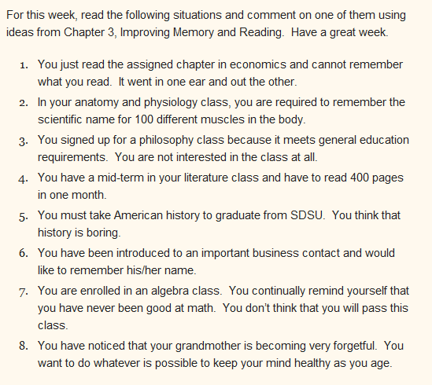

Slide 33
Lead by Example
The professor sets the tone and provides leadership
How you begin is how you will end
  Modeling
  Showing examples

Slide 34
Interactivity
The heart and soul of online education
Interactivity with:
  The professor
  Other students
  The textbook
  The Internet

Slide 35

Interactive Online Textbook

Slide 36
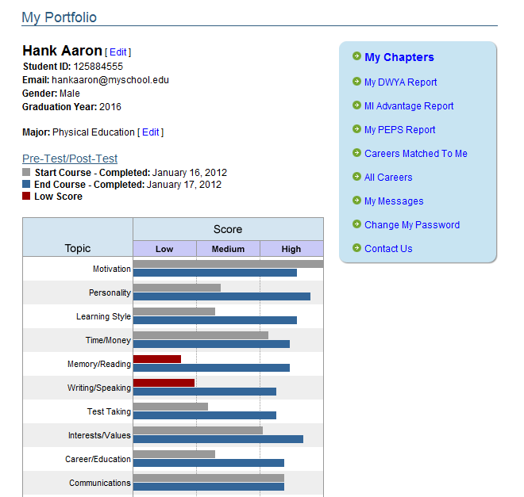

Slide 37
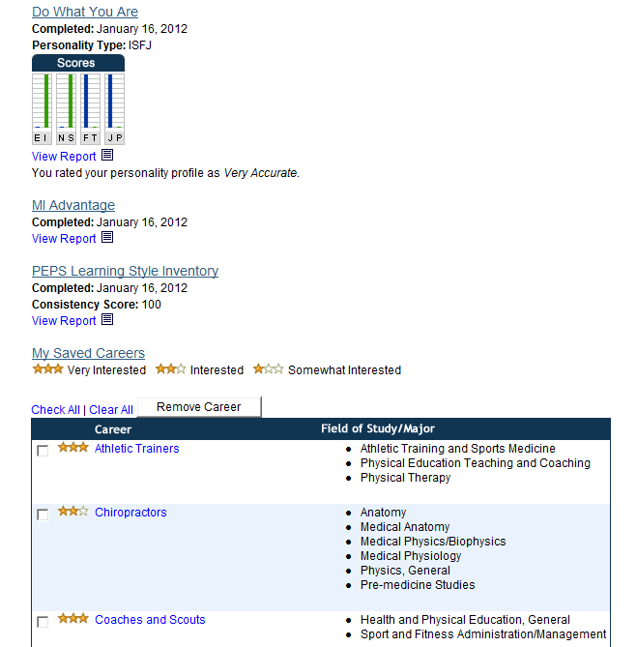

Slide 38
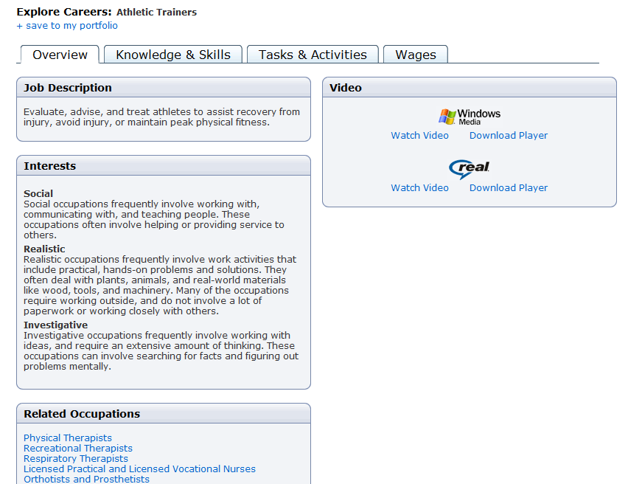

Slide 39
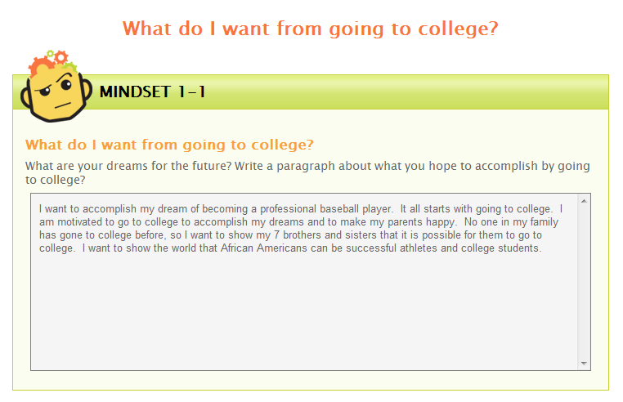

Slide 40
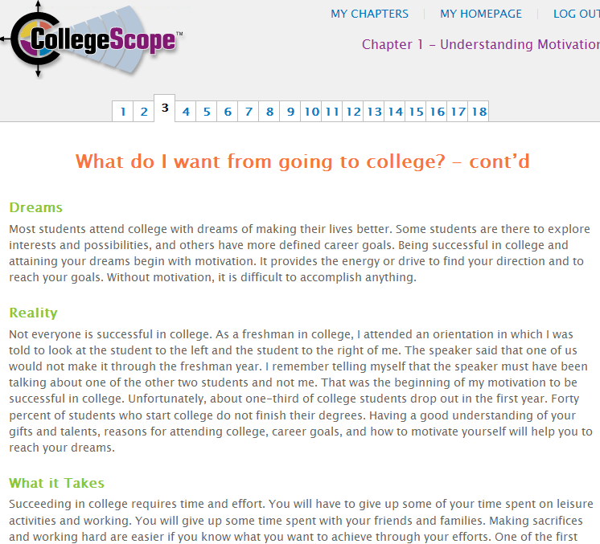

Slide 41
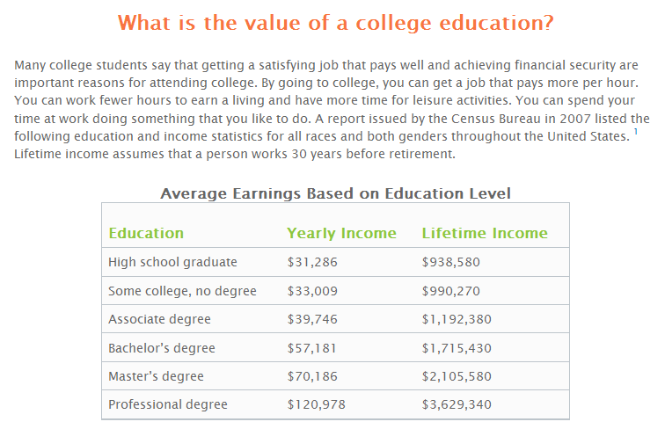

Slide 42
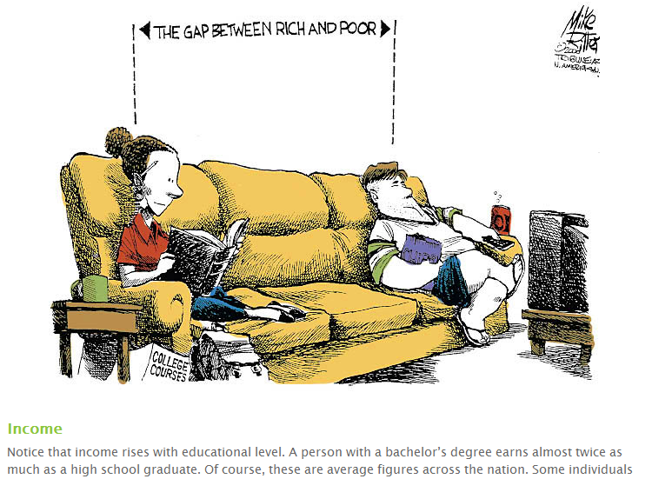

Slide 43
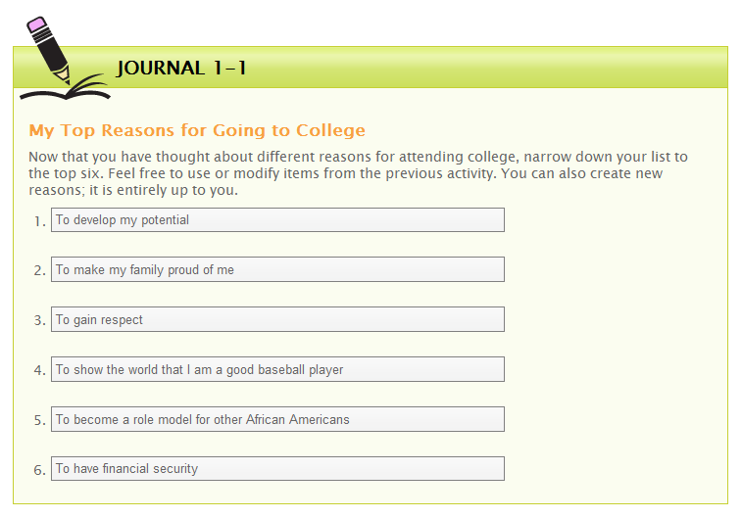

Slide 44
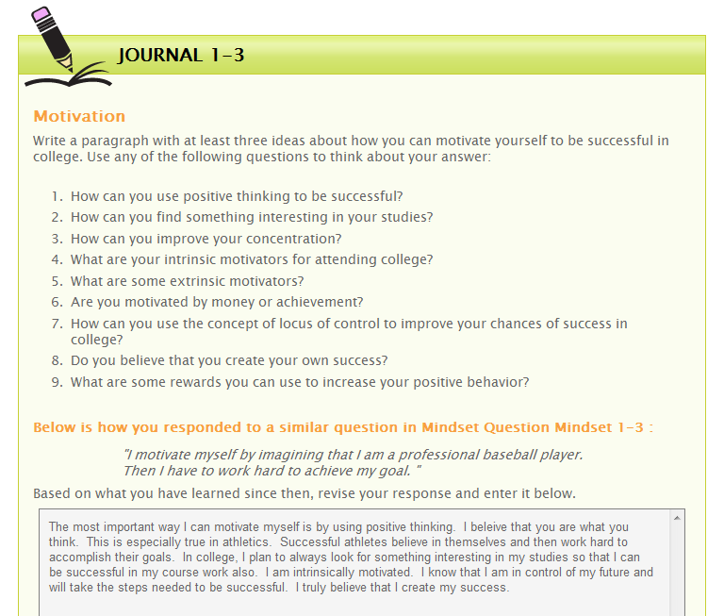

Slide 45
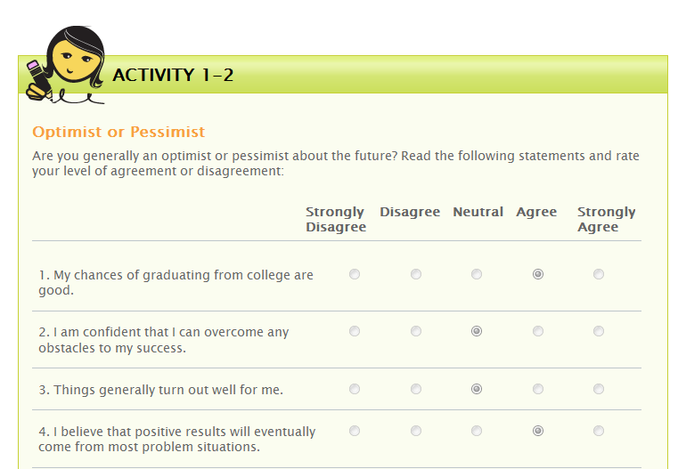

Slide 46
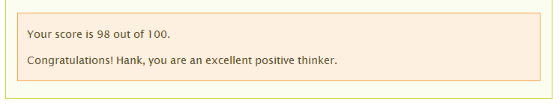
Immediate Feedback

Slide 47
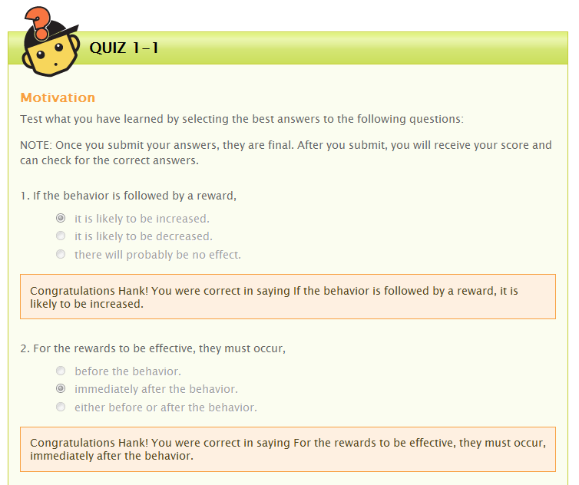

Slide 48
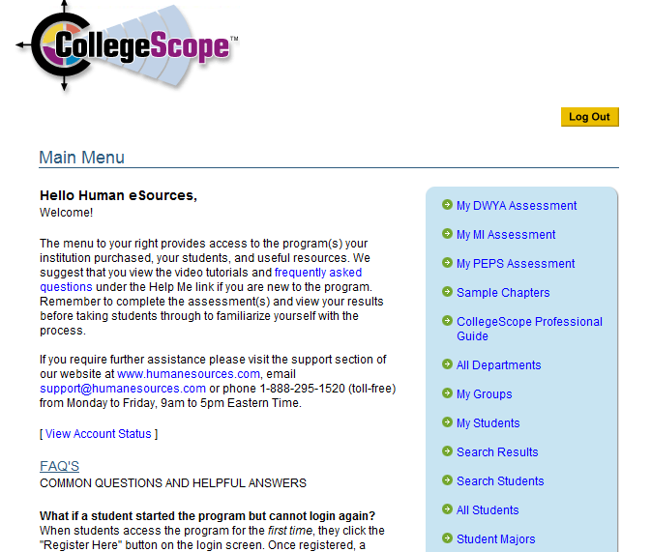
Faculty
Portfolio

Slide 49
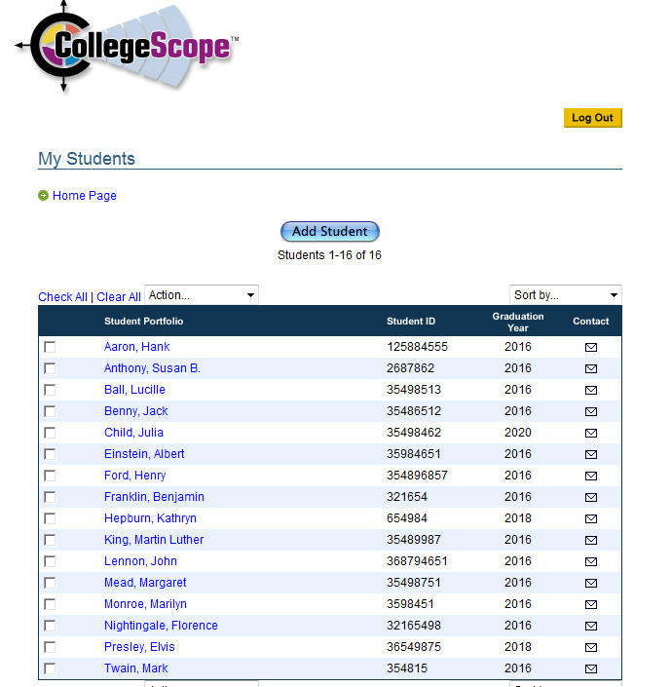
My Students

Slide 50
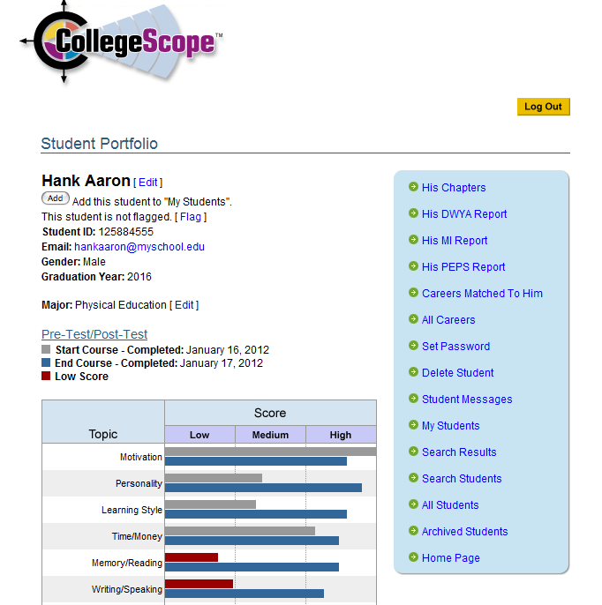

Slide 51
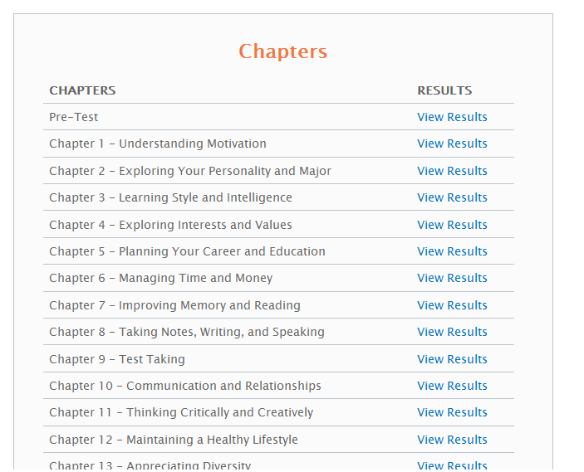

Slide 52
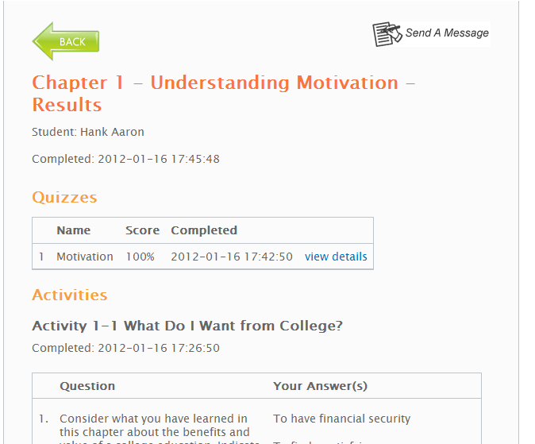

Slide 53
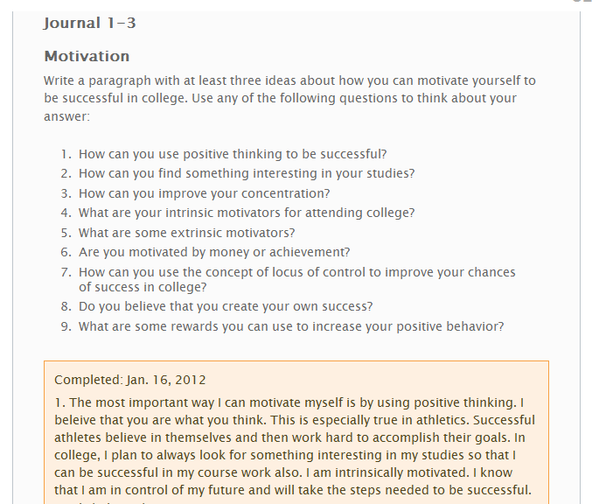

Slide 54
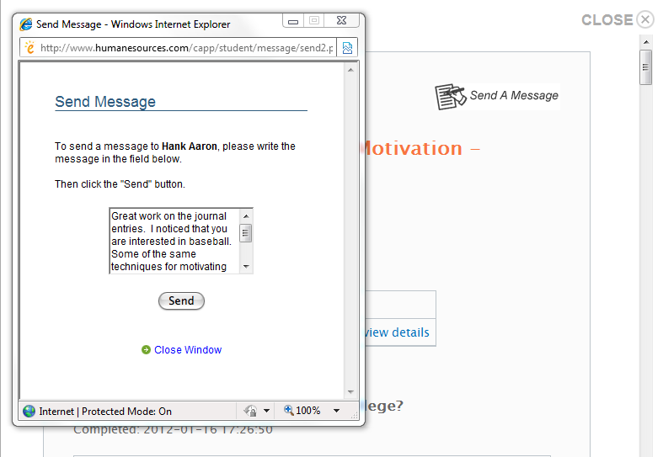

Slide 55
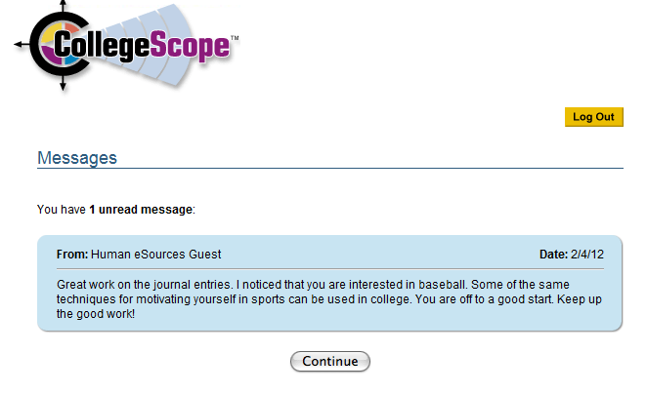
From Dr. Marsha Fralick

Slide 56
Personalization
Personality type (Do What You Are)
Learning style (Productivity Environmental Preference Survey)
Multiple intelligences (MI Advantage)
“I must say that I am really enjoying how personal this textbook feels. It helps me to think about my future.” Mariessa O’Neil

Slide 57
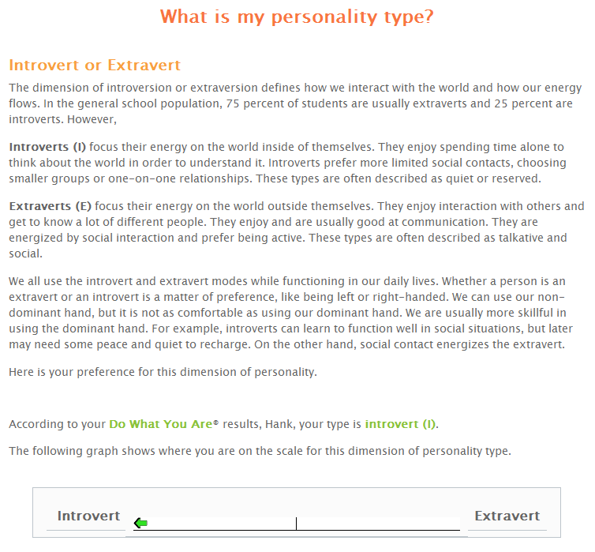

Slide 58
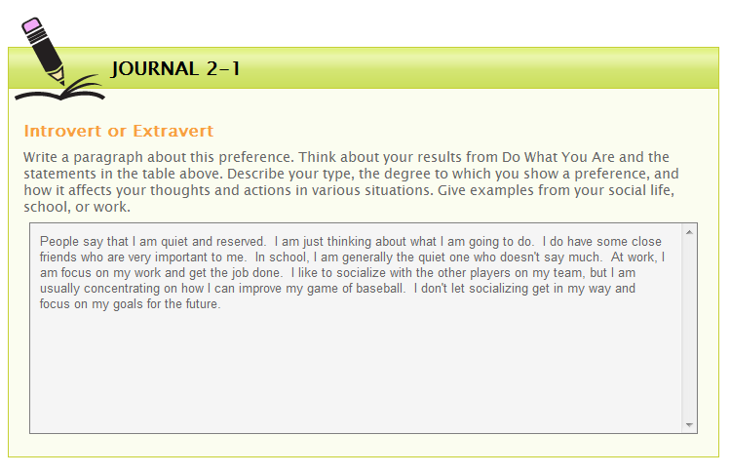

Slide 59
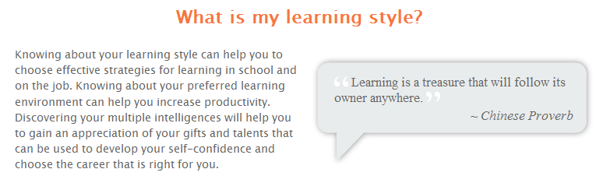
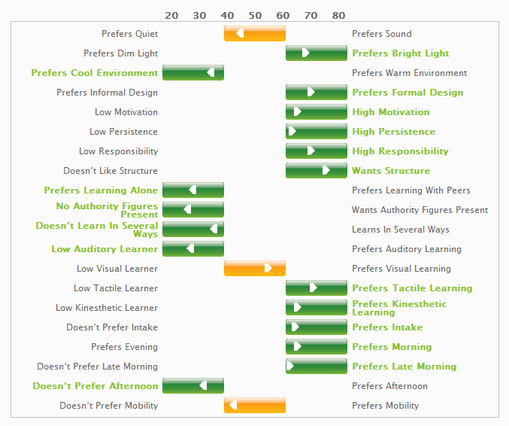

Slide 60
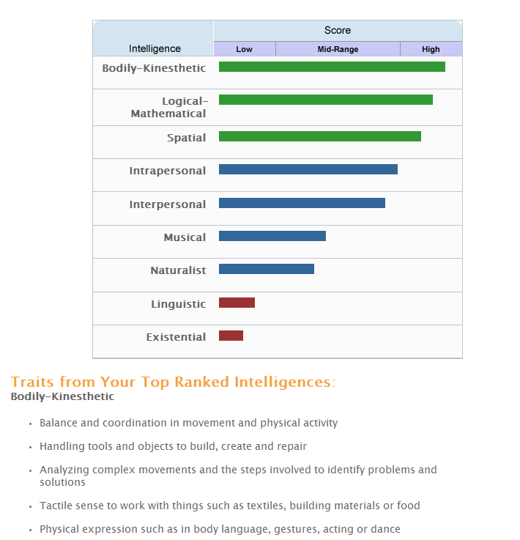

Slide 61
Quality Online Education
Visible
Organized
Compassionate
Analytical
Lead by example
Interactive!

