Slide 1
Increasing Happiness in Learning and Life Dr. Marsha Fralick and Dr. Seth Batiste

Slide 2
Introductions
Dr. Marsha Fralick
Author of textbooks on college and career success
Attaining happiness in life is a key theme in all her materials
Community college counselor and FYE instructor for 43 years
Dr. Seth Batiste
Co-author of college and career success textbook
Presented workshops on employee mental health and wellness
Notes:
Seth
Introduce Marsha
Marsha
Introduce Seth

Slide 3
Resources
www.collegesuccess1.com
Conferences
Notes:
Marsha
Resources including the Ppt. presentation, research articles, and student exercises are located at www.collegesuccess1.com.

Slide 4
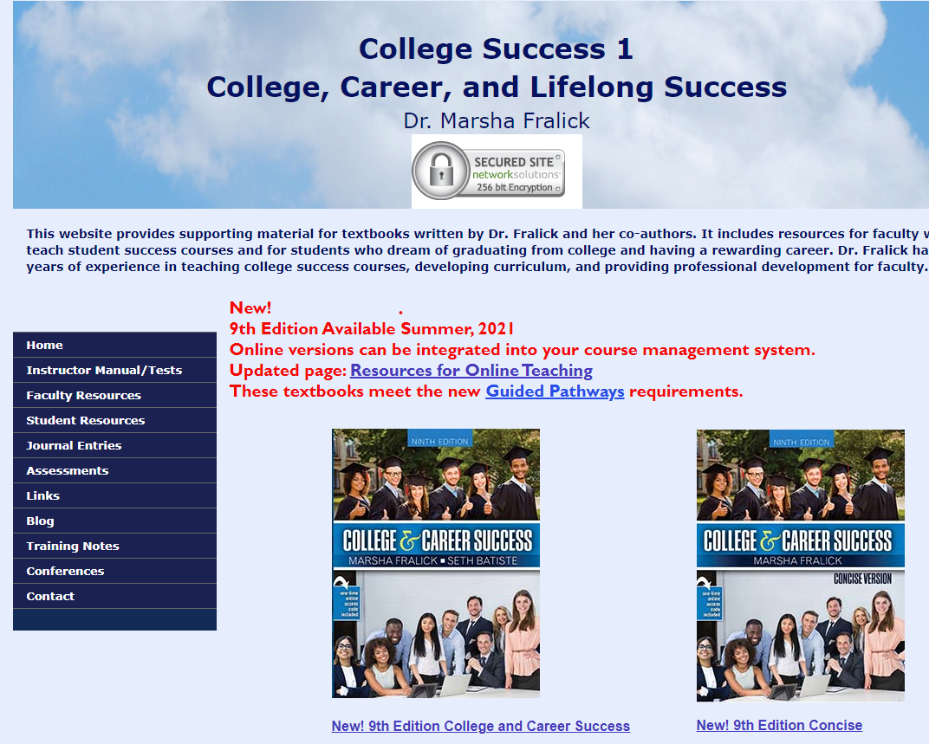
Notes:
Marsha
Here is my website. Click on Training Notes

Slide 6
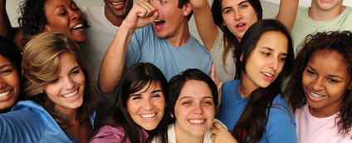
Research on happy people:
Live longer and have fewer disabilities.
Enjoy their jobs more.
Have rich and fulfilling social lives.

Slide 7
Agenda Achieving Happiness in Life
Keys to happiness based on research by positive psychologists:
Authentic Happiness by Martin Seligman
The How of Happiness by Sonja Lyubomirsky
Grit and happiness
Grit by Angela Duckworth
Mindset and happiness
Mindset by Carol Dweck
Practical Exercises

Slide 8
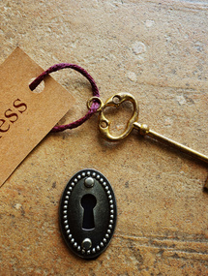
Key Idea
How will we achieve happiness in a post pandemic world?
What ideas can you use to achieve happiness for yourself and your students?
As we go through this presentation make a list of your intention statements for improving happiness for yourself and your students. We will share ideas at the end.

Slide 9
Martin Seligman’s General Happiness Scale
In general, I consider myself:
1 2 3 4 5 6 7
Not a happy person A very happy person
2. Compared to most of my peers, I consider myself:
1 2 3 4 5 6 7
Less happy More happy
3. Some people are generally very happy. They enjoy life regardless of what is going on, getting the most out of everything. To what extent does this describe you?
1 2 3 4 5 6 7
Not at all A great deal
4. Some people are generally not very happy. Although they are not depressed, the never seem to be as happy as they might be. To what extent does this characterization describe you?
1 2 3 4 5 6 7
A great deal Not at all

Slide 10
Scoring
Add up your numbers and divide by 4. The mean for adult Americans is 4.8. Two-thirds of people score between 3.8 and 5.8.

Slide 11
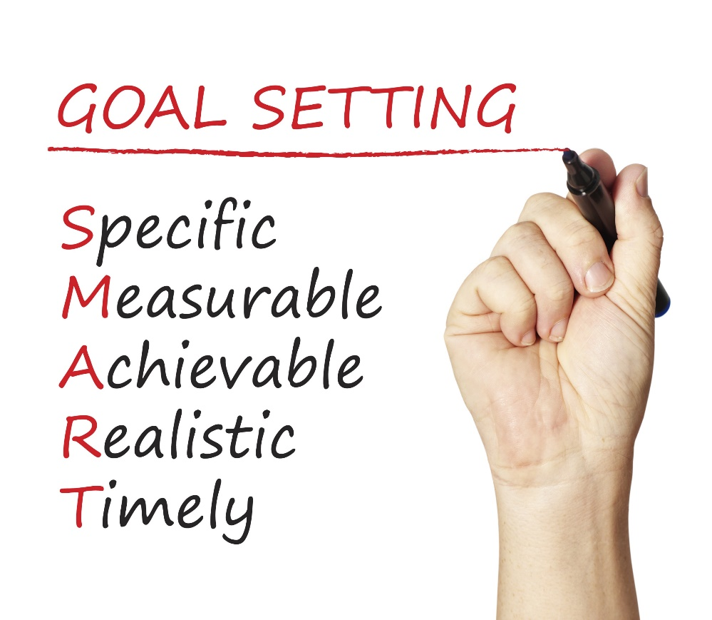
Happiness is a common goal.
How does it fit with SMART Goals?

Slide 12
Happiness is not a goal!
Achieving our goals is one of the ways to achieve happiness.

Slide 13
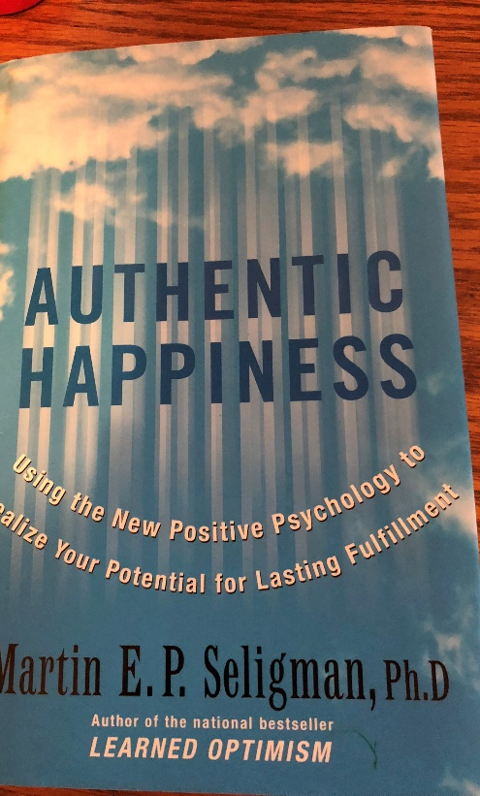
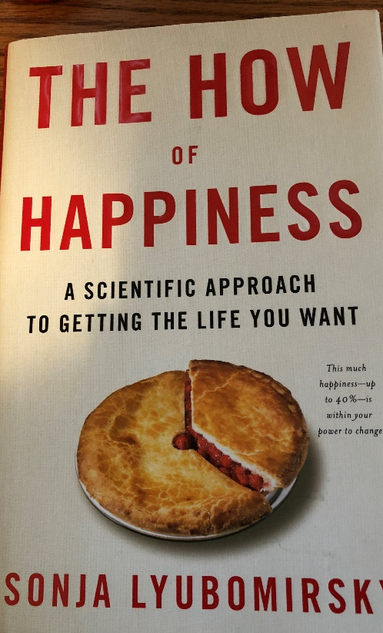
Martin Seligman Sonja Lyubomirsky
Positive psychologists who have done research on how to achieve happiness in your life. See the references on the handout.

Slide 14
Happiness or Hedonism?
Hedonist
The hedonist wants as many good moments and as few bad moments as possible.
Why doesn’t it work?
Hedonistic Adaptation
The more material possessions we have, the greater our expectations, and we no longer appreciate what we have.

Slide 15
Martin Seligman Happiness = S + C + V
S is your set range (50% of happiness is determined by heredity)
C is your circumstance (8-15% of happiness)
V is what is under your voluntary control (40% of happiness!)

Slide 16
Set Range
Your set range is determined by heredity.
Lottery winners return to their level of happiness before winning.
Those experiencing misfortune also return to their previous level of happiness.

Slide 17
Martin Seligman Happiness = S + C + V
S is your set range (50% of happiness is determined by heredity)
C is your circumstance (8-15% of happiness)
V is what is under your voluntary control (40%)

Slide 18
Circumstances 8-15% of Happiness
Once basic needs are met, greater wealth does not increase happiness.
Having a good marriage is related to happiness.
Happy people are more social.
Moderate ill health does not bring unhappiness, but severe illness does.
Educated people are slightly happier.
Climate, race, and gender do not affect level of happiness.
Religious people are somewhat happier than nonreligious people.

Slide 19
Martin Seligman Happiness = S + C + V
S is your set range (50% of happiness is determined by heredity)
C is your circumstance (8-15% of happiness)
V is what is under your voluntary control (40%)

Slide 20
What are some examples of factors under your voluntary control?

Slide 21
Voluntary Control 40% of Happiness
Can you add some of these items to your list?
The past does not determine your future. The future is open to possibilities.
Be grateful.
Forgive and forget.
Increase optimism and hope for the future.
Engage in activities that make you happy.
Take the time to savor the happy times.
Take the time to enjoy the present moment.
Build more flow into your life. Flow is the state of gratification we feel when totally absorbed in an activity that matches our strengths.

Slide 22
Sonya Lyubomirsky The How of Happiness 12 Happiness Activities Which ones can you use for yourself or your students?

Slide 23
1. Express Gratitude
Gratitude is one of the most powerful happiness techniques.

Slide 24
Gratitude Exercise
What are 5 things in life for which you are grateful or thankful?
Keep a gratitude journal. Each week list at least five things for which you’re grateful or simply take some time to contemplate why you are grateful.
Do this exercise with your students.
Make it a Thanksgiving tradition.

Slide 25
Why Gratitude is Important
Savoring positive life experiences.
Increases self-esteem.
Helps people cope with stress and trauma.
Encourages moral behavior. You are more likely to help others.
Builds social bonds.
Diminishes negative emotions such as anger, bitterness, and greed.
Inhibits invidious comparisons by be appreciative of what you have.
Helps avoid hedonistic adaptation.

Slide 26
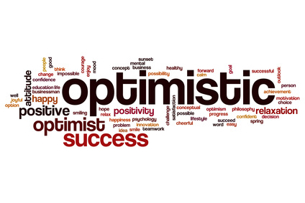
2. Cultivate Optimism

Slide 27
Cultivate optimism with mindset.

Slide 28
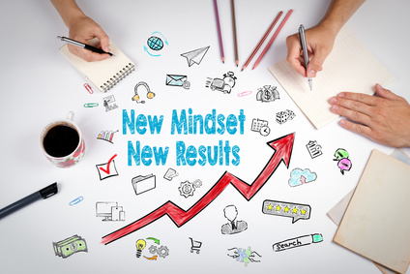
Positive Thinking and Mindset
Growth Mindset
Fixed Mindset
Intelligence is increased as you acquire new knowledge.
Through practice and effort, skills can be improved.
Failure is an opportunity to learn.
Intelligence is fixed at birth.
Increased effort does not lead to success.
Roadblocks are an excuse to be absent.

Slide 29
What Went Well Exercise
What are three things that went well last week?
We tend to focus on what does not go well and not enough on what goes right in our lives.
Challenge: For two weeks, at the end of each day, set aside 10 minutes to think or write about what went well during the day.

Slide 30
What Went Well Exercise for Students
Have students write down daily 3 good things that happened to them.
Write about one of the following:
Why did this good thing happen?
What does this mean to you?
How can you have more of this good thing in the future?

Slide 31
3. Avoid Overthinking and Social Comparison
“Overthinking is thinking too much, needlessly, passively, endlessly, and excessively pondering the meaning, causes, and consequences of your character, your feelings, and your problems.” – Sonja Lyubomirsky
Negative Consequences:
Increases sadness
Fosters negative thinking
Impairs the ability to solve problems
Decreases motivation
Interferes with concentration

Slide 32
Social Comparison
Noticing our friends, coworkers, family members, and even fictional characters
Imagining they are smarter, richer, healthier, wittier, or more attractive than we are
A result of excessive use of social media.
Dealing with overthinking and social comparison:
Yell stop!
Don’t sweat the small stuff.
Will it matter in a year? If so, begin taking small steps to resolve the issue.

Slide 33
4. Practice Acts of Kindness
Why does it work?
View others more positively
Connect with others
Appreciate your own good fortune
Leads to positive social consequences
Feel good about yourself
Chain of kindness

Slide 34
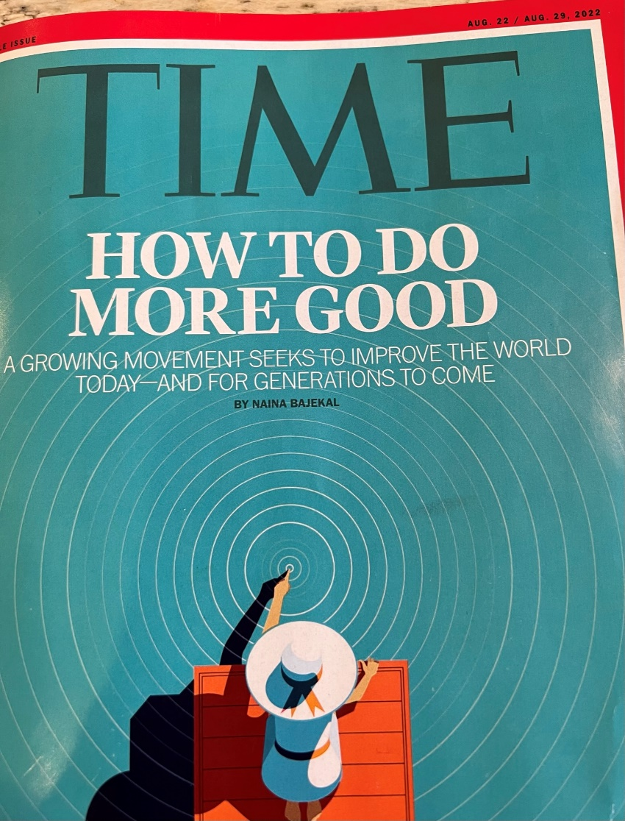

Slide 35
Kindness Exercise
Practice an act of kindness.
Examples?
Seligman states that this exercise is the “single most reliable momentary increase in well-being of any exercise he has tested.”

Slide 36
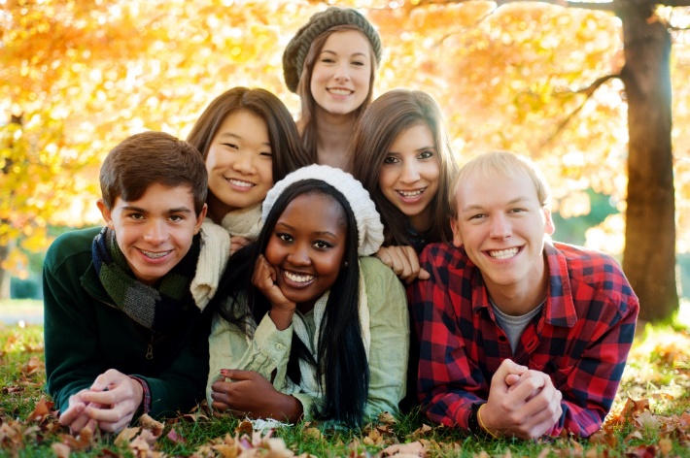
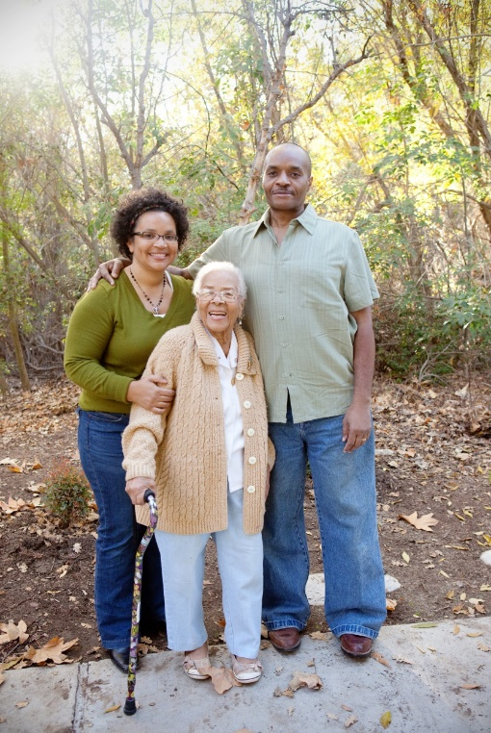
5. Nurture Social Relationships
Make time for others.
Express admiration and appreciation.
Be supportive and loyal.
An essential component of FYE courses.

Slide 37
6. Develop Strategies for Coping Meditation Mindfulness Breathing Exercise Sleep How can we integrate these ideas into our FYE courses?

Slide 38
Grit is a powerful strategy for coping.
Grit = Passion and Perseverance

Slide 39
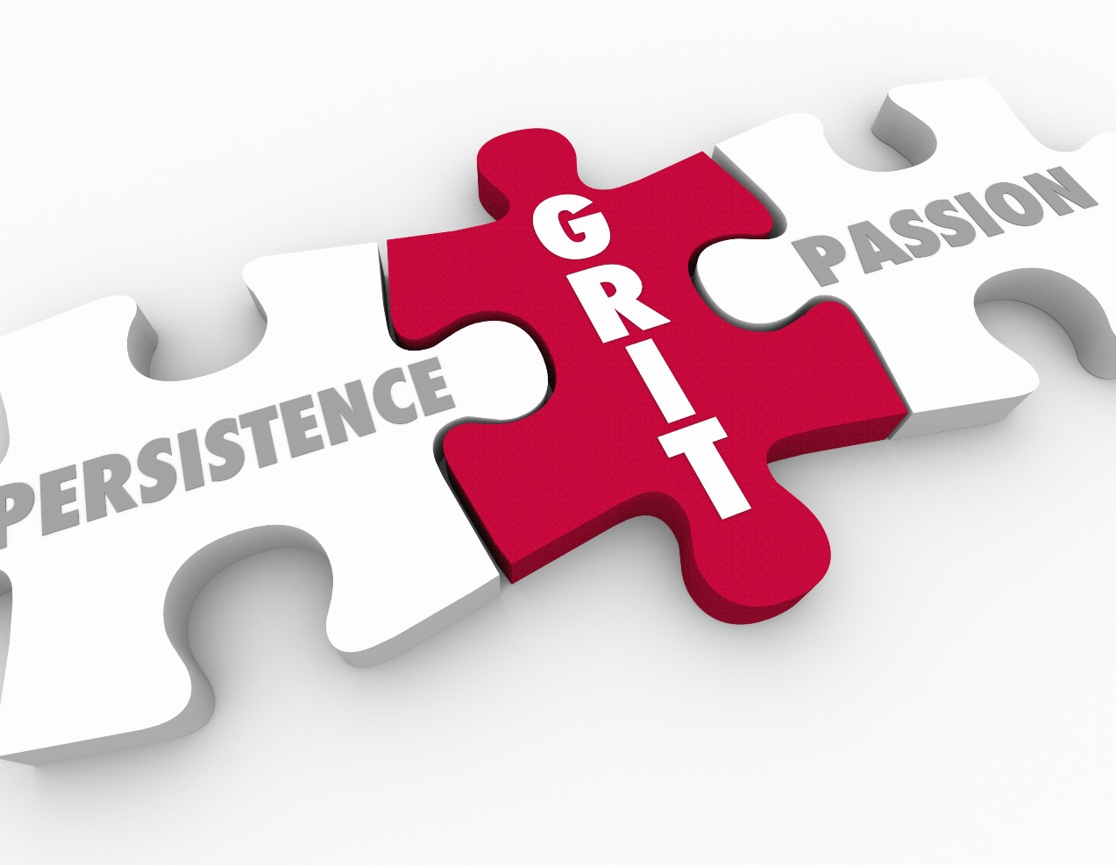
Grit: Key Ideas
Those who are gritty keep going after challenges or failure.
Grit is simply a “never give up” attitude.
What we accomplish may depend more on our passion and perseverance than our innate talent.
Talent is how quickly your skills improve when you invest effort.

Slide 40
Grit: Key Ideas
Without effort, your talent is nothing more than your unmet potential.
Effortful training is more important than natural talent. It takes 10,000 hours to become an expert.
Those with a growth mindset are grittier.

Slide 41
7. Learn to Forgive

Slide 42
8. Increase Flow Activities
Flow is the state of intense absorption and involvement with the present moment.
Flow is one of the characteristics of the happy life.
The key to creating flow is to establish a balance between skills and challenges.
To maintain flow, we must test ourselves in challenging situations.

Slide 43
Flow and grit are related.
Begin with interest
Next comes practice. Practice increases interest.
Then comes purpose. We become passionate when we are convinced that our work matters and has meaning.
Finally comes hope for a better future.

Slide 44
9. Savor Life’s Joys
The ability to savor positive experiences in life is one of the most important ingredients of happiness.
Brainstorm: Life’s Joys
Relish ordinary experiences
Savor and reminisce with family and friends.
Replay happy days.
Celebrate good news.
Be open to beauty and excellence.
Be mindful.

Slide 45
10. Commit to Your Goals
“An aim in life is the only fortune worth finding.” -Robert Louis Stevenson
“Find a happy person and you will find a project.” -Sonja Lyubomirsky
Working toward a goal is as important to well-being as it’s attainment.
Goals provide structure and meaning to our lives.
Goals help us to master our time.
Accomplish goals with grit.

Slide 46
11. Practice Religion and/or Spirituality
Provides social support and a sense of identity
Helps people deal with trauma
Provides hope
Promotes forgiveness
FYE Courses
Help students find meaning and purpose.

Slide 47
12. Take Care of Your Body
Exercise increases self-esteem.
It provides opportunities for flow.
Spend more time outside
Learn the basics of good nutrition
Get enough sleep

Slide 48
Intention Statements
Make a list of at least five things you can do to improve your happiness. Review your notes and the handout.
Make a list of at least five ways you can help your students to improve their happiness. Review the above lists.
Share some of your ideas

Slide 49
Custom Online and Print Versions Available
Chapter 1: Motivation
Chapter 2: Exploring Personality and Major
Chapter 3: Exploring Multiple Intelligences, Interests and Values
Chapter 4: Planning Your Career and Education
Chapter 5: Managing Time and Money
Chapter 6: Using Brain Science to Improve Memory
Chapter 7: Using Brain Science to Improve Study Skills
Chapter 8: Taking Notes, Writing, and Speaking
Chapter 9: Test Taking
Chapter 10: Communication and Relationships
Chapter 11: Thinking Critically and Creatively
Chapter 12: Diversity and Current Social Issues
Chapter 13: Thinking Positively about the Future: Optimism, Hope, Future-Mindedness, Making Positive Changes, Secrets to Happiness
Notes:
Seth
The new 9th Edition of College and Career Success contains 2 newly updated chapters:
Critical Thinking
Diversity and Social Issues
Marsha
The textbook has a career emphasis to help students match their personal strengths with a major and career as well as the traditional college success topics such as motivation, time management, study skills, and lifelong success topics.
It is available in print and interactive digital media options.
Directions for ordering a complimentary review copy are located on my resource page at collegesuccess1.com

Slide 50
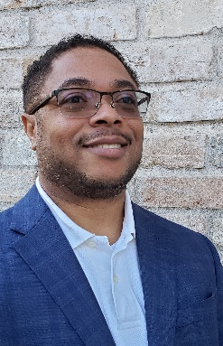
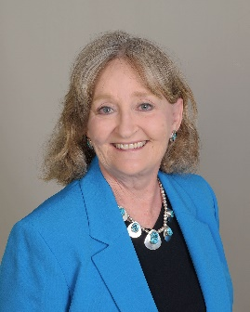
Contact the Authors
Dr. Seth Batiste
Dr. Marsha Fralick
www.batisteconsulting.us
www.collegesuccess1.com
Conferences
Textbooks

Slide 51
Discussion Questions

Slide 52
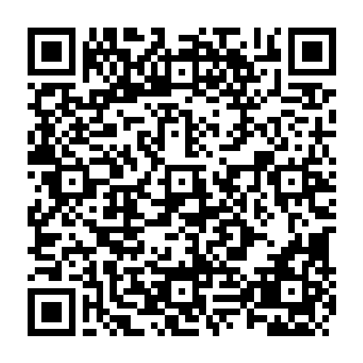
Please remember to submit your evaluation on Guidebook!
#FYE23

