Slide 1
Increasing Happiness in Life
Dr. Marsha Fralick and Dr. Seth Batiste
Notes:
Welcome to our presentation today. We’re happy you could join us.

Slide 2
Introductions
Dr. Marsha Fralick
Author of textbooks on college and career success
Attaining happiness in life is a key theme in all her materials
Community college counselor for 30 years
Dr. Seth Batiste
Co-author of college and career success textbook
Presented workshops on employee mental health and wellness
Promotes mental health and work/life balance through financial literacy
Notes:
Seth
Introduce Marsha
Marsha
Introduce Seth

Slide 3
Key Ideas
How will we achieve happiness in a post pandemic world?
What ideas can you use to achieve happiness?
As we go through this presentation make a list of ideas you can use to improve happiness.
We will share ideas at the end.
Notes:
Seth:
Here are some key ideas for our presentation today.
Alternate

Slide 4
Why is happiness important?
Happy people:
Live longer and have fewer disabilities.
Enjoy their jobs more.
Have rich and fulfilling social lives.
Notes:
Seth
Read slide

Slide 5
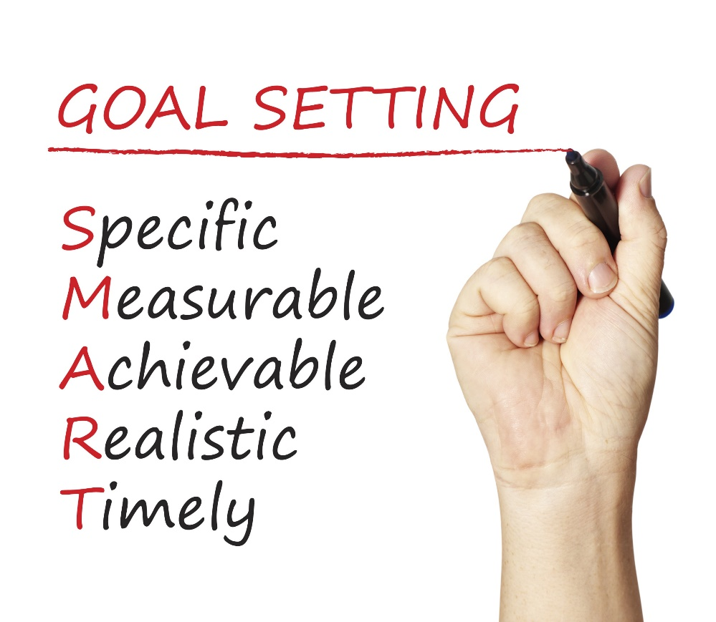
Happiness is a common goal.
Notes:
Marsha
In working with my students over the years, I found out that happiness was commonly mentioned as an important goal.
However, we know that goals should be
Specific
Measurable
Achievable
Realistic
Timely
How do these ideas apply to happiness?

Slide 6
Happiness is not a goal!
Achieving our goals is one of the ways to achieve happiness.
Notes:
Seth
Positive psychologists who study happiness tell us that happiness is not a goal!
Achieving goals is one of the ways to achieve happiness.
Are you taking the steps to achieve your goals?

Slide 7
Happiness or Hedonism?
Hedonist
The hedonist wants as many good moments and as few bad moments as possible.
Why doesn’t it work?
Hedonistic Adaptation
The more material possessions we have, the greater our expectations, and we no longer appreciate what we have.
Notes:
Marsha
Positive psychologists describe the difference between happiness and hedonism, and it is important to understand this difference.
Read Slide
Provide Example
Buying a TV or car

Slide 8
Expressing gratitude
Being optimistic
Being employed
Having positive self-esteem
Enjoying leisure activities
Having good health
Enjoying friendships
Notes:
Seth
Psychologists remind us to choose happiness over hedonism. What does this mean?
Choosing happiness means . . . (Read slide)

Slide 9
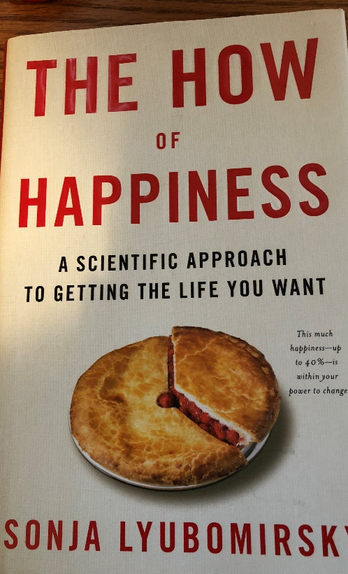
Sonya Lyubomirsky The How of Happiness 12 Happiness Activities Which ones can you use?
Notes:
Marsha
One of my favorite books on happiness in Sonya Lyubomirsky’s (Lubirmiskey) book on the How of Happiness.
She suggests 12 happiness activities which we will review today.
Can you use some of these ideas?

Slide 10
1. Express Gratitude
Gratitude is one of the most powerful happiness techniques.
What are some synonyms for gratitude? What does it mean?
Notes:
Seth
The first activity is expressing gratitude. It is one of the most powerful happiness techniques.
What are some synonyms for gratitude?
Marsha and Seth Alternate:
Thankfulness
Wonder
Appreciation
Looking at the bright side
Savoring the good times
Present oriented
Not taking things for granted

Slide 11
What is gratitude?
“A felt sense of wonder, thankfulness, and appreciation for life.” -Robert Emmons
Antidote for negative emotions such as envy, avarice, hostility, worry, and irritation
Notes:
Seth
Read slide

Slide 12
Gratitude Exercise
What are 5 things in life for which you are grateful or thankful.
Keep a gratitude journal. Each week list at least five things for which you’re grateful or simply take some time to contemplate why you are grateful.
Make it a Thanksgiving tradition.
Notes:
Marsha
Lead group in exercise
While participants are thinking, Marsha and Seth provide examples of being grateful for what we have in life.

Slide 13
Why Is Gratitude Important?
Savoring positive life experiences.
Increases self-esteem.
Helps people cope with stress and trauma.
Encourages moral behavior. You are more likely to help others.
Builds social bonds.
Diminishes negative emotions such as anger, bitterness, and greed.
Inhibits invidious comparisons by be appreciative of what you have.
Helps avoid hedonistic adaptation.
Notes:
Seth
Why is gratitude important?
Alternate reading boxes.

Slide 14
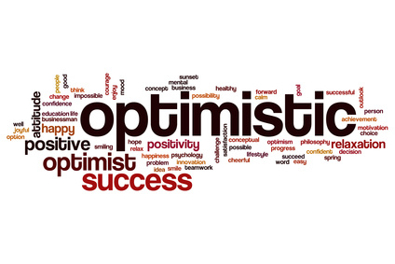
2. Cultivate Optimism
Notes:
Marsha
Another way to increase happiness is to cultivate optimism.

Slide 15
Cultivate optimism with mindset.
Notes:
Seth
One of the ways you can cultivate optimism is being aware of your mindset.
If you are interested, Carol Dweck has a book on this topic.

Slide 16
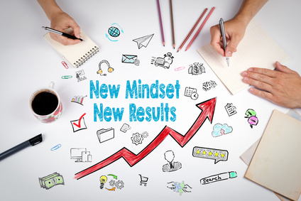
Positive Thinking and Mindset
Growth Mindset
Fixed Mindset
Intelligence is increased as you acquire new knowledge.
Through practice and effort, skills can be improved.
Failure is an opportunity to learn.
Intelligence is fixed at birth.
Increased effort does not lead to success.
Roadblocks are an excuse to be absent.
Notes:
Marsha
Here are just a few key ideas from the psychology of mindset:
Growth Mindset
Seth
Fixed Mindset

Slide 17
What Went Well Exercise
What are three things that went well last week?
We tend to focus on what does not go well and not enough on what goes right in our lives.
Challenge: For two weeks, at the end of each day, set aside 10 minutes to think or write about what went well during the day.
Notes:
Marsha introduces exercise
While group members are thinking, Seth and Marsha provide examples of what went well recently.

Slide 18
3. Avoid Overthinking and Social Comparison
“Overthinking is thinking too much, needlessly, passively, endlessly, and excessively pondering the meaning, causes, and consequences of your character, your feelings, and your problems.” – Sonja Lyubomirsky
Negative Consequences:
Increases sadness
Fosters negative thinking
Impairs the ability to solve problems
Decreases motivation
Interferes with concentration
Notes:
Seth
Read slide

Slide 19
Social Comparison
Noticing our friends, coworkers, family members, and even fictional characters
Imagining they are smarter, richer, healthier, wittier, or more attractive than we are
Dealing with overthinking and social comparison:
Yell stop!
Don’t sweat the small stuff.
Will it matter in a year? If so, begin taking small steps to resolve the issue.
Notes:
Marsha
Read slide

Slide 20
4. Practice Acts of Kindness
Why does it work?
View others more positively
Connect with others
Appreciate your own good fortune
Leads to positive social consequences
Feel good about yourself
Chain of kindness
Notes:
Seth
Another way to increase happiness is through random acts of kindness. Read slide.
(Provide examples on next slide.)

Slide 21
Kindness Exercise
Practice an act of kindness.
Examples?
Seligman states that this exercise is the “single most reliable momentary increase in well-being of any exercise he has tested.”
Notes:
Seth and Marsha provide examples while group thinks of examples to possibly add in the chat window.

Slide 22
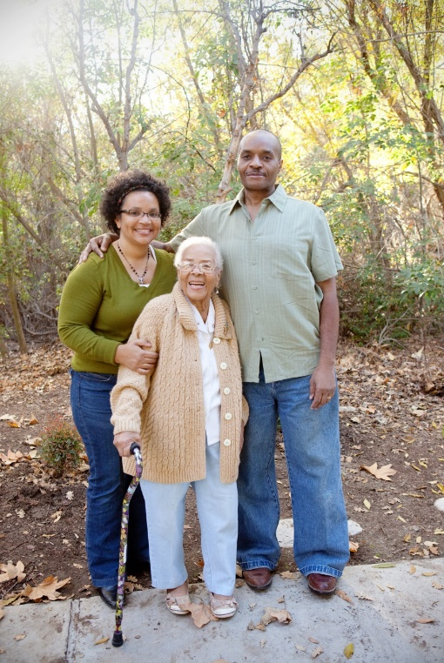
5. Nurture Social Relationships
Make time for others.
Express admiration and appreciation.
Be supportive and loyal.
Notes:
Marsha
Read slide and provide examples.
Seth add an example

Slide 23
6. Develop Strategies for Coping
Meditation
Mindfulness
Breathing
Exercise
Sleep
Notes:
Seth
Read Slide
Seth and Marsha provide examples.

Slide 24
What is mindfulness?
It is taking the time to notice your environment. I provides distraction from worry.
Examples?
Notes:
Marsha
This is my personal favorite idea. Examples of how I use it each day.

Slide 25
7. Learn to Forgive
Notes:
Seth
Read slide

Slide 26
8. Increase Flow Activities
Flow is the state of intense absorption and involvement with the present moment.
Flow is one of the characteristics of the happy life.
The key to creating flow is to establish a balance between skills and challenges.
To maintain flow, we must test ourselves in challenging situations.
Notes:
Marsha
Read slide
Seth and Marsha provide examples

Slide 27
9. Savor Life’s Joys
The ability to savor positive experiences in life is one of the most important ingredients of happiness.
Brainstorm: Life’s Joys
Relish ordinary experiences
Savor and reminisce with family and friends.
Transport yourself.
Replay happy days.
Celebrate good news.
Be open to beauty and excellence.
Be mindful.
Notes:
Seth
Read Slide
Marsha and Seth
Provide examples

Slide 28
10. Commit to Your Goals
“An aim in life is the only fortune worth finding.” -Robert Louis Stevenson
“Find a happy person and you will find a project.” -Sonja Lyubomirsky
Working toward a goal is as important to well-being as it’s attainment.
Goals provide structure and meaning to our lives.
Goals help us to master our time.
Accomplish goals with grit.
Notes:
Seth
Read slide
Provide examples of goals. Marsha add goals.

Slide 29
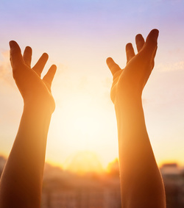
11. Practice Religion and/or Spirituality
Provides social support and a sense of identity
Helps people deal with trauma
Helps people find meaning and purpose in life
Provides hope
Promotes forgiveness
Notes:
Marsha
Read slide

Slide 30
12. Take Care of Your Body
Exercise increases self-esteem.
It provides opportunities for flow.
Spend more time outside
Learn the basics of good nutrition
Get enough sleep
Notes:
Seth
Read slide

Slide 31
Intention Statements
Express Gratitude
Cultivate Optimism
Avoid Over-thinking and Social Comparison
Practice Random Acts of Kindness
Nurture Social Relationships
Develop Coping Strategies
Learn to Forgive
Increase Flow Activities
Savor Life’s Joys
Commit to Your Goals
Practice Religion/Spirituality
Take Care of Your Body
Make a list of at least five things you can do to improve your happiness.
Review these ideas.
Share some of your ideas
Notes:
Marsha
Introduce exercise.
While group participants are thinking:
Seth, what are some of your intention statements?
Marsha share intention statements also.

Slide 32
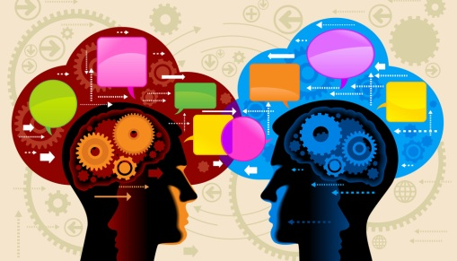
Discussion Questions
seth@batisteconsulting.us
marsha@marshafralick.com
Notes:
Seth
It would be great to hear any comments or questions you may have.
Marsha
Thanks for attending and hope you have some ideas that can increase happiness in your life.

