Slide 1
Increasing Happiness in Learning and Life Dr. Marsha Fralick

Slide 2
Introduce yourself to the person next to you. Name? What College or University? What should I see if I visit your city? Which country is the happiest? A. The United States B. Norway C. Costa Rica D. Singapore What makes people happy?

Slide 3
10 Happiest Countries 2021
Finland
Denmark
Switzerland
Iceland
Netherlands
Norway
Sweden
Luxembourg
New Zealand
Austria
The U.S. is 19th.
Afghanistan is last

Slide 4
Why
Caring
Freedom
Trust
Generosity
Honest/Perceived Lack of Corruption
Healthy Life Expectancy
Social Support
Income
Good Governance/Perceived Lack of Corruption
Work/Life Balance

Slide 5
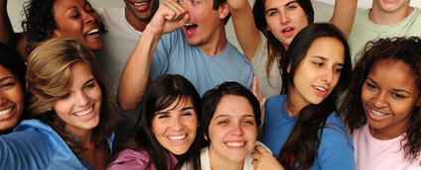
Research on happy people:
Live longer and have fewer disabilities.
Enjoy their jobs more.
Have rich and fulfilling social lives.

Slide 6
Agenda Achieving Happiness in Life
Keys to happiness based on research by positive psychologists:
Authentic Happiness by Martin Seligman
The How of Happiness by Sonja Lyubomirsky
Grit and happiness
Grit by Angela Duckworth
Mindset and happiness
Mindset by Carol Dweck
Practical Exercises

Slide 7
Key Idea
How will we achieve happiness in a post pandemic world?
What ideas can you use to achieve happiness for yourself and your students?
As we go through this presentation make a list of your intention statements for improving happiness for yourself and your students. We will share ideas at the end.

Slide 8
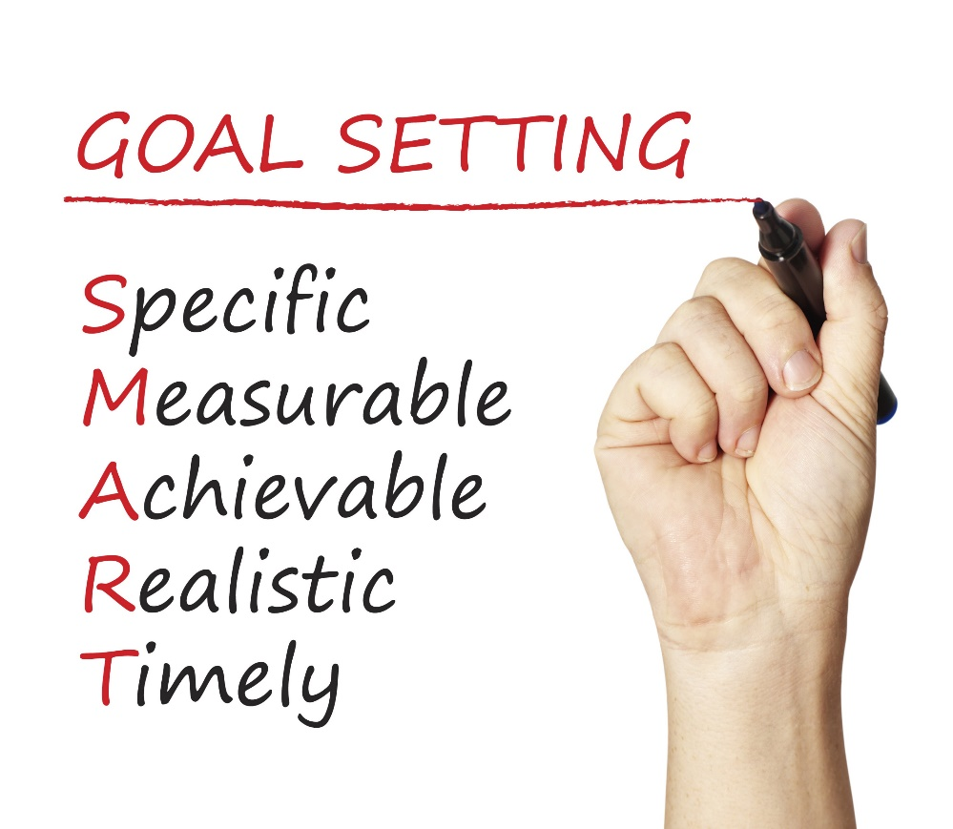
Happiness is a common goal.
How does it fit with SMART Goals?

Slide 9
Happiness is not a goal!
Achieving our goals is one of the ways to achieve happiness.

Slide 10
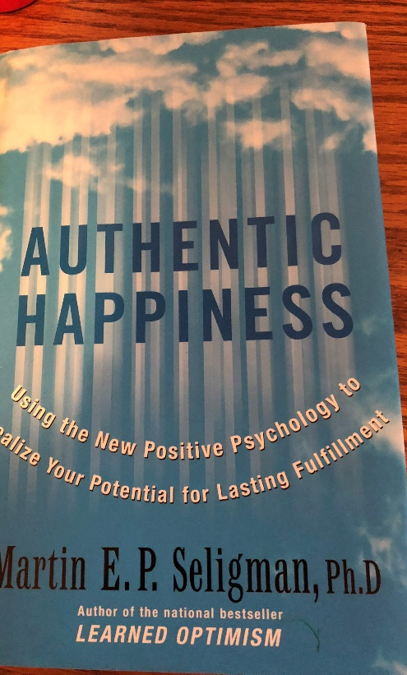
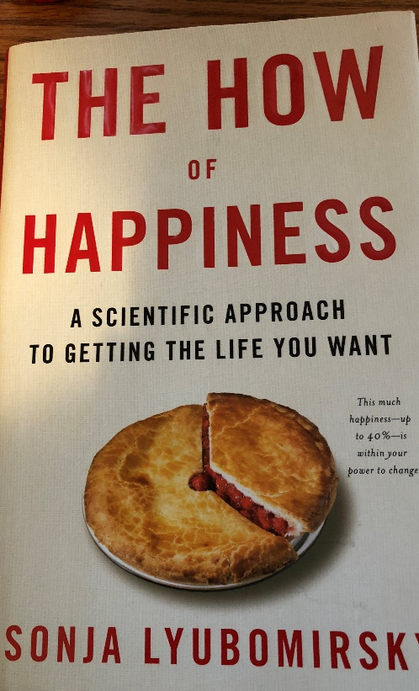
Martin Seligman Sonja Lyubomirsky
Positive psychologists who have done research on how to achieve happiness in your life. See the references on the handout.

Slide 11
Happiness or Hedonism?
Hedonist
The hedonist wants as many good moments and as few bad moments as possible.
Why doesn’t it work?
Hedonistic Adaptation
The more material possessions we have, the greater our expectations, and we no longer appreciate what we have.

Slide 12
Expressing gratitude
Being optimistic
Being employed
Having positive self-esteem
Enjoying leisure activities
Having good health
Enjoying friendships

Slide 13
Martin Seligman Happiness = S + C + V
S is your set range (50% of happiness is determined by heredity)
C is your circumstance (8-15% of happiness)
V is what is under your voluntary control (40% of happiness!)

Slide 14
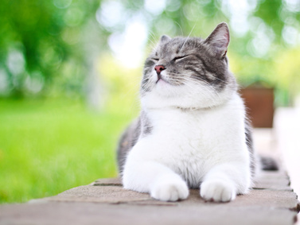
What is your set range? This is 50% of happiness. Martin Seligman Happiness Scale

Slide 15
1. In general, I consider myself:
1 2 3 4 5 6 7
Not a very happy person
A very happy person

Slide 16
2. Compared to most of my peers, I consider myself:
1 2 3 4 5 6 7
Less happy
More happy

Slide 17
3. Some people are generally very happy. They enjoy life regardless of what is going on, getting the most out of everything. To what extent does this describe you?
1 2 3 4 5 6 7
Not at all
A great deal

Slide 18
4. Some people are generally not very happy. Although they are not depressed, they never seem to be as happy as they might be. To what extent does this characterization describe you?
1 2 3 4 5 6 7
A great deal
Not at all

Slide 19
Scoring
Add up your numbers and divide by 4.
The mean for adult Americans is 4.8.
Two-thirds of people score between 3.8 and 5.8.

Slide 20
Set Range
Your set range is determined by heredity.
Lottery winners return to their level of happiness before winning.
Those experiencing misfortune also return to their previous level of happiness.

Slide 21
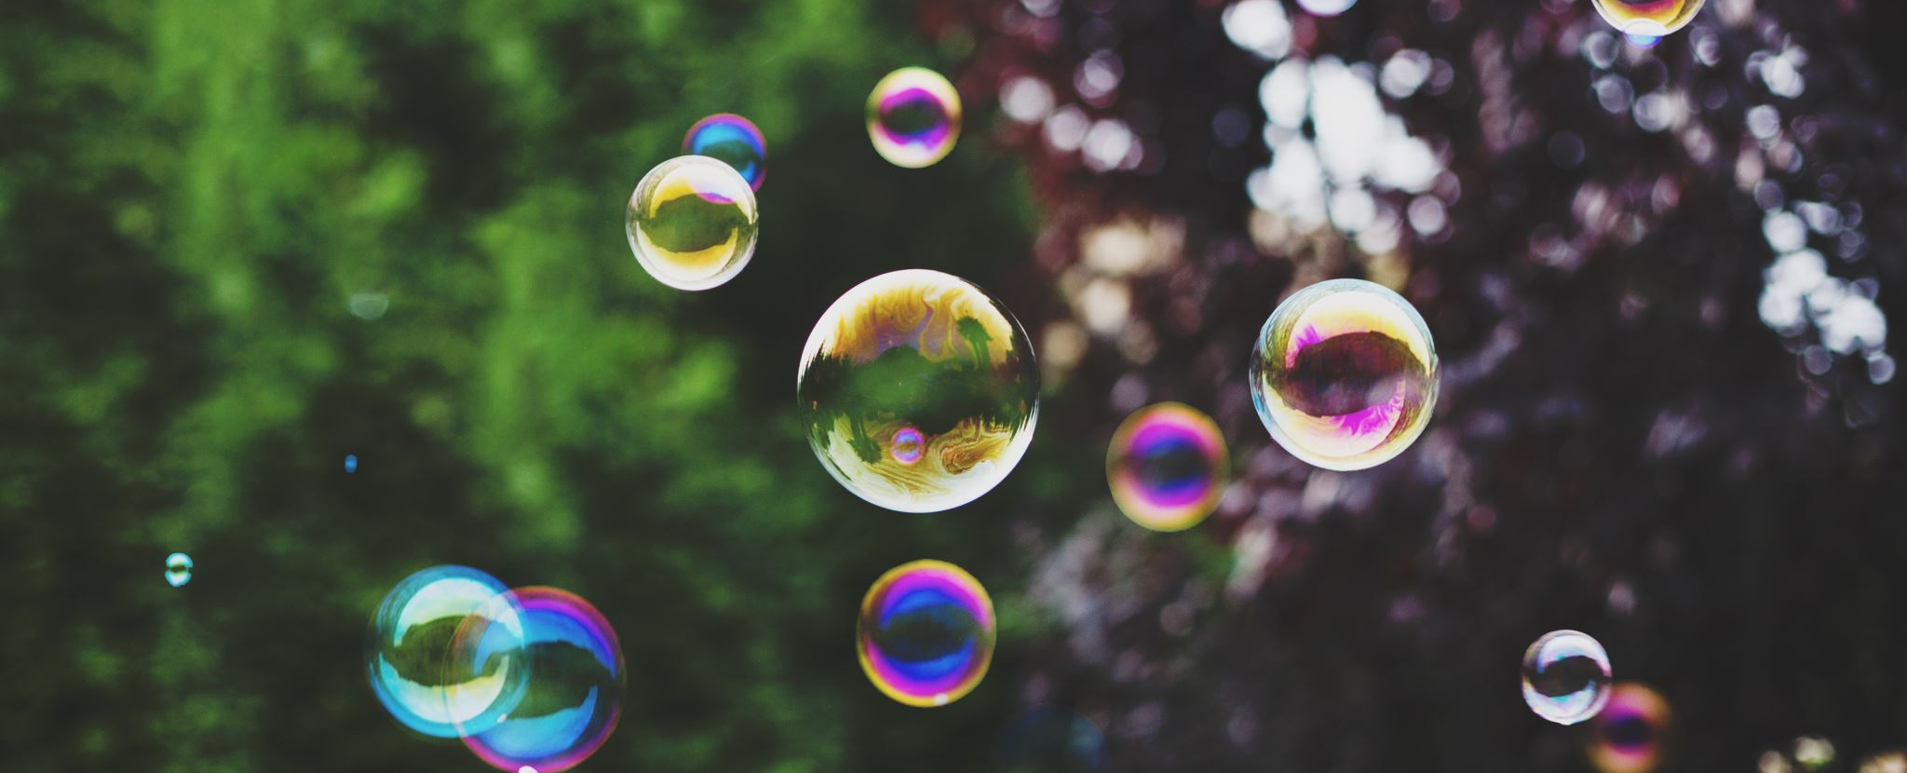
Martin Seligman Happiness = S + C + V
S is your set range (50% of happiness is determined by heredity)
C is your circumstance (8-15% of happiness)
V is what is under your voluntary control (40%)

Slide 22
Circumstances 8-15% of Happiness
Once basic needs are met, greater wealth does not increase happiness.
Having a good marriage is related to happiness.
Happy people are more social.
Moderate ill health does not bring unhappiness, but severe illness does.
Educated people are slightly happier.
Climate, race, and gender do not affect level of happiness.
Religious people are somewhat happier than nonreligious people.

Slide 23
Martin Seligman Happiness = S + C + V
S is your set range (50% of happiness is determined by heredity)
C is your circumstance (8-15% of happiness)
V is what is under your voluntary control (40%)

Slide 24
What are some examples of factors under your voluntary control?

Slide 25
Voluntary Control 40% of Happiness
Can you add some of these items to your list?
The past does not determine your future. The future is open to possibilities.
Be grateful.
Forgive and forget.
Increase optimism and hope for the future.
Engage in activities that make you happy.
Take the time to savor the happy times.
Take the time to enjoy the present moment.
Build more flow into your life. Flow is the state of gratification we feel when totally absorbed in an activity that matches our strengths.

Slide 26
Sonya Lyubomirsky The How of Happiness 12 Happiness Activities Which ones can you use for yourself or your students?

Slide 27
1. Express Gratitude
Gratitude is one of the most powerful happiness techniques.
What are some synonyms for gratitude? What does it mean?

Slide 28
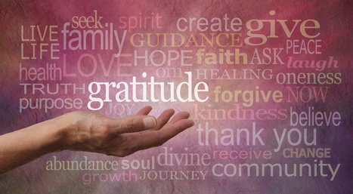
What is gratitude?
“A felt sense of wonder, thankfulness, and appreciation for life.” -Robert Emmons
Wonder
Appreciation
Looking at the bright side
Thankfulness
Savoring
Coping
Present oriented
Not taking things for granted
Antidote for negative emotions such as envy, avarice, hostility, worry, and irritation

Slide 29
Gratitude Exercise
Think
Pair
Share
What are 5 things in life for which you are grateful or thankful.
Keep a gratitude journal. Each week list at least five things for which you’re grateful or simply take some time to contemplate why you are grateful.
Do this exercise with your students.
Make it a Thanksgiving tradition.

Slide 30
Why Gratitude is Important
Savoring positive life experiences.
Increases self-esteem.
Helps people cope with stress and trauma.
Encourages moral behavior. You are more likely to help others.
Builds social bonds.
Diminishes negative emotions such as anger, bitterness, and greed.
Inhibits invidious comparisons by be appreciative of what you have.
Helps avoid hedonistic adaptation.

Slide 31
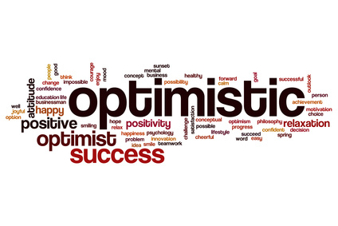
2. Cultivate Optimism

Slide 32
Cultivate optimism with mindset.

Slide 33
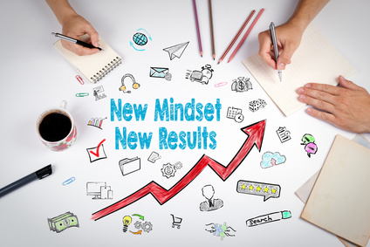
Positive Thinking and Mindset
Growth Mindset
Fixed Mindset
Intelligence is increased as you acquire new knowledge.
Through practice and effort, skills can be improved.
Failure is an opportunity to learn.
Intelligence is fixed at birth.
Increased effort does not lead to success.
Roadblocks are an excuse to be absent.

Slide 34
What Went Well Exercise
Think
Pair
Share
What are three things that went well last week?
We tend to focus on what does not go well and not enough on what goes right in our lives.
Challenge: For two weeks, at the end of each day, set aside 10 minutes to think or write about what went well during the day.

Slide 35
What Went Well Exercise for Students
Have students write down daily 3 good things that happened to them.
Write about one of the following:
Why did this good thing happen?
What does this mean to you?
How can you have more of this good thing in the future?

Slide 36
3. Avoid Overthinking and Social Comparison
“Overthinking is thinking too much, needlessly, passively, endlessly, and excessively pondering the meaning, causes, and consequences of your character, your feelings, and your problems.” – Sonja Lyubomirsky
Negative Consequences:
Increases sadness
Fosters negative thinking
Impairs the ability to solve problems
Decreases motivation
Interferes with concentration

Slide 37
Social Comparison
Noticing our friends, coworkers, family members, and even fictional characters
Imagining they are smarter, richer, healthier, wittier, or more attractive than we are
Dealing with overthinking and social comparison:
Yell stop!
Don’t sweat the small stuff.
Will it matter in a year? If so, begin taking small steps to resolve the issue.

Slide 38
4. Practice Acts of Kindness
Why does it work?
View others more positively
Connect with others
Appreciate your own good fortune
Leads to positive social consequences
Feel good about yourself
Chain of kindness

Slide 39
Kindness Exercise
Practice an act of kindness.
Examples?
Seligman states that this exercise is the “single most reliable momentary increase in well-being of any exercise he has tested.”

Slide 40
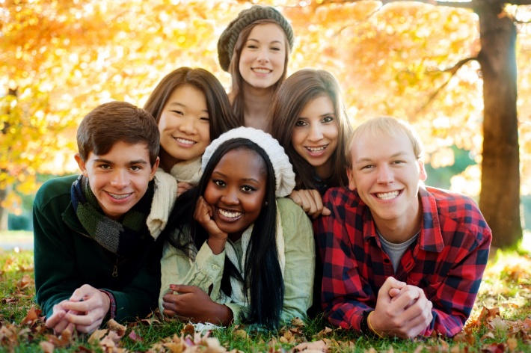
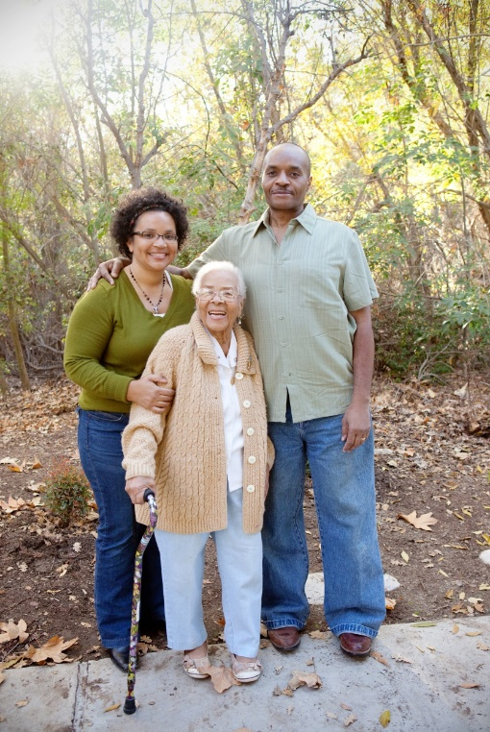
5. Nurture Social Relationships
Make time for others.
Express admiration and appreciation.
Be supportive and loyal.

Slide 41
6. Develop Strategies for Coping Meditation Mindfulness Breathing Exercise Sleep

Slide 42
Grit is a powerful strategy for coping.
Grit = Passion and Perseverance

Slide 43
Grit: Key Ideas
Those who are gritty keep going after challenges or failure.
Grit is simply a “never give up” attitude.
What we accomplish may depend more on our passion and perseverance than our innate talent.
Talent is how quickly your skills improve when you invest effort.
Without effort, your talent is nothing more than your unmet potential.
Effortful training is more important than natural talent. It takes 10,000 hours to become an expert.
Those with a growth mindset are grittier.

Slide 44
7. Learn to Forgive

Slide 45
8. Increase Flow Activities
Flow is the state of intense absorption and involvement with the present moment.
Flow is one of the characteristics of the happy life.
The key to creating flow is to establish a balance between skills and challenges.
To maintain flow, we must test ourselves in challenging situations.

Slide 46
Flow and grit are related.
To increase grit (passion and perseverance):
Begin with interest
Next comes practice. Practice increases interest.
Then comes purpose. We become passionate when we are convinced that our work matters and has meaning.
Finally comes hope for a better future.

Slide 47
9. Savor Life’s Joys
The ability to savor positive experiences in life is one of the most important ingredients of happiness.
Brainstorm: Life’s Joys
Relish ordinary experiences
Savor and reminisce with family and friends.
Transport yourself.
Replay happy days.
Celebrate good news.
Be open to beauty and excellence.
Be mindful.

Slide 48
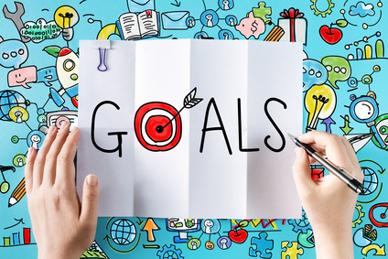
10. Commit to Your Goals
“An aim in life is the only fortune worth finding.” -Robert Louis Stevenson
“Find a happy person and you will find a project.” -Sonja Lyubomirsky
Working toward a goal is as important to well-being as it’s attainment.
Goals provide structure and meaning to our lives.
Goals help us to master our time.
Accomplish goals with grit.

Slide 49
11. Practice Religion and/or Spirituality
Provides social support and a sense of identity
Helps people deal with trauma
Helps people find meaning and purpose in life
Provides hope
Promotes forgiveness

Slide 50
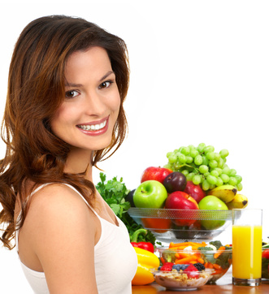
12. Take Care of Your Body
Exercise increases self-esteem.
It provides opportunities for flow.
Spend more time outside
Learn the basics of good nutrition
Get enough sleep

Slide 51
Intention Statements
Make a list of at least five things you can do to improve your happiness. Review your notes and the handout.
Make a list of at least five ways you can help your students to improve their happiness. Review the above lists.
Share some of your ideas

Slide 52
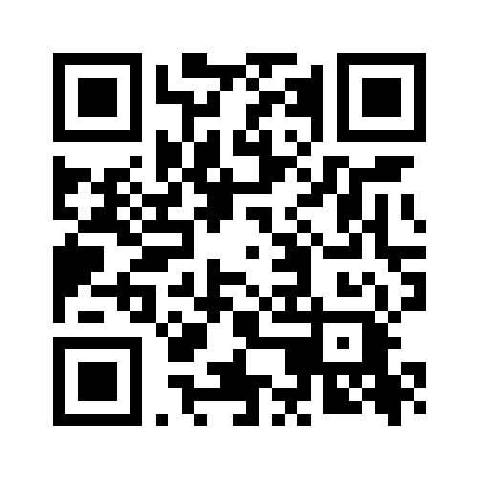
Please remember to submit your evaluation on Guidebook!
#FYE22

Slide 53
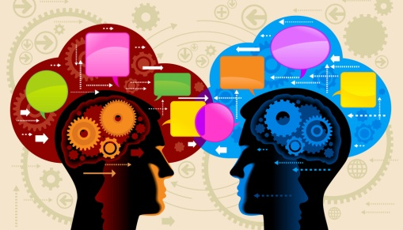
Discussion Questions

