Slide 1
Create Your Success
Chapter 1

Slide 2
What is Career Success?
Create your own personal definition based on:
Using your personal strengths
Doing what you enjoy
Feeling happy and fulfilled in your life
Income
Taking care of your physical and mental health
Being motivated to accomplish your goals

Slide 3
Career Satisfaction
Learn about current job trends
Gain skills while in college through employment or internships
Use updated job search strategies
Identify factors important for career satisfaction

Slide 4

Choosing Your Major
Making a good choice of a major helps increase your motivation for success.

Slide 5

How to Choose a Major
What is my personality type? What are my personal strengths?
What are my multiple intelligences?
What are my interests?
What are my values?
How can I match my personal strengths to the world of work?

Slide 6
Using Motivation to Increase Your Success

Slide 7

Value of a College Education

Slide 8

Education Increases Earnings

Slide 9
Yearly Income
HIGH SCHOOL $46,748
SOME COLLEGE $51,584
ASSOCIATE
$55,016
BACHELORS
$77,636
PROFESSIONAL $114,712

Slide 10

Lifetime Income
HIGH SCHOOL $1,402,440
SOME COLLEGE $1,547,520
ASSOCIATE $1,650,480
BACHELORS $2,329,080
PROFESSIONAL $3,441,360

Slide 11
What is the Value of a College Degree?
$2,329,080 College Graduate
$1,402,440 High School Graduate
$926,640 Value of College
Degree

Slide 12
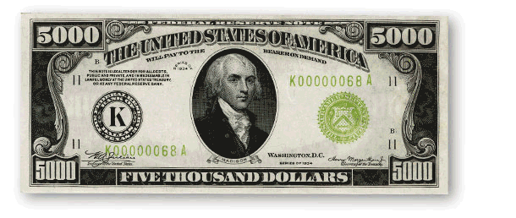
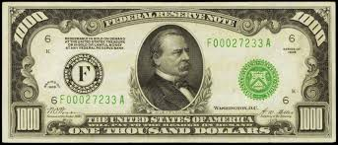
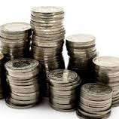
How much is each college class worth?
$23,166
and some

Slide 13
$23,166 per 3-unit class
($926,640) divided by 40 classes for a BA or BS)

Slide 14

What is
of a college class worth?

Slide 15
$483 per hour in class ($23,166 divided by 48 hours in class)

Slide 16

Would you attend class today and be prepared if I paid you $483?

Slide 17

How do you motivate yourself?
What if you don’t feel like coming to class or doing your homework. How do you motivate yourself to do it anyway?
      Think
      Discuss with the person next to you
      Share ideas

Slide 18
There are many ways to be motivated. Let’s see if any are useful to you.
Create Your Own Success:
Intrinsic or extrinsic motivation
Think positively about the future
Locus of control
Successful beliefs

Slide 19

Two types of Motivation

Slide 20

Motivation
Intrinsic motivation comes from within.
  Look for ways to enjoy college and find some personal meaning in it.

Slide 21

Motivation
Extrinsic motivation comes as a result of an external reward.
What is the payoff for attending college?
Higher earnings
Having a satisfying career
Buying a car or home

Slide 22

Which is the more powerful motivator?
Intrinsic or extrinsic motivation?

Slide 23
Intrinsic motivation is the most powerful.

Slide 24

Positive Thinking

Slide 25

Optimism Vs. Pessimism
How does it apply to college?

Slide 26

If you are optimistic and believe that a goal is achievable, you are more likely to take the steps necessary to accomplish it.

Slide 27

Believe in Yourself
If we have positive beliefs about ourselves, we will feel confident and accomplish our life goals.

Slide 28
Think Positively about the Future
If you believe that your chances of graduating from college are good, you can increase motivation and take the steps needed to be successful.
If you believe that your chances of graduating from college are poor, it is difficult to motivate yourself to continue.

Slide 29
Benefits of Positive Thinking
Good health
Longevity
Happiness
Perseverance
Improved problem solving
Enhances ability to learn

Slide 30
No pessimist ever discovered the secrets of the stars, or sailed to an uncharted land, or opened a new doorway for the human spirit.
Helen Keller

Slide 31
If you are optimistic and believe that a goal is achievable, you are more likely to take the steps necessary to accomplish it.

Slide 32
Taking Control of Your Life
Where do you place the responsibility for control over your life?

Slide 33

Create Your Success

Slide 34
What is Locus of Control?
Where you place responsibility for control over your life.

Slide 35
Locus of Control
Internal
External
Believe you are in control of your life.
Be self-motivated.
Learn from mistakes.
Think positively.
Rely on yourself.
Life is a result of luck or fate.
Rely on others for motivation.
Look for someone to blame.
Think negatively.
Rely on others.

Slide 36
Exercise:
I am successful when I:

Slide 37
Exercise:
I am successful when I:
Behaviors which interfere with my success.:

Slide 38
Exercise:
I am successful when I:
Behaviors which interfere with my success:
I would like to:

Slide 39
10 Habits of Successful College Students
Attend class.
Read the textbook.
Have an educational plan.
Use college services.
Get to know the faculty.

Slide 40
10 Habits of Successful College Students
Limit outside employment to 20 hours a week for a full time student.
Take one step at a time.
Have a goal for the future.
Visualize your success.
Ask questions.

Slide 41
Beliefs:
Personal opinions about yourself, your life and the world around you

Slide 42
For Example
If I believe I am not good in math, I may not do the assignment or may even avoid taking math.
If I believe I can be good in math, I can take the steps needed to be successful.

Slide 43

Seven Habits of Highly Successful People

Slide 44
Be Proactive
Accept responsibility for your life.

Slide 45
Begin with the end in mind.
Know what is important.
What do you want to accomplish in your life?

Slide 46
Put first things first.
Set priorities.

Slide 47
Think win-win.
Seek solutions that benefit everyone.
Focus on cooperation rather than competition.

Slide 48
First seek to understand. Then be understood.
Listening is the first step in effective communication.

Slide 49
Synergize.
The whole is greater than the sum of its parts.
Working together as a team, you can accomplish more than each member can accomplish separately.

Slide 50
Sharpen the saw.
Invest time in yourself to stay healthy:
  Physically
  Mentally
  Spiritually
  Socially

Slide 51
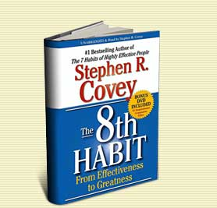
Find your voice and inspire others to find theirs.
Believe that you can make a difference in the world and inspire others to do the same.

Slide 52

Let’s Visualize Your Future

Slide 53

As a college student:
Visualize yourself in your cap and gown walking across the stage to receive your diploma.

Slide 54

Athletes Use Visualization
A good way to practice
Helps you to pre-experience events in your mind
For example, pole-vaulters imagine the perfect jump before they make it

Slide 55
Visualization
We create all things twice.
  Create a mental picture.
  Create the physical reality by taking action.

Slide 56
For example:
In building a house we
  Create a blueprint or plan
  Then we build the house

Slide 57
Exercise:
Visualize Your Success
Draw a picture, make a list or write some sentences.
Share with the class

Slide 58
Secrets to Happiness

Slide 59
Secrets to Happiness
Martin Seligman
Achieve happiness by identifying, cultivating, and using your personal strengths in work, love, play, and parenting.

Slide 60
Happiness = S + C + V
S is your set range (50% of happiness is determined by heredity)
C is your circumstance (8-15 % of happiness)
V is what is under your voluntary control (40%)

Slide 61
What are some examples of factors under your voluntary control?

Slide 62
Steps to Happiness
Express gratitude.
Cultivate optimism.
Avoid over thinking and social comparison.
Practice acts of kindness.
Increase flow activities.

Slide 63
Discussion:
Brainstorm:
I am grateful for . . .

Slide 64
Steps to Happiness
Savor life’s joys.
Commit to accomplishing your goals.
Take care of your body.

Slide 65
Discussion:
Brainstorm:
What are some of life’s joys?

Slide 66
More Secrets to Happiness

Slide 67
Secrets to Happiness
Happiness can’t be bought.
Happiness is more internal than external.
Happiness is not determined by age, race, gender or income.
Happiness won’t arrive in the Publisher’s Clearinghouse envelope.

Slide 68
Secrets to Happiness
Happiness depends less on things than on our attitude toward the things we have.

Slide 69
Make a decision to choose happiness.

Slide 70


Keys to Success:
Learn to Laugh at Life

Slide 71
Laugh more. Laughter produces a relaxation response.

Slide 72
Have a laugh at life and look around for happiness instead of sadness.
--Red Skelton

Slide 73

If you do not feel happy, smile and pretend to be happy.
Smiling produces serotonin which is a neurotransmitter linked with feelings of happiness.

Slide 74

So, smile and be happy. Use your creativity to make some positive changes in your life.

Slide 75

Assignment
Measure Your Success

Slide 76
Next week take the TruTalent Personality Assessment at the beginning of Chapter 2

Slide 77
Job Jar Activity
Introducing the assessments

Slide 78

What is Personality Type?

Slide 79
Personality Type
We are born with certain preferences that we develop over a lifetime.
Each person is different and unique just like fingerprints or snow flakes.
Knowing your personal strengths will increase self-understanding and help you make a good choice of a major.

Slide 80
Personality Assessment
Use your access code to set up an online portfolio and take this assessment.
The assessments are integrated into the online versions of the text.
Your results are linked to matching careers.

Slide 81
Directions:
Personality assessment
Find a time when you are not tired or rushed.
There are no right or wrong answers.
Answer quickly giving your first impression. Do not over analyze.
You will have a chance to look at your profile and change it if you think it is not correct.

Slide 82
Directions
Answer the questions honestly to get the best results.
Answer the questions how you usually are when you are not stressed.
Do not answer the questions:
  How you want to be
  How you have to be at home, work or school
  How others want you to be

Slide 83
Important
There are no good or bad types. Each type has personal strengths that can be used in the workplace.
Answer the questions honestly to get the best results. If you don’t answer the questions honestly, the career suggestions will not be a good match for you.

Slide 84
Directions
The test does not measure:
  Intelligence
  Psychological or emotional health
It assesses your personal strengths and matches them to possible careers.

