Slide 1
Planning Your Career and Education
Chapter 4

Slide 2

Keep Your Eyes on the Future
Stay informed about new developments that will affect your future.

Slide 3

Baby Boomers, Generation X, the Millennials and the New Generation Z

Slide 4

What is Your Generation?
Baby Boomers 1946-1964
Generation X 1965-1977
New Millennials 1977-1995
Generation Z 1995-Present

Slide 5

Baby Boomers
Born between 1946 and 1964
Four out of every ten adults today
The population is getting older
How will the Baby Boom generation affect careers of the future?

Slide 6

Generation X
Born between 1965 and 1977

Slide 7
Advantages of Generation X
More highly educated
Greater demand for skilled workers
Computer literate
Good work ethic
As Baby Boomers retire, more job opportunities

Slide 8

The New Millennials
Born between 1977 and 1995

Slide 9
The New Millennials
Sometimes called the “Echo Boomers”
By 2010, they will be the largest teen population is U.S. history
Will exceed the number of Baby Boomers
In the next 10 years, college enrollments will increase by 300,000 students per year
College admission will become increasingly competitive.

Slide 10

The New Millennials
The cyber generation
Their most important values are individuality and uniqueness
Greatest concerns: terrorism and school shootings
Decreasing use of alcohol, drugs and tobacco
Have the promise of changing institutions for the better

Slide 11

The New Generation Z
Born since 1995
Many Names: Generation Wii, iGeneration,Gen Tech, Digital Natives, Net Gen, The Plurals

Slide 12
Generation Z
Also known at Generation Wii, iGeneration, Gen Tech and Digital Natives
Will use technology as a tool to change the world
Value cultural diversity
The age of “girl power”

Slide 13
Generation Z
Last generation with a Caucasian majority
Accept diversity
Decline of “traditional families”
Because of recession, less likely to believe in the American dream of having more
The age of “girl power”
Hope to use technology to change the world

Slide 14

Career Trends for 2020

Slide 15

Service Occupations in Demand
Health Care
Business
Education
Finance
Insurance
Real Estate
Transportation
Communication.

Slide 16
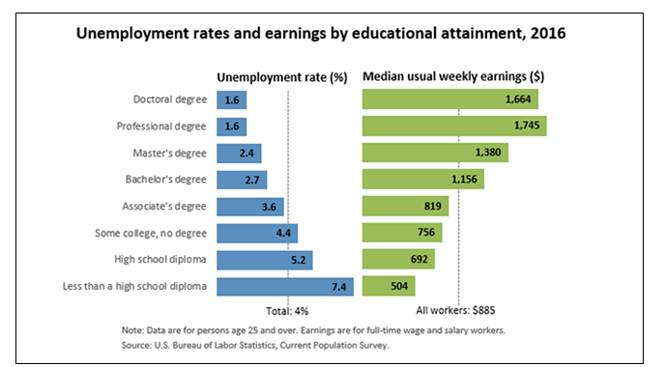
Increased Need for Education

Slide 17
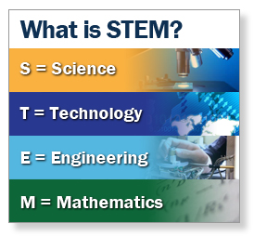
Increased Opportunities for STEM Careers
Will grow 17% by 2020
Highest paying jobs.

Slide 18

Beware of Outsourcing
Likely to be outsourced:
Less likely to be outsourced
Repetitive jobs such as accounting
Well-defined jobs such as customer service
Software
Technical support
Top management
Trouble shooters
Marketing
Repair
Product design
Entertainment

Slide 19
Avoid Outsourcing
Be the best in your field
Be creative and innovative
Avoid repetitive jobs
Choose a career high in demand
Consider a job in skilled trades (carpenters, plumbers, hair stylists, dental hygienists)

Slide 20

Globalization
Speak different languages
Study international business

Slide 21
Nontraditional Workers
Do not have full time jobs with benefits
Contingent and part time workers
Independent contractors
Temporary workers

Slide 22
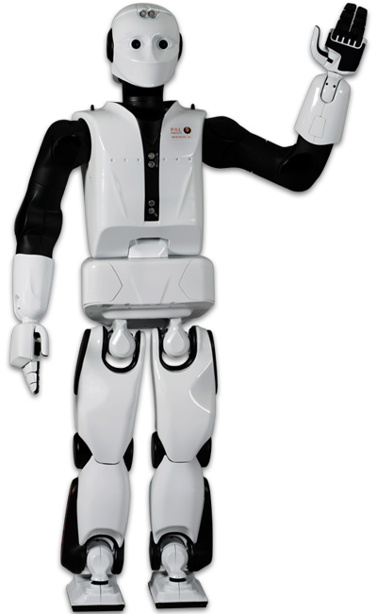
Automation
Robots will do the work
Engineers and technicians will be needed to design and maintain the robots

Slide 23

Mismatch between workers and jobs
More workers needed in scientific and technical fields

Slide 24

New Technology
Teleworking
Using smart phones to do some work at home
Virtual Collaboration
Using skype and other tools
New Media
Required for job success

Slide 25

Data Analysis
Using data for market research
Requires math skills

Slide 26

Mental Health
Because of increasing violence, we are starting to realize the importance of mental health

Slide 27

Technology
Information and technology workers are the largest group of workers in the U.S.

Slide 28

New Technology Jobs
Computer network administrators
Data communications analysts
Web developers
Data loss prevention
Online security
Video game designer

Slide 29

Radiation and Laser Technologies
Used in medicine, energy, computers, communications, entertainment

Slide 30

Fiber Optics and Telecommunications
Fiber optics are thin glass fibers that transmit light.
Copper wire will soon become obsolete.

Slide 31

Artificial Intelligence
Enables computers to approximate human thought

Slide 32

Research
Engineering
Chemistry
Engineering
Biology
Biotechnology
Requires advanced degrees

Slide 33

21st Century
The Biology Century

Slide 34

New Advances in Biology
The 21st Century will be the biology century
  Human Genome Project
  Biotechnology
  Biomedical technology

Slide 35

Biotechnology
Genomic profiling
Biomedical engineering
New pharmaceuticals
Genetic engineering
DNA identification
Biotechnology will be used to find cures for diabetes, arthritis, heart disease and Alzheimer’s disease.

Slide 36
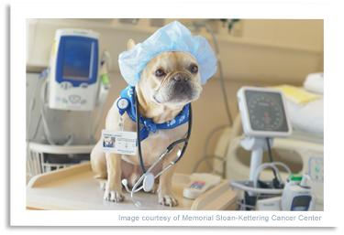
Veterinary Medicine
Expected to increase 35% because of increased demand for pet products and services.
However there are many more jobs in nursing.

Slide 37

Increase Opportunities in Healthcare
Most of the new jobs will be in healthcare.

Slide 38
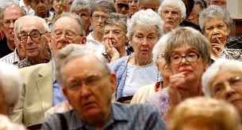
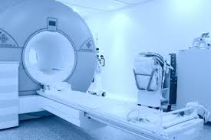
Why the increase?
Aging baby boomers
Healthcare reform
New pharmaceuticals
New developments in medicine

Slide 39

More Assistants Needed
Because of increased cost, we will need more:
  Physician’s assistants
  Medical assistants
  Physical therapy assistants
  Dental assistants

Slide 40

Environmental Science
Conserve water
Control pollution
Manage global warming
Produce food

Slide 41
Energy Shortages
Recycling
Alternative energy
Concerns about global warming and climate change

Slide 42

Going Green!

Slide 43



Going Green!
As fossil fuels are depleted, look for more:
  Wind turbines
  Solar panels
  Biofuels
  Emphasis on sustainability
  Taking care of the environment

Slide 44

Green Jobs
Environmental lawyer
Green architect
Sustainability consultant
Marine biologist
Environmental technician
Energy efficiency specialist
Organic farmer
Compliance manager
Product engineer
Wind energy engineer
Solar Engineer

Slide 45

Business
Finance
Investments
Taxes
Entrepreneurship and small businesses
E-commerce

Slide 46

Teaching
As older teachers retire, there will be an increasing need for teachers of the New Millennial generation.

Slide 47

Security
Law enforcement
Intelligence
Forensics
International relations
Foreign affairs
Security administration

Slide 48

Top Jobs for the Future
Business
Education
Entertainment
Health
Information Technology
Travel/Transportation
Law/Law enforcement
Services
Sports and related
Technology
Trades

Slide 49
10 Fastest Growing
Biomedical engineer
Network systems and data communications analyst
Home health aides
Personal and home care aides
Financial examiners
Medical scientists
Physician assistants
Skin care specialists
Biochemists and biophysicists
Athletic Trainers

Slide 50
10 Highest Salary Increase
Management Scientific, Technical
Physicians
Computer Systems design
General merchandise stores
Employment Services
Local government
Home health care services
Services for elderly and disabled
Nursing care facilities
Full-service restaurants

Slide 51
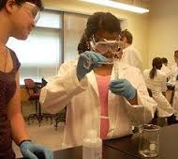

Top Paying Jobs (Over $50,000)
Require math and science
Chemical engineering
Computer engineering
Occupational therapy
Electrical engineering
Aerospace engineering
Computer science
Civil engineering
Nursing
Environmental engineering
Construction management
Physics
Economics

Slide 52


Largest Numerical Openings
Registered nurses
Home health aides
Customer services rep
Food preparation workers
Personal and home care aides
Retail salespersons
Office clerks
Accountants and auditors
Nursing aides, orderlies
Postsecondary teachers

Slide 53

Rate Your Skills for Success
In the workplace

Slide 54


Basic Skills
Reading
Math
Writing
Listening
Speaking
Computers

Slide 55

Thinking Skills
Creative Thinking
Decision Making
Problem Solving
Mental Visualization
Knowing How to Learn
Reasoning

Slide 56

Personal Qualities
Responsibility
Self-esteem
Sociability
Self-management
Integrity and Honesty

Slide 57

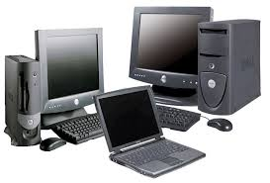
Workplace Competencies
Manage time and money.
Participate as a member of a team.
Use computers to access information.
Develop efficient management systems
Use technology.

Slide 58

How to Research Your Career

Slide 59

Career Description
Nature of the work
Working conditions
Training
Qualification
Advancement

Slide 60

The Career Outlook
Salary
Availability of employment
Will this career exist in the future?

Slide 61

To Research Your Career
Use the College Success Web Site
Visit the Career Center
Use the library

Slide 62

Planning Your Education
Vocational Certificate?
Associate Degree?
Bachelors Degree?
Masters Degree?
Doctorate Degree?
Professional Degree?

Slide 63

Degrees
Associate of Arts Degree 2 years
Bachelor’s Degree 4 to 5 years
Teaching Credential BA + 1 year
Master’s Degree BA + 2 years
Law Degree BA + 3 years
Professional Degree BA + 4 to 5 years

Slide 64

How many Units do I need to Graduate
1-29 units Freshman
30-59 units Sophomore
60-89 units Junior
90+ units Senior
Total number of units for graduation depends on the university

Slide 65

Develop and Educational Plan
It is the roadmap to your future.

Slide 66
Steps in Planning Your Education
Assessment tests
Take English the first semester
Start math classes early
Take general education
Prepare for your major

Slide 67

For Your Success
See a counselor or adviser
Develop an educational plan

Slide 68
Making a Career Decision

Slide 69

There is a choice you have to make,
In everything you do.
And you must always keep in mind,
The choice you make, makes you.

Slide 70

Steps in Making a Career Decision
Self-assessment
  Personality, Interests, Values, Skills
Explore Options
Research careers
Plan your education
Make a commitment and take action
Evaluate
How is it working?

Slide 71
Planful Decisions
Weigh the consequences
What are the pros and cons

Slide 72
Use Planful Decisions for:
What is my major?
What is my career?
Who should I marry?

Slide 73
Steps in Planful Decisions
State the problem
Consider your values
What are your talents?
Gather information
Generate alternatives
Evaluate the pros and cons of the options
Select the best alternative
Take action

Slide 74

Group Activity: Planful Decision

Slide 75
Keys to Success:
Life is a Dangerous Opportunity

Slide 76
The Chinese Word for Crisis Has Two Characters:
Danger
Opportunity

Slide 77
What is the danger?
What is the opportunity?

Slide 78

Every adversity has the seed of a greater benefit or possibility.

