Slide 1
Planning Your Career and Education
Chapter 4

Slide 2
Keep Your Eyes on the Future
Stay informed about new developments that will affect your future.

Slide 3
Baby Boomers, Generation X, the Millennials and the New Generation Z

Slide 4
What is Your Generation?
Baby Boomers 1946-1964
Generation X 1965-1977
New Millennials 1977-1995
Generation Z 1995-Present

Slide 5
Baby Boomers
Born between 1946 and 1964
Four out of every ten adults today
The population is getting older
How will the Baby Boom generation affect careers of the future?

Slide 6
Generation X
Born between 1965 and 1977

Slide 7
Advantages of Generation X
More highly educated
Greater demand for skilled workers
Computer literate
Good work ethic
As Baby Boomers retire, more job opportunities

Slide 8
The New Millennials
Born between 1977 and 1995

Slide 9
The New Millennials
Sometimes called the “Echo Boomers”
By 2010, they will be the largest teen population is U.S. history
Will exceed the number of Baby Boomers
In the next 10 years, college enrollments will increase by 300,000 students per year
College admission will become increasingly competitive.

Slide 10
The New Millennials
The cyber generation
Their most important values are individuality and uniqueness
Greatest concerns: terrorism and school shootings
Decreasing use of alcohol, drugs and tobacco
Have the promise of changing institutions for the better

Slide 11
The New Generation Z
Born since 1995
Many Names: Generation Wii, iGeneration,Gen Tech, Digital Natives, Net Gen, The Plurals

Slide 12
Generation Z
Also known at Generation Wii, iGeneration, Gen Tech and Digital Natives
Will use technology as a tool to change the world
Value cultural diversity
The age of “girl power”

Slide 13
Generation Z
Last generation with a Caucasian majority
Accept diversity
Decline of “traditional families”
Because of recession, less likely to believe in the American dream of having more
The age of “girl power”
Hope to use technology to change the world

Slide 14
Career Trends for 2020

Slide 15
Service Occupations in Demand
Health Care
Business
Education
Finance
Insurance
Real Estate
Transportation
Communication.

Slide 16
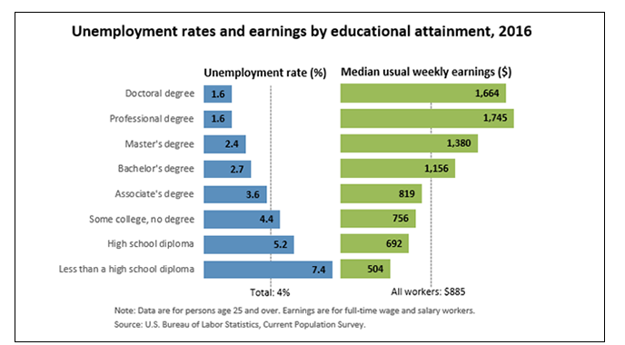
Increased Need for Education

Slide 17
Increased Opportunities for STEM Careers
Will grow 17% by 2020
Highest paying jobs.

Slide 18
Beware of Outsourcing
Likely to be outsourced:
Less likely to be outsourced
Repetitive jobs such as accounting
Well-defined jobs such as customer service
Software
Technical support
Top management
Trouble shooters
Marketing
Repair
Product design
Entertainment

Slide 19
Avoid Outsourcing
Be the best in your field
Be creative and innovative
Avoid repetitive jobs
Choose a career high in demand
Consider a job in skilled trades (carpenters, plumbers, hair stylists, dental hygienists)

Slide 20
Globalization
Speak different languages
Study international business

Slide 21
Nontraditional Workers
Do not have full time jobs with benefits
Contingent and part time workers
Independent contractors
Temporary workers

Slide 22
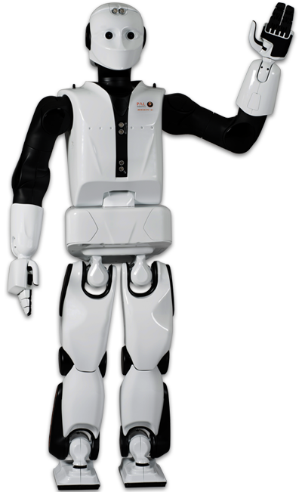
Automation
Robots will do the work
Engineers and technicians will be needed to design and maintain the robots

Slide 23
Mismatch between workers and jobs
More workers needed in scientific and technical fields

Slide 24
New Technology
Teleworking Using smart phones to do some work at home
Virtual Collaboration Using skype and other tools
New Media Required for job success

Slide 25
Data Analysis
Using data for market research
Requires math skills

Slide 26
Mental Health
Because of increasing violence, we are starting to realize the importance of mental health

Slide 27
Technology
Information and technology workers are the largest group of workers in the U.S.

Slide 28
New Technology Jobs
Computer network administrators
Data communications analysts
Web developers
Data loss prevention
Online security
Video game designer

Slide 29
Radiation and Laser Technologies
Used in medicine, energy, computers, communications, entertainment

Slide 30
Fiber Optics and Telecommunications
Fiber optics are thin glass fibers that transmit light.
Copper wire will soon become obsolete.

Slide 31
Artificial Intelligence
Enables computers to approximate human thought

Slide 32
Research
Engineering
Chemistry
Engineering
Biology
Biotechnology
Requires advanced degrees

Slide 33
21st Century
The Biology Century

Slide 34
New Advances in Biology
The 21st Century will be the biology century
Human Genome Project
Biotechnology
Biomedical technology

Slide 35
Biotechnology
Genomic profiling
Biomedical engineering
New pharmaceuticals
Genetic engineering
DNA identification
Biotechnology will be used to find cures for diabetes, arthritis, heart disease and Alzheimer’s disease.

Slide 36
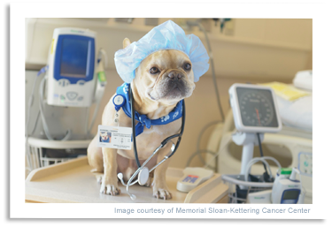
Veterinary Medicine
Expected to increase 35% because of increased demand for pet products and services.
However there are many more jobs in nursing.

Slide 37
Increase Opportunities in Healthcare
Most of the new jobs will be in healthcare.

Slide 38
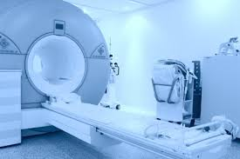
Why the increase?
Aging baby boomers
Healthcare reform
New pharmaceuticals
New developments in medicine

Slide 39
More Assistants Needed
Because of increased cost, we will need more:
Physician’s assistants
Medical assistants
Physical therapy assistants
Dental assistants

Slide 40
Environmental Science
Conserve water
Control pollution
Manage global warming
Produce food

Slide 41
Energy Shortages
Recycling
Alternative energy
Concerns about global warming and climate change

Slide 42
Going Green!

Slide 43
Going Green!
As fossil fuels are depleted, look for more:
Wind turbines
Solar panels
Biofuels
Emphasis on sustainability
Taking care of the environment

Slide 44
Green Jobs
Environmental lawyer
Green architect
Sustainability consultant
Marine biologist
Environmental technician
Energy efficiency specialist
Organic farmer
Compliance manager
Product engineer
Wind energy engineer
Solar Engineer

Slide 45
Business
Finance
Investments
Taxes
Entrepreneurship and small businesses
E-commerce

Slide 46
Teaching
As older teachers retire, there will be an increasing need for teachers of the New Millennial generation.

Slide 47
Security
Law enforcement
Intelligence
Forensics
International relations
Foreign affairs
Security administration

Slide 48
Top Jobs for the Future
Business
Education
Entertainment
Health
Information Technology
Travel/Transportation
Law/Law enforcement
Services
Sports and related
Technology
Trades

Slide 49
10 Fastest Growing
Biomedical engineer
Network systems and data communications analyst
Home health aides
Personal and home care aides
Financial examiners
Medical scientists
Physician assistants
Skin care specialists
Biochemists and biophysicists
Athletic Trainers

Slide 50
10 Highest Salary Increase
Management Scientific, Technical
Physicians
Computer Systems design
General merchandise stores
Employment Services
Local government
Home health care services
Services for elderly and disabled
Nursing care facilities
Full-service restaurants

Slide 51
Top Paying Jobs (Over $50,000) Require math and science
Chemical engineering
Computer engineering
Occupational therapy
Electrical engineering
Aerospace engineering
Computer science
Civil engineering
Nursing
Environmental engineering
Construction management
Physics
Economics

Slide 52
Largest Numerical Openings
Registered nurses
Home health aides
Customer services rep
Food preparation workers
Personal and home care aides
Retail salespersons
Office clerks
Accountants and auditors
Nursing aides, orderlies
Postsecondary teachers

Slide 53
Rate Your Skills for Success In the workplace

Slide 54
Basic Skills
Reading
Math
Writing
Listening
Speaking
Computers

Slide 55
Thinking Skills
Creative Thinking
Decision Making
Problem Solving
Mental Visualization
Knowing How to Learn
Reasoning

Slide 56
Personal Qualities
Responsibility
Self-esteem
Sociability
Self-management
Integrity and Honesty

Slide 57
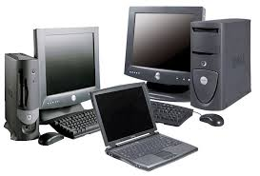
Workplace Competencies
Manage time and money.
Participate as a member of a team.
Use computers to access information.
Develop efficient management systems
Use technology.

Slide 58
How to Research Your Career

Slide 59
Career Description
Nature of the work
Working conditions
Training
Qualification
Advancement

Slide 60
The Career Outlook
Salary
Availability of employment
Will this career exist in the future?

Slide 61
To Research Your Career
Use the College Success Web Site
Visit the Career Center
Use the library

Slide 62
Planning Your Education
Vocational Certificate?
Associate Degree?
Bachelors Degree?
Masters Degree?
Doctorate Degree?
Professional Degree?

Slide 63
Degrees
Associate of Arts Degree 2 years
Bachelor’s Degree 4 to 5 years
Teaching Credential BA + 1 year
Master’s Degree BA + 2 years
Law Degree BA + 3 years
Professional Degree BA + 4 to 5 years

Slide 64
How many Units do I need to Graduate
1-29 units Freshman
30-59 units Sophomore
60-89 units Junior
90+ units Senior
Total number of units for graduation depends on the university

Slide 65
Develop and Educational Plan
It is the roadmap to your future.

Slide 66
Steps in Planning Your Education
Assessment tests
Take English the first semester
Start math classes early
Take general education
Prepare for your major

Slide 67
For Your Success
See a counselor or adviser
Develop an educational plan

Slide 68
Writing a Resume

Slide 69
Your Resume
A snapshot of your education and experience
Generally one page

Slide 70
Resume
Contact information
Name
Address
Telephone
E-mail

Slide 71
Resume
Career Objective
Education
Experience
Special skills, honors, awards
References

Slide 72
Good Resume
Write clearly
Be brief
Be neat
Be honest
Print professionally or post online
Your resume represents you!

Slide 73
Letters of Reference
Ask for letters of reference from your current employers and professors. Keep them on file.
Ask for endorsements on LinkedIn.
Use them to apply for jobs and scholarships.

Slide 74
Online Resumes
Many jobs today will be posted on the Internet and will require online resumes

Slide 75
The Cover Letter

Slide 76
Cover Letter
State briefly the job you are interested in.
Briefly state how your education and experience would be an asset to the company.
Ask for an interview.
Attach your resume.

Slide 77
Assignment
Complete a resume and cover letter for your ideal job.
Assume you have graduated from college and are applying for that job that motivated you to finish college.

Slide 78
Establishing Your Personal Brand Online

Slide 79
Personal Branding
Through the use of social media, you can use this concept to market your strengths to potential employers and to find a satisfying career.

Slide 80
Personal Branding
Define your brand.
What are your passions, goals, and personal strengths and how can they be used in the job market?

Slide 81
Personal Branding
Manage your online presence.
Beware of materials like these:
Photos or references to drug or alcohol abuse
Discriminatory comments on race, religion or gender
Negative comments about previous employers
Poor communication skills (grammar and spelling)

Slide 82
Personal Branding
Set up a nameplate website.
About.me
Sites.google.com
Zerply.com
These are free.

Slide 83
Using Online Tools
Top sites:
LinkedIn
Facebook

Slide 84
Using Online Tools
Classified Ads
careerbuilder.com
Job Search Engines
Indeed.com
Employment agencies
Using email to find a job

Slide 85
The Job Interview

Slide 86
First Learn About the Job
Library
Personnel Office
Friends and Contacts
Web Site

Slide 87
Interviewers Look For:
Enthusiasm and commitment
How you can be an asset to the company
How you can work as part of a team

Slide 88
Make a Good Impression
Dress appropriately.
Relax.
Anticipate interview questions.
Smile and introduce yourself.
Maintain eye contact.

Slide 89
Some Interview Questions
Tell us about yourself.
Why do you want this job?
Why are you leaving your present job?
What are your strengths and weaknesses?
Tell us about a difficulty or problem you solved on the job.

Slide 90
Interview Questions
Tell us about one of your achievements on the job.
What do you like best about your job?
What do you like least?
Are there any questions you would like to ask?

Slide 91
Write a thank you note.
It makes a good impression.
It causes the interviewer to think about you again.

Slide 92
Interview Worksheet
1. Answer the questions in 5 minutes.
2. Practice the questions with your partner.

Slide 93
Keys to Success: Life is a Dangerous Opportunity

Slide 94
The Chinese Word for Crisis Has Two Characters:
Danger
Opportunity

Slide 95
What is the danger? What is the opportunity?

Slide 96
Every adversity has the seed of a greater benefit or possibility.

