Slide 1
Introduction
Welcome to Class!
Welcome

Slide 2

Counseling 120
College and Career Success

Slide 3

Getting to Know You
Ice Breakers

Slide 4

Group Activity: What do I want from college?

Slide 5
Introduction

Slide 6
What is this course about?
Success
In College
and in Your Career

Slide 7
Chapters
Chapter 1: Understanding Motivation
Chapter 2: Exploring Your Personality and Major
Chapter 3: Managing Time and Money
Chapter 4: Using Brain Science to Improve Memory

Slide 8
Chapters
Chapter 5: Using Brain Science to Improve Study Skills
Chapter 6: Taking Notes, Writing and Speaking
Chapter 7: Test Taking
Chapter 8: Thinking Positively about the Future

Slide 9

What will you get out of this course? You will get what you put into it.

Slide 10
Attendance is essential
Group discussions are an integral part of the class, you cannot participate if you are not here.
If you are absent (4) times you will be dropped from my roster. You must drop officially with Admissions. The deadline is April 24 in order to avoid a failing grade.

Slide 11

Recommended Materials
Notebook
Highlighter
Pens/pencils
Scantrons (3)

Slide 12

Textbook By
Marsha
Fralick

Slide 13
Who Should Take This Course?
Transfer Student
New Student
Undecided Students
Students Who Get Good Grades
Students Who Need to Improve Grades

Slide 14
Let’s at the
Syllabus

Slide 15
Grading
Chapter Journal Entries and Quizzes
Blackboard Assignments
Mid-Term Exams (2)
Final Exam
A B C D F

Slide 16


Slide 17
College Success Web Site
www.collegesuccess1.com

Slide 18

Course Credit
General education credit for California State Universities, Area E
Associate degree credit

Slide 19

Course Objectives
Read these on your own

Slide 20

Assignments
Read (or at least skim) the chapters to be covered before you come to class
We will read approximately one chapter per week

Slide 21


Contact me if you need help
VOICE MAIL
E-MAIL
IN PERSON

Slide 22

How to make the instructor happy

Slide 23

Arrive on time
However, better late than never!

Slide 24
Attendance is essential
You will be dropped for missing class.

Slide 25

Respect other students

Slide 26

Appreciate Differences
Culture
Race
Language
Academic Ability
Physical Disability
Lifestyle

Slide 27
Be prepared
Read the material before you
come to class. However,
come if you’re not prepared. You
will miss a great deal of material
if you are not here.

Slide 28
How to irritate the instructor and other students
Talking while another student is talking
Talking while the instructor is talking
Cell Phones

Slide 29
Academic Accommodations
Let me know privately if you have any disabilities so that I can provide assistance and understanding
  Learning disability
  Hearing or vision problems
  Health problems
  Other situations which may affect your academic performance

Slide 30
My Teaching Philosophy
Teach you and you will forget
Show you and you will remember
Involve you and you will understand

Slide 31

We will be using an electronic book
College and Career Success 5th Edition
by
Dr. Marsha Fralick
The electronic book is published by
HumanEsources under the name of:

Slide 32
Where do I find it?
www.collegescope.com/ccs/cuyamaca
Fee is $50.00
or
Cuyamaca College Bookstore
Fee is $65.00
Do not buy a paper textbook

Slide 33
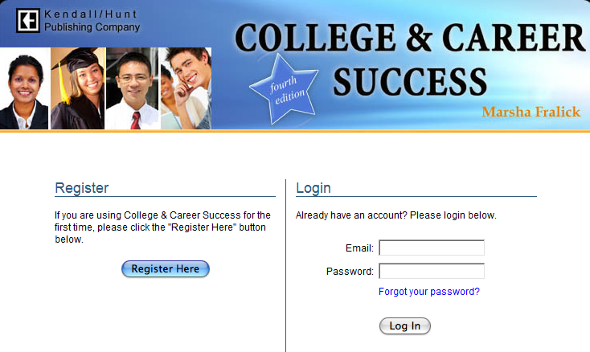
College Scope Registration
You can register for College Scope without paying

Slide 34
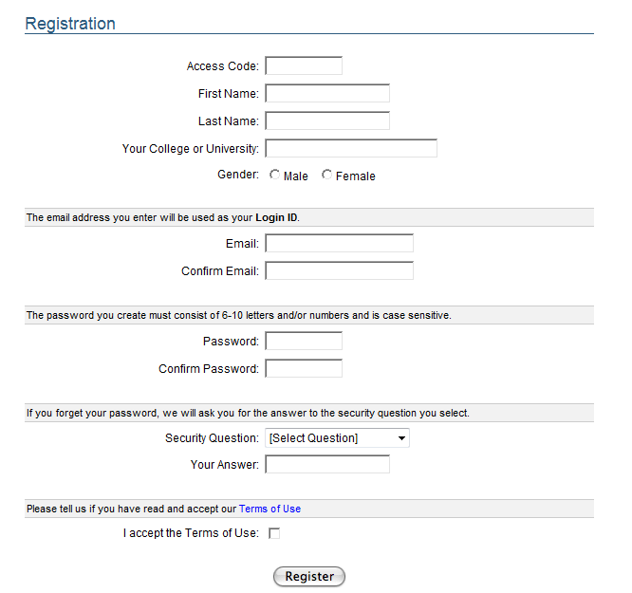
Fill out the registration page.
Remember the email and password you create.

Slide 35
After you register you will use the Login section to start College Scope.

Slide 36
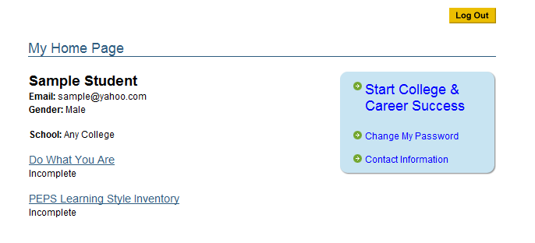
Your first assignment
Is a self assessment to see what you already know.
Just relax and answer the questions honestly.

Slide 37
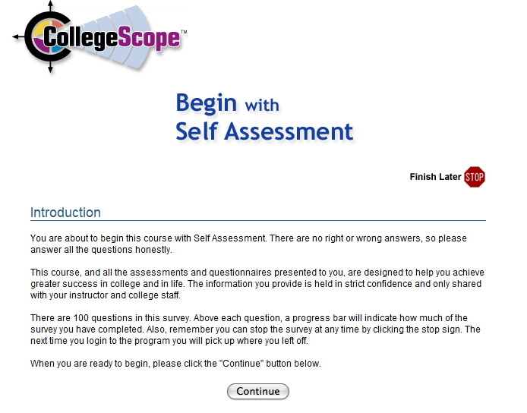
Read the Introduction

Slide 38
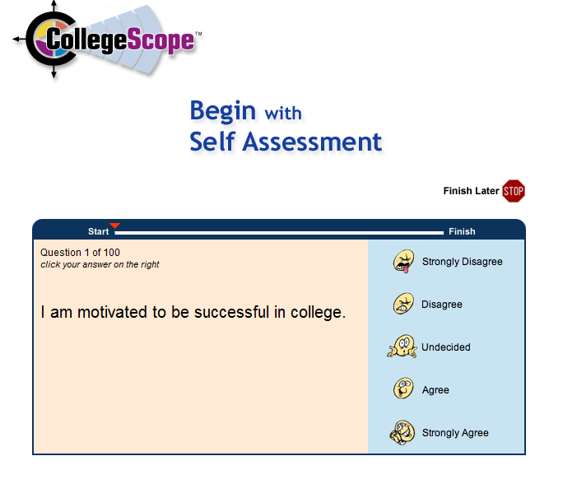
Sample Self Assessment Question

Slide 39
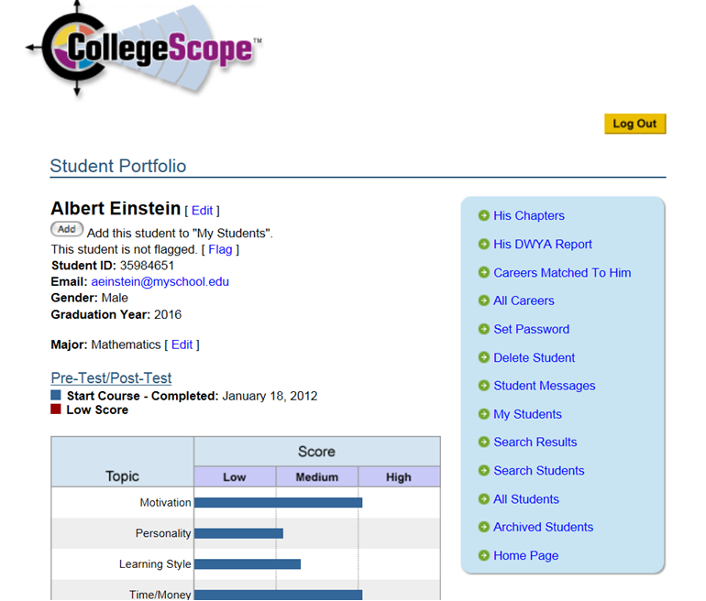
Once you have completed the assessment you can view your results under My Chapters in your portfolio page.

Slide 40
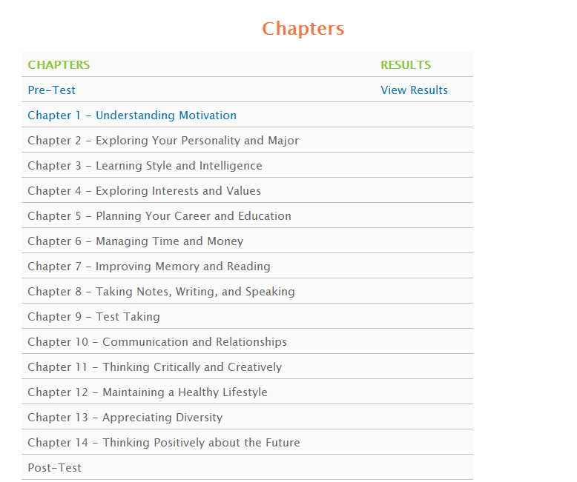
You can view you results here

Slide 41
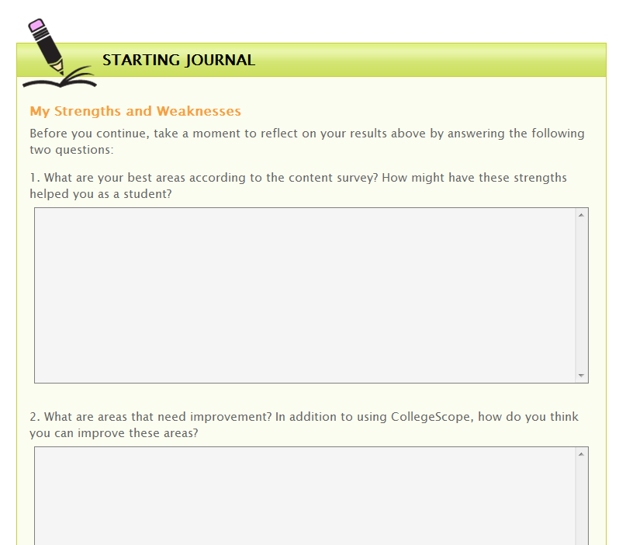
You will copy the two questions and turn in on Wednesday. See Blackboard 1st assignment

Slide 42
You may now begin Chapter 1

Slide 43
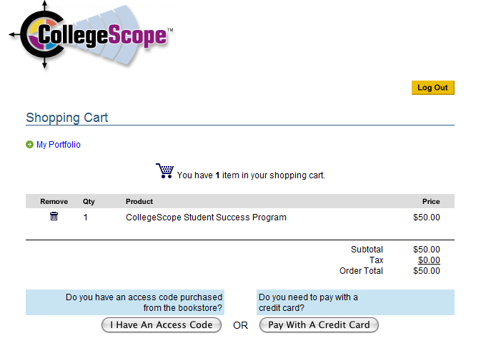
When do I Pay for College Scope?
You must pay before you start Chapter 2

Slide 44
You are now ready to begin
Chapter 2

Slide 45
Group Activity:
How to be an “A” student

Slide 46

Assignment:
Measure Your Success
SucceWheel

