Slide 1
Managing Time and Money
Chapter 3

Slide 2
What is the longest and yet the shortest thing in the world?
The swiftest and yet the slowest,
The most divisible and the most extended
The least valued and the most regretted,
Without which nothing can be done
Which devours everything, however small,
And yet opens the life and spirit,
To every object, however great?

Slide 3
Time

Slide 4
Time Management is Not:
Restriction and control
Someone else’s agenda

Slide 5
Time Management Is:
Accomplishing your personal goals
Having fun with your life
Friends and family
A successful career

Slide 6

Manage time and money to reach your goals.

Slide 7
What are your lifetime goals?

Slide 8

Successful Goal Setting
Is it achievable?
Is it realistic?
Is it specific and measureable?
Do you want to do it?
Are you motivated to achieve it?
Does the goal match your values?
What steps will you take to begin?
When will you finish this goal?

Slide 9

Smart Goals

Slide 10
Knowing your goals is the key to time management.

Slide 11
Class Exercise:
My Lifetime Goals

Slide 12

Rules for Brainstorming
Generate as many ideas as possible
No censorship
Choose the best ideas later
Set a time limit
Establish a goal or quota

Slide 13

In 5 minutes, list your lifetime goals. Write anything that comes to mind. Can you list at least 10?

Slide 14

Look over your list and highlight or mark the most important goals.

Slide 15

In 5 minutes, list what you would like to accomplish in the next 5 years. Include your educational and career goals. See if you can come up with 10 items.

Slide 16
Again, highlight or mark your best answers.

Slide 17
What goals would you like to accomplish in the next year?
Consider these goals:
  Education
  Work
  Leisure
  Family
  Social

Slide 18
Highlight your best ideas.
Share with the class one of your most important ideas from this question.

Slide 19
Assignment:
Finish My Lifetime Goals

Slide 20
What is the difference between a goal and a fantasy?

Slide 21

Is this car a goal or a fantasy?

Slide 22
A Goal Requires
ACTION

Slide 23
Turn Your Dreams Into Reality
Dream or visualize
Convert the dream into goals
Convert your goals into tasks
Convert your tasks into steps
Take your first step and then the next

Slide 24
Activity: Make a quick list of what you have done today and what you plan to do until you go to bed tonight.

Slide 25

Priorities are the key to effective time management.
What are priorities?

Slide 26



Prioritize your list
Related to Lifetime Goals
Important--Have to Do
Could Postpone

Slide 27
Beware: “C” Fever
The tendency to do “C” activities first
  They are easier
  We can see the results
  Doesn’t take too much effort or creativity
  Little thought required

Slide 28
Work Your “A’s” Off
Make sure to accomplish what is most important
Work toward your lifetime goals

Slide 29
Schedule Your Success

Slide 30

What Is Your Chronotype?
Chronotype refers to different time preferences
Larks get up early
Owls stay up late
Hummingbirds are combination types

Slide 31

Owls Often Have Lower GPA’s
They are sleep deprived
Loss of sleep interferes with attention, memory, mathematical skills, logical reasoning and manual dexterity

Slide 32

Night Owls
Avoid:
Staying up late
Alcohol, nicotine, and food late in the evening
Do this:
Relax before bedtime
Develop a regular pattern of sleep
Get some exercise so you feel tired at night

Slide 33
Balancing Work and Study Time
You need 2 hours of study time for each hour in class.
Research on college success has shown that you should work no more than 20 hours a week to be successful in college.
Working 20 hours a week provides valuable work experience.

Slide 34
Full Time College Schedule
15 Hours Attending Class
30 Hours in Reading and Studying
45 Hours Total
This is like having a full time job.

Slide 35
College and Work Schedule
12 Hours Attending Class
24 Hours of Reading and Studying
20 Hours Work
56 Hours Total
This is like having a full time job
and a part time job.

Slide 36
The Impossible Schedule
12 Hours Attending Class
24 Hours Reading and Studying
40 Hours Work
76 Hours Total
This is like having
two full time jobs!

Slide 37
Part Time Student Schedule
6 Hours Attending Class
12 Hours Reading and Studying
40 Hours Work
58 Hours Total

Slide 38

Schedule Your Success
Create a Master Schedule
  Class Times
  Work Time
  Scheduled Activities

Slide 39
Tips for Scheduling
Write in study times on your Master Schedule
Use the daylight hours for studying
Use your prime time for important tasks
Allow time for sleep and meals
Use priorities
Leave some unscheduled time for the unexpected
Leave time for recreation

Slide 40
Benefits of Using a Schedule
Gets you started
Helps avoid procrastination
Relieves pressure
Frees the mind of details
Helps find time to study
Helps avoid panic
Find time for recreation and exercise

Slide 41
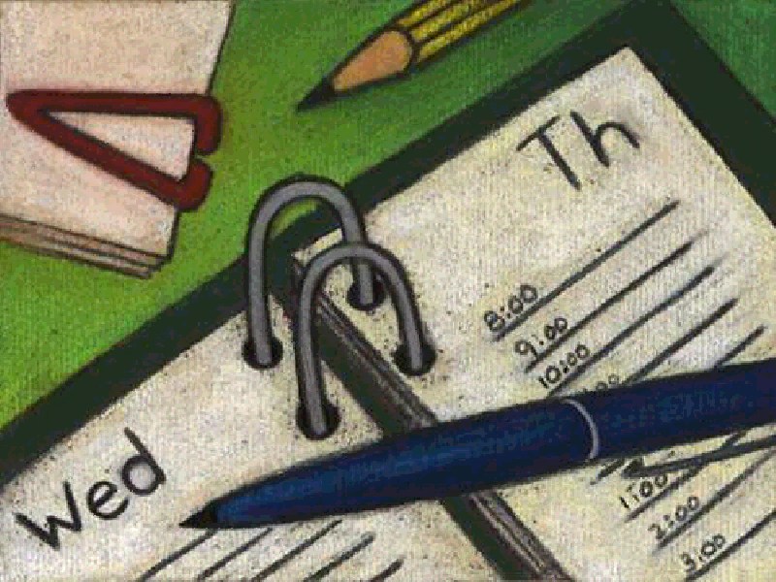
Types of Schedules
Weekly
Daily
Monthly
Yearly

Slide 42
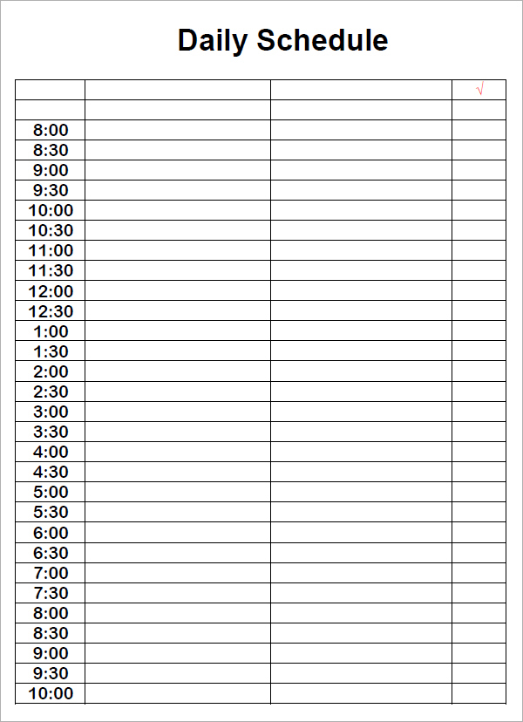

Slide 43
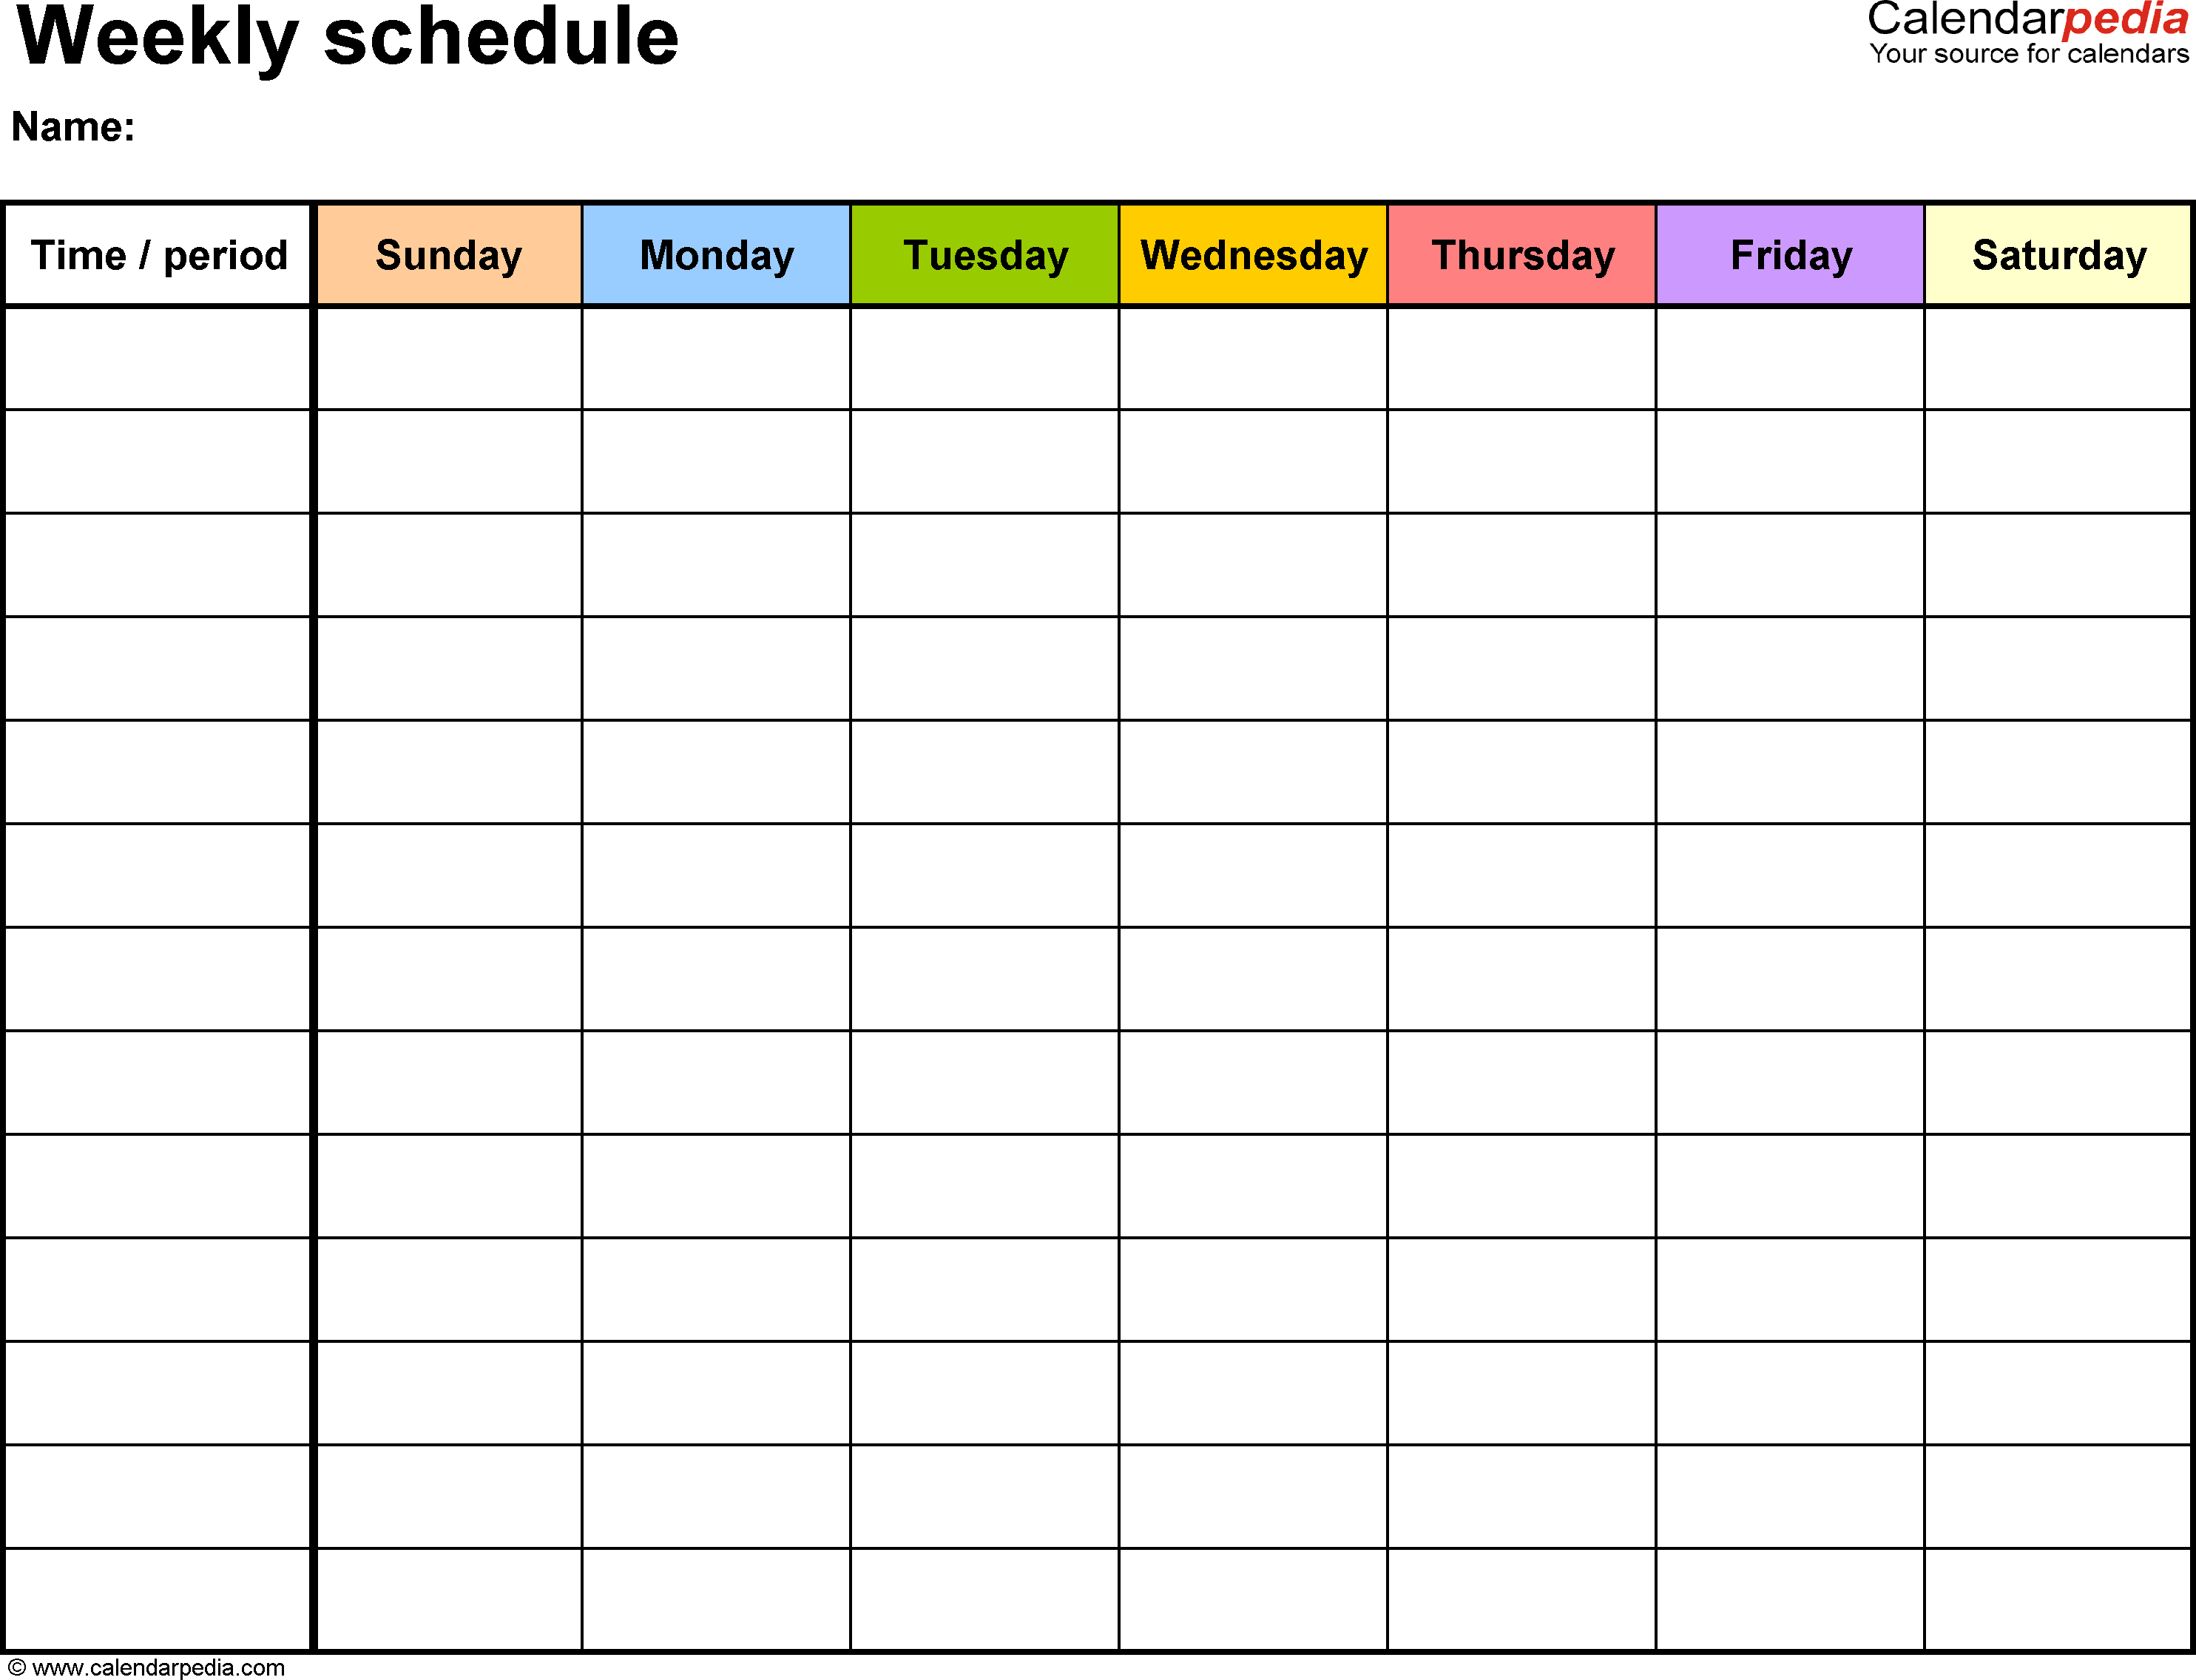

Slide 44
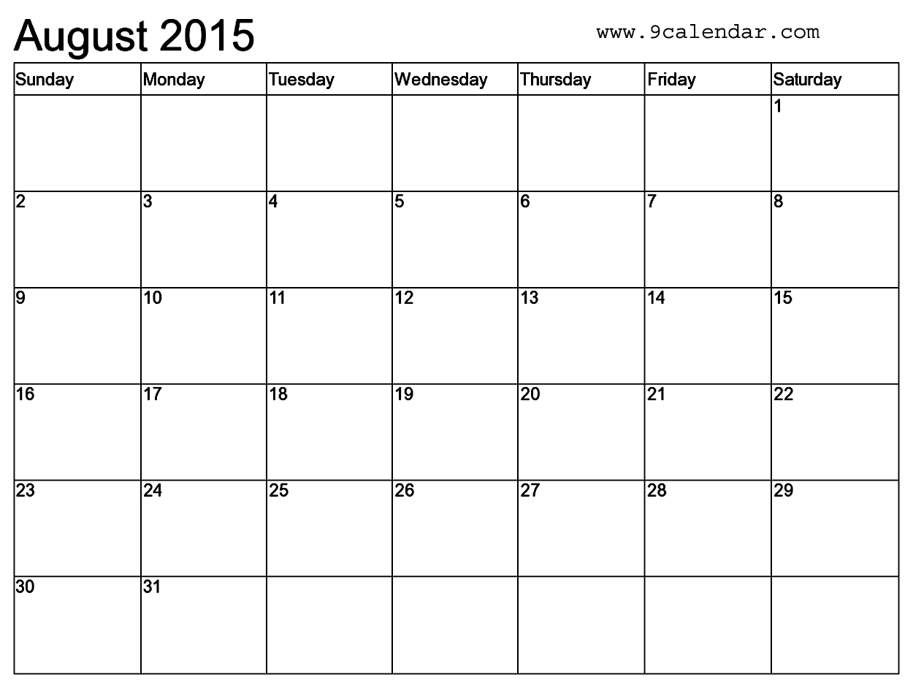
Monthly

Slide 45
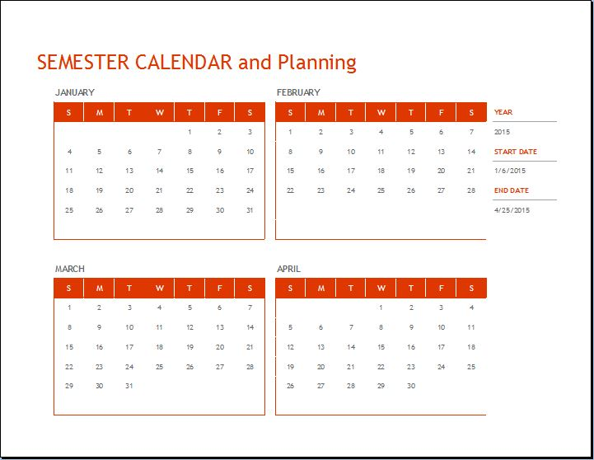

Slide 46
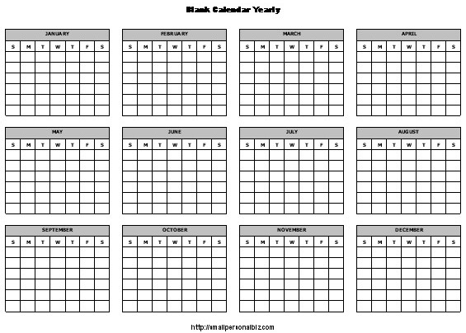
Yearly schedule

Slide 47

Dislike schedules?
Use a “To Do List” with priorities
Use a calendar to write important due dates
Lakein’s Question: What is the best use of my time right now?
Reminders and sticky notes
Other ideas?

Slide 48
TO DO List
1. Batteries for watch
B 2. Grocery store
A 3. Dr. appointment
4. Clean house
A 5. Dinner with family
B 6. Gas in car
A 7. Prepare for class
8. Balance checkbook
9. Watch TV
10. Wash car

Slide 49
Assignment:
Monitor your time for a week. Turn it in next Tuesday along with analysis sheet.

Slide 50
Time Management Tricks

Slide 51
Divide and Conquer

Slide 52
Do the First Small Step

Slide 53
80/20 Rule
80% of the value comes from 20% of the items on a list.

Slide 54
80/20 Examples
We only wear 20% of our clothes
80% of file usage is in 20% of files
80% of dinners repeat 20% of recipes
80% of the dirt is on 20% of the floors
Can you think of others?

Slide 55

Aim for Excellence,
Not Perfection
Is perfection necessary?
Maybe “it ain’t no piano”

Slide 56
Make Learning Fun
By Finding a Reward

Slide 57

Just Take a Break

Slide 58

Study in the Library
Everyone else is studying there
It is difficult to do something else in the library

Slide 59
Learn to Just Say No
no

Slide 60

What are your time bandits?

Slide 61

Dealing with Time Bandits
Schedule time for other people
Use some of them as rewards
Use prime time wisely
Remind yourself of your priorities
Use a schedule
What is the payoff?

Slide 62
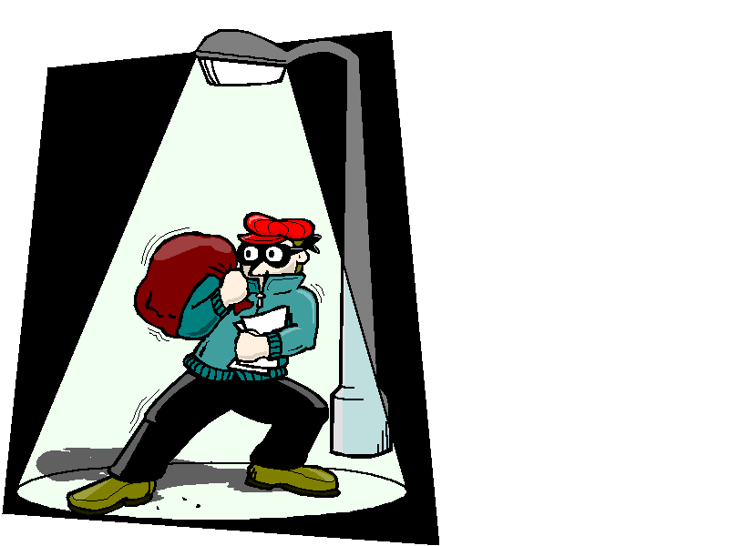
How to Deal With People Who Are Time Bandits
Communicate your goals
Spend quality time
Schedule
Keep your word
Tell them they are important
Be assertive if necessary

Slide 63
Think
Pair
Share
How can you avoid procrastination? For example, you have an assignment due and you are having a difficult time getting started. How do you motivate yourself to get started?

Slide 64

Dealing With Procrastination

Slide 65

Why do we procrastinate?

Slide 66

Reasons for Procrastination
Fear of failure
Fear of success
Perfectionism
Need for excitement
Excellence without effort
Loss of control

Slide 67

How can you avoid procrastination?

Slide 68

You have a term paper due next week, but you are procrastinating getting started on this project.
How can you find the to get started?
Lets hear some answers!

Slide 69
Avoiding Procrastination
Select a goal.
Visualize your progress.
Be careful not to sabotage yourself.
Stick to a time limit.
Don’t wait until you feel like it.
Follow through.
Reward yourself.

Slide 70
Avoiding Procrastination
Re-evaluate your goals if you are procrastinating.
Are they dreams or goals?
Are your goals realistic?
Are your goals achievable?
And remember, you do not have to be perfect.

Slide 71
Managing Your Money

Slide 72
Challenge Question: To become a millionaire by age 68, how much would you need to save each month if you started saving at age 22? (Assuming a 10% return on your investments?)

Slide 73
To Become a Millionaire
At age 22, save $87 per month
At age 26, save $130 per month
At age 30, save $194 per month
At age 35, save $324 per month

Slide 74

Save money to accomplish your goals.

Slide 75
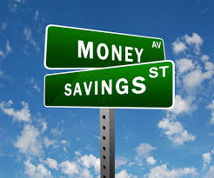
As a college student, how can you spend your money wisely and begin a savings habit?

Slide 76
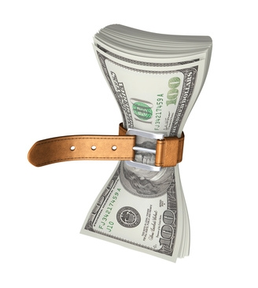
Group Exercise:
The College Student Tightwad Gazette

Slide 77

Budgeting is the Key to Money Management.

Slide 78
Start with a Money Monitor.

Slide 79
Try it on your own!
Budgeting for College

Slide 80
Need More Money?

Slide 81
Apply for Financial Aid
Loans
Grants
Work Study

Slide 82
The College Success Web site has links for getting information and applying for Financial Aid online. www.collegesuccess1.com

Slide 83

Apply for a Scholarship

Slide 84
How to Apply for a Scholarship
Research
  The College Success Web Site
  Library
  Scholarship Office

Slide 85
How to Apply for a Scholarship
Establish a scholarship file
  3 letters of recommendation
  Statement of personal goals
  Statement of financial need
  Copies of your transcripts
  Copies of other scholarship applications

Slide 86

Best Ideas for Financial Security
Use a budget
Have a financial plan
Save 10% of your income
Don’t take on too much debt. Beware of credit cards.
Learn about investments.
Don’t procrastinate. The earlier you take these steps the better.

Slide 87
Willpower, restriction and self-control may not work.

Slide 88

The trick is not to manage our time or money, but to manage ourselves.

Slide 89
Manage Yourself
Know your values.
Set goals.
Visualize the actions you will take.
Make decisions based on your values.

Slide 90
Keys to Success:
Do What Is Important First

Slide 91
Put First Things First.
--Steven Covey
Author of Seven Habits of Highly Effective People

