Slide 1
Understanding Motivation
Chapter 1

Slide 2
What are the behaviors and attitudes of an “A” student?
List three important behaviors that an “A” student would have.
Get in a group of three students and compare lists
Report

Slide 3

What Do I Want from College?

Slide 4
Exercise:
What Do I Want from
College?
Share your most important reason with the class.

Slide 5

Value of a College Education

Slide 6

Education Increases Earnings

Slide 7

Yearly Income
HIGH SCHOOL $34,736
SOME COLLEGE $38,352
ASSOCIATE $41,184
BACHELORS $57,252
MASTERS $68,952
PROFESSIONAL $85,228

Slide 8
Lifetime Income
HIGH SCHOOL $1,042,080
SOME COLLEGE $1,155,960
ASSOCIATE $1,235,520
BACHELORS $1,717,560
MASTERS $2,068,560
PROFESSIONAL $2,556,840

Slide 9
What is the Value of a College Degree?
$1,717,560 College Graduate
$1,042,080 High School Graduate
$675,480 Value of College
Degree

Slide 10
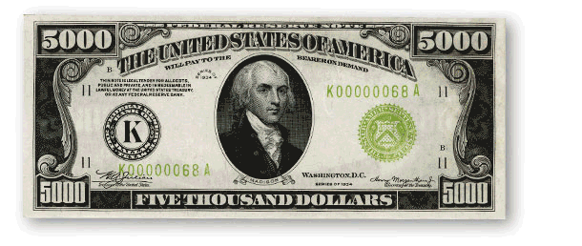
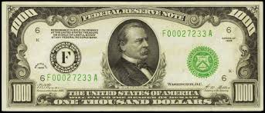
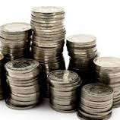
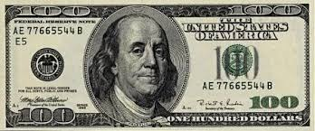
How much is each college class worth?
$16,146
and some

Slide 11
$16,887 per 3 unit class
($675,480 divided by 40 classes for a BA or BS)

Slide 12

What is
of a college class worth?

Slide 13
$352 per hour in class ($16,887 divided by 48 hours in class)

Slide 14

Would you attend class today and be prepared if I paid you $352?

Slide 15
Of course, these payments are over a working lifetime of 30 years.

Slide 16
Choosing Your Major
Making a good choice of a major helps increase your motivation for success.

Slide 17
How to Choose a Major
What is my personality type? What are my personal strengths?
What are my multiple intelligences?
What are my interests?
What are my values?
How can I match my personal strengths to the world of work?

Slide 18
How do you motivate yourself?
What if you don’t feel like coming to class or doing your homework. How do you motivate yourself to do it anyway?
      Think
      Discuss with the person next to you
      Share ideas

Slide 19
How to Be Motivated

Slide 20
There are many ways to be motivated. Let’s see if any are useful to you.
Have a positive mindset
Think positively about the future
Look for something interesting
Improve your concentration
  Manage your external environment
Intrinsic or extrinsic motivation
Locus of control
Achievement motivation
Use a reward

Slide 21
Your Mindset
Makes a Difference
Growth Mindset:
Intelligence is increased as you learn new knowledge
Through practice and effort, skills can be improved
Failure is an opportunity to learn
Fixed Mindset:
Intelligence is fixed at birth
Hard work is unpleasant
The amount of work needed to be successful is underestimated
Roadblocks are an excuse to be absent

Slide 22


Slide 23
Think Positively about the Future
If you believe that your chances of graduating from college are good, you can increase motivation and take the steps needed to be successful.
If you believe that your chances of graduating from college are poor, it is difficult to motivate yourself to continue.

Slide 24
No pessimist ever discovered the secrets of the stars, or sailed to an uncharted land, or opened a new doorway for the human spirit.
Helen Keller

Slide 25
Benefits of Positive Thinking
Good health
Longevity
Happiness
Perseverance
Improved problem solving
Enhances ability to learn

Slide 26
If you are optimistic and believe that a goal is achievable, you are more likely to take the steps necessary to accomplish it.

Slide 27

Optimism Vs. Pessimism
How does it apply to college?

Slide 28
Find something interesting in your studies.
Exercise: Textbook Skimming

Slide 29

Ways to Improve Your Concentration and Attention

Slide 30
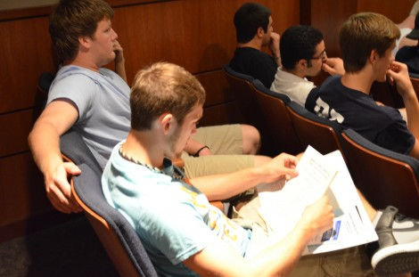
Concentration and motivation are connected.
If you can focus on what you are doing, you are motivated to continue.

Slide 31

Avoid Multi-tasking
A person who is interrupted takes 50% longer to complete a task
The interruptions results in 50% more errors.
Avoid distractions from cell phones and other electronics.

Slide 32

Minimize Distractions
If you study in the kitchen, you will be distracted by food
If you study in front of the TV, you will be tempted to watch it
If you study in bed, it will be difficult to say awake

Slide 33
Be Here Now
Choose where you will place your attention
When your mind wanders, gently bring it back. Forcing attention does not work.

Slide 34
For example, do not think about pink elephants!

Slide 35
How many of you thought about pink elephants?

Slide 36
When your mind wanders, gently bring it back to the here and now.

Slide 37
Can you be here now for two minutes?

Slide 38
Focus on this number for 2 minutes:
1

Slide 39
Where did your mind go during these two minutes?

Slide 40
The Spider Technique
Learn to ignore distractions and keep your attention focused

Slide 41
Set up a Worry Time
Set a time each day
When worries distract you, remind yourself of the time set aside to worry
Be here now
Keep your worry appointment
Find solutions

Slide 42
Increase Your Activity
Take a break
Stretch
Move
Read and listen actively

Slide 43
The Checkmark Technique
When you find yourself distracted, place a checkmark on a piece of paper and refocus your attention
With practice you will have fewer checkmarks and distractions

Slide 44
Change Topics
You may need to study for a short period of time and change subjects.

Slide 45

Two types of Motivation

Slide 46
Motivation
Intrinsic motivation comes from within.
  Look for ways to enjoy college and find some personal meaning in it.

Slide 47

Motivation
Extrinsic motivation comes as a result of an external reward.
What is the payoff for attending college?
Higher earnings
Having a satisfying career
Buying a car or home

Slide 48
Which is the more powerful motivator?
Intrinsic or extrinsic motivation?

Slide 49
Intrinsic motivation is the most powerful.

Slide 50
Taking Control of Your Life
Where do you place the responsibility for control over your life?

Slide 51


Slide 52
What is Locus of Control?
Where you place responsibility for control over your life.

Slide 53
Locus of Control
Internal
External
Believe you are in control of your life.
Be self-motivated.
Learn from mistakes.
Think positively.
Rely on yourself.
Life is a result of luck or fate.
Rely on others for motivation.
Look for someone to blame.
Think negatively.
Rely on others.

Slide 54
As a college student you are looking for what kind of Motivation?
Intrinsic Motivation
What kind of locus of control?
Internal locus of control

Slide 55
Exercise: Locus of Control
CSI Activity

Slide 56

More Types of Motivation

Slide 57

Affiliation Motivation

Slide 58
How can you use affiliation motivation to be successful in college?

Slide 59
Affiliation Motivation
Study Groups
Friends
Athletics
Clubs
Activities

Slide 60

Achievement Motivation

Slide 61
Are you motivated by achievement?
Competition for grades
Winning the game
Earning money
Recognition for achievement

Slide 62
Learning and Motivation
Psychologists believe that much of our behavior is learned.

Slide 63

Find a reward to increase desirable behavior.

Slide 64


1. Do not involve alcohol or drugs
Good Rewards

Slide 65
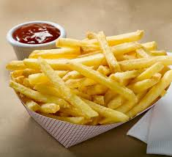
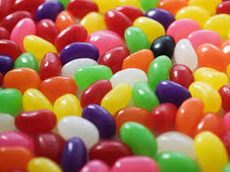
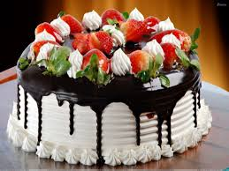
1. Do not involve alcohol or drugs
2. Do not have too many calories
Good Rewards

Slide 66

1. Do not involve alcohol or drugs
2. Do not have too many calories
3. Do not cost too much money
Good Rewards

Slide 67

What are some good rewards for studying?

Slide 68
Success is a HABIT

Slide 69
Success is a Habit
We establish habits by taking small actions each day.
You can establish habits for success.

Slide 70
Exercise:
I am successful when I:

Slide 71

Describe a class where you were not motivated to learn. Why?
Think of a class where you were very motivated to learn. What made the class motivating?

Slide 72
Exercise:
I am successful when I:
Behaviors which interfere with my success.:

Slide 73
Exercise:
I am successful when I:
Behaviors which interfere with my success:
I would like to:

Slide 74
A PRACTICAL EXAMPLE

Slide 75
Step 1.
State the problem.
I have a chocolate chip
cookie eating habit.

Slide 77
Step 2
Choose one small behavior at a time
Make it small.

Slide 78

Changing one small behavior is like making a ripple on a lake.

Slide 79
Change one small behavior and you can change your life.

Slide 80
I will eat a healthy snack.
NOT
I will lose weight. or
I will never eat cookies.

Slide 81
Step 3:
State in a positive way the behavior you wish to accomplish.

Slide 82

EXAMPLE
I will eat a healthy snack. instead of eating cookies.

Slide 83
Write an intention statement.
I intend to eat a healthy
snack.

Slide 84
Step 4
Count the behavior
How many cookies do I
eat each day?

Slide 86
Step 5:
Picture in your mind the actions you will take. Visualize your success.

Slide 87
Step 6
Practice
10 days
Keep a Log

Slide 88
Step 7
Find a reward for your behavior.

Slide 89
Step 6: What reward will you use?

Slide 90
10 Habits of Successful College Students
Attend class.
Read the textbook.
Have an educational plan.
Use college services.
Get to know the faculty.

Slide 91
10 Habits of Successful College Students
Limit outside employment to 20 hours a week for a full time student.
Take one step at a time.
Have a goal for the future.
Visualize your success.
Ask questions.

Slide 92
Assignment
How to Change a Habit
Keep a log for 10 days

Slide 93
Keys to Success: Persistence

Slide 94
Persistence Will Get You Almost Anything Eventually
When is this true?
When is it not true?

Slide 95
90% of success is showing up!
(You also have to do some work when you get there.)

Slide 96
Make a commitment to reach your dreams.

Slide 97

Getting a college degree can be like climbing Mt. Everest.

Slide 98

How to Climb Mt. Everest
A small step at a time

Slide 99


How do you achieve College success?
One step at a time

Slide 100

Success all depends on the second letter

Slide 101
Succeed in college one step at a time.
Get started.
Attend the first class.
Read the first chapter.
Start a new study habit.

Slide 102

Assignment
Measure Your Success

Slide 103
Next week take the Do What You Are Personality Assessment at the beginning of Chapter 2

Slide 104
Job Jar Activity
Introducing the assessments

Slide 105
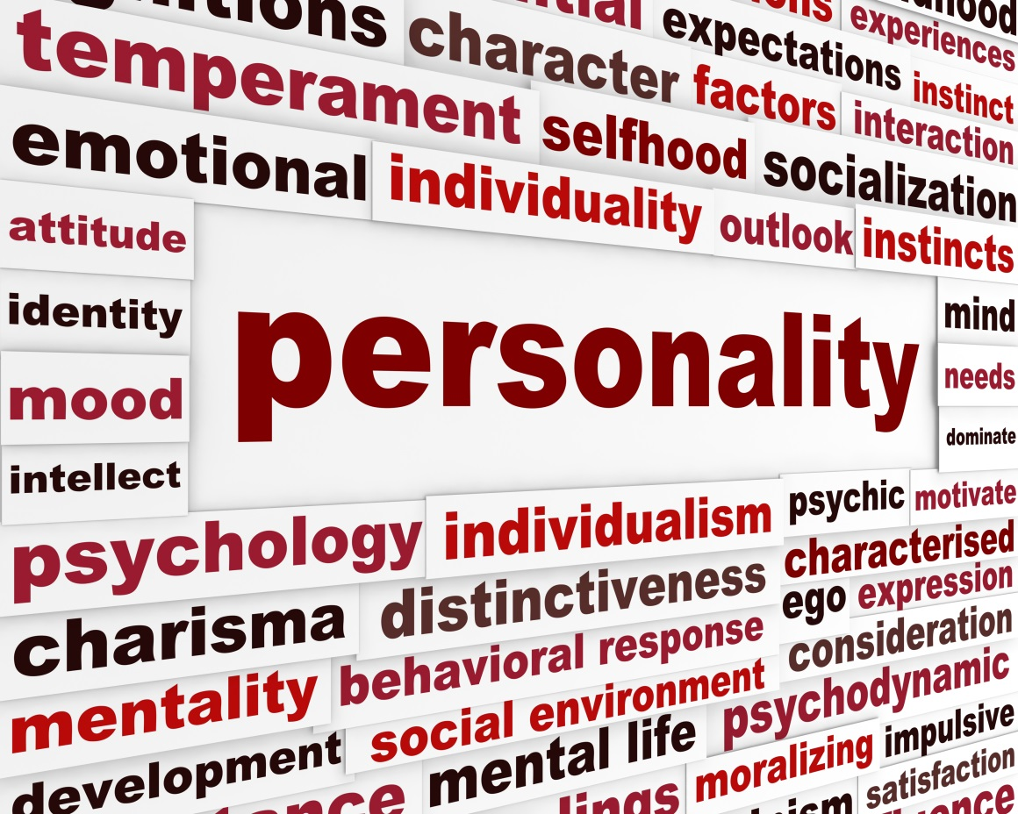
What is Personality Type?

Slide 106
Personality Type
We are born with certain preferences that we develop over a lifetime.
Each person is different and unique just like fingerprints or snow flakes.
Knowing your personal strengths will increase self-understanding and help you make a good choice of a major.

Slide 107

Personality Assessment (DWYA)
Use your access code to set up an online portfolio and take this assessment.
Your results are linked to matching careers.

Slide 108
Directions for the DWYA
Find a time when you are not tired or rushed.
There are no right or wrong answers.
Answer quickly giving your first impression. Do not over analyze.
You will have a chance to look at your profile and change it if you think it is not correct.

Slide 109
Directions for the DWYA
Answer the questions honestly to get the best results.
Answer the questions how you usually are when you are not stressed.
Do not answer the questions:
  How you want to be
  How you have to be at home, work or school
  How others want you to be

Slide 110
Important
There are no good or bad types. Each type has personal strengths that can be used in the workplace.
Answer the questions honestly to get the best results. If you don’t answer the questions honestly, the career suggestions will not be a good match for you.

Slide 111
Directions for DWYA
The test does not measure:
  Intelligence
  Psychological or emotional health
The DWYA assesses your personal strengths and matches them to possible careers.

Slide 112

Take the MI Advantage in Chapter 2
This assessment helps you to think positively about your abilities and connect them to careers. Answer the questions honestly for the best results.

Slide 113
Multiple Intelligences
Developed by Howard Gardner
Defined as the human ability to solve problems or design or compose things valued in at least one culture.
He selected these intelligences because they are all represented by an area in the brain that are valued in different cultures.

Slide 114


Slide 115
Multiple Intelligences
Measures 9 Elements of Intelligence
Musical: hearing and remembering musical patterns
Interpersonal: understanding other people
Mathematical: working with numbers
Spatial: manipulating objects in space
Bodily-Kinesthetic: using your body
Linguistic: using language
Intrapersonal: understanding yourself
Naturalist: understanding the environment
Existential: pondering the meaning of life and our place in the universe

