Slide 1
Introduction
Welcome to Class!
Welcome

Slide 2

Counseling 120
College and Career Success

Slide 3

Getting to Know You
Ice Breakers

Slide 4

Group Activity: What do I want from college?

Slide 5
Introduction

Slide 6
What is this course about?
Success
In Your Career
Chapters 1-4
In College
Chapters 5-9
In Your Personal Life
Chapters 10-14

Slide 7
Career success
Chapter 1: Understanding Motivation
Chapter 2: Exploring Your Personality and Major
Chapter 3: Exploring Multiple Intelligences, Interests, and Values
Chapter 4: Planning Your Education and Career

Slide 8
College success
Chapter 5: Managing Time and Money
Chapter 6: Using Brain Science to Improve Memory
Chapter 7: Using Brain Science to Improve Study Skills
Chapter 8: Taking Notes, Writing and Speaking
Chapter 9: Test Taking

Slide 9
Lifelong Success
Chapter 10: Communication and Relationships
Chapter 11: Thinking Critically and Creatively
Chapter 12: Maintaining a Healthy Lifestyle
Chapter 13: Appreciating Diversity
Chapter 14: Thinking Positively about the Future

Slide 10

What will you get out of this course?
Learning Techniques
Self Knowledge
Communication Skills
You will learn about yourself and apply knowledge to your career and personal life.
You will have a

Slide 11

You will get what you put into it.

Slide 12
Attendance is essential
Group discussions are an integral part of the class, you cannot participate if you are not here.
If you are absent (4) times you will be dropped from my roster. You must drop officially with Admissions. The deadline is April 24 in order to avoid a failing grade.

Slide 13

Recommended Materials
Notebook
Highlighter
Pens/pencils
Scantrons (3)

Slide 14

Textbook By
Marsha
Fralick

Slide 15
Who Should Take This Course?
Transfer Student
New Student
Undecided Students
Students Who Get Good Grades
Students Who Need to Improve Grades

Slide 16
Let’s at the
Syllabus

Slide 17
Grading
Chapter Journal Entries and Quizzes
Blackboard Assignments
Mid-Term Exams (2)
Final Exam
A B C D F

Slide 18


Slide 19
College Success Web Site
www.collegesuccess1.com

Slide 20

Course Credit
General education credit for California State Universities, Area E
Associate degree credit

Slide 21

Course Objectives
Read these on your own

Slide 22

Assignments
Read (or at least skim) the chapters to be covered before you come to class
We will read approximately one chapter per week

Slide 23


Contact me if you need help
VOICE MAIL
E-MAIL
IN PERSON

Slide 24

How to make the instructor happy

Slide 25

Arrive on time
However, better late than never!

Slide 26
Attendance is essential
You will be dropped for missing class.

Slide 27

Respect other students

Slide 28

Appreciate Differences
Culture
Race
Language
Academic Ability
Physical Disability
Lifestyle

Slide 29
Be prepared
Read the material before you
come to class. However,
come if you’re not prepared. You
will miss a great deal of material
if you are not here.

Slide 30
How to irritate the instructor and other students
Talking while another student is talking
Talking while the instructor is talking
Cell Phones

Slide 31
Academic Accommodations
Let me know privately if you have any disabilities so that I can provide assistance and understanding
  Learning disability
  Hearing or vision problems
  Health problems
  Other situations which may affect your academic performance

Slide 32
My Teaching Philosophy
Teach you and you will forget
Show you and you will remember
Involve you and you will understand

Slide 33

We will be using an electronic book
College and Career Success 5th Edition
by
Dr. Marsha Fralick
The electronic book is published by
HumanEsources under the name of:

Slide 34
Where do I find it?
www.collegescope.com/ccs/cuyamaca
Fee is $50.00
or
Cuyamaca College Bookstore
Fee is $65.00
Do not buy a paper textbook

Slide 35
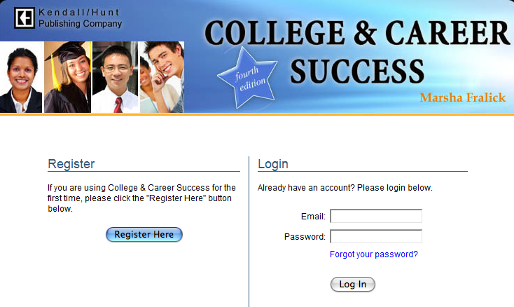
College Scope Registration
You can register for College Scope without paying

Slide 36
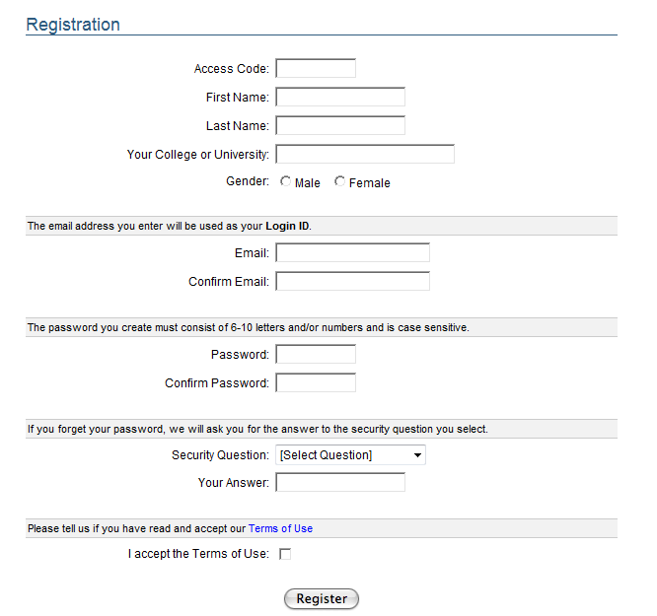
Fill out the registration page.
Remember the email and password you create.

Slide 37
After you register you will use the Login section to start College Scope.

Slide 38
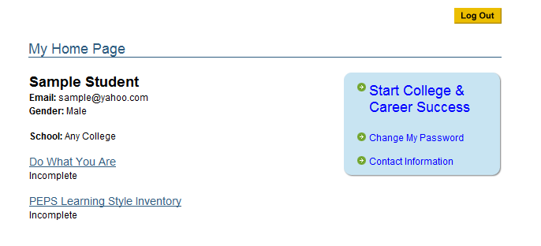
Your first assignment
Is a self assessment to see what you already know.
Just relax and answer the questions honestly.

Slide 39
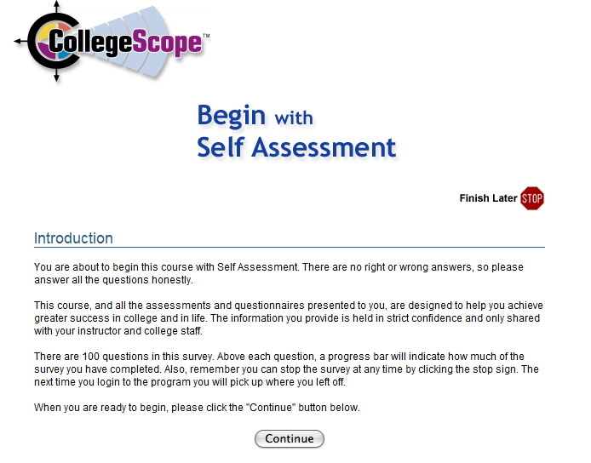
Read the Introduction

Slide 40
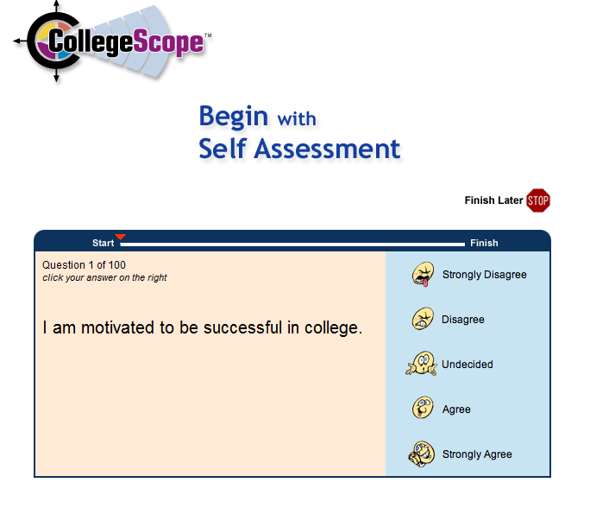
Sample Self Assessment Question

Slide 41
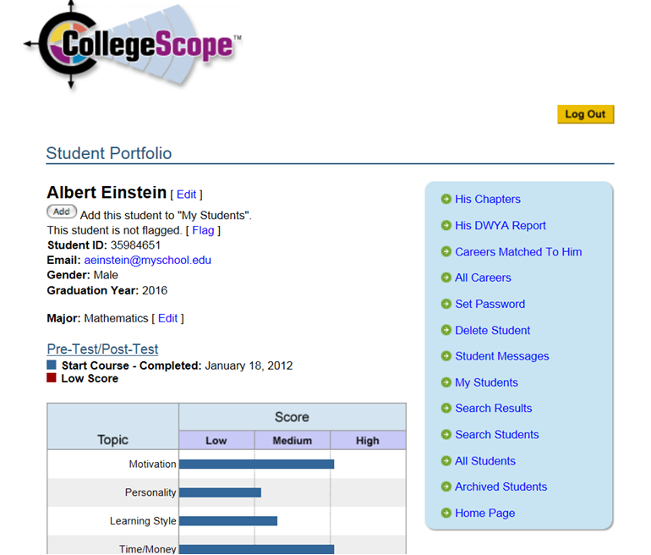
Once you have completed the assessment you can view your results under My Chapters in your portfolio page.

Slide 42
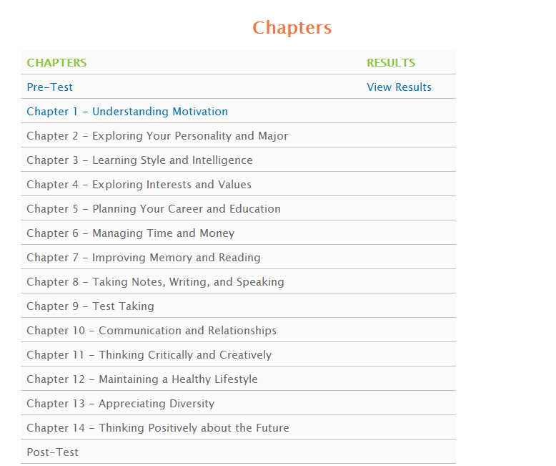
You can view you results here

Slide 43
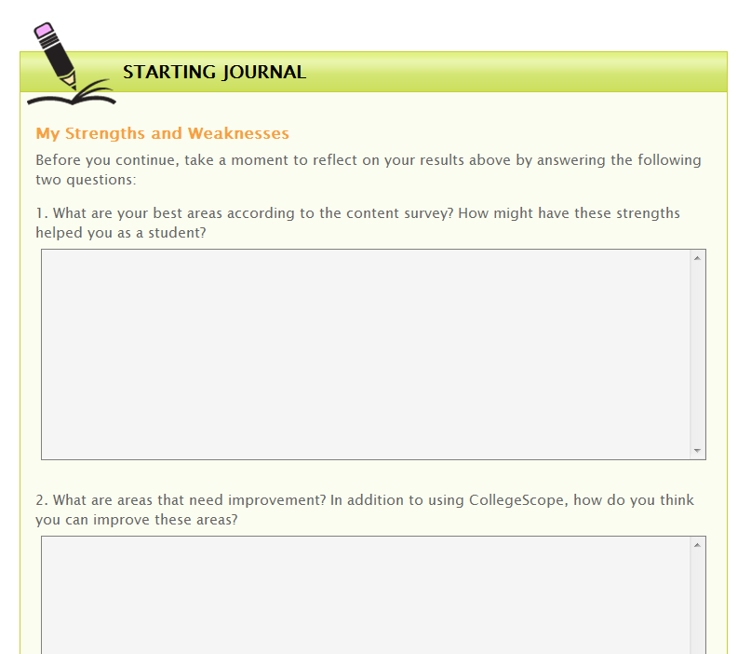
You will copy the two questions and turn in on Wednesday. See Blackboard 1st assignment

Slide 44
You may now begin Chapter 1

Slide 45
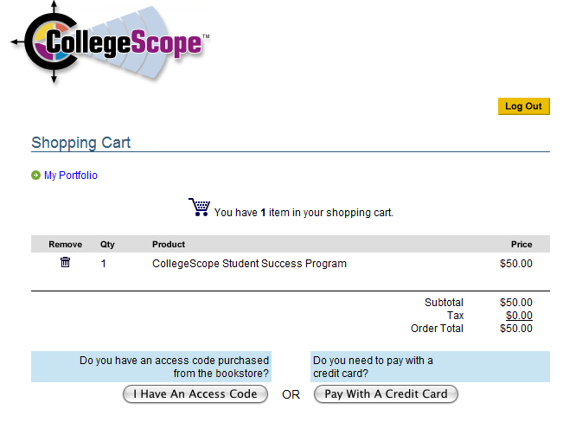
When do I Pay for College Scope?
You must pay before you start Chapter 2

Slide 46
You are now ready to begin
Chapter 2

Slide 47
Group Activity:
How to be an “A” student

Slide 48

Assignment:
Measure Your Success
SucceWheel

