Slide 1
Planning Your Career and Education
Chapter 4

Slide 2

Keep Your Eyes on the Future
Stay informed about new developments that will affect your future.

Slide 3

Career Trends 2024-2030

Slide 4
Artificial Intelligence (AI)
Benefits
Increased productivity
Improved healthcare
Increased access to education
New careers
Challenges
Some careers will be eliminated
Greater automation in all careers

Slide 5
Artificial Intelligence and Careers
AI will create more jobs than it replaces
Important to acquire skills in AI to keep up with new and changing careers
People skills such as collaboration, teamwork, communication, time management and adaptability will become more important as careers adapt to AI

Slide 6

New High Paying Careers
AI will create many new careers that pay over $100,000 a year.

Slide 7

Flexibility and Working from home
Teleworking
Using smart phones to do some work at home
Virtual Collaboration
Using Zoom, Skype and other tools
New Media
Required for job success

Slide 8

Diversity
Productivity and profits are increased when a diverse group of people feel appreciated and work together.

Slide 9
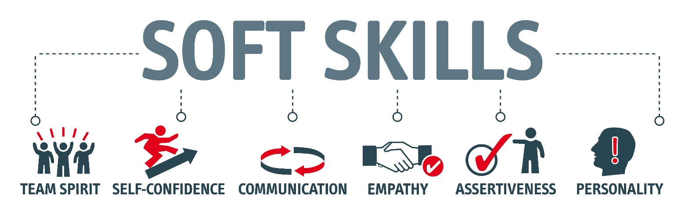
Preference for Soft Skills

Slide 10

Careers of the Future: Business
Finance
Investments
Taxes
Entrepreneurship and small businesses
E-commerce

Slide 11

Going Green!
Efficient use of energy
Renewable sources of energy
Preserving the environment

Slide 12

Environmental Science
Conserve water
Control pollution
Manage global warming
Produce food

Slide 13
Energy Shortages
Recycling
Alternative energy
Concerns about global warming and climate change

Slide 14


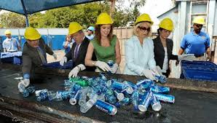
Going Green!
As fossil fuels are depleted, look for more:
  Wind turbines
  Solar panels
  Biofuels
  Emphasis on sustainability
  Taking care of the environment

Slide 15

Green Jobs
Environmental lawyer
Green architect
Sustainability consultant
Marine biologist
Environmental technician
Energy efficiency specialist
Organic farmer
Compliance manager
Product engineer
Wind energy engineer
Solar Engineer

Slide 16

Higher Earnings in STEM Occupations

Slide 17

Research
Engineering
Chemistry
Engineering
Biology
Biotechnology
Requires advanced degrees

Slide 18

Technology
Information and technology workers are the largest group of workers in the U.S.

Slide 19

Mismatch between workers and jobs
More workers needed in scientific and technical fields

Slide 20
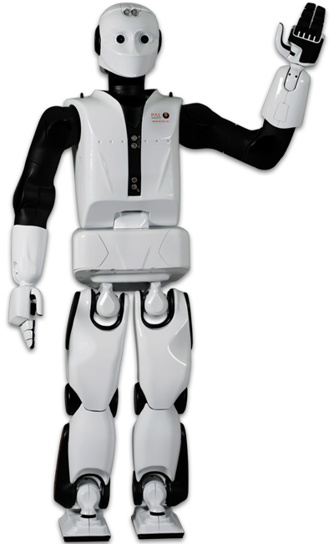
Automation
Robots will do the work
Engineers and technicians will be needed to design and maintain the robots

Slide 21
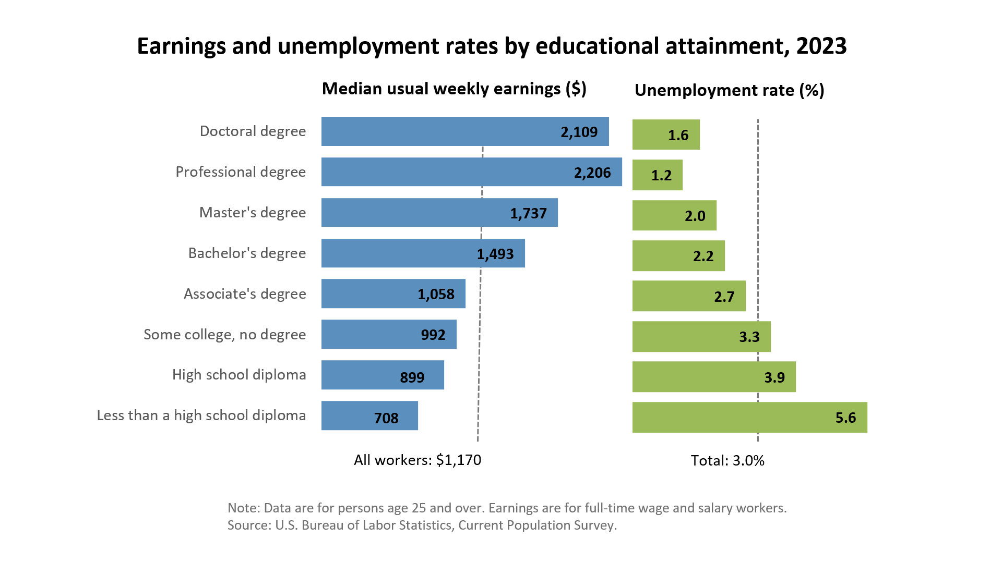
Increased Need for Education

Slide 22
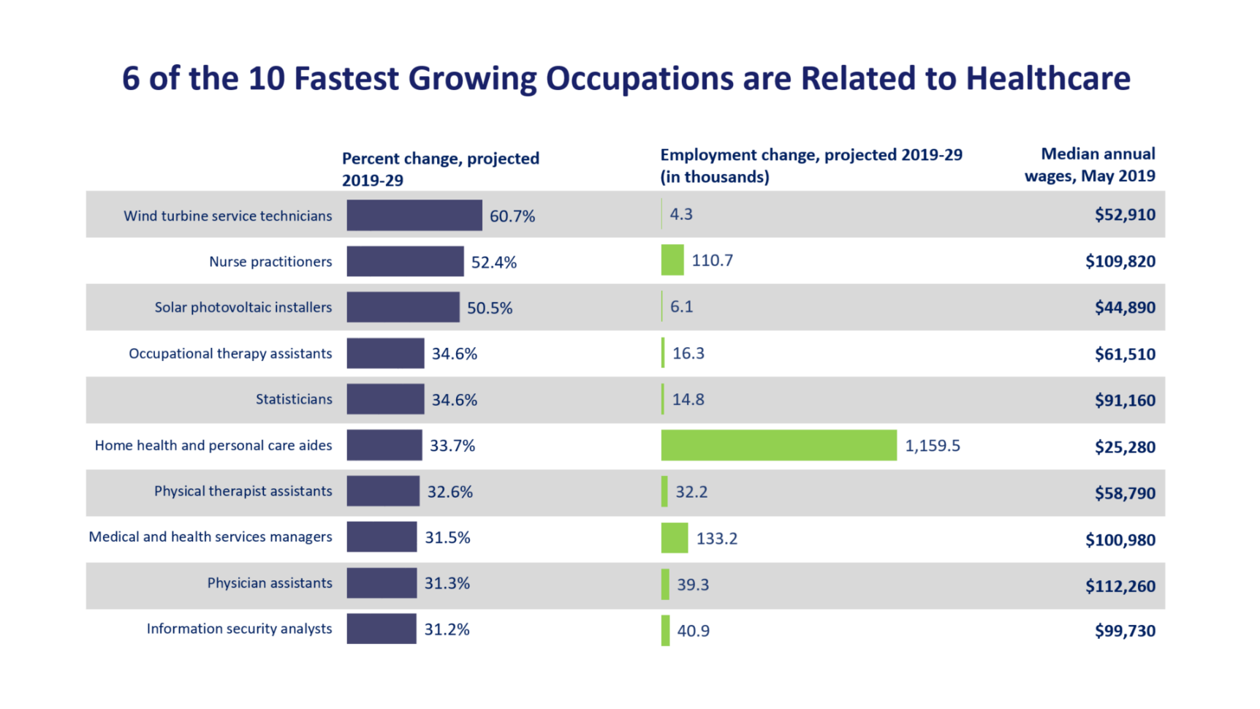
Increasing Opportunities

Slide 23


Largest Numerical Openings
Registered nurses
Home health aides
Customer services rep
Food preparation workers
Personal and home care aides
Retail salespersons
Office clerks
Accountants and auditors
Nursing aides, orderlies
Postsecondary teachers

Slide 24

Increased Opportunities in Healthcare
Most of the new jobs will be in healthcare.

Slide 25
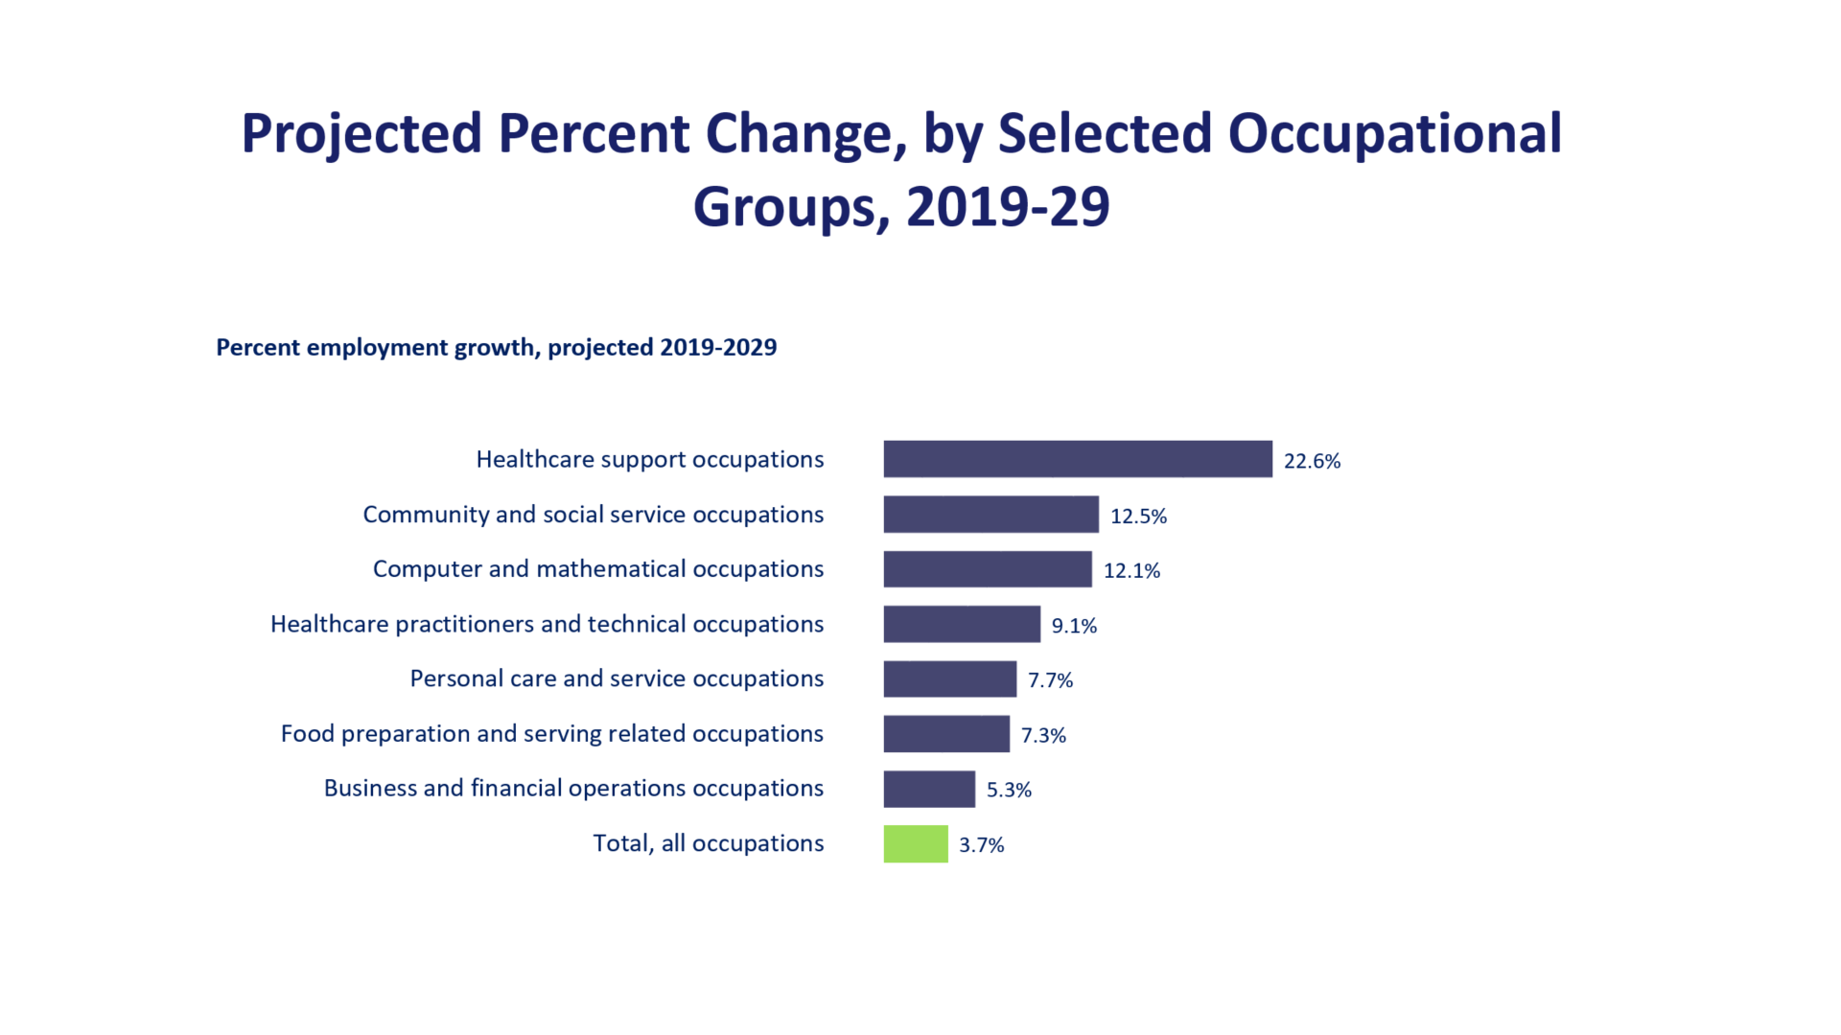
Employment Growth

Slide 26

Service Occupations in Demand
Health Care
Business
Education
Finance
Insurance
Real Estate
Transportation
Communication

Slide 27

Mental Health
Because of increasing violence, we are starting to realize the importance of mental health

Slide 28
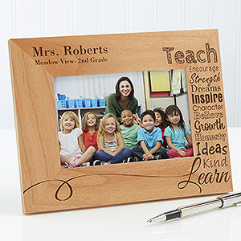
Teaching
As older teachers retire, there will be an increasing need for teachers.

Slide 29

Security
Law enforcement
Intelligence
Forensics
International relations
Foreign affairs
Security administration

Slide 30

Top Jobs for the Future
Business
Education
Entertainment
Health
Information Technology
Travel/Transportation
Law/Law enforcement
Services
Sports and related
Technology
Trades

Slide 31
10 Highest Salary Increase
Management Scientific, Technical
Physicians
Computer Systems design
General merchandise stores
Employment Services
Local government
Home health care services
Services for elderly and disabled
Nursing care facilities
Full-service restaurants

Slide 32
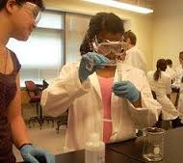

Top Paying Jobs
Require math and science
Chemical engineering
Computer engineering
Occupational therapy
Electrical engineering
Aerospace engineering
Computer science
Civil engineering
Nursing
Environmental engineering
Construction management
Physics
Economics

Slide 33

The TruTalent Skills Assessment
Rate Your Skills for Success
In the workplace

Slide 34


Basic Skills Required
Reading
Math
Writing
Listening
Speaking
Computers

Slide 35

Thinking Skills
Creative Thinking
Decision Making
Problem Solving
Mental Visualization
Knowing How to Learn
Reasoning

Slide 36

Personal Qualities
Responsibility
Self-esteem
Sociability
Self-management
Integrity and Honesty

Slide 37

How to Research Your Career

Slide 38

Career Description
Nature of the work
Working conditions
Training
Qualification
Advancement

Slide 39

The Career Outlook
Salary
Availability of employment
Will this career exist in the future?
Career outlook information is available in your assessment results

Slide 40

To Research Your Career
Use the search tools in your assessment results
Visit the Career Center
Use the library
Use AI to research career information

Slide 41

Planning Your Education
Vocational Certificate?
Associate Degree?
Bachelors Degree?
Masters Degree?
Doctorate Degree?
Professional Degree?

Slide 42

Degrees
Associate of Arts Degree 2 years
Bachelor’s Degree 4 to 5 years
Teaching Credential BA + 1 year
Master’s Degree BA + 2 years
Law Degree BA + 3 years
Professional Degree BA + 4 to 5 years

Slide 43

How Many Units Do I Need to Graduate?
1-29 units Freshman
30-59 units Sophomore
60-89 units Junior
90+ units Senior
Total number of units for graduation depends on the university and major

Slide 44

Develop and Educational Plan
It is the roadmap to your future.

Slide 45
Steps in Planning Your Education
Assess
1
Take English the first semester
2
Start math classes early
3
Take general education
4
Prepare for your major
5

Slide 46

For Your Success
See a counselor or adviser
Develop an educational plan

Slide 47

Writing a Resume

Slide 48
Your Resume
A snapshot of your education and experience
Usually one page

Slide 49
Resume
Contact information
  Name
  Address
  Telephone
  E-mail

Slide 50
Resume
Career Objective
Education
Experience
Special skills, honors, awards
References

Slide 51

Good Resume
Write clearly
Be brief
Be neat
Be honest
Print professionally or post online
Your resume represents you!

Slide 52

Letters of Reference
Ask for letters of reference from your current employers and professors. Keep them on file.
Ask for endorsements on LinkedIn.
Use them to apply for jobs and scholarships.

Slide 53
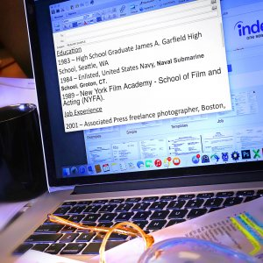
Online Resumes
Many jobs today will be posted on the Internet and will require online resumes.

Slide 54

The Cover Letter

Slide 55
Cover Letter
List the job.
Briefly state how your education and experience would be an asset to the company.
Ask for an interview.
Attach your resume.

Slide 56
Assignment
Complete a resume and cover letter for your ideal job.
Assume you have graduated from college and are applying for that job that motivated you to finish college.

Slide 57

Establishing Your Personal Brand Online

Slide 58

Personal Branding
Through the use of social media, you can use this concept to market your strengths to potential employers and to find a satisfying career.

Slide 59
Personal Branding
Define your brand.
What are your passions, goals, and personal strengths and how can they be used in the job market?

Slide 60
Personal Branding
Manage your online presence.
Beware of materials like these:
Photos or references to drug or alcohol abuse
Discriminatory comments on race, religion or gender
Negative comments about previous employers
Poor communication skills (grammar and spelling)

Slide 61
Personal Branding
Set up a nameplate website.
About.me
Sites.google.com
These are free.

Slide 62

Using Online Tools
Top sites:
LinkedIn
Facebook

Slide 63
Using Online Tools
Classified Ads
careerbuilder.com
Job Search Engines
  Indeed.com
Employment agencies
Using email to find a job

Slide 64

The Job Interview

Slide 65
First Learn About the Job
Library
Personnel Office
Friends and Contacts
Web Site

Slide 66

Interviewers Look For:
Enthusiasm and commitment
How you can be an asset to the company
How you can work as part of a team

Slide 67

Make a Good Impression
Dress appropriately.
Relax.
Anticipate interview questions.
Smile and introduce yourself.
Maintain eye contact.

Slide 68
Some Interview Questions
Tell us about yourself.
Why do you want this job?
Why are you leaving your present job?
What are your strengths and weaknesses?
Tell us about a difficulty or problem you solved on the job.

Slide 69
Interview Questions
Tell us about one of your achievements on the job.
What do you like best about your job?
What do you like least?
Are there any questions you would like to ask?

Slide 70

Write a thank you note.
It makes a good impression.
It causes the interviewer to think about you again.

Slide 71
Interview Worksheet
1. Answer the questions in 5 minutes.
2. Practice the questions with your partner.

Slide 72
Keys to Success:
Life is a Dangerous Opportunity

Slide 73
The Chinese Word for Crisis Has Two Characters:
Danger
Opportunity

Slide 74
What is the danger?
What is the opportunity?

Slide 75

Every adversity has the seed of a greater benefit or possibility.

