Slide 1
Thinking Critically and Creatively
Chapter 11

Slide 2
“The function of education is to teach one to think intensively and to think critically. Intelligence plus character—that is the goal of true education.”
Martin Luther King, Jr.

Slide 3


Critical thinking is needed to solve the complex problems in the world today.

Slide 4
For example:
“Now that I look back, I realize that a life predicated on being obedient and taking orders is a very comfortable life indeed. Living in such a way reduces to a minimum one’s own need to think.”
--Adolph Eichman who played a central role
in the killing of six million Jews

Slide 5
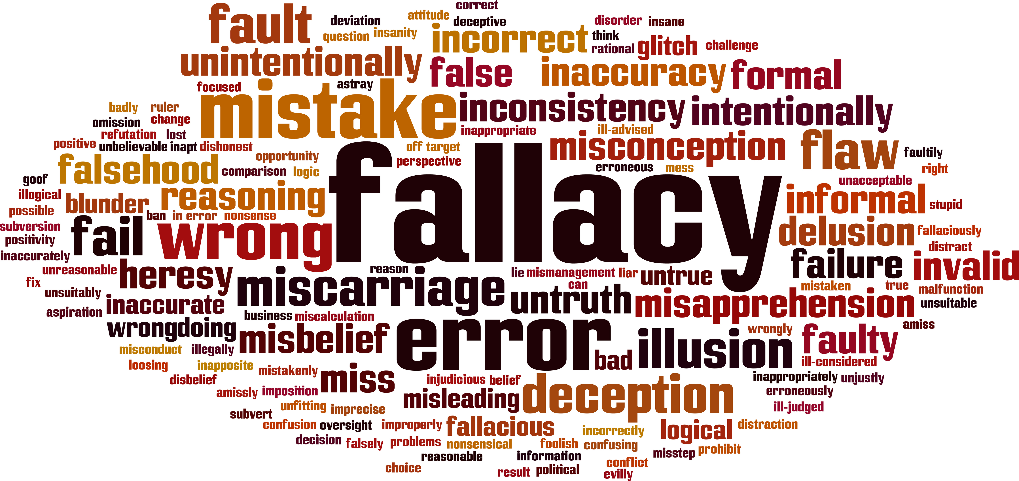
Fallacies in Reasoning
Patterns of incorrect reasoning

Slide 6
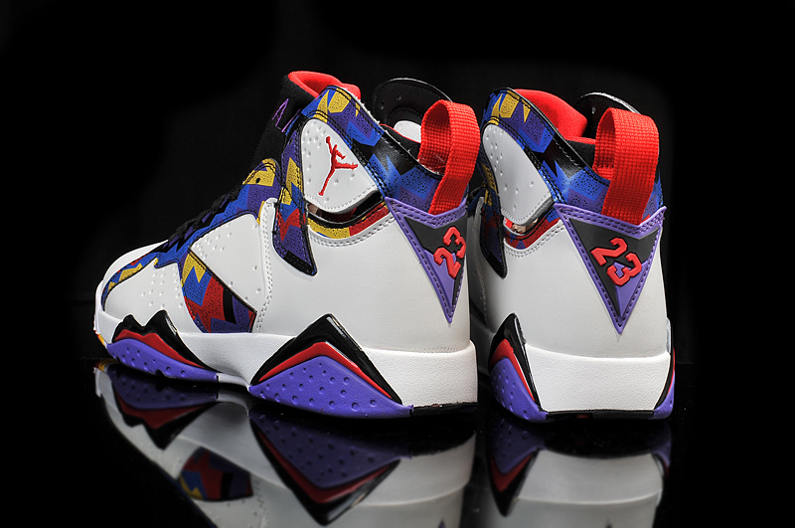
Appeal to A Questionable Authority
Example: Using sports figures to endorse products

Slide 7
Jumping to Conclusions
A hasty generalization
Example: One college student does not pay back a loan. The bank manager concludes that students are poor risks for loans.

Slide 8
Making Generalizations
Assume all members of the group are the same
Example: All lawyers are greedy.

Slide 9
Attacking the Person
We attack the person rather than discussing the issue.
Example: Attacking a politician to sidetrack the issues

Slide 10
Appeal to Common Belief
Just because it is common belief does not make it true
Example: At one time people believed that the world was flat.

Slide 11
Common Practice
If everyone does it, it must be OK
Example: It’s OK to cheat on your taxes. Everyone else does.

Slide 12
Appeal to Tradition
We’ve always done it that way.
Example: Some jobs are only for men and others only for women.

Slide 13
Two Wrongs
It is OK to do something wrong because other people do it.
Example: Someone cuts you off on the freeway, so you pull in front and cut them off.

Slide 14
Slippery Slope
Dire consequences
Example: If you fail this class, you are a failure for life.

Slide 15
Wishful Thinking
An extremely positive outcome is proposed to distract from logic.
Example: Get rich quick schemes

Slide 16
Appeal to Fear or Scare Tactics
Emotions interfere with rational thinking.
Example: Political advertisements that describe dire consequences

Slide 17
Appeal to Pity
Again, emotions replace logic.
Example: Sob story

Slide 18
Appeal to Loyalty
Group behavior, right or wrong
Example: Voting for the candidate who appears most popular

Slide 19
Appeal to Prejudice
A stereotype in which all members of a group are judged to be the same
Example: racial prejudices

Slide 20
Appeal to Vanity
Making compliments
Example: “Apple polishing”

Slide 21
Post Hoc Reasoning or False
Causes
Cause and effect are not related.
Example: Superstitions

Slide 22
Straw Men or Women
Create an image of someone else, like a scarecrow, to discredit the person.
Example: Political speeches which
paint the opponent in an unfavorable
light

Slide 23
Cult Behavior
Beliefs for which hard evidence is lacking
Example: cults and conspiracy theories
The opposite of critical thinking
Blindly following a charismatic leader
Belonging to a group

Slide 24

Critical Thinking out of the Box
In the following line of letters, cross out six letters so that the remaining letters, without altering their sequence, will spell a familiar English word.
BSAINXLEATNTEARS

Slide 25

Exercise
What letter is missing?
Does it go on the top or bottom line?
Why?
A EF HI KLMN T V WXY
BCD G J OPQ RS U

Slide 26

The Scientific Method
Question
Research
Hypothesis
Experiment
Data/Analysis
Conclusion
Notes:
Marsha
One of the topics in the news recently is trust or lack of trust in science. It is helpful to understand some of the basics of the scientific method.

Slide 27

Cognitive Biases
These systematic errors in in thinking are shortcuts the brain makes to quickly make sense of what is happening in the world.
Notes:
Marsha
Brief overview

Slide 28
Cognitive Biases
The Dunning-Kruger Effect
The less you know, the more you think you know
Confirmation Bias
Following only the evidence that confirms your own beliefs
Self-serving Bias
Blame your failures on someone else.
Overconfidence Bias
Using only one source
Groupthink
Adopting the opinions of a group
The Status Quo
Resistance to change
Notes:
Alternate
Marsha
Seth

Slide 29
Critical Thinking Over the Internet
Beware of appearances.
What is the source?
Why was the information posted?
What is the date of the Web site?
Can the information be verified elsewhere?

Slide 30
Beware of Scams
It’s too good to be true.
There is a rush to make a decision.
You have to pay money or give your credit card number.
High pressure, time limits
Prizes and big promises
The word “free”

Slide 31
How to Become a Critical Thinker

Slide 32
Universal Standards to Assure Quality Thinking
Clarity
Accuracy
Precision
Relevance
Depth
Breadth
Logic
Fairness

Slide 33

Alternative Views

Slide 34
The Critical Thinking Process
State the problem in a clear way
Identify the alternative views
Watch for fallacies in reasoning and biases
Find at least 3 different answers
Construct your own reasonable view

Slide 35
Exercise: Critical Thinking

Slide 36
Tips for Critical Thinking
Beware of your mind-set.
Be willing to say, “I don’t know.”
Practice tolerance.
Understand different points of view.
Understand before criticizing.
Emotions get in the way of clear thinking.
Examine the source.

Slide 37

Questions for Critical Thinkers
Who said it?
What makes the author think so?
So what?

Slide 38

Critical Thinking and Moral Reasoning

Slide 39
Level 1: Pre-Conventional Morality
Obedience and punishment:
Heinz should not steal the drug because it is against the law.
Heinz should steal the drug because the pharmacist is asking too much money for it.

Slide 40
Level 1: Pre-Conventional Morality
Individualism and exchange:
Heinz should not steal the drug because he will be unhappy if he goes to prison.
Heinz should steal the drug because he will be happier if he can save his wife.

Slide 41
Level 2: Conventional Morality
Interpersonal relationships:
Heinz should not steal the drug because stealing is bad and he is not a criminal.
Heinz should steal the drug because he is a good husband and wants to take care of his wife.

Slide 42
Level 2: Conventional Morality
Maintaining social order:
Heinz should not steal the drug because the law prohibits stealing. If everyone broke the law, there would be no order in society.
Heinz should steal the drug, but be prepared
to accept the punishment and repay the druggist.

Slide 43
Level 3: Post-Conventional Morality
Social contract and individual rights: Heinz should not steal the drug because a scientist has a right to fair compensation which encourages new research.
Heinz should steal the drug because
everyone has the right to life, regardless
of the law.

Slide 44
Level 3: Post-Conventional Morality
  Universal principles:
  Heinz should not steal the drug because others may need the drug just as badly and all lives are equally important.
Heinz should steal the drug because saving a human life is more important than property rights.

Slide 45
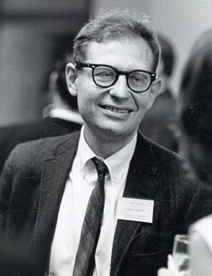
What resolution does Kohlberg suggest?

Slide 46
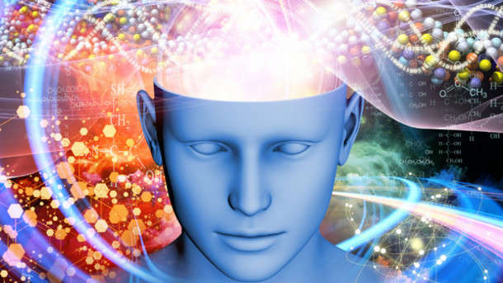
Creative Thinking

Slide 47
Creative thinking is part of the critical thinking process. Use it for:
Generating alternatives
Thinking of possibilities
Creative problem solving
Creating new ideas
Using more of your potential

Slide 48
The Creative Individual
Asks, “Why?”
Is curious about the world
Looks at many possibilities or alternatives (divergent thinking)

Slide 49
The Three S’s of Creativity
S's
Sensitivity
Synergy
Serendipity

Slide 50
Creativity Techniques
Sensitivity
Uses the senses to discover the world
Asks, “Why does this happen?”
“How can I do this?”
Problem finders as well as problem solvers

Slide 51
Creativity Techniques
Synergy
Two or more elements are associated in a new way and the result is greater than the sum of the parts.
Example: “Two heads are better than one.”

Slide 52
Creativity Techniques
Serendipity
Unexpected discoveries
Lucky accidents
Some examples . . . .

Slide 53
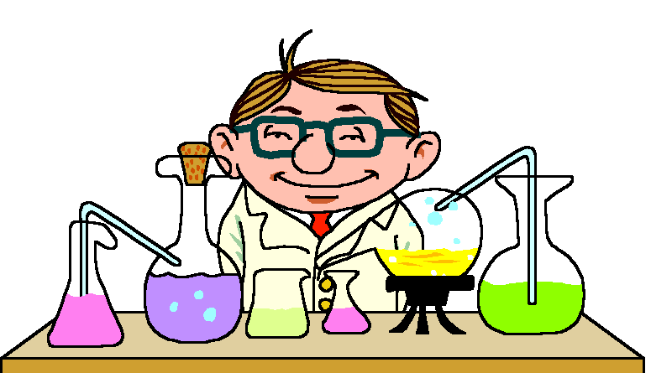
Serendipity
Remember Alexander Fleming?

Slide 54

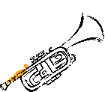
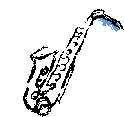


Serendipity: Duke Ellington

Slide 55

Creative Thinking Techniques

Slide 56
Brainstorming
Quantity without regard
to quality as a first step
Time limit
Goal or quota
Wild and unusual is good
Use synergy by doing it in a group
Use fantasy and imagination
Select the best ideas as a last step

Slide 57
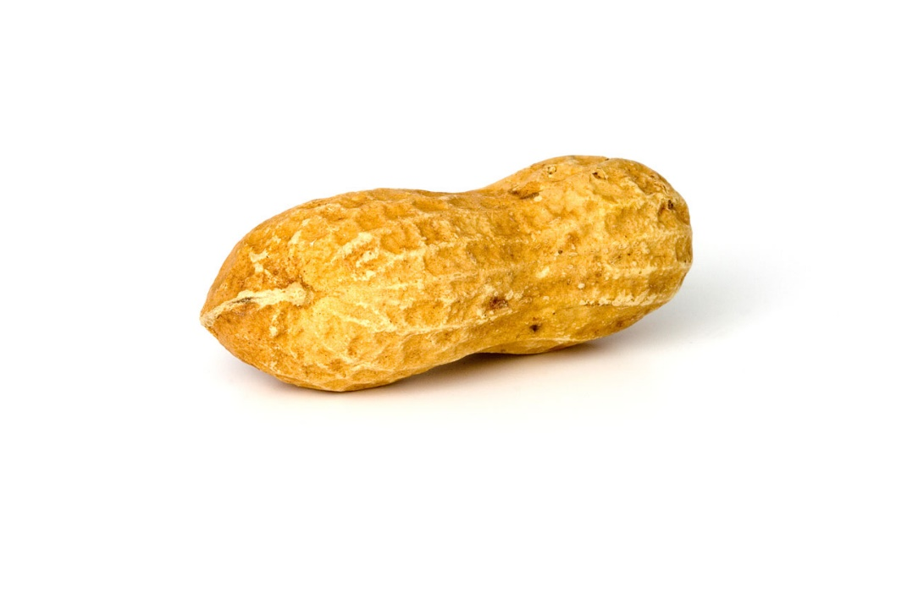
Brainstorming Exercise:
The Peanut

Slide 58
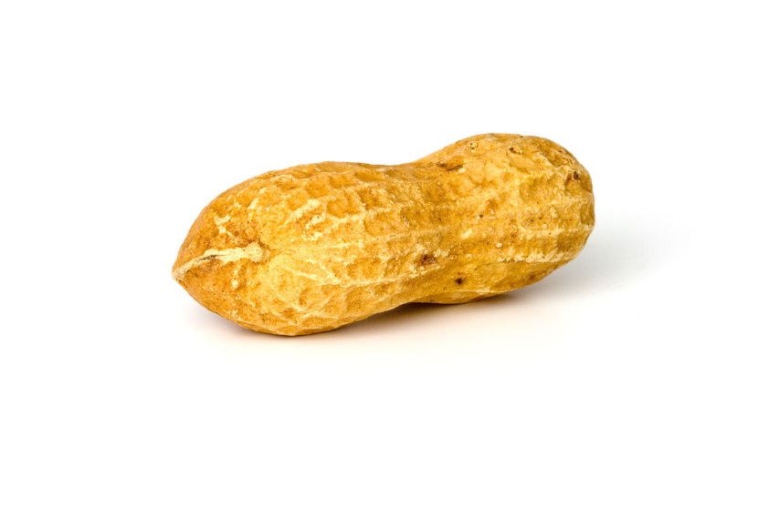
Look at your peanut.
How is this peanut like you?

Slide 59

Can you come up with 10 answers in 3 minutes?

Slide 60
Let’s hear your creative ideas.

Slide 61
How is this peanut like you?
It’s wrinkled, like me.
It’s brown, like me.
It cracks under pressure.
What you see is not always what you get.
Everyone is different.
It just sits in class.

Slide 62
How is this peanut like going to college?
Let’s use some synergy and work together on this one.

Slide 63
How many answers can we come up with in 5 minutes?
You can build on other people’s ideas.

Slide 64
How is this peanut like going to college?
There are 2 nuts inside. One is the teacher and one is the student.
We’re all nuts to a degree!
College drives me nuts!
It’s rough.
We both went to class today.

Slide 65
Elements of Creativity
Use the pressure of a time limit.
Use a goal or quota.
Be relaxed.
Suspend judgment.
Focus your attention.
Have fun with it.
Use a different perspective.

Slide 66

More Techniques

Slide 67
Relaxed Attention
The paradox of:
  Ho-hum
  Aha!
Relax and then focus.

Slide 68
Relaxed Attention
Think about it.
Relax and let it incubate.
The creative inspiration is the aha!

Slide 69
Use Relaxed Attention in Studying
If you get stuck on a problem, relax and come back to it later.
You are likely to come up with a creative inspiration while relaxing.
Come back to the problem and solve it.

Slide 70
Idea Files
Ideas you find interesting
Can you think of examples?

Slide 71
Visualization and Imagination
Useful for:
Memory
Relaxation
Creativity

Slide 72
Exercise:
Using Visualization and Imagination

Slide 73

Can you make the light go on?

Slide 74
More Creativity Techniques
Read
Keep a journal
Think critically

Slide 75
Sum: Acquiring Wisdom and Knowledge
Creativity
Curiosity
Love of learning
Open-mindedness
Perspective

Slide 76

Keys to Success:
Learn to Laugh at Life

Slide 77
Have a laugh at life and look around for happiness instead of sadness.
--Red Skelton

Slide 78

If you do not feel happy, smile and pretend to be happy.
Smiling produces serotonin which is a neurotransmitter linked with feelings of happiness.

Slide 79
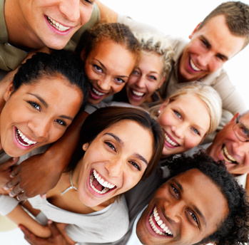
So, smile and be happy. Use your creativity to make some positive changes in your life.

