Slide 1
Communication and Relationships
Chapter 10

Slide 2


What is your personal communication style?

Slide 3


Extrovert
Social types
Start conversations easily
Energized by talking to people
Find it easy to start a conversation or ask someone for a date
In conflict situations, they talk louder and faster

Slide 4

Introvert
Rehearse what they are going to say before they say it
Need quiet for concentration
Enjoy peace and quiet
Often labeled as “quiet” or “shy”
Find it difficult to start a conversation or ask someone for a date
Withdraw from conflict situations to think it over

Slide 5
To improve communication, extroverts need to:
Pause to give the introvert time to think.
Avoid monopolizing the conversation.

Slide 6
To improve communication, introverts need to:
Make an effort to communicate.

Slide 7
Communication
An introvert and an extravert are having an argument.
How is the introvert likely to act?
How is the extravert likely to act?
How can they improve communication?

Slide 8
Sensing Types
Are practical and realistic
Like communication that is exact and step by step
Want concrete answers
Like to get to the point
Will describe a date in terms of actual experience

Slide 9
Intuitive Types
They look at possibilities and relationships
They are often ingenious and creative
They start imagining what the date will be like before it even happens
Talk about dreams, visions, beliefs and creative ideas

Slide 10
Sensing and Intuitive Types
Sensing types need intuitive types to bring up new possibilities, deal with changes and understand different perspectives.
Intuitive types need sensing types to deal with facts and details.

Slide 11
Communication
A sensing and intuitive type are on a date.
What is the sensing type likely to talk about?
What is the intuitive type likely to talk about?

Slide 12
Feeling Types
Prefer to avoid disagreements to preserve peace and harmony
In a conflict situation, they take things personally

Slide 13
Thinking Types
Are logical, detached and objective
In a conflict situation, they use logical arguments to prove that they are right

Slide 14
Feeling and Thinking Types
Feeling types need thinking types to analyze, organize, follow policy and weigh the evidence.
Thinking types need feeling types to understand how others feel and to establish harmony in the family and business environments.

Slide 15
Communication
A thinking type and a feeling type are having a problem with their relationship.
How is the thinking type likely to approach the problem?
How is the feeling type likely to approach the problem?
How can they improve communication?

Slide 16
Judging Types
They need events to be structured and organized in order to relax.
They make decisions quickly and do not like to change them.
They schedule and plan dates.
When traveling, they make a list and pack carefully.

Slide 17
Perceptive Types
They prefer the environment to be flexible and spontaneous.
They like to keep their options open.
They provide the fun and find it easier to relax.
They often feel controlled by judging types.
When traveling, they are open to new ideas and pack their suitcases at the last minute.

Slide 18
Judging and perceptive types need each other.
Judging types need perceptive types to relax and have fun.
Perceptive types need judging types to be more organized and productive.

Slide 19
Communication
A judging type and a perceptive type are married. The judging type likes to keep the house neat and orderly. The perceptive type likes creative disorder.
How can they resolve their conflict?

Slide 20
Communication for Success

Slide 21

Problems in Communication
Just because a message was sent does not mean that it was received.

Slide 22

Problems in Communication
Message Overload
Worries and Anxiety
Rapid Thought
Being a Good Listener
Assumptions
Hearing Problems
Talking Too Much

Slide 23
How to Be a Good Listener

Slide 24

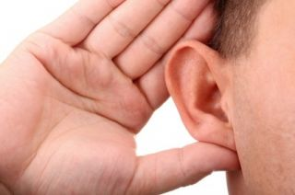
Hearing vs. Listening

Slide 25
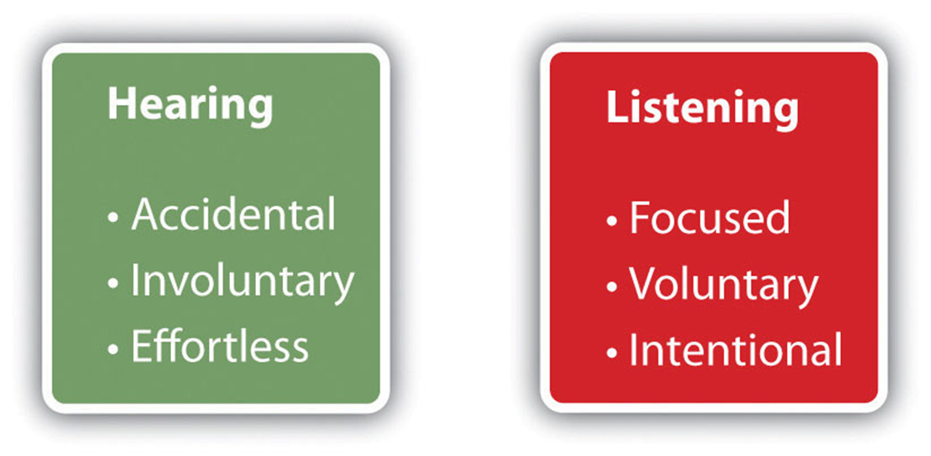
Hearing vs Listening

Slide 26
Talk Less

Slide 27
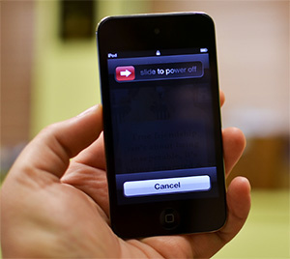
Minimize Distractions
Turn off the TV, music and phones. Focus on being a good listener.

Slide 28
Don’t Judge Too Soon
Understand first and then evaluate.
Put aside your mindset to hear and understand.

Slide 29
Listen for the Main Point

Slide 30

Ask Questions

Slide 31
Feedback Meaning
Speakers often:
  Say one thing and mean another.
  Say something and not mean it.
  Speak in a way that causes confusion.

Slide 32
How to Feedback Meaning
Restate what has been said.
Ask for clarification.
Reword the message to check understanding.
Listen for feelings.
Use your own words to rephrase the message to check understanding.

Slide 33
Exercise: Feedback Meaning

Slide 34
Tips for Good Listening

Slide 35
Let the person talk. Talking helps to clarify thinking.

Slide 36
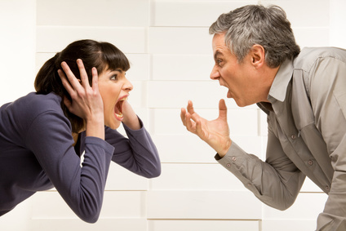
Avoid being critical. It causes anger that interferes with communication.

Slide 37
Share your experiences but resist giving advice.

Slide 38

Ask questions to clarify.

Slide 39

Be supportive. I am here if you need me.

Slide 40
Let people express their feelings.
It is not helpful to say,
“Don’t feel sad.”

Slide 41
Don’t minimize the situation. It’s only a _____.

Slide 42
Replace pity with understanding.

Slide 43
The Language of Responsibility. “I” and “You” Statements.

Slide 44

Example: You must be crazy!
What reaction do you get?

Slide 45
“You” statements:
Label and blame.
Demand rebuttal.
Cause negative emotions.
Escalate the situation.

Slide 46
“I” Statement:
Instead of: You must be crazy.
I don’t understand.

Slide 47
“I” Statements
You accept responsibility for yourself.
Better communication is possible.

Slide 48
Ways to Make an “I” Statement
Make an observation.
State your feelings.
Share your thoughts.
Say what you want.
State your intentions.

Slide 49
Example: Instead of “You’re a Slob!”:
Your things are all over the floor.
I get angry when I step over your things.
I think it is time to clean up.
Please pick up your things.
I will pay your allowance when your room is clean.

Slide 50
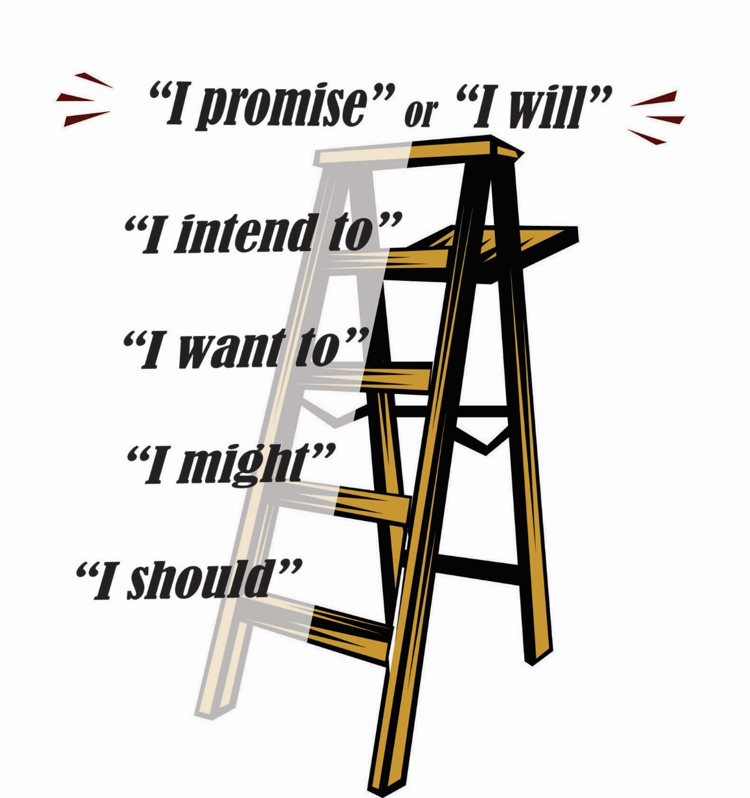
Ladder of Powerful Speaking

Slide 51
For example, if I loan you the money, will you pay it back?

Slide 52
I should pay it back.

Slide 53
I might pay it back.

Slide 54
I want to pay it back.

Slide 55
I intend to pay it back.

Slide 56
I promise to pay it back.

Slide 57
Will you marry me and be true to me?

Slide 58
I should.

Slide 59
I might.

Slide 60
You know, I really want to.

Slide 61
I intend to.

Slide 62
Yes, I do. I promise.

Slide 63
Will you finish your career paper on time? Be careful about the language you use.

Slide 64

Be Aware of Negative Self-Talk. Do You Recognize any of These?
I have to be perfect
I need the approval of everyone
That’s always the way it is.
You made me feel that way.
I’m helpless in this situation.
If something bad can happen,
it will happen. (Murphy’s Law)

Slide 65
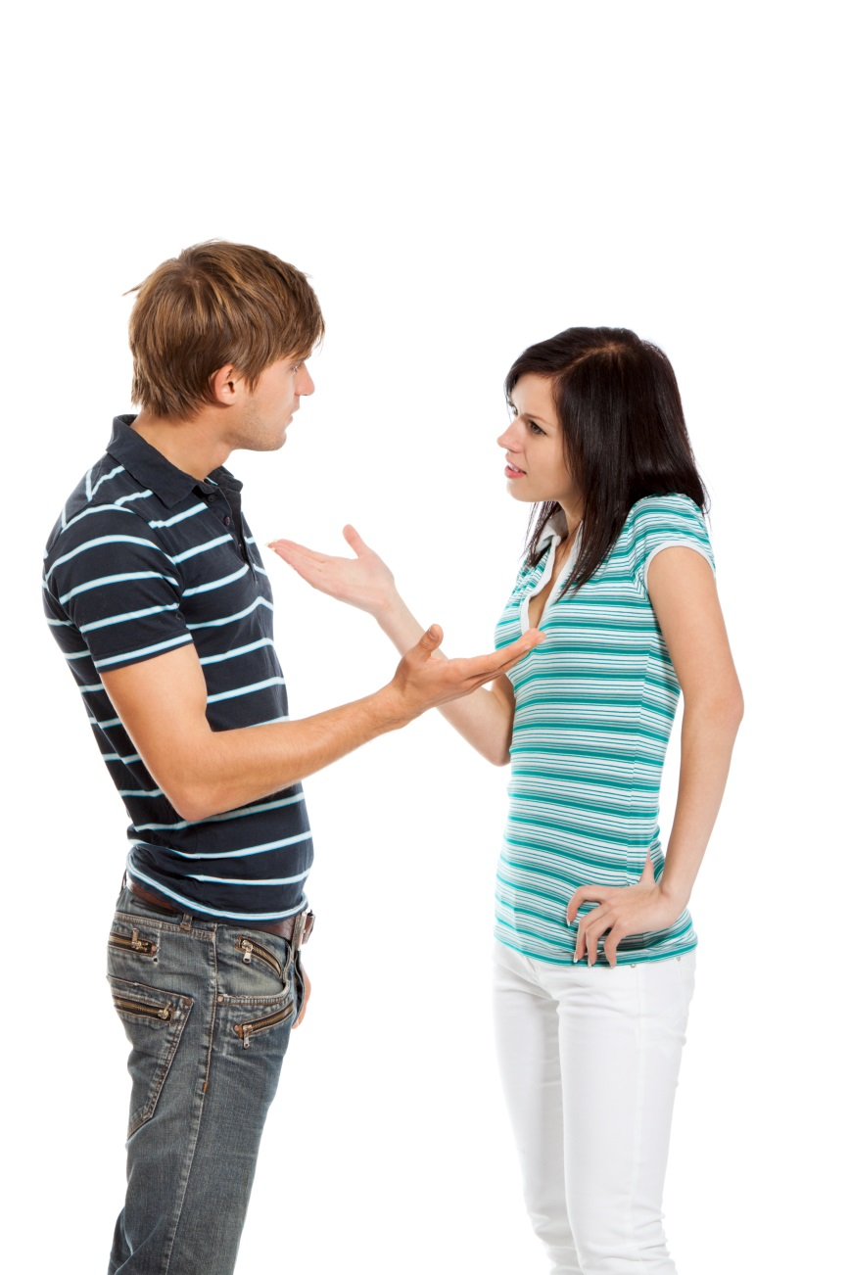
Barriers to Effective Communication
Criticizing
Name-calling or labeling
Giving advice
Ordering or commanding
Threatening
Moralizing
Diverting
Logical arguing

Slide 66
How to Approach a Conflict
Win-Lose
Lose-Lose
Compromise
Win-Win

Slide 67
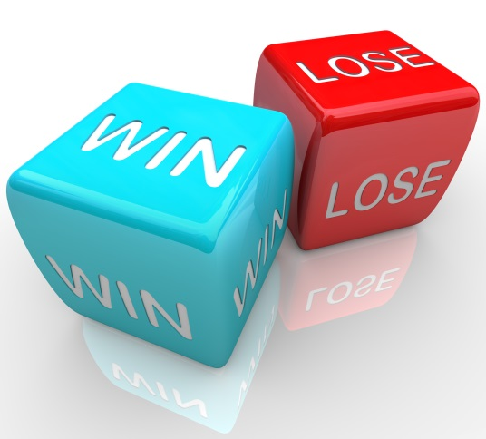
Win-Lose
One person wins and the other loses
Example: games and sports
Involves competition and power
There is only one winner.
What happens to the loser?

Slide 68
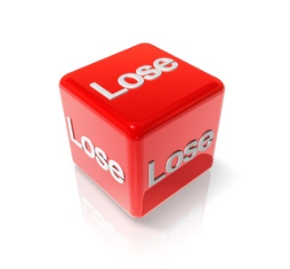
Lose-Lose
Both people lose
Fighting to the death
Example: wars, divorce
What is the result?

Slide 69
Compromise
Both parties in the conflict have some of their needs met
Example: Buyer and seller of a used car
As long as both are satisfied, the outcome is positive
Problems arise when people are asked to compromise their values

Slide 70

Win-Win
Both parties work together to find a solution in which both win.
There is no loser.

Slide 71

Steps in a Win-Win Solution
Identify the problem.
Set a good time to discuss the issue.
Describe your problem and needs.
Look at the other point of view.
Look for alternatives that work for both parties.

Slide 72
Group Discussion:
1. What are the qualities of a good friend?
2. What are the five most important qualities of a good relationship?

Slide 73
Surviving the Loss of a Relationship

Slide 74
Stages of Recovery from Loss
Shock or denial
Anger or depression
Understanding or acceptance

Slide 75
Suggestions for Recovery
It takes time.
It is OK to feel sad and cry.
Talk or write about it.
Take care of yourself.
  Get plenty of rest and eat well.
  Avoid addictive behaviors.
  Relax and exercise.

Slide 76

Keys to Success:
Failure is an Opportunity for Learning

Slide 77
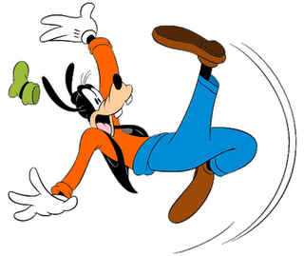
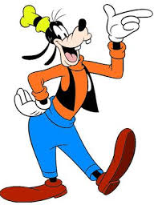
Falling down is not failure
Failing to get up is

Slide 78

F is for Feedback, not Failure.

Slide 79
Use the No Shame, No Blame Approach:
What went wrong?
How much damage was done?
How can I fix it?

Slide 80
Life is not a spelling bee. It is more like a baseball season. You have many opportunities to win.

