Slide 1


College Success Faculty Training
December 10, 2009
Lone Star College System
Dr. Marsha Fralick

Slide 2
Ice Breaker
Happiness is ____
We all know our friends and family make us happy. What else?

Slide 3
What are your goals for this workshop?
Think
Pair
Share

Slide 4
Overview
Resources for Faculty
Features
Research (brief)
Administering and interpreting the Do What You Are (DWYA) and Productivity Environmental Preference (PEPS) learning style inventory
Teaching New Millennial Students
Teaching Tips
Interactive activities

Slide 5
College Success 1
Resources for faculty and students
http://www.collegesuccess1.com/
Training Notes

Slide 6
Features

Slide 7

Keys to Success
The program helps students to make a good choice of a major and career.
Notes:
One of the keys to success of this program is that it helps students to make a good choice of a major and career. How do we do this?

Slide 8
Job Jar Activity

Slide 9

Statistically accurate
Valid and reliable
College scenarios are easy to read and understand.

Slide 10
Careers: A Key Component
Personality
Learning Style
Interests
Values
Career Research

Slide 11

Keys to Success
The program helps students to understand their learning style and how to become a lifelong learner.
Notes:
Another central theme is learning style. If students understand their learning style, it helps them to learn new and difficult material in college and throughout life.

Slide 12

Comprehensive
  20 factors affecting learning style
Helps students understand how they learn best

Slide 13
Keys to Success
At the end of each chapter
Inspiration
Positive thinking
For example:
  Life is a dangerous opportunity

Slide 14
Broad Scope
College success
Career success
Lifelong success

Slide 15

College Success
Motivation
Time and Money
Memory and Reading
Test Taking
Taking Notes, Writing and Speaking

Slide 16

Career Success
Personality and Related Majors
Learning Style and Intelligence
Interests and Values
Career and Educational Planning

Slide 17

Lifelong Success
Communication and Relationships
Critical and Creative Thinking
Maintaining a Healthy Lifestyle
Appreciating Diversity
Positive Thinking
Life Stages

Slide 18
Applied Psychology
From theory to practice
Academically rigorous, yet practical
Easy to read

Slide 19
Engaging Students in Learning
Interactive online format with journal entries, quizzes, activities, surveys, videos
Classroom exercises for engaging students in learning

Slide 20
Personalization
The text is the same for each student
CollegeScope is personalized for each student based on their personality type and learning style

Slide 21
Bridge
High School
Community College
University
Notes:
This course serves as a bridge from high school to community college to the university. Many of our local high schools offer the course in dual enrollment programs where students receive both high school and college credit. High school counselors and students see the course as valuable preparation for college.
The course helps students to persist in community colleges and to transfer to universities. In the San Diego area, the course has become an important part of transfer programs to the university. Most universities have college success programs to improve student success and retention.

Slide 22
Research

Slide 23
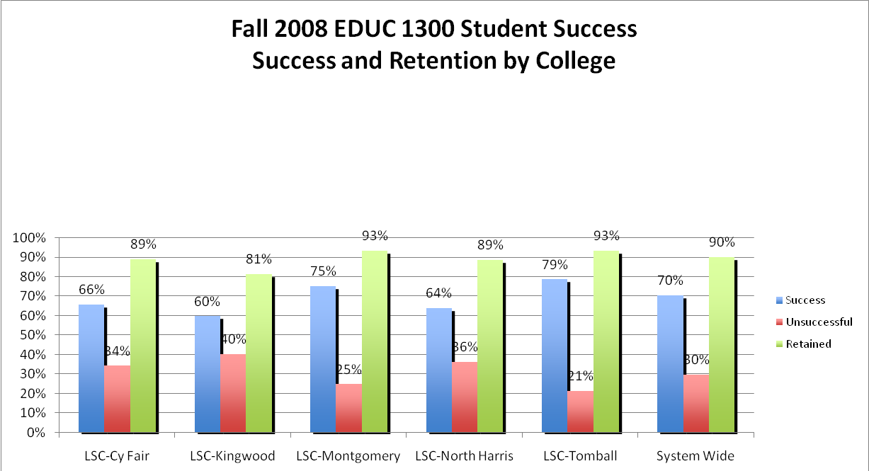
Lone Star College System Results

Slide 24
Lone Star College System
College | Persistence rate of students who were successful | Persistence rate of students who were unsuccessful | Persistence rate of those students that withdrew (W) | Persistence rate of all Student Types
LSC – CyFair | 94% | 52% | 78% | 79%
LSC – Kingwood | 82% | 61% | 38% | 67%
LSC –Montgomery | 88% | 57% | 25% | 77%
LSC – North Harris | 90% | 71% | 67% | 81%
LSC – Tomball | 82% | 50% | 0% | 70%
System Average | 87% | 58% | 42% | 75%

Slide 25
Program Results
Program Review 2000, 2005

Slide 26


Slide 27

The most significant finding is increased persistence.

Slide 28
Persistence
Students who return the next semester
Approximately half of community college students nationwide do not persist after the first semester

Slide 29
College Persistence Semester to Semester
5 Year Average at Cuyamaca College
All successful PDC students 89%
All students 63%
A 26% improvement!

Slide 30
Do What You Are Personality Assessment

Slide 31


Slide 32
Carl Jung 1875-1961
We are born with natural preferences which we develop over a lifetime.
There are no good or bad types.
Each type has their own unique gifts and talents.
Exercise: What is a preference?

Slide 33
Key Theme
Choosing a major
Career choice
Learning Style
Communication
Self-understanding

Slide 34
Administering the DWYA
Find a time when you are not tired or rushed.
There are no right or wrong answers.
Answer quickly giving your first impression. Do not over analyze.
You will have a chance to look at your profile and change it if you think it is not correct.

Slide 35
Administering the DWYA
Answer the questions honestly to get the best results.
Answer the questions how you usually are when you are not stressed.
Do not answer the questions:
  How you want to be
  How you have to be at home, work or school
  How others want you to be

Slide 36
Getting Good Results
Encourage students to give honest answers.
What are some reasons students would not give honest answers?
Think, Pair, Share

Slide 37
Administering the DWYA
The test does not measure:
  Intelligence
  Psychological or emotional health

Slide 38
Resources http://www.collegesuccess1.com/DoWhatYouAre.htm
CollegeScope User’s Manual
Do What You Are Handbook
Psychometric Report

Slide 39
Interpreting the Do What You Are personality assessment

Slide 40
Begin Self-Assessment
How we interact with the world and where we place our energy
E_____________________________|____________________________I
Extraversion Introversion

Slide 41
Self-Assessment
The kind of information we naturally notice and remember
S_____________________________|___________________________N
Sensing Intuition

Slide 42
Personality Exercise
Write about the picture for 3 minutes

Slide 43

By Ian Jackson

Slide 44
Self-Assessment
How we make decisions
T_____________________________|___________________________F
Thinking Feeling

Slide 45
Self-Assessment
Whether we prefer to live in a more structured or spontaneous way
J_____________________________|_____________________________P
Judging Perceiving

Slide 46
J and P Exercise:
Where do you stand?
  I can play anytime
  I have to finish my work before I play

Slide 47
The PEPS Learning Style Assessment
Measures preferences in 20 areas

Slide 48
Administering the PEPS
Give your initial response
No need to over analyze
Answer as though you were learning new or difficult information

Slide 49
Important Considerations
It is not a test
It describes how you prefer to learn new or difficult material
Usually there are 6 or 7 areas out of 20 that are important for an individual

Slide 50
The PEPS Learning Style Assessment
Measures preferences in 20 areas
  Perceptual
    Auditory
    Visual
    Kinesthetic
    Tactile

Slide 51
PEPS
Immediate environment
  Sound
  Heat
  Light
  Design (formal or informal)

Slide 52
PEPS
Emotionality
  Motivation
  Responsibility
  Persistence
  Structure

Slide 53
PEPS
Sociological
  Self oriented
  Peer oriented
  Adult oriented

Slide 54
PEPS
Physical
  Time of day
  Food intake
  Mobility

Slide 55
Perceptual
Auditory (one third)
Visual (one third)
Tactile/Kinesthetic (one third)
Learning disabled as well as gifted prefer tactile/kinesthetic

Slide 56
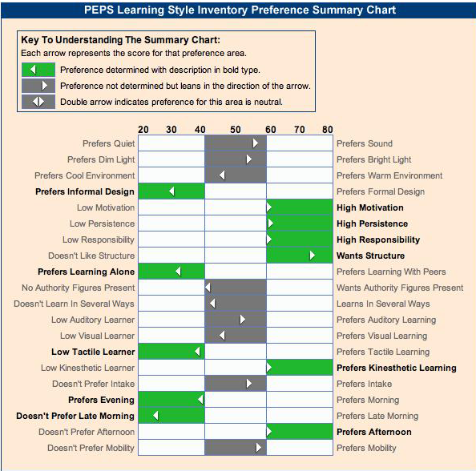

Slide 57
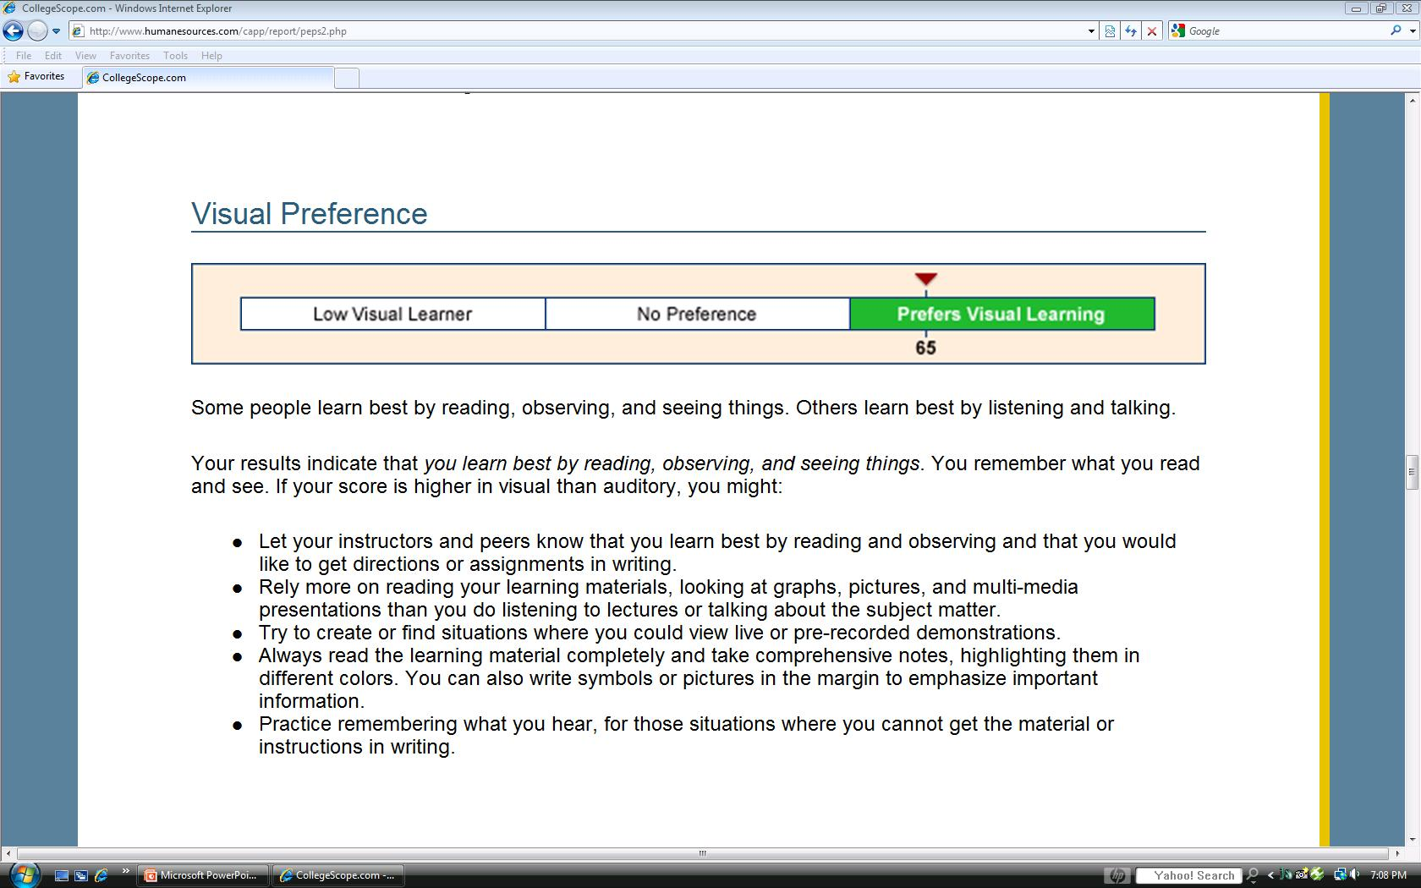
Note that a detailed list of learning strategies for your style follows this chart.

Slide 58
Learning Style Exercise: The Paper Airplane

Slide 59
New Millennial Students
Retention
Success
Engagement

Slide 60
These New Millennial students are now being called Generation E
What does the “E” stand for?

Slide 61
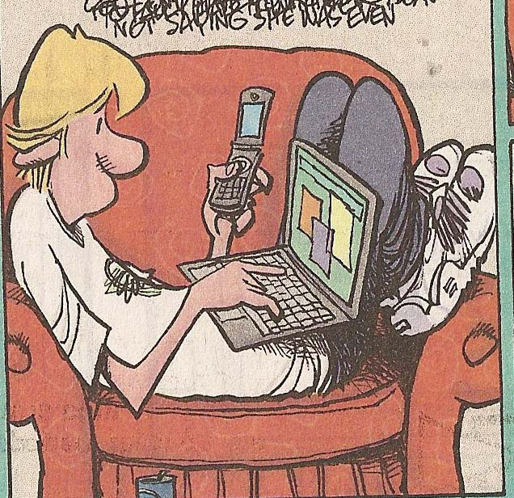
New Millennials or Generation E
18-30 years old
Empowered
Entitled
Electronic
  Leading change from paper to electronic media

Slide 62
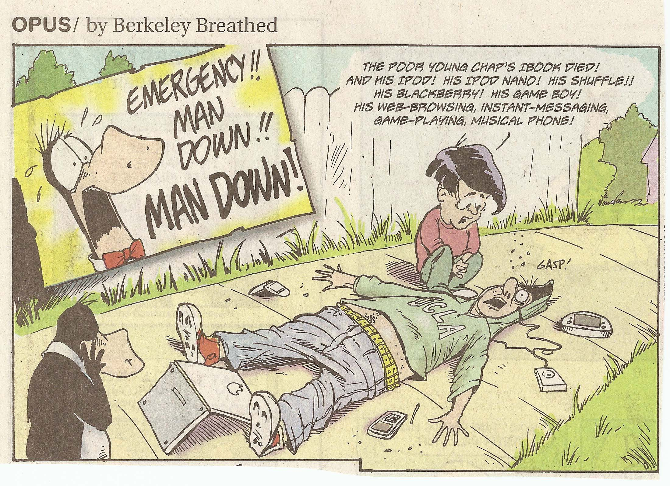

Slide 63

New Millennials
Our current college students were born after 1990.
Most were born with a computer in the home and were using them by age 5
Cyber generation
The connected generation
82% are online daily
Average 12 hours per week online

Slide 64
Being in the Millennial Generation, I did start using computers as a young child. I learned how to spell with the help of computers and how to read with computerized books. Computers have always been a part of my life, which is probably why I am so drawn to them.
Dawn Cardenas
College Success Student

Slide 65
Introduce yourself.
Where are you in the technology continuum?
Baby boomer 1946-1964
Generation X 1965-1977
New Millennials 1977-1995
How much technology did you use in college?

Slide 66

Why is the world flat?

Slide 67
Technology
A Skill Needed for College Success

Slide 68
Technology
Most college courses, especially upper division courses, have online components
Working in an online environment is essential for high paying careers
Students are disadvantaged if they do not have access to the Internet and are skilled in using it

Slide 69
Rationale for Using Technology
It prepares students for good paying jobs in flat world
Improves retention and success
New roles for faculty
Your students use it
It captures their attention
Education any time or place

Slide 70
CollegeScope: An Overview

Slide 71

Increasing Student Success and Retention

Slide 72
The Critical Period
The first two weeks is when most students drop.
This is our best opportunity to help students to be successful.

Slide 73
The Critical First 2 Weeks
With CollegeScope, you will know who has begun the program and who has not started.
How can you help the students who have not begun?
Think
Pair
Share

Slide 74
The first day of class is also critical
Most of your students will attend the first day.
It is an opportunity to impact student success and retention.

Slide 75
What should you do on the first day?

Slide 76
The first day is the most important
Introduce the CollegeScope Student Success Program
Make your expectations clear
  The course syllabus
Get to know your students and help them to meet other students
Do something that motivates students on the first day

Slide 77
Introductory Activities http://www.collegesuccess1.com/MotivationM.htm
Exercise: Life Stories

Slide 78
Tips for New Instructors http://www.collegesuccess1.com/TipsNewInstructors.htm

Slide 79
Tips for New Instructors
Write your syllabus
Take the assessments
Read the User’s Manual
Expect your students to read the chapter before class begins
Use the Instructor Manual to select activities to engage students in learning

Slide 80
Teaching Excellence
If you were evaluating a class, what would you look for?
  Think
  Pair
  Share

Slide 81
Teaching Excellence
Students are engaged in learning
The professor uses a variety of teaching techniques to appeal to different learning styles
Students have good attendance
The professor has a good syllabus
The professor establishes a positive learning environment

Slide 82
Tips for
Engaging Students in Learning
How to quickly engage students
How to run a group successfully
Favorite Exercises

Slide 83
Share what has worked for you

Slide 84
What is
Something you learned?
Something you found useful?

Slide 85
Questions?
Discussion
Evaluation

