Slide 1

Faculty Training
December 10, 2009
Lone Star College System
Dr. Marsha Fralick

Slide 2
Overview CollegeScope
Logging in
A quick tour
Introducing CollegeScope to your students
Improving retention and success
Common problems and easy solutions

Slide 3
Log into your account
http://www.collegescope.com/lonestar
New: There is now a single account for the district. When students register, they will be asked to select a college. You will only see the students in your college.

Slide 4
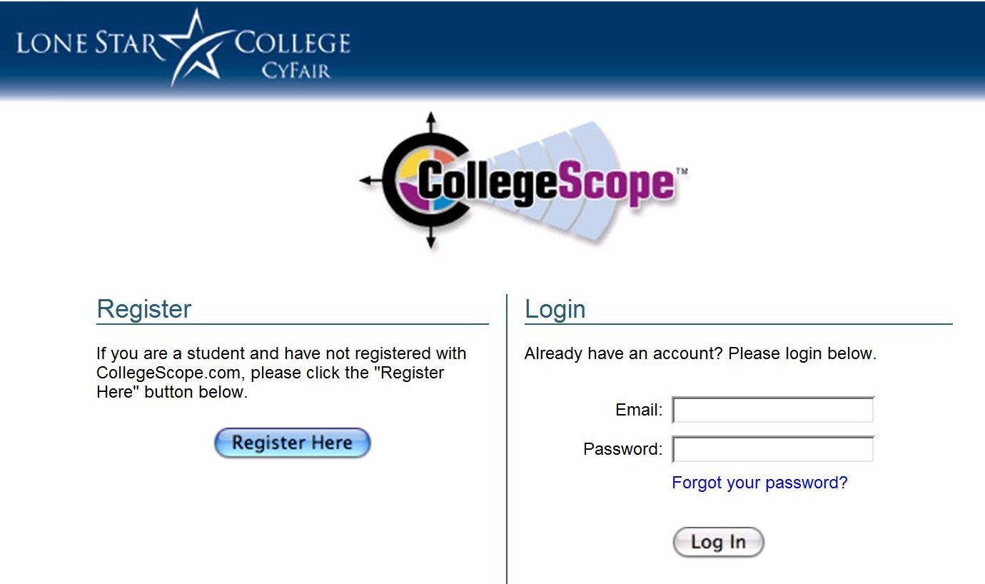

Slide 5
A Quick Tour

Slide 6
Add a Student
Click on My Students
Click on Add Students
Put a checkmark in the box next to Sample Student
Click Add to Me

Slide 7
New!
Archive Students
There will be an archive link on your home page. Use the archive link to access students from the past. They are archived after the graduation date they list. Students can still access their accounts.

Slide 8
How Students Register and Log In
http://www.collegescope.com/ccs/lonestar

Slide 9
The difference between a faculty and student account
The student account has /ccs/
ccs stands for college and career success

Slide 11
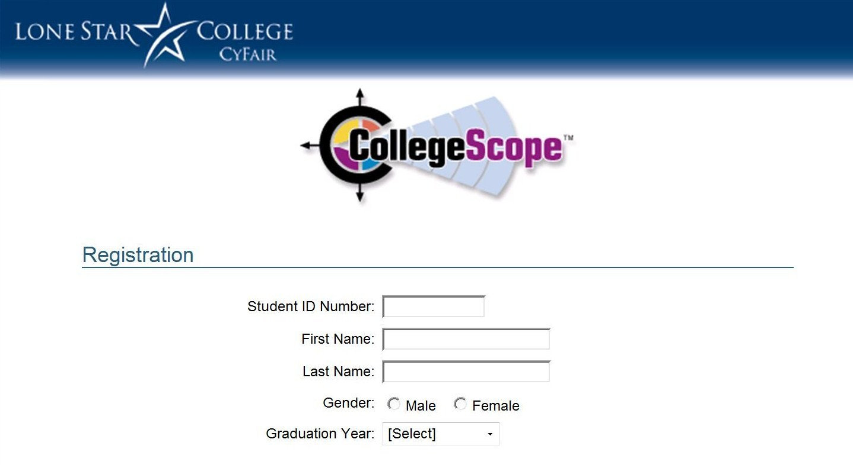

Slide 12
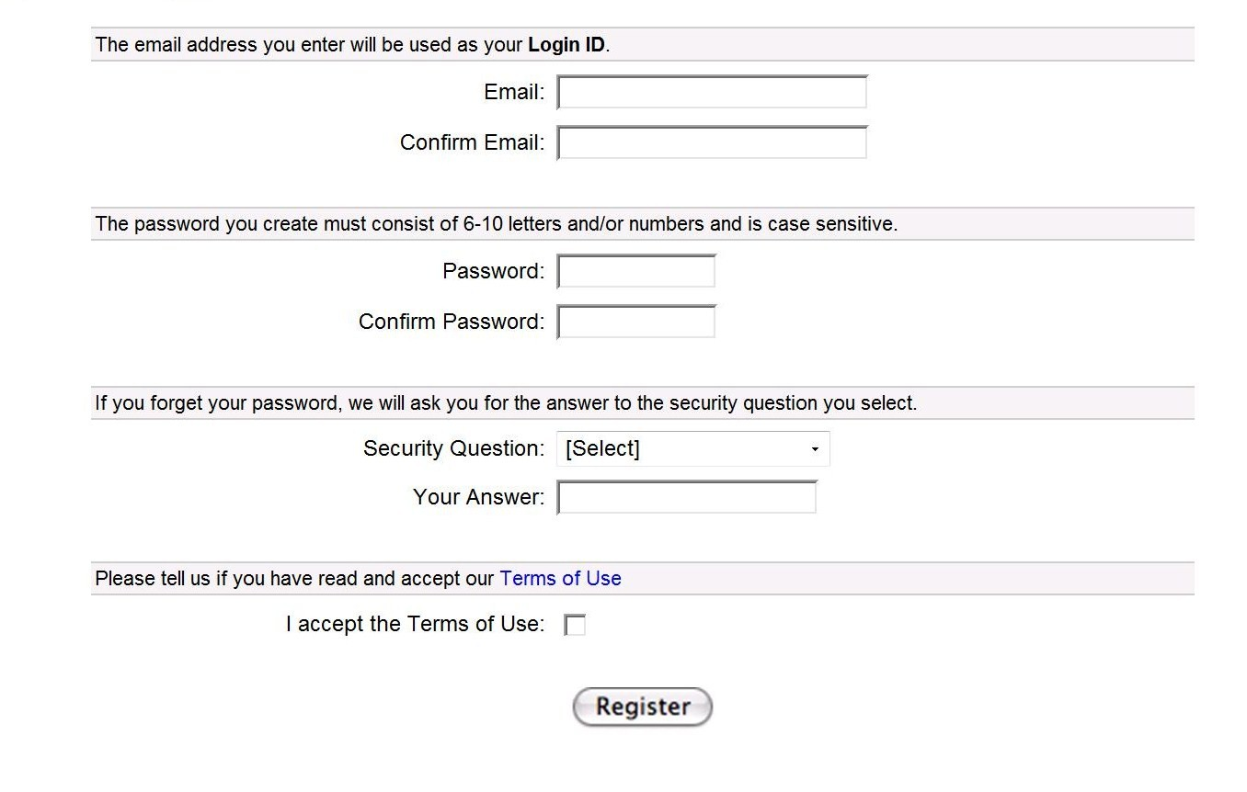

Slide 13
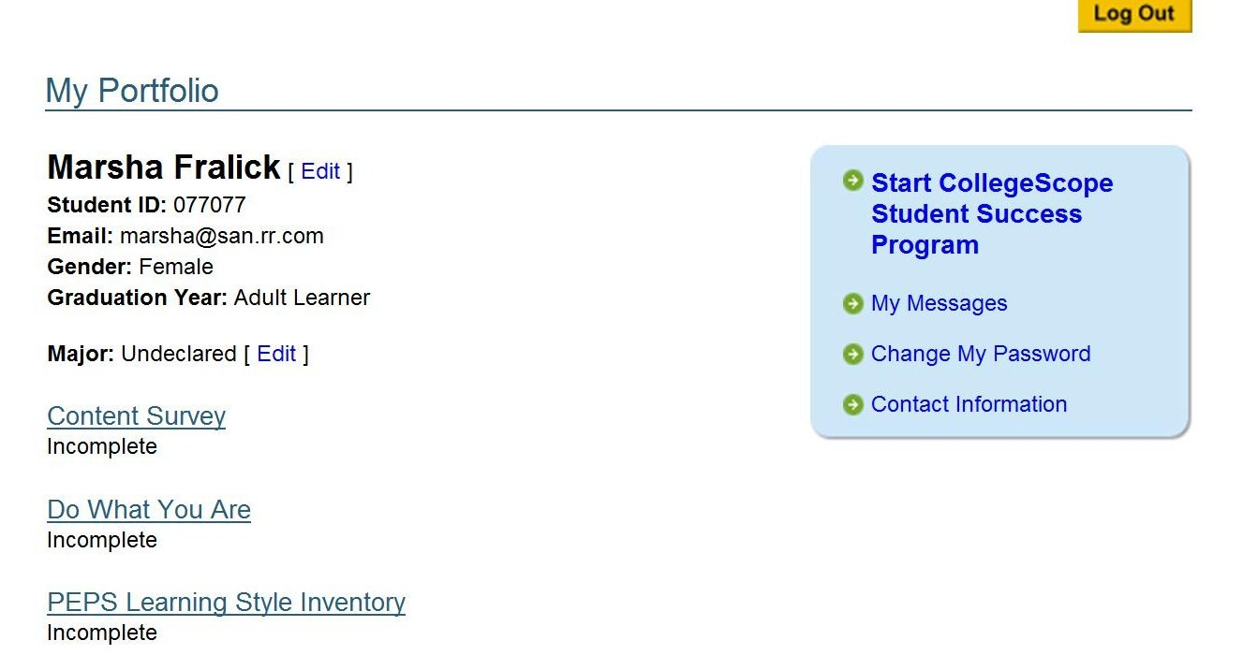

Slide 14
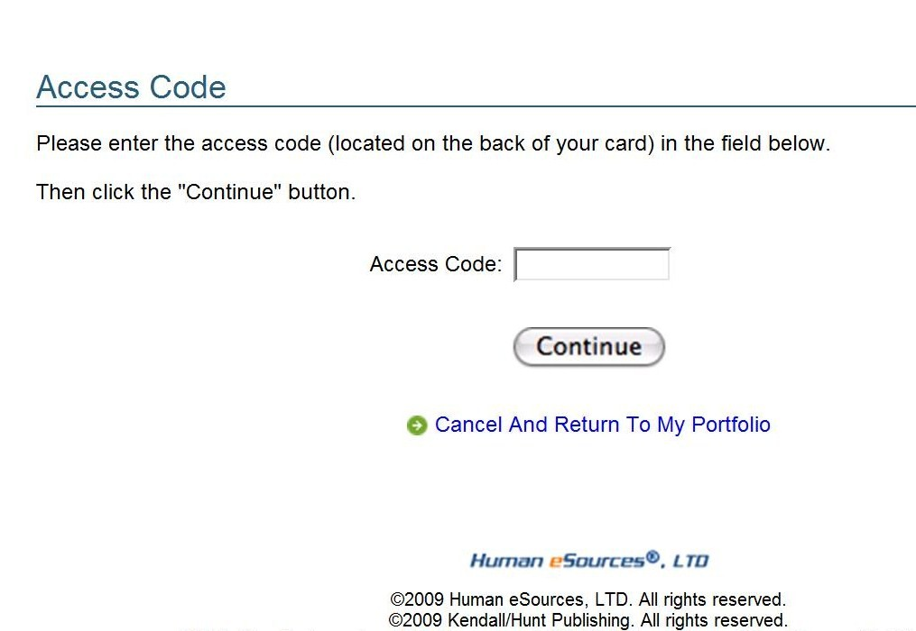

Slide 15
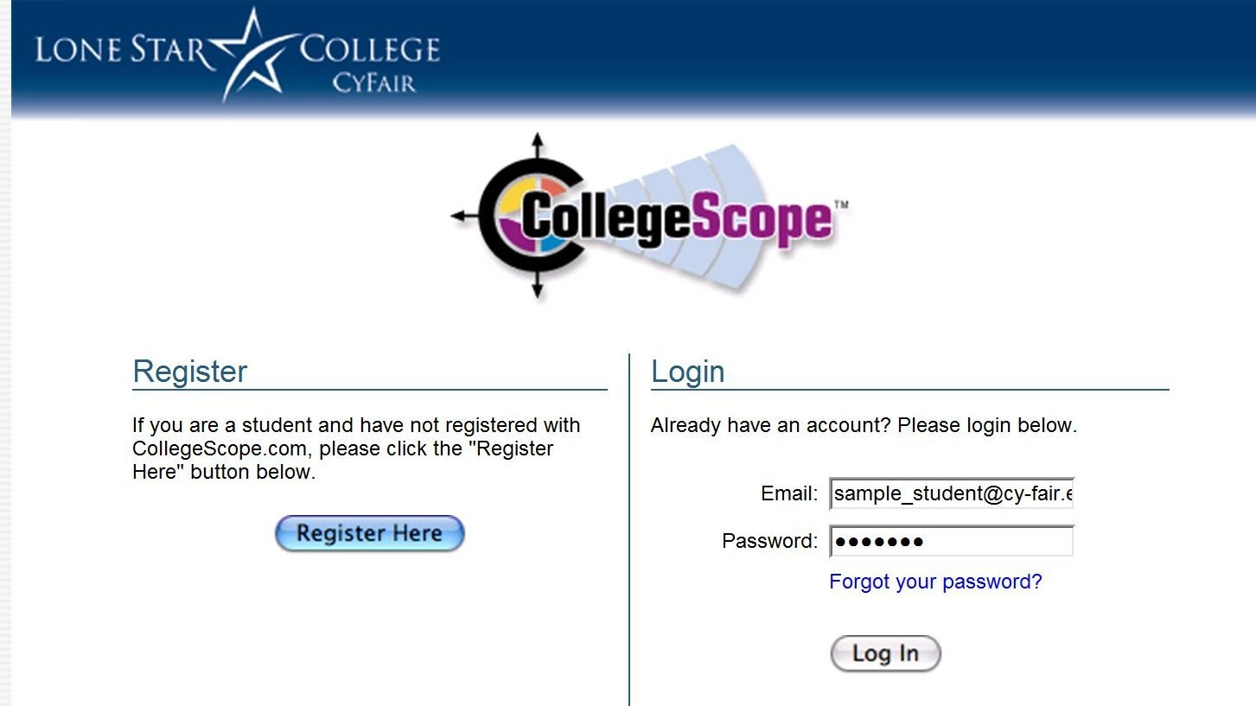

Slide 16
Personalized for each student
Based on personality and learning style
Refers to the student by their name
This is not possible in a printed text

Slide 17
To Begin
Take the assessments
  Content Survey
  Do What You Are
  PEPS Learning Style Inventory

Slide 18

Improving Retention and Success with CollegeScope

Slide 19
What should you do on the first day/week?

Slide 20
The first day is the most important
Introduce the CollegeScope Student Success Program
Make your expectations clear
  The course syllabus
Get to know your students and help them to meet other students
Do something that motivates students on the first day

Slide 21
Introduce CollegeScope
What is it?
How to log in
Show sample student
  Online portfolio
  Chapters
  Sample journal entries

Slide 22
Sample Student Account sample_student@cy-fair.edu

Slide 23
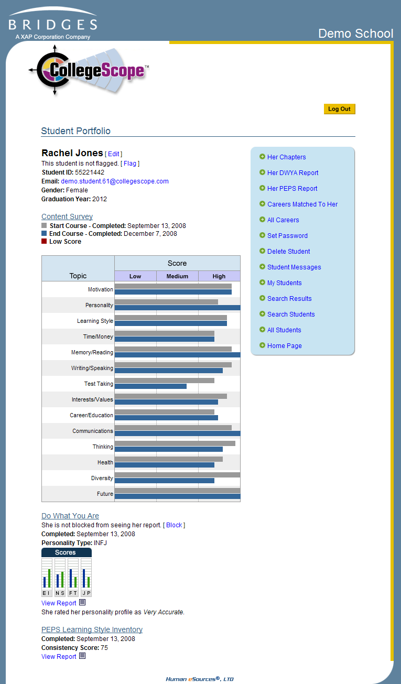
Introducing the Online Portfolio
On the first day, show the students the online portfolio and features.
Let them know that faculty have access.

Slide 24
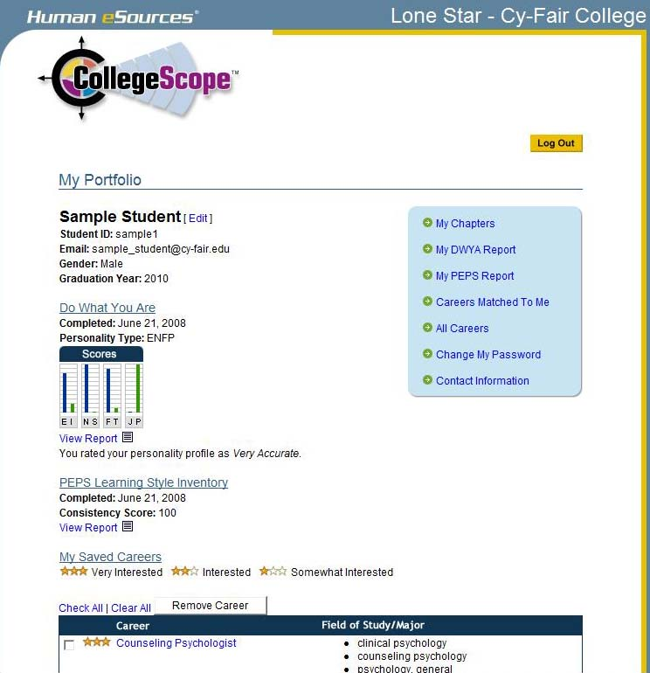

Slide 25
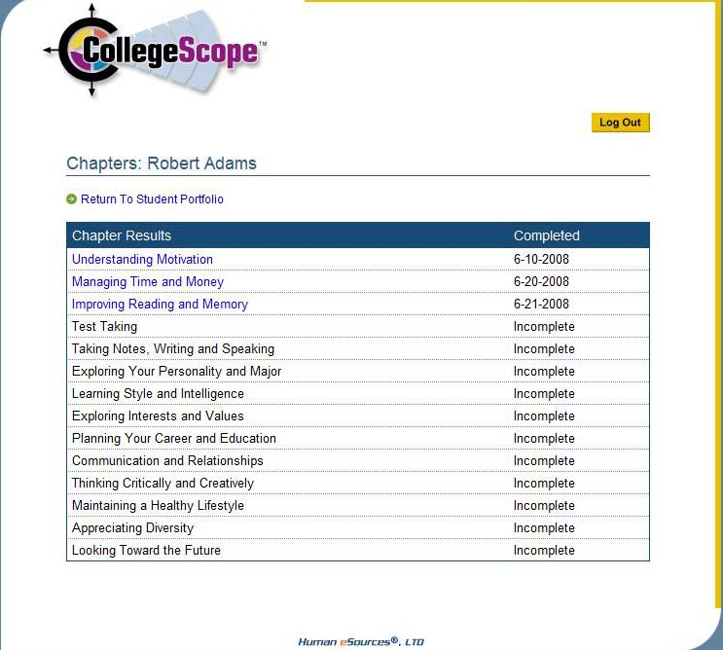
Sample Student

Slide 26
The Electronic Journal
It is an opportunity for students to read and think about how to apply the material in their personal lives.
Make your expectations clear.
Expect a well-developed paragraph for most questions.
Show a sample.

Slide 27
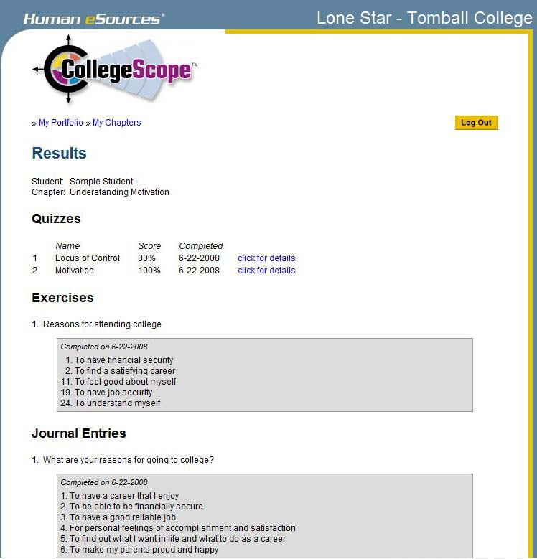

Slide 28
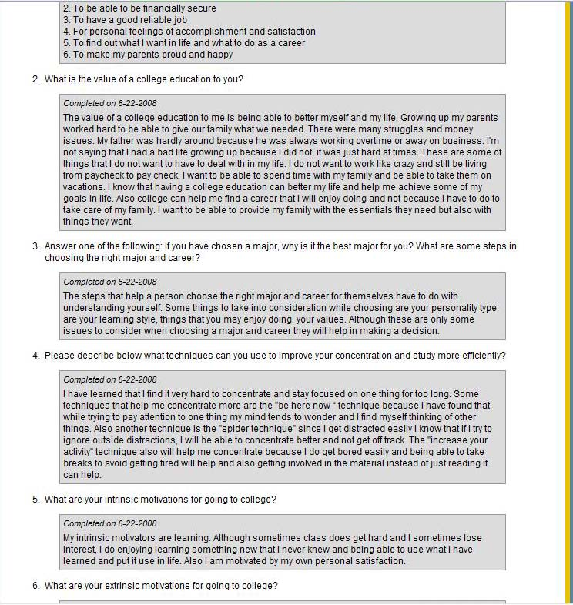

Slide 29
The Electronic Quizzes
This is an interactive feature that helps students with reading comprehension.
Students get immediate feedback.
Students cannot change their answers.
Expect students to do their best.

Slide 30
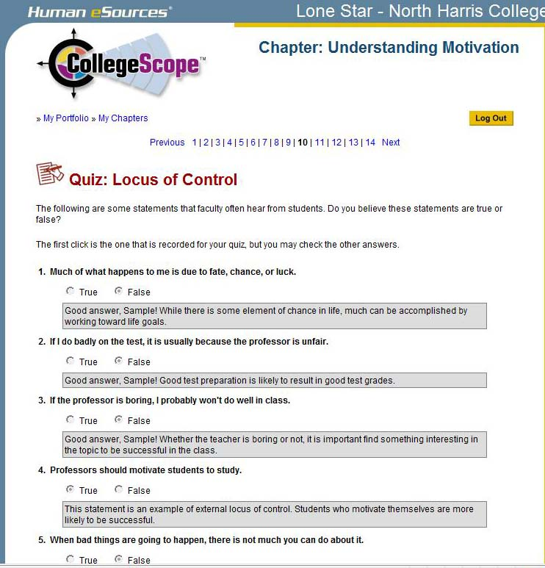

Slide 31
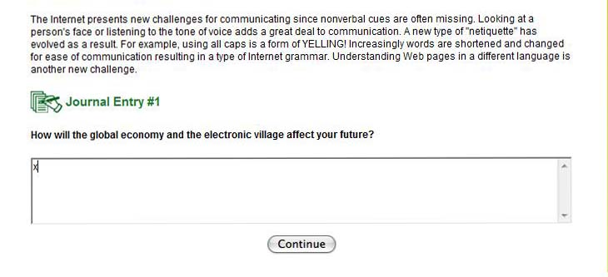
How to Cheat

Slide 32
How you will be caught

Slide 33
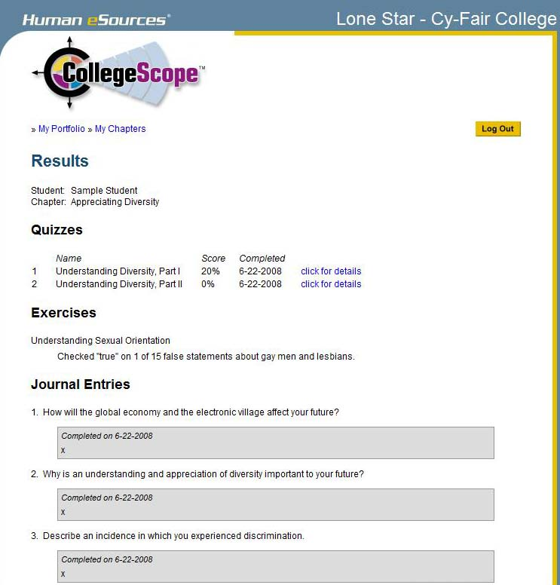

Slide 34
Expect students to read the chapter before coming to class
You can focus on engaging students in learning, discussion and sharing your experiences.
This is a good strategy for other classes too.
Minimizes the need to lecture.
All classes cover the same material in an interactive way.

Slide 35
How to help students get started?
The first 2 weeks are critical for student success and retention
Use CollegeScope to monitor progress

Slide 36
Review the second day
Review the information on CollegeScope the second day for those who were absent or those who need motivation to get started.
Congratulate those who have started.
Meet with students who have not started CollegeScope.

Slide 37
Most Common Problems
And Easy Solutions

Slide 38
Helping Your Students Log In
Students register only once. Then they log in with the e-mail address and password they created.

Slide 39
Remind students to write down the email address and password they use to create their accounts.

Slide 40
I forgot my email address
You can find the email address that students used to create their account by looking at their portfolio on My Students or All Students in your instructor account.

Slide 42
I forgot my password
You can look at the Student Portfolio and reset the password. Tell the student what the new password is. They can reset it when then log into their portfolio.

Slide 44
My Account Disappeared
They tried to log into the instructor account. Make sure that they have /ccs/ in the URL
http://www.collegescope.com/ccs/lonestar
Don’t use Google to find CollegeScope. You may end up in a different college account.

Slide 45
When I tried to register, it says that my email already exists.
If the email already exists, they have already registered. Tell students to log in with the email address and password they created when they registered the first time.

Slide 47
When I tried to log in, it says that my email does not exist.
There are several reasons for this:
They are using a different email.
They entered the info incorrectly.
They have not registered.

Slide 48
Contact Customer Service
If you have any problem you cannot resolve. This does not happen very often.
If you need to have a student’s account reset. If a student fails and takes the course again, it can be reset so they can start over.

Slide 49
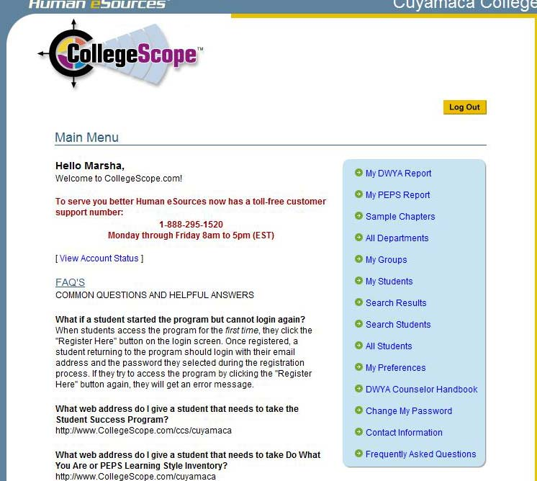

Slide 50
This info is available at the College Success Website
http://www.collegesuccess1.com/
Click on CollegeScope
There is a PowerPoint slide show on how to introduce CollegeScope.

