Slide 1

Faculty Training
January 13, 2010
Lone Star College System
Dr. Marsha Fralick

Slide 2
What are your goals for this workshop?
Think
Pair
Share

Slide 3
Overview Morning
Resources for Faculty
Features
Research (brief)
Administering and interpreting the Do What You Are (DWYA) and Productivity Environmental Preference (PEPS) learning style inventory

Slide 4
Overview Afternoon
Using CollegeScope to improve student retention and success
Demonstration
Technology for the New Millennial Student
Helping students log in
Workshop evaluation

Slide 5
College Success 1
Resources for faculty and students
http://www.collegesuccess1.com/
Training Notes

Slide 6
Features

Slide 7

Keys to Success
The program helps students to make a good choice of a major and career.
Notes:
One of the keys to success of this program is that it helps students to make a good choice of a major and career. How do we do this?

Slide 8

Statistically accurate
Valid and reliable
College scenarios are easy to read and understand.

Slide 9
Careers: A Key Component
Personality
Learning Style
Interests
Values
Career Research

Slide 10

Keys to Success
The program helps students to understand their learning style and how to become a lifelong learner.
Notes:
Another central theme is learning style. If students understand their learning style, it helps them to learn new and difficult material in college and throughout life.

Slide 11

Comprehensive
  20 factors affecting learning style
Helps students understand how they learn best

Slide 12
Keys to Success
At the end of each chapter
Inspiration
Positive thinking
For example:
  Life is a dangerous opportunity

Slide 13
Applied Psychology
From theory to practice
Academically rigorous, yet practical
Easy to read

Slide 14
Broad Scope
College success
Career success
Lifelong success

Slide 15

College Success
Motivation
Time and Money
Memory and Reading
Test Taking
Taking Notes, Writing and Speaking

Slide 16

Career Success
Personality and Related Majors
Learning Style and Intelligence
Interests and Values
Career and Educational Planning

Slide 17

Lifelong Success
Communication and Relationships
Critical and Creative Thinking
Maintaining a Healthy Lifestyle
Appreciating Diversity
Positive Thinking
Life Stages

Slide 18
Engaging Students in Learning
Interactive online format with journal entries, quizzes, activities, surveys, videos
Classroom exercises for engaging students in learning

Slide 19
Personalized for each college
Includes your information about counseling, financial aid, health and other student services

Slide 20
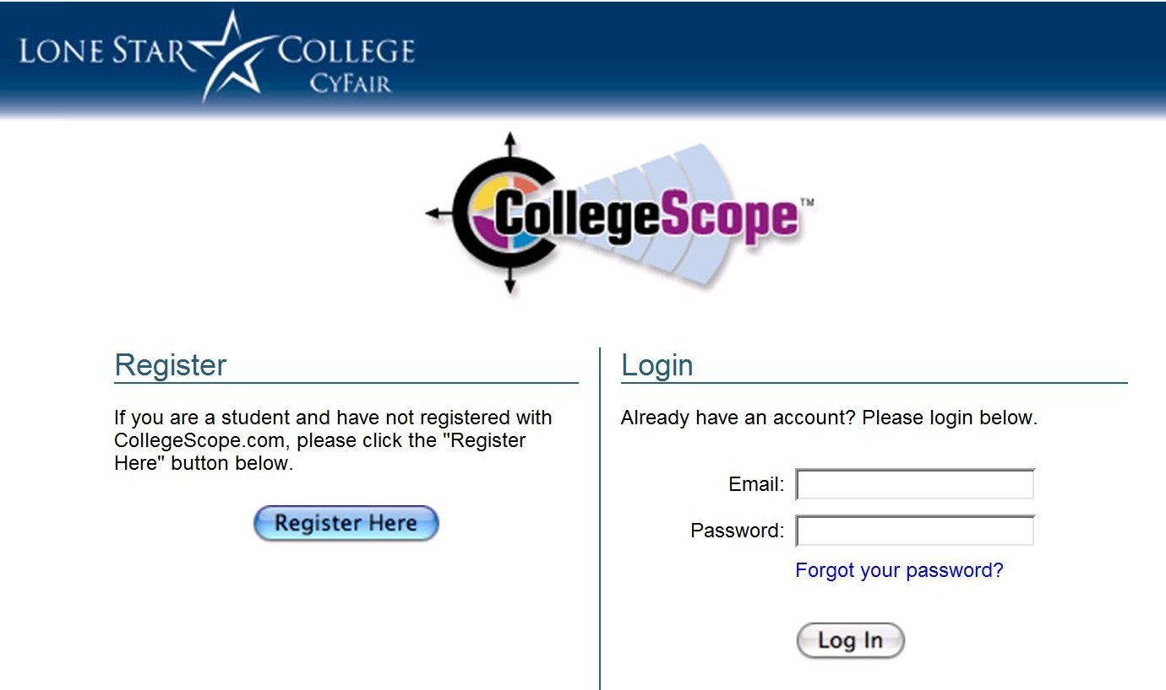

Slide 21
Personalized for each student
Based on personality and learning style
Refers to the student by their name
This is not possible in a printed text

Slide 22
Bridge
High School
Community College
University
Notes:
This course serves as a bridge from high school to community college to the university. Many of our local high schools offer the course in dual enrollment programs where students receive both high school and college credit. High school counselors and students see the course as valuable preparation for college.
The course helps students to persist in community colleges and to transfer to universities. In the San Diego area, the course has become an important part of transfer programs to the university. Most universities have college success programs to improve student success and retention.

Slide 23
Research

Slide 24
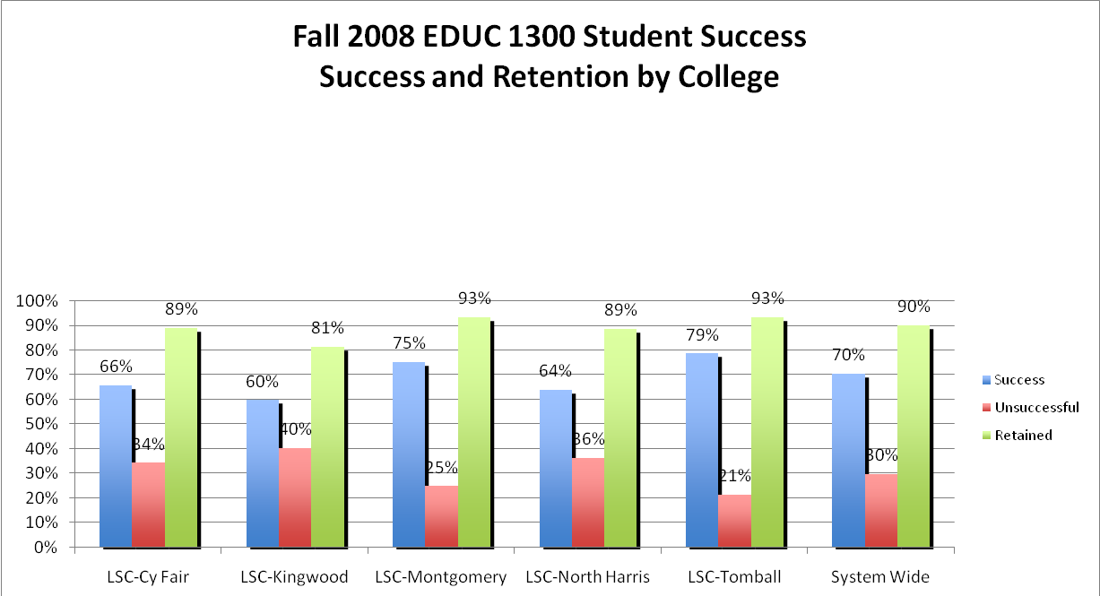
Lone Star College System Results

Slide 25
Lone Star College System
College | Persistence rate of students who were successful | Persistence rate of students who were unsuccessful | Persistence rate of those students that withdrew (W) | Persistence rate of all Student Types
LSC – CyFair | 94% | 52% | 78% | 79%
LSC – Kingwood | 82% | 61% | 38% | 67%
LSC –Montgomery | 88% | 57% | 25% | 77%
LSC – North Harris | 90% | 71% | 67% | 81%
LSC – Tomball | 82% | 50% | 0% | 70%
System Average | 87% | 58% | 42% | 75%

Slide 27
Program Results
Program Review 2000, 2005

Slide 28


Slide 29

The most significant finding is increased persistence.

Slide 30
Persistence
Students who return the next semester
Approximately half of community college students nationwide do not persist after the first semester

Slide 31
College Persistence Semester to Semester
5 Year Average at Cuyamaca College
All successful PDC students 89%
All students 63%
A 26% improvement!

Slide 32
Technology
A Skill Needed for College Success

Slide 33
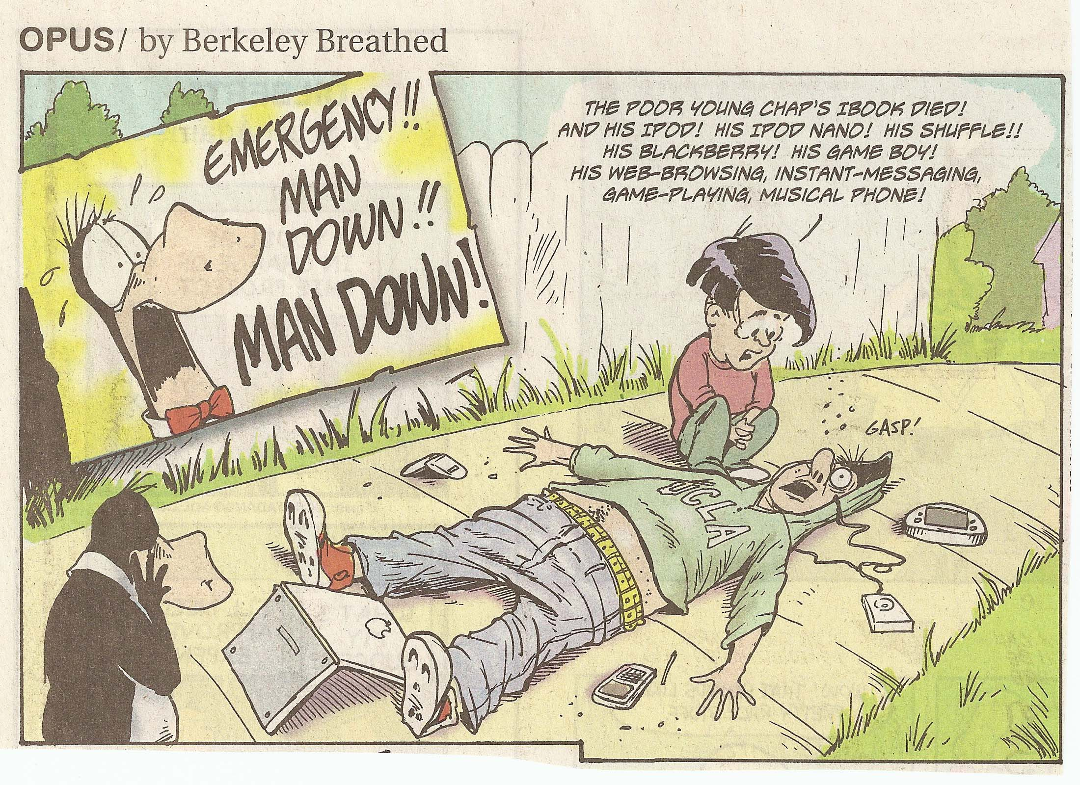

Slide 34

Why is the world flat?

Slide 35
Three Great Eras of Globalization
1492 Columbus set sail to find new trade routes
  the earth is round
1880-2000 Industrial Revolution
  Railways, highways and communication makes the world smaller

Slide 36
Globalization 3.0
Began in 2000
Convergence of the computer and fiber optic cable that enables global collaboration and competition
The flat world

Slide 37
Rapid Change
Berlin Wall fell in 1990
World Wide Web created in 1991
Windows, Netscape and Internet Explorer invented 1995
Google invented 1998
iPhone invented 2007

Slide 38
New Question
Where do I as an individual fit into the global competition and opportunities of the day, and how can I, on my own, collaborate with others globally?
Outsourcing is changing the way we do business.

Slide 39
Skills Needed for the Flat World
Reading
Computer skills
Math
Science
Learn how to learn
Intrinsic motivation
People skills
Passion and curiosity
Being able to navigate the virtual world
Be a good adapter, synthesizer and collaborator
Appreciation of diversity

Slide 40
Rapid Change
Berlin Wall fell in 1990
World Wide Web created in 1991
Windows, Netscape and Internet Explorer invented 1995
Google invented 1998
iPhone invented 2007

Slide 41

New Millennials
Our current college students were born after 1990.
Most were born with a computer in the home and were using them by age 5
Cyber generation
The connected generation
82% are online daily
Average 12 hours per week online

Slide 42
Being in the Millennial Generation, I did start using computers as a young child. I learned how to spell with the help of computers and how to read with computerized books. Computers have always been a part of my life, which is probably why I am so drawn to them.
Dawn Cardenas
College Success Student

Slide 43
These New Millennial students are now being called Generation E
What does the “E” stand for?

Slide 44
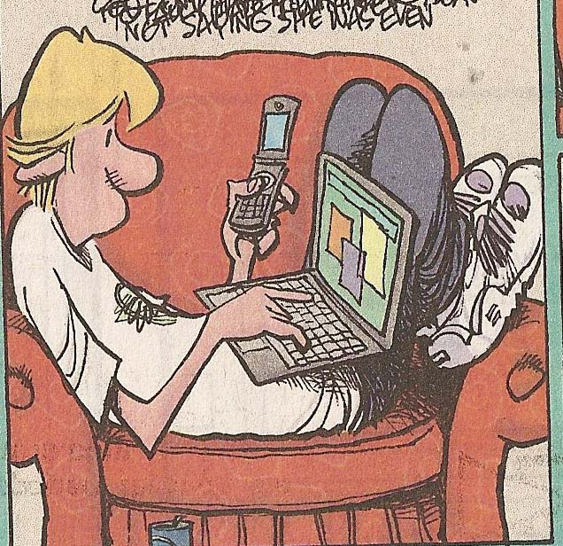
New Millennials or Generation E
18-30 years old
Empowered
Entitled
Electronic
  Leading change from paper to electronic media

Slide 45
Introduce yourself.
Where are you in the technology continuum?
Baby boomer 1946-1964
Generation X 1965-1977
New Millennials 1977-1995
How much technology did you use in college?

Slide 46
Technology
Most college courses, especially upper division courses, have online components
Working in an online environment is essential for high paying careers
Students are disadvantaged if they do not have access to the Internet and are skilled in using it

Slide 47
Rationale for Using Technology
It prepares students for good paying jobs in flat world
Improves retention and success
New roles for faculty
Your students use it
It captures their attention
Education any time or place

Slide 48
Do What You Are Personality Assessment

Slide 49


Slide 50
Carl Jung 1875-1961
We are born with natural preferences which we develop over a lifetime.
There are no good or bad types.
Each type has their own unique gifts and talents.
Exercise: What is a preference?

Slide 51
Key Theme
Choosing a major
Career choice
Learning Style
Communication
Self-understanding

Slide 52
Administering the DWYA
Find a time when you are not tired or rushed.
There are no right or wrong answers.
Answer quickly giving your first impression. Do not over analyze.
You will have a chance to look at your profile and change it if you think it is not correct.

Slide 53
Administering the DWYA
Answer the questions honestly to get the best results.
Answer the questions how you usually are when you are not stressed.
Do not answer the questions:
  How you want to be
  How you have to be at home, work or school
  How others want you to be

Slide 54
Getting Good Results
Encourage students to give honest answers.
What are some reasons students would not give honest answers?
Think, Pair, Share

Slide 55
Administering the DWYA
The test does not measure:
  Intelligence
  Psychological or emotional health

Slide 56
Resources http://www.collegesuccess1.com/DoWhatYouAre.htm
CollegeScope User’s Manual
Do What You Are Handbook
Psychometric Report

Slide 57
Interpreting the Do What You Are personality assessment

Slide 58
Begin Self-Assessment
How we interact with the world and where we place our energy
E_____________________________|____________________________I
Extraversion Introversion

Slide 59
Self-Assessment
The kind of information we naturally notice and remember
S_____________________________|___________________________N
Sensing Intuition

Slide 60
Personality Exercise
Write about the picture for 3 minutes

Slide 61

By Ian Jackson

Slide 62
Self-Assessment
How we make decisions
T_____________________________|___________________________F
Thinking Feeling

Slide 63
Self-Assessment
Whether we prefer to live in a more structured or spontaneous way
J_____________________________|_____________________________P
Judging Perceiving

Slide 64
J and P Exercise:
Where do you stand?
  I can play anytime
  I have to finish my work before I play

Slide 65
The PEPS Learning Style Assessment
Measures preferences in 20 areas

Slide 66
Administering the PEPS
Give your initial response
No need to over analyze
Answer as though you were learning new or difficult information

Slide 67
Important Considerations
It is not a test
It describes how you prefer to learn new or difficult material
Usually there are 6 or 7 areas out of 20 that are important for an individual

Slide 68
The PEPS Learning Style Assessment
Measures preferences in 20 areas
  Perceptual
    Auditory
    Visual
    Kinesthetic
    Tactile

Slide 69
PEPS
Immediate environment
  Sound
  Heat
  Light
  Design (formal or informal)

Slide 70
PEPS
Emotionality
  Motivation
  Responsibility
  Persistence
  Structure

Slide 71
PEPS
Sociological
  Self oriented
  Peer oriented
  Adult oriented

Slide 72
PEPS
Physical
  Time of day
  Food intake
  Mobility

Slide 73
Perceptual
Auditory (one third)
Visual (one third)
Tactile/Kinesthetic (one third)
Learning disabled as well as gifted prefer tactile/kinesthetic

Slide 74
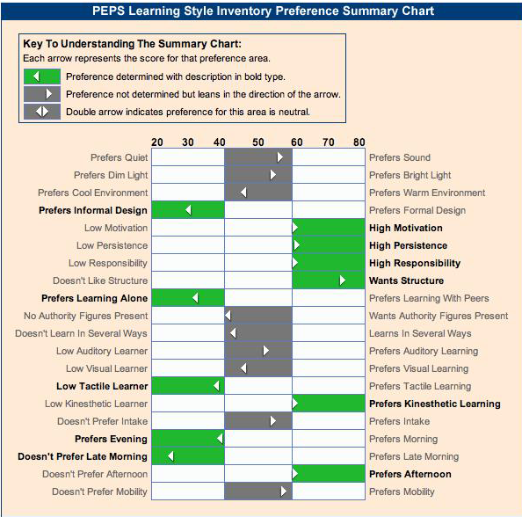

Slide 75
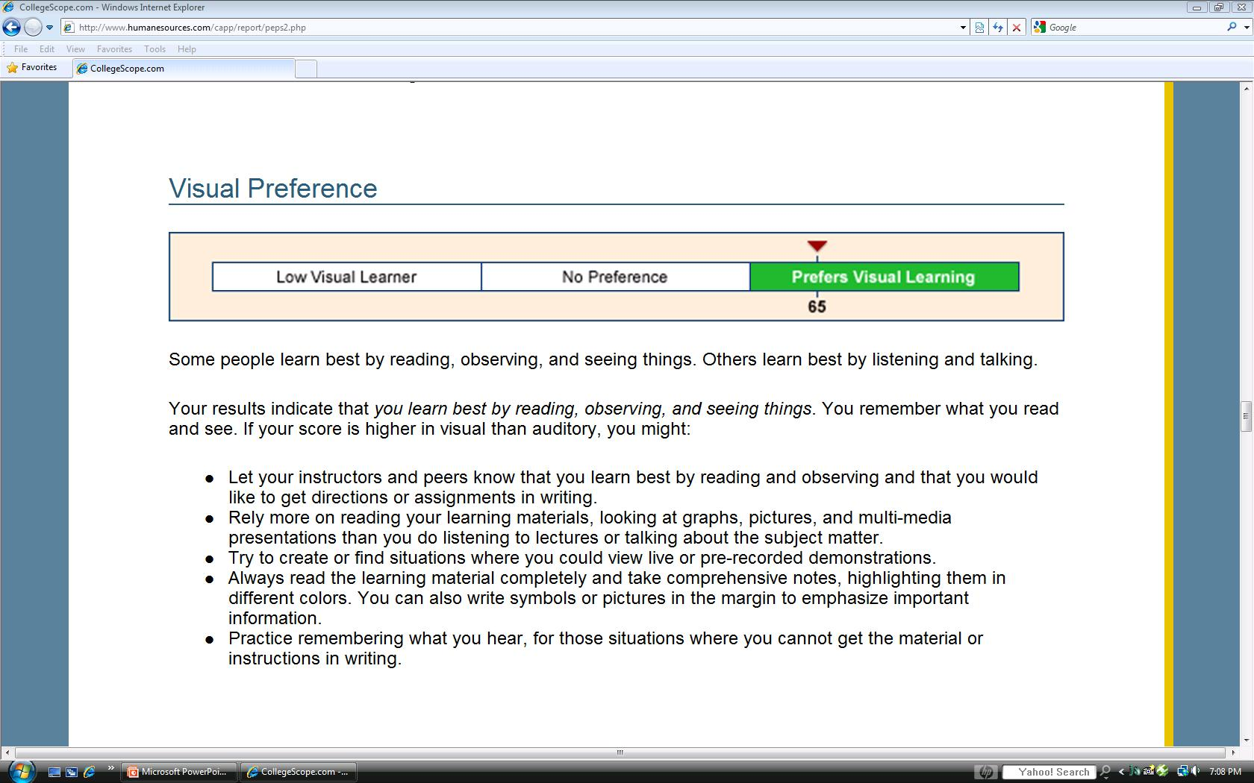
Note that a detailed list of learning strategies for your style follows this chart.

Slide 76
Learning Style Exercise: The Paper Airplane

Slide 77

Improving Retention and Success with CollegeScope

Slide 78
CollegeScope: An Overview
http://www.collegescope.com/cuyamaca

Slide 79
Add a Student
Click on My Students
Click on Add Students
Put a checkmark in the box next to Sample Student
Click Add to Me

Slide 80
The Critical Period
The first two weeks is when most students drop.
This is our best opportunity to help students to be successful.

Slide 81
The Critical First 2 Weeks
You will know who has begun the program and who has not started.
How can you help the students who have not begun?
Think
Pair
Share

Slide 82
The first day of class is also critical
Most of your students will attend the first day.
It is an opportunity to impact student success and retention.

Slide 83
What should you do on the first day?

Slide 84
The first day is the most important
Introduce the CollegeScope Student Success Program
Make your expectations clear
  The course syllabus
Get to know your students and help them to meet other students
Do something that motivates students on the first day

Slide 85
Introductory Activities http://www.collegesuccess1.com/MotivationM.htm
Exercise: Life Stories

Slide 86
Introduce CollegeScope
What is it?
How to log in
Show sample student
  Online portfolio
  Chapters
  Sample journal entries

Slide 87
Logging in to CollegeScope

Slide 88
Log into your account
All colleges at Lone Star now have the same log in:
http://www.collegescope.com/lonestar

Slide 89
How Students Register and Log In
All students at Lone Star now have the same login:
http://www.collegescope.com/ccs/lonestar

Slide 90
The difference between a faculty and student account
The student account has /ccs/
ccs stands for college and career success

Slide 92
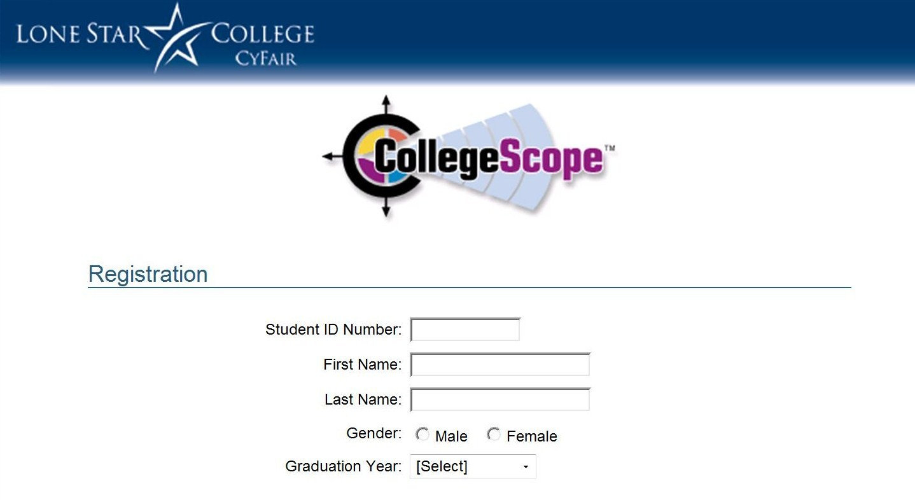

Slide 93
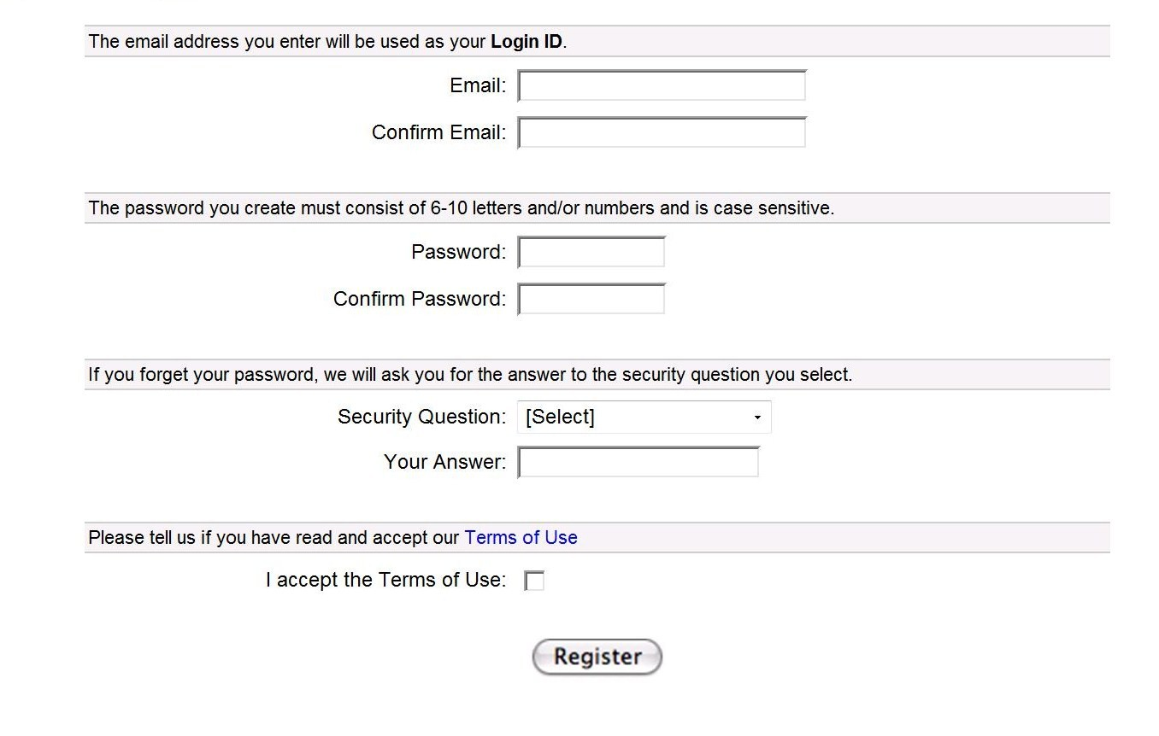

Slide 94
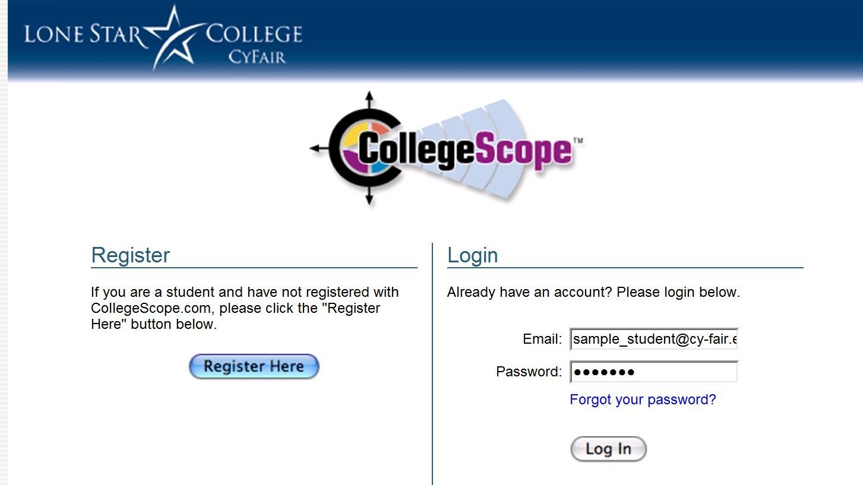

Slide 95
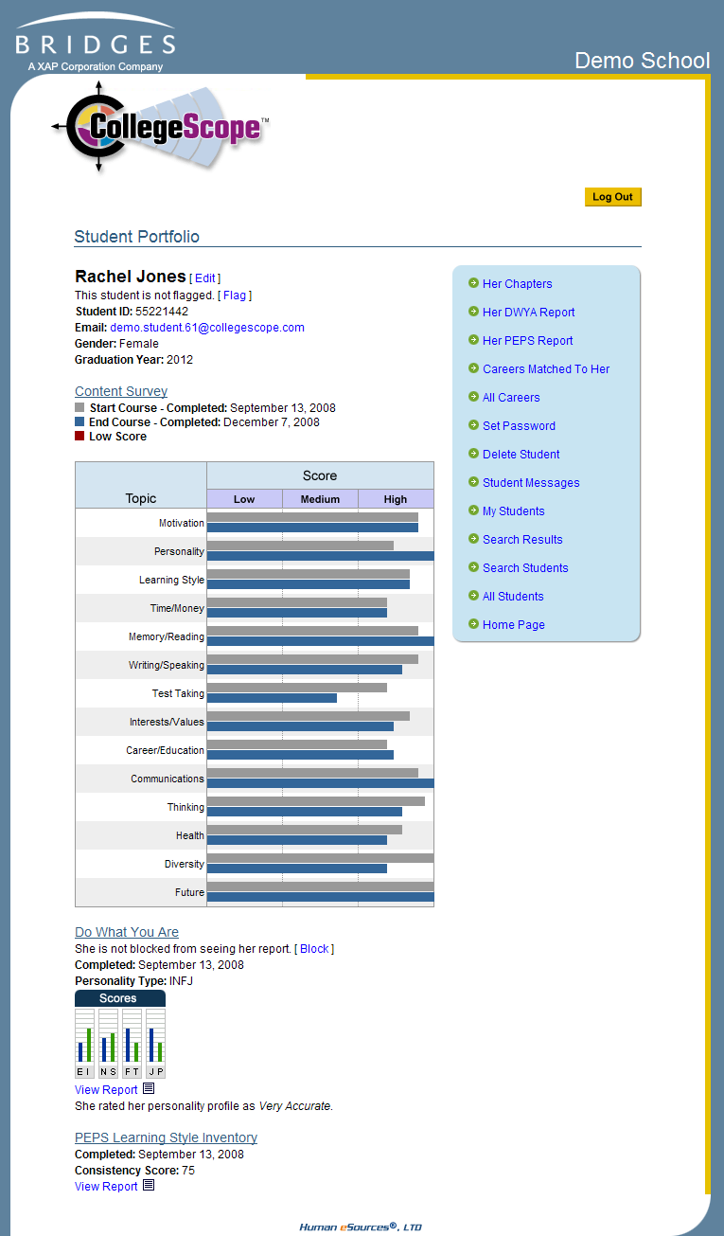
Introducing the Online Portfolio
On the first day, show the students the online portfolio and features.
Let them know that faculty have access.

Slide 96
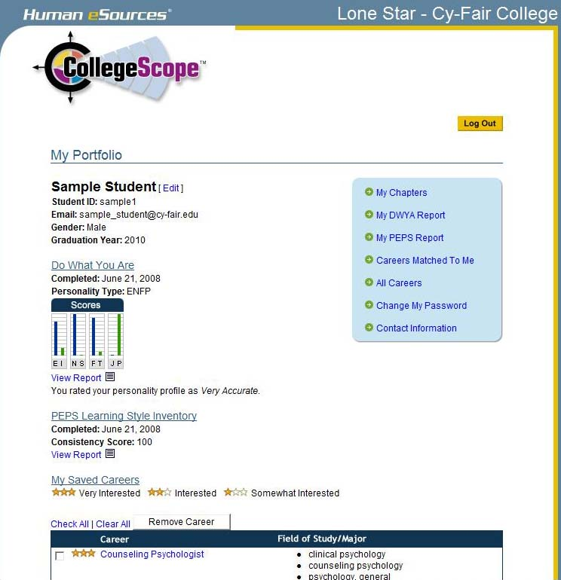

Slide 97
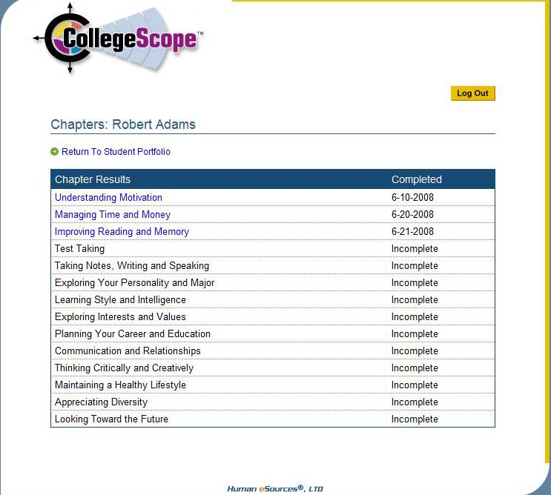
Sample Student

Slide 98
The Electronic Journal
It is an opportunity for students to read and think about how to apply the material in their personal lives.
Make your expectations clear.
Expect a well-developed paragraph for most questions.
Show a sample.

Slide 99
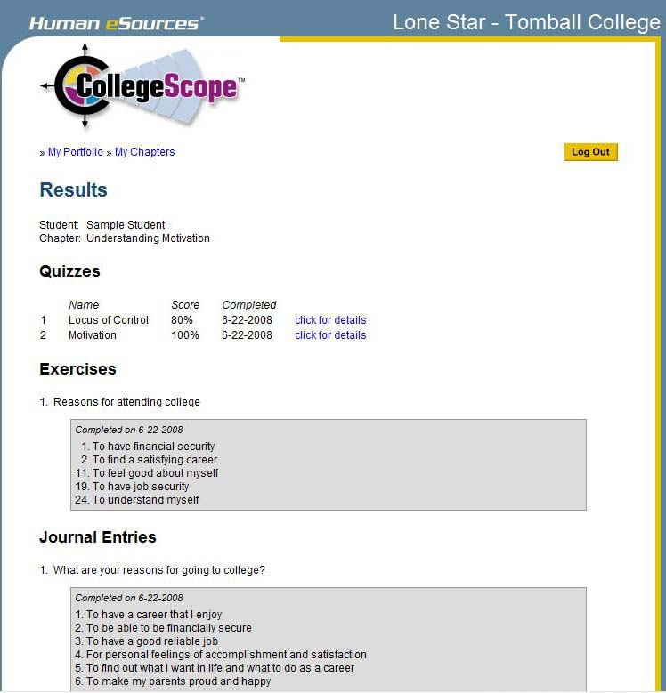

Slide 100
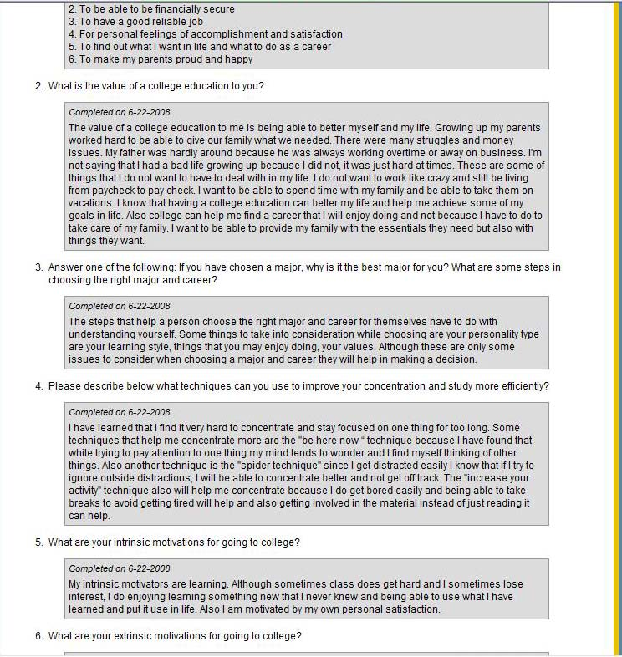

Slide 101
The Electronic Quizzes
This is an interactive feature that helps students with reading comprehension.
Students get immediate feedback.
Students cannot change their answers.
Expect students to do their best.

Slide 102
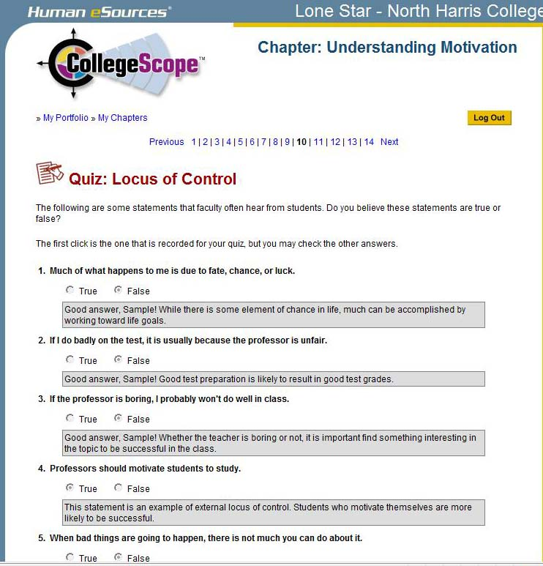

Slide 103
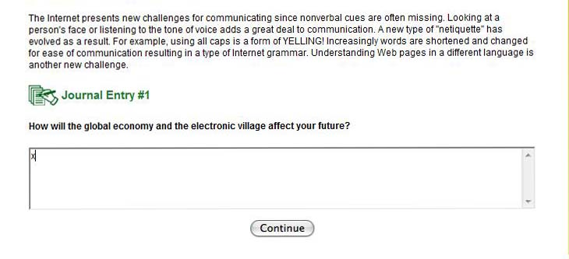
How to Cheat

Slide 104
How you will be caught

Slide 105
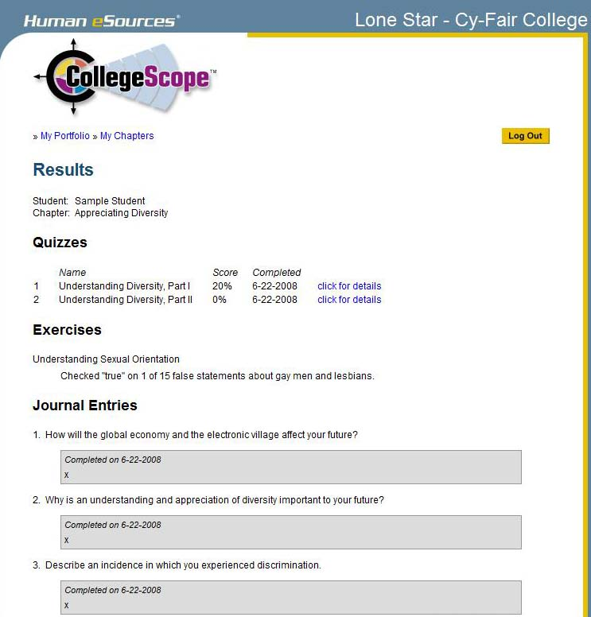

Slide 106
Expect students to read the chapter before coming to class
You can focus on engaging students in learning, discussion and sharing your experiences.
This is a good strategy for other classes too.
Minimizes the need to lecture.
All classes cover the same material in an interactive way.

Slide 107
Review the second day
Review the information on CollegeScope the second day for those who were absent or those who need motivation to get started.
Congratulate those who have started.
Meet with students who have not started CollegeScope.

Slide 108
Most Common Problems
And Easy Solutions

Slide 109
Helping Your Students Log In
Students register only once. Then they log in with the e-mail address and password they created.

Slide 110
Remind students to write down the email address and password they use to create their accounts.

Slide 111
I forgot my email address
You can find the email address that students used to create their account by looking at their portfolio on My Students or All Students in your instructor account.

Slide 113
I forgot my password
You can look at the Student Portfolio and reset the password. Tell the student what the new password is. They can reset it when then log into their portfolio.

Slide 115
My Account Disappeared
They tried to log into the instructor account. Make sure that they have /ccs/ in the URL
http://www.collegescope.com/ccs/tomball

Slide 116
When I tried to register, it says that my email already exists.
If the email already exists, they have already registered. Tell students to log in with the email address and password they created when they registered the first time.

Slide 118
When I tried to log in, it says that my email does not exist.
There are several reasons for this:
They are using a different email.
They entered the info incorrectly.
They have not registered.

Slide 119
Contact Customer Service
If you have any problem you cannot resolve. This does not happen very often.
If you need to have a student’s account reset. If a student fails and takes the course again, it can be reset so they can start over.

Slide 120
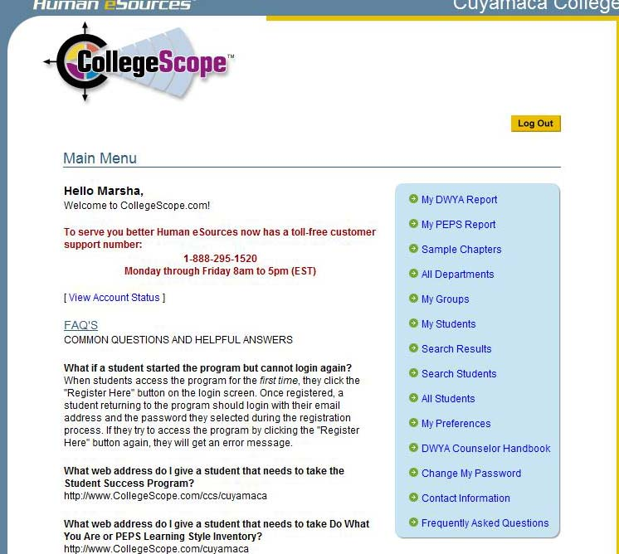

Slide 121
This info is available at the College Success Website
http://www.collegesuccess1.com/
Click on CollegeScope
There is a PowerPoint slide show on how to introduce CollegeScope.

Slide 122
Tips for New Instructors http://www.collegesuccess1.com/TipsNewInstructors.htm

Slide 123
Tips for New Instructors
Write your syllabus
Take the assessments
Read the User’s Manual
Expect your students to read the chapter before class begins
Use the Instructor Manual to select activities to engage students in learning

Slide 124
Teaching Excellence
If you were evaluating a class, what would you look for?
  Think
  Pair
  Share

Slide 125
Teaching Excellence
Students are engaged in learning
The professor uses a variety of teaching techniques to appeal to different learning styles
Students have good attendance
The professor has a good syllabus
The professor establishes a positive learning environment

Slide 126
Tips for
Engaging Students in Learning
How to quickly engage students
How to run a group successfully
Favorite Exercises

Slide 127
Share what has worked for you

Slide 128
What is
Something you learned?
Something you found useful?

Slide 129
Questions?
Discussion
Evaluation

