Slide 1
Helping Your Developmental Students Succeed at Lone Star College Dr. Marsha Fralick

Slide 2
Ice Breaker
Introduce yourself.
Happiness is . . . . . .

Slide 3
Overview
Key Features
How can we help students to be successful?
Matching Your Learning Outcomes

Slide 4
Key Features

Slide 5
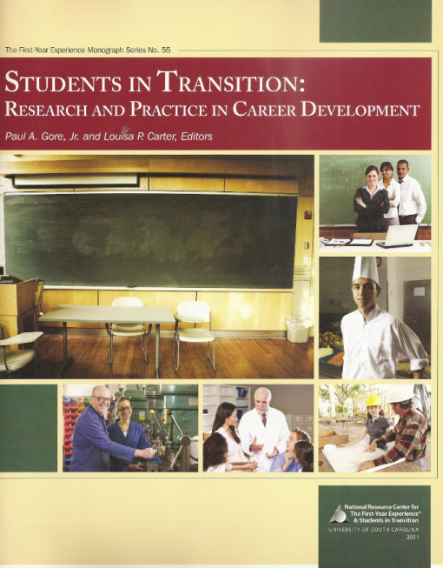
Evidence Based
The textbook is based on current educational research.

Slide 6
Noteworthy Results
26% increase in persistence rates!
5 year average course completion rate of 82.7%
87% of students had chosen a major by the end of the course
62% of students reported more confidence in their academic skills
88% of students rated the course as good or very good

Slide 7
College Success: A Study of Positive and Negative Attrition
Fits with the new completion by design agenda which includes early career exploration

Slide 8
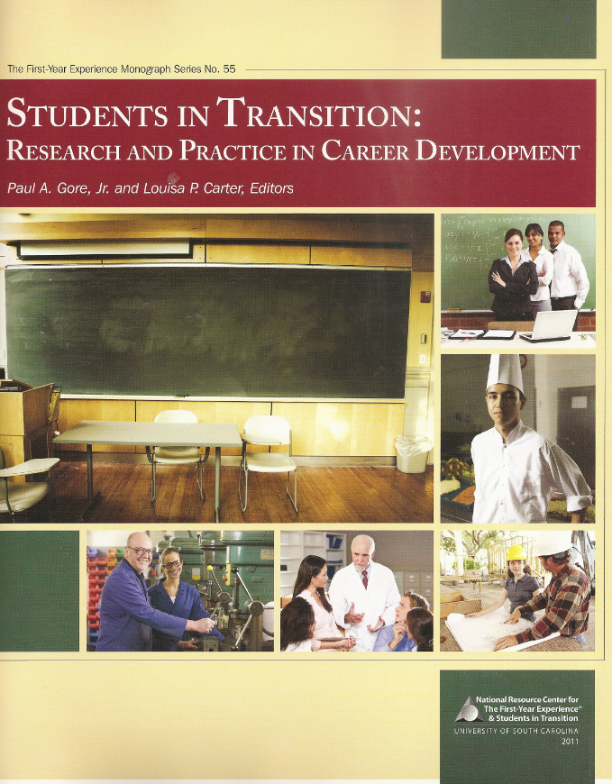
New Career Article
Summarizes current research
Proposes a model for career development

Slide 9
Strength Based
Build on personal strengths
Personality type
Multiple intelligences
Provides motivation for developmental students

Slide 10
Positive Thinking
Students are more likely to be successful when they think positively about the future. Includes:
Future-mindedness
Hope for the future

Slide 11
Encourages Self-Responsibility
What is my road to success?
Making a good career choice
Developing an educational plan
Setting goals
Managing time to reach goals

Slide 12
For Community College Students
The textbook was developed for community college students.
Examples are based on diverse population of community college students, many of whom need developmental courses.

Slide 13
Appropriate Reading Level
Written at 8th grade level
Short sentences
New terms defined
Examples
Has been used successfully with developmental students
Incorporates some strategies to help students with learning disabilities

Slide 14
Help with Writing
Each chapters contains 5 journal entries
Helps students think critically about the information and apply it to their personal lives
Frequent quizzes and answer keys help with reading comprehension
Scaffolding helps students with writing
Topic sentences
Brief outlines
Ideas to consider

Slide 15
Interactive Activities
Engage students in learning
Break up the reading material
Practice the material
Additional individual or group activities at the end of the chapter

Slide 16
Resources
www.collegesuccess1.com
500 pages of resources
Group activities
Handouts
Videos
Internet links
http://www.top20sites.com/Top-College-Success-Sites
Almost 30,000 people have accessed this site since last fall.

Slide 17
Custom Instructor Manual
Classroom activities, exercises and handouts to match your course topics.
Can include a daily plan.
This will be especially helpful for new faculty who are often hired just before class begins.

Slide 18
How can we help students to be successful?

Slide 19
At the beginning, 90% say they are motivated for success.

Slide 20
Almost 50% drop out before the start of their second year.

Slide 21
Matching Your Student Learning Outcomes

Slide 22
Learning Outcome 1
Students in the college success course will assess their current skill level and apply new strategies to help ensure successful college performance.

Slide 23
Objective: What is a successful student?
Chapter 1: Getting Started
Focus on Motivation
What do I want from college?
What is the value of a college education?
What is your vision for the future?
How can you motivate
yourself to stay in school
and complete your goals?

Slide 24
Objective: Identify barriers and paths to success

Slide 25
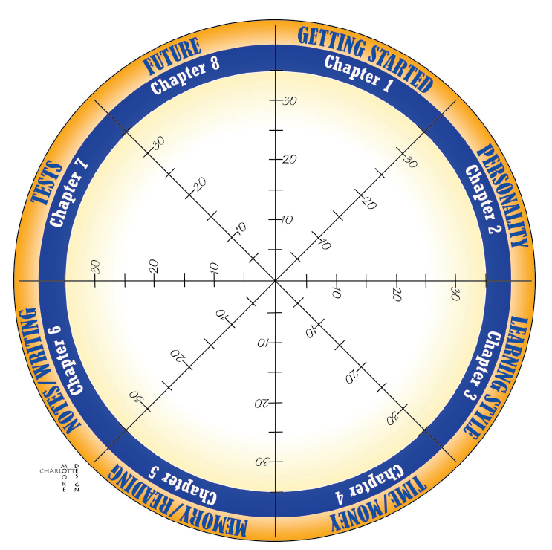
Success Wheel

Slide 26
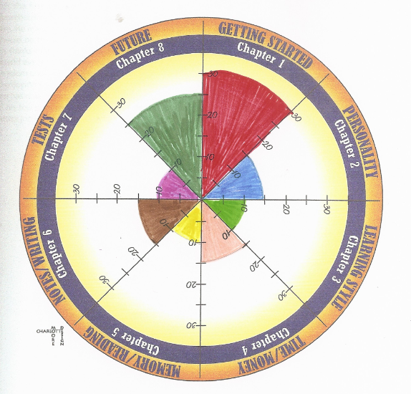
Pre-test

Slide 27
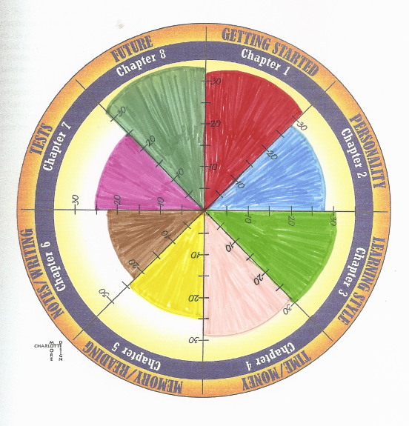
Post-test

Slide 28
Chapter 1 Sample Additional Activities
Roadblocks and Pathways to Success (see sample)
The Successful College Student (relate to careers)
Differences between High School and College
Locus of Control
10 Habits of Successful College Students
Value of Persistence

Slide 29
Paths to Success
Time Management: Chapter 4
What are my lifetime goals?
How can I manage my time to accomplish my goals?
How much time do I need for study and work?
How can I make an effective schedule?
What are some time management tricks?
How can I deal with procrastination?

Slide 30
Paths to Success
Chapter 8: Thinking Positively about the Future
Optimism, hope and future-mindedness
Believing in yourself
Beliefs of successful people
Using personal values to make decisions about the future
The language of success
Visualize your success
What does happiness mean for you?
Life is a dangerous opportunity (overcoming roadblocks)

Slide 31
Objective: Effective Academic Communication Skills
Chapter 6: Taking Notes, Writing and Speaking
Why take notes?
How to take notes
Note taking systems
How to be a good listener
Steps to good writing: POWER
Introduction to public speaking
Your personal communication style (from personality chapter)

Slide 32
Objective: Learning Style and Learning Strategies
Chapter 3: Learning Style and Intelligence
What is my learning style?
What strategies match my learning style?
How is learning style connected to personality type?
What learning strategies match my personality type?
What kinds of intelligence do I have?
What learning strategies match my multiple intelligences?

Slide 33
Measures preferences in 20 areas:
Perceptual
Environmental
Emotional
Sociological
Physical
New revision

Slide 34
20 Learning Style Factors
Perceptual
Auditory, visual, kinesthetic, tactile
Environmental
Sound, light, heat, design
Physical
Time of day, food, mobility
Emotional
Motivation, responsibility, persistence, structure
Sociological
Self, peer or adult oriented

Slide 35
Learning Outcome 2
Students in the college success course will exhibit an increased awareness, utilization, and value of academic support services.

Slide 36
Resource Awareness
The Digital Scavenger Hunt
Students use their cell phones or digital cameras to photograph resources on campus. They use the photographs for a class presentation. A handout provides the guidelines.

Slide 37
Resource Awareness
Custom Option:
Material about the resources on your campus can be included in a custom textbook. You can provide the information and I can write this section for you.
Why is it important?
Where do I go for . . . .

Slide 38
Learning Outcome 3
Students in the college success course will participate in academic advising to progress academically, including developing educational goals, career goals, and a learning plan.
This is a central focus of College and Career Success.

Slide 39
Completion by Design
Success
Time Management
Educational Planning
Career Goals
Discover Personal Strengths
Start with a dream

Slide 40
Objective: Career Discovery
Chapter 2: Exploring Your Personality and Major
What are my personal strengths?
How are my personal strengths related to my choice of a major?
What are the characteristics of my ideal career?
What are other factors to consider in choosing a major?
Career outlook
Earnings and employment availability

Slide 41
Custom Option
An additional chapter is available:
Exploring Your Interests and Values
Includes the Interest Profiler
What are my interests?
What lifestyle do I prefer?
How do my interests relate to possible careers?
What are my values?
How do I make good decisions?

Slide 42
Objective: Career Survey, i.e., Do What You Are
Students who have made a good choice of a college major are motivated to finish their education.
The Do What You Are personality assessment helps students identify personal strengths and matching careers.
These careers are linked to the O*Net Database of careers which makes research easy

Slide 43
Do What You Are
Valid and reliable
Easy to read and understand
Used with developmental students
Used at the Lone Star College System for over 10 years
Expand partnerships with Career Services and Advising who use DWYA
Not just an assessment added to a textbook.
Integrated into the textbook so that students can understand and use the results.
Students say that it is their favorite part of the course!

Slide 44
Student Comment on DWYA
The personality assessment opened my eyes to things I would have never thought on my own. Because of DWYA, my options for a specific career path has broadened. I have realized what type of person I am and learned the different ways I prefer to learn and interact with other people. I found this assignment to be really helpful and kind of helped me clear out the mist of uncertainty on my road toward success.

Slide 46
Online Portfolio
Use the access code on the inside cover of the book.
Assessments
Personality
Learning Style and Productivity
Career Database

Slide 47
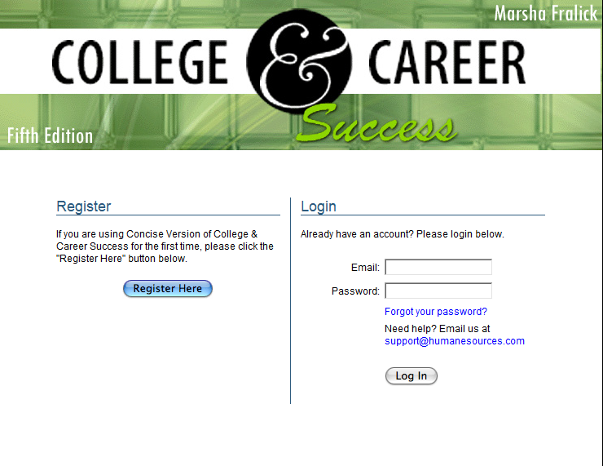

Slide 48
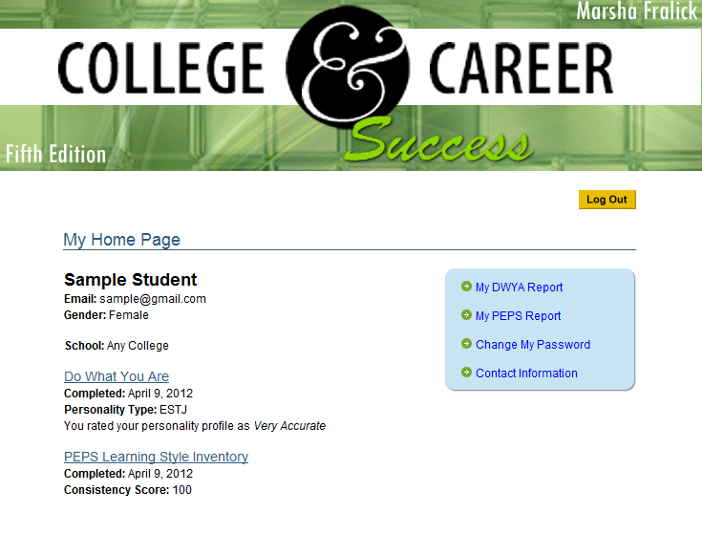

Slide 49
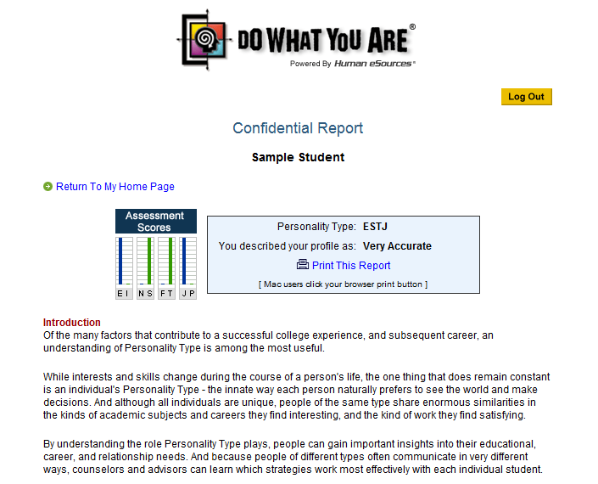

Slide 50
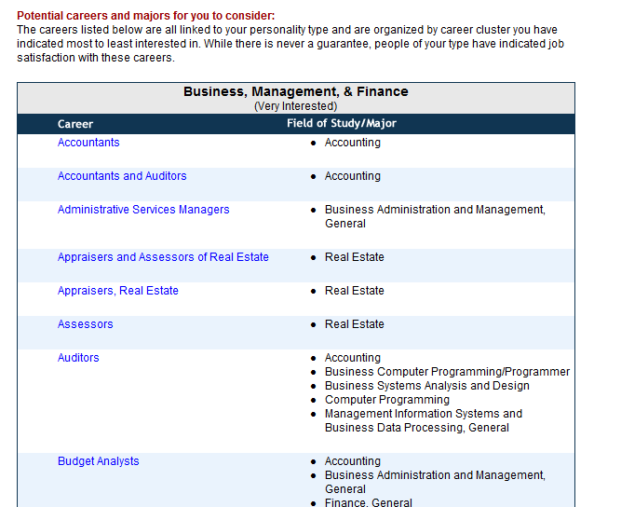

Slide 51
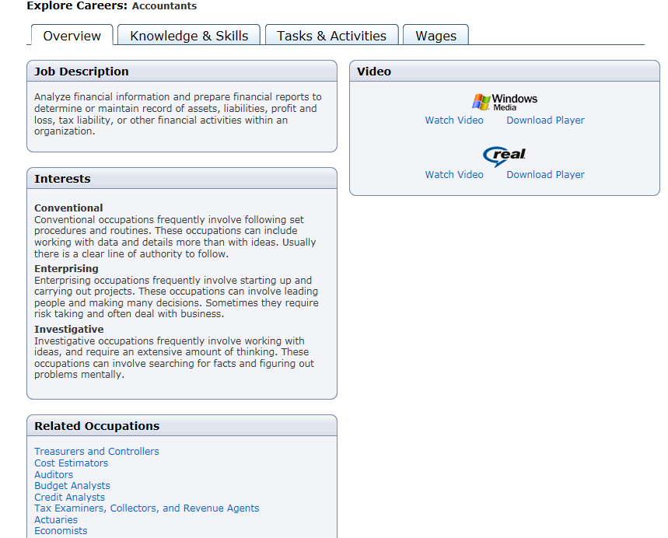

Slide 52
Objective: Educational Major Explorations
Chapter 2:
Exploring Your Personality and Major

Slide 53
Objective: Degree Planning
As a custom option, another chapter is available:
Planning Your Career and Education
Employment trends
How to research your career
Planning your education
Making good decisions

Slide 54
Objective: 3 topics
Research
Note Taking
Test Taking
Studying
Organization
Memorization

Slide 55
Option 1: Memory/Studying/Organization
Chapter 5: Improving Memory and Reading
How does the memory work?
How can I remember what I study?
What are some memory techniques?
How can I apply memory techniques to reading and studying?
How does organization help with memory and studying?

Slide 56
Option 2: Test Taking
Chapter 7: Test Taking
What are some test preparation techniques?
How should I review?
How can I deal with test anxiety?
How can I study math and deal with math anxiety?
What are some tips for taking tests?
Objective
Essay
Includes practice in taking various types of tests.

Slide 57
Option 3: Note taking
Chapter 6:
Taking Notes, Writing and Speaking

Slide 58
Professional Development
Training workshops will be provided for all faculty
Face to face and webinar
Topics
Using the text
Resources
Strategies for working with developmental students based on current research
Interactive exercises

Slide 59
Faculty Support
Ongoing support from the author
Online meetings
Email
Phone

Slide 60
Questions? Discussion
College and Career Success, Concise Edition
Dr. Marsha Fralick

