Slide 1



Slide 2
Overview CollegeScope
Overview of key features
Research on effectiveness (Brief)
Resources for faculty
A quick tour (student and faculty view)
Helping your students log in
Introducing CollegeScope to your students
Improving retention and success
Common login problems and easy solutions
Assessments

Slide 3

Keys to Success
The program helps students to make a good choice of a major and career.
Notes:
One of the keys to success of this program is that it helps students to make a good choice of a major and career. How do we do this?

Slide 4

Keys to Success
The program helps students to understand their learning style and how to become a lifelong learner.
Notes:
Another central theme is learning style. If students understand their learning style, it helps them to learn new and difficult material in college and throughout life.

Slide 5

Technology for the New Millennial Generation

Slide 6
New Millennials
Our current college students were born after 1992.
Most were born with a computer in the home and were using them by age 5
Cyber generation
The connected generation
82% are online daily
Average 12 hours per week online

Slide 7
Personalized for each student
Based on personality and learning style
Refers to the student by their name
This is not possible in a printed text

Slide 8
CollegeScope Enhancements
All students can start on time.
All students begin for free. They take the pre-test and complete Chapter 1 before they pay online. If they cannot pay online, they can purchase an access code in your bookstore.
Scholarship Program
We give you 2 free access codes for each section. You can use the access codes to help disadvantaged students.

Slide 9
Key Themes
Personality type
Positive student development
Positive thinking
Personal development
Motivation

Slide 10

Noteworthy Results at Cuyamaca Community College
Implementing our Student Success Program on college campuses has resulted in a 26% increase in persistence rates!
CUYAMACA COMMUNITY COLLEGE RESULTS:
87% of students had chosen a major by the end of the course
62% of students reported more confidence in their academic skills
88% of students rated the course as good or very good

Slide 11
Results: Lone Star College System
College | Persistence rate of all Student Types | Persistence rate of CollegeScope students
LSC – CyFair | 79% | 94%
LSC – Kingwood | 67% | 82%
LSC –Montgomery | 77% | 88%
LSC – North Harris | 81% | 90%
LSC – Tomball | 70% | 82%
System Average | 75% | 87%

Slide 12
Resources at http://www.collegesuccess1.com
Instructor Manual
Resources for Faculty
  Videos
  Internet Links
  Many other resources
Training Notes

Slide 13
Quick Tour Sample Student Portfolio
http://www.collegescope.com/ccs/leeward
sample_student@leeward.edu
Password: sample1

Slide 14
A Quick Tour Faculty Portfolio
www.collegescope.com/cuyamaca
How to log in
How to add students
The faculty menu
Locating the chapters

Slide 15
How Students Register and Log In
www.collegescope.com/ccs/leeward

Slide 16
The difference between a faculty and student account
The student account has /ccs/
ccs stands for college and career success

Slide 17
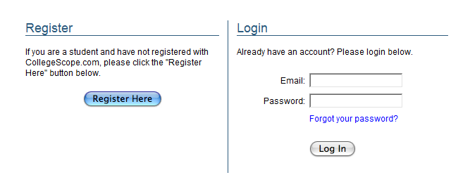
Click: Register Here

Slide 18
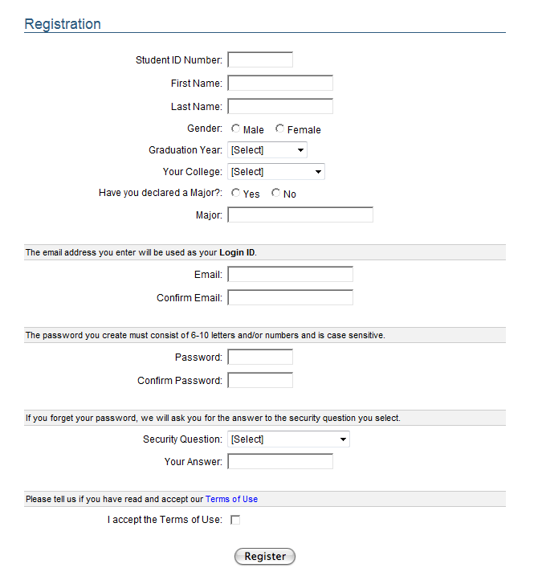
Fill out the registration information.
Click the Register Button at the bottom of the page.

Slide 19
Fill out the registration information.
Click the Register Button at the bottom of the page.

Slide 20
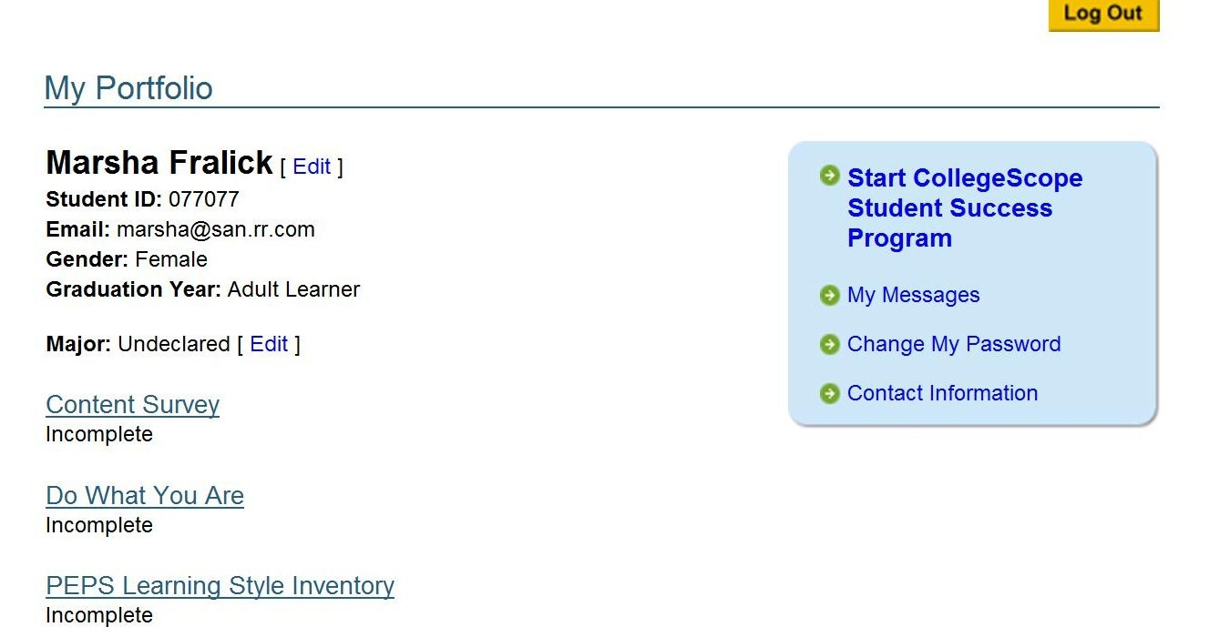

Slide 21
Click: Start CollegeScope

Slide 22
Start with an assessment
The assessment is a pre-test to measure your skills at the present time.
You will take this assessment again at the end to see how you have improved.
Relax and answer the questions honestly.
The assessment is a good outline of the content of CollegeScope.

Slide 23
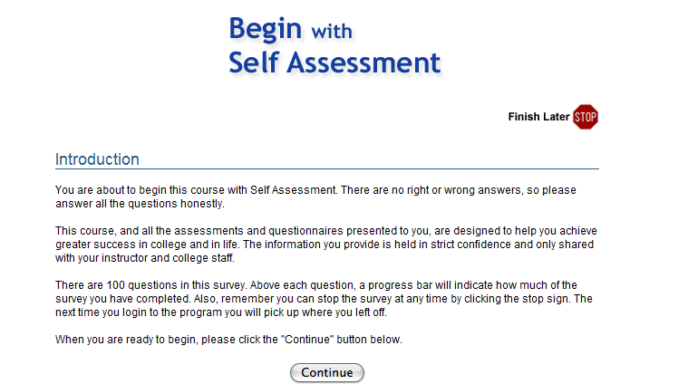

Slide 24
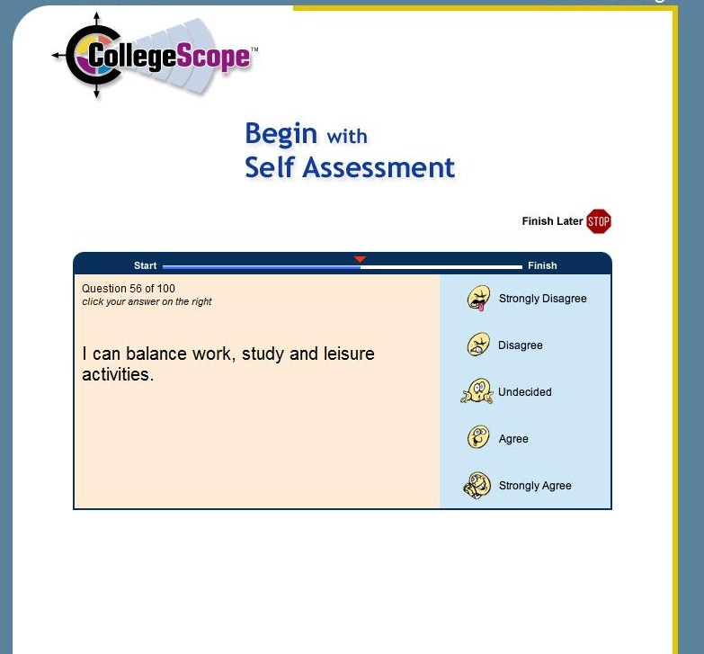
The Content Survey
There are 100 easy questions. Just answer quickly. You can click on Finish Later if you don’t complete the survey all at once.

Slide 25
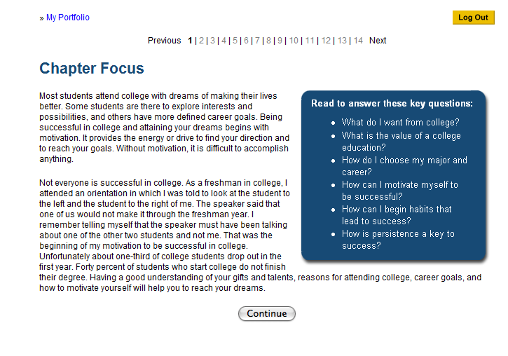
After you finish the assessment, you will see this page. Begin Chapter 1: Understanding Motivation.

Slide 26
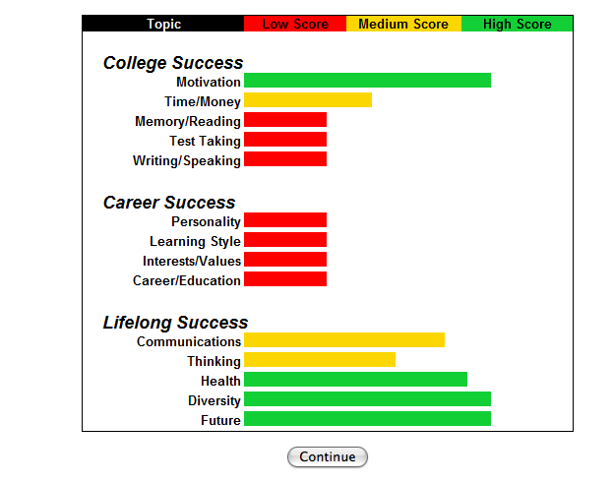
Chapter 1 contains your assessment results.

Slide 27
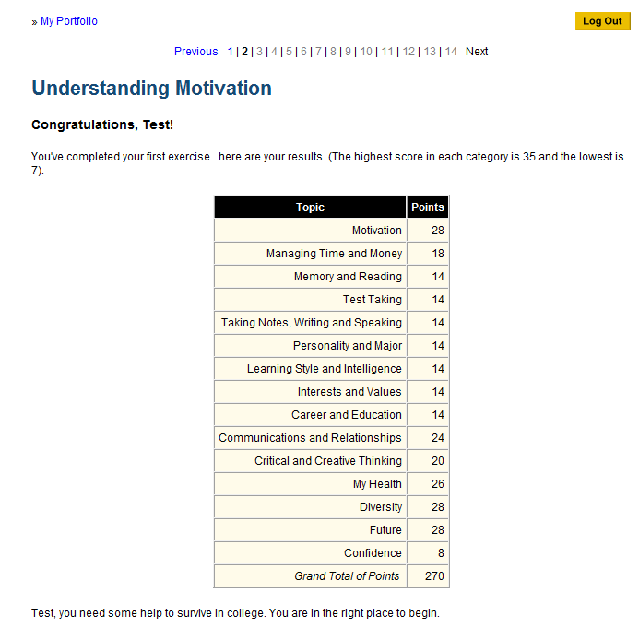
Remember that you will be improving your skills throughout the program.

Slide 28
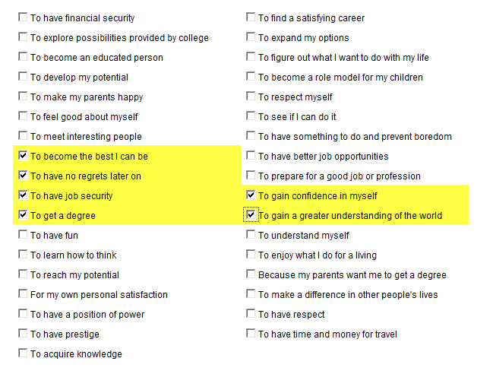
There are many interactive features in the text.

Slide 29
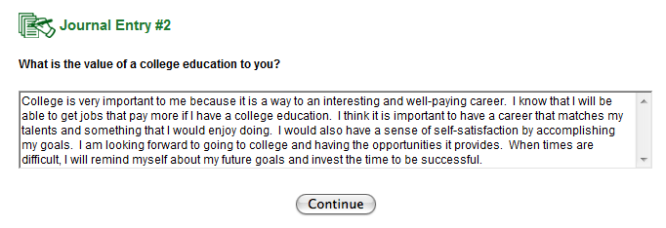
Journal entries provide the opportunity to think about the material and apply it to your personal life. They are generally a well-developed paragraph. The journal entries become part of your portfolio visible to you and your instructor.

Slide 30
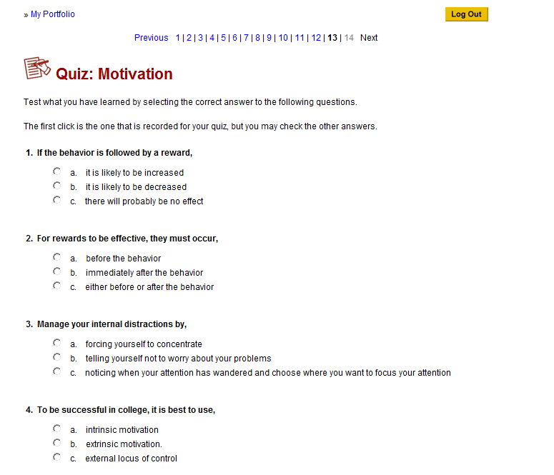
Quizzes provide immediate feedback. Read the text carefully and do your best on the quizzes. You cannot change your answers. Quizzes are part of your portfolio and your grade.

Slide 31
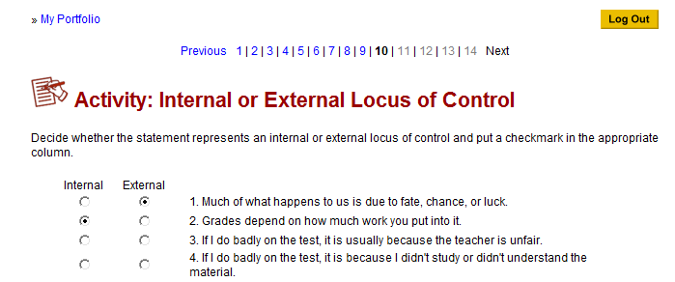
Complete the interactive activities along the way.

Slide 32
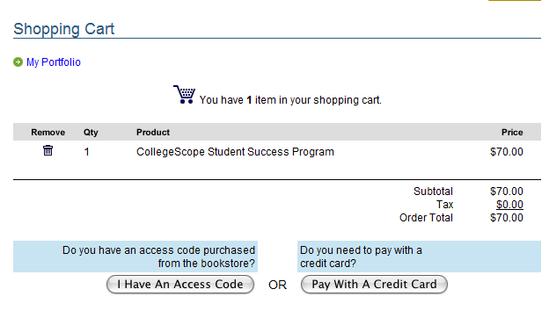
Pay the fee to continue Chapter 2 and the rest of the program.
$60.00
60.00
0.00
60.00

Slide 33
Pay online with a credit card.
Get a discount by paying online ($60).
You can use your financial aid voucher in the bookstore to purchase an access code to use instead of a credit card. The bookstore charges $__.

Slide 34
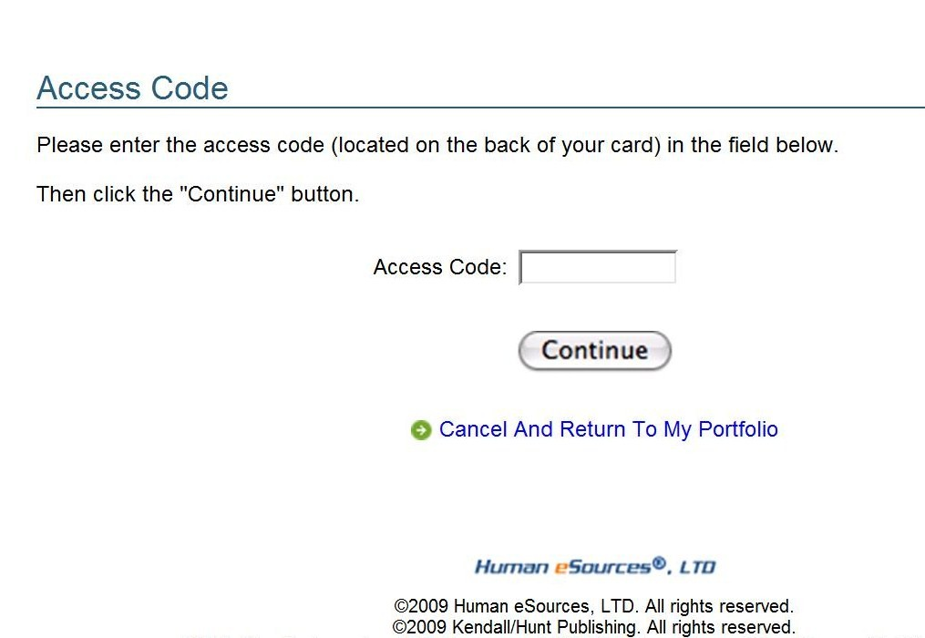
If you purchase an access code from the bookstore, enter it here.

Slide 35
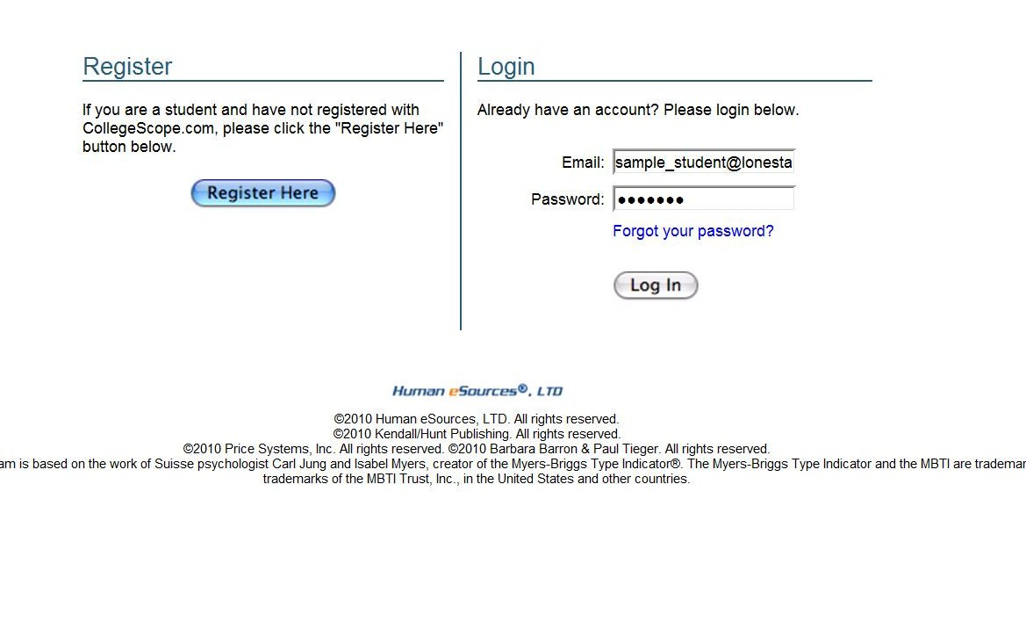
Next time, just log in.
Use the email address and password you created to log in. Do not register again.

Slide 36
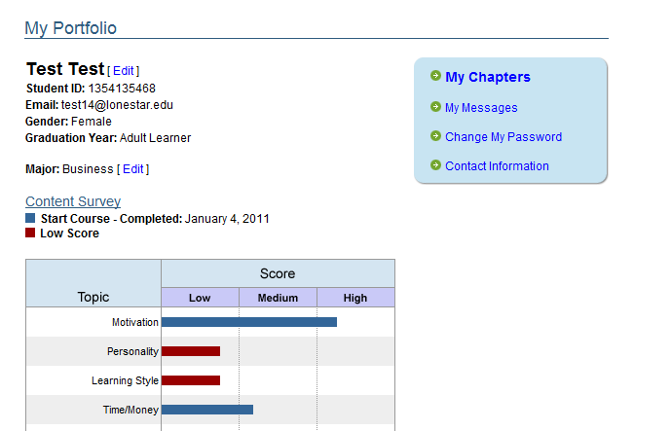
To continue, click: My Chapters.

Slide 37
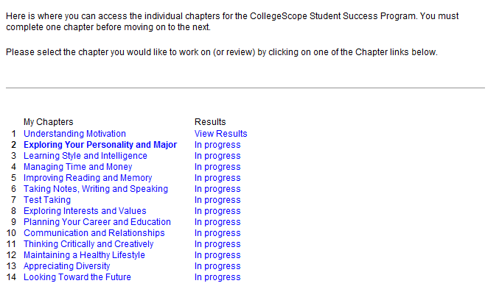
Now you may begin Chapter 2.

Slide 38
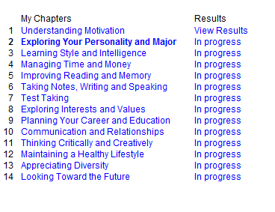
You can also view your results from previous chapters.

Slide 39
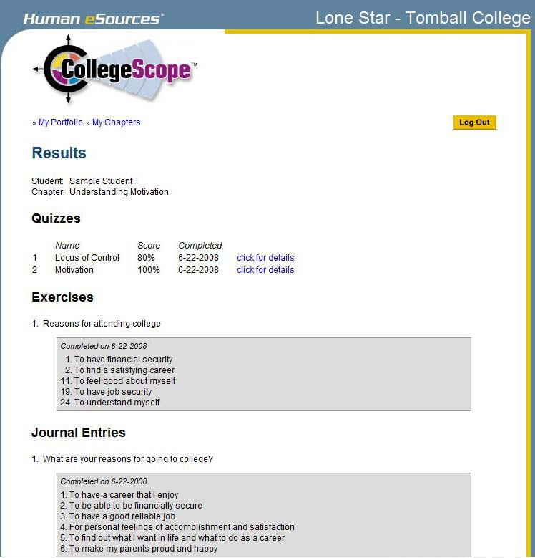

Slide 40

Improving Retention and Success with CollegeScope

Slide 41
What should you do on the first day/week?

Slide 42
The first day is the most important
Introduce the CollegeScope Student Success Program
Make your expectations clear
  The course syllabus
Get to know your students and help them to meet other students
Do something that motivates students on the first day

Slide 43
Sample Student Account sample_student@leeward.edu

Slide 44
PowerPoint: Getting Started with CollegeScope
Located at www.collegesuccess1.com
Click on CollegeScope
I will email this to you

Slide 45
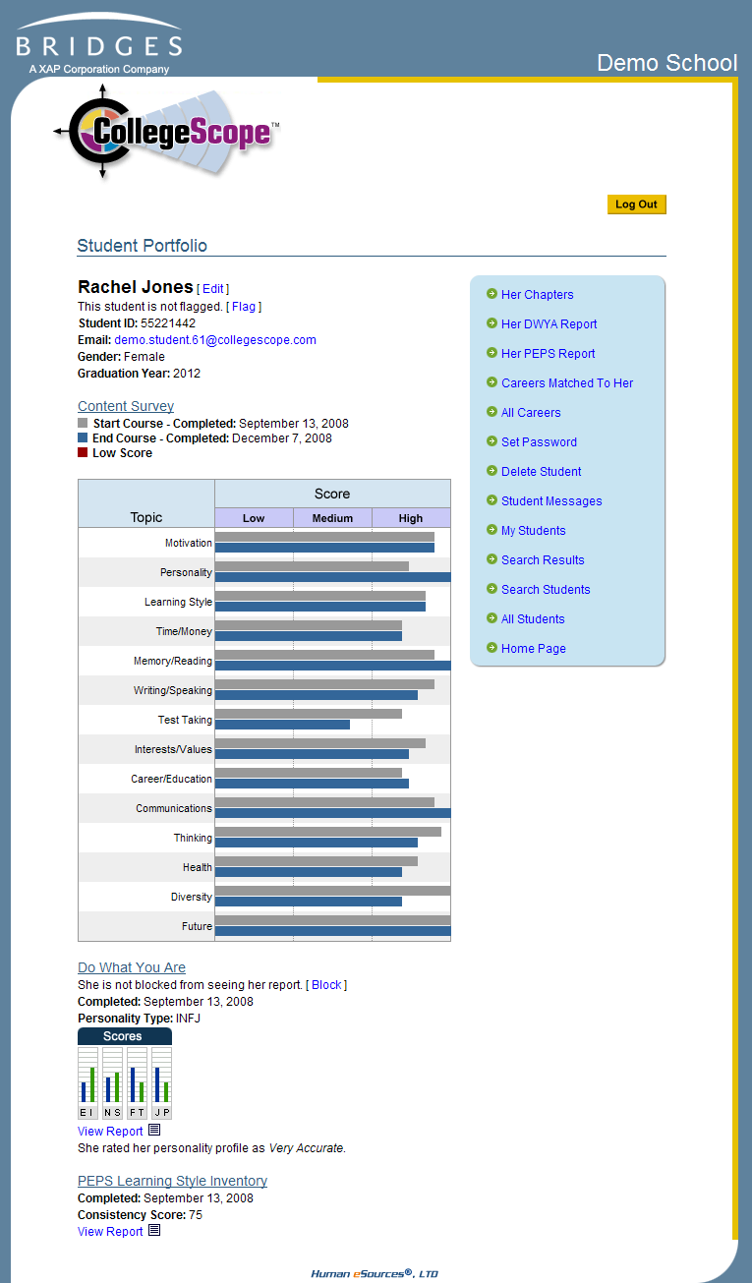
Introducing the Online Portfolio
On the first day, show the students the online portfolio and features.
Let them know that faculty have access.

Slide 46
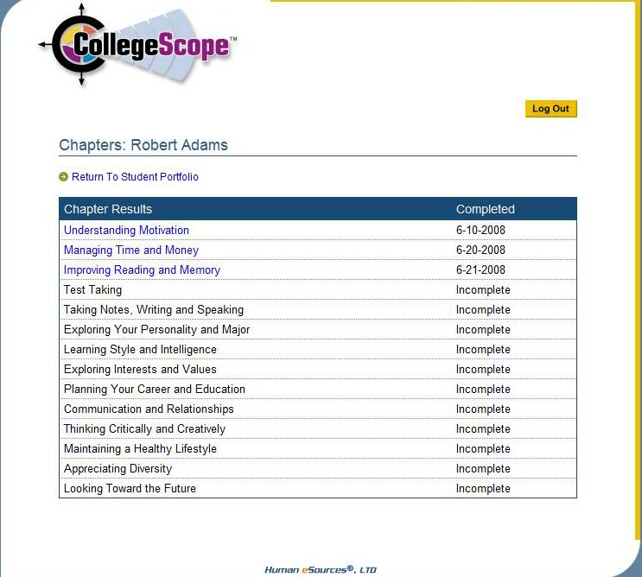
Sample Student

Slide 47
The Electronic Journal
It is an opportunity for students to read and think about how to apply the material in their personal lives.
Make your expectations clear.
Expect a well-developed paragraph for most questions.
Show a sample.

Slide 49
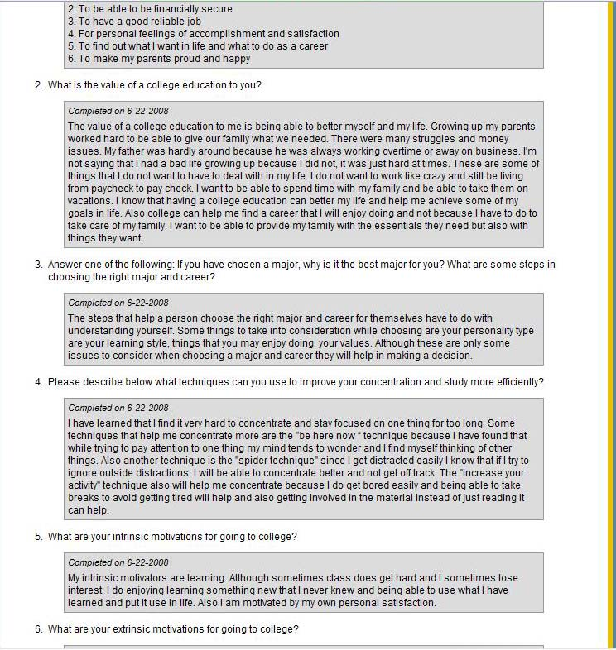

Slide 50
The Electronic Quizzes
This is an interactive feature that helps students with reading comprehension.
Students get immediate feedback.
Students cannot change their answers.
Expect students to do their best.

Slide 51
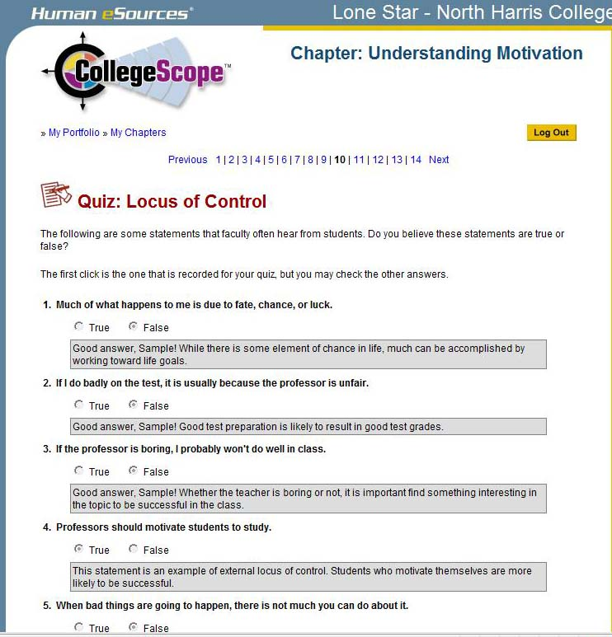

Slide 52
How to help students get started?
The first 2 weeks are critical for student success and retention.
Use CollegeScope to monitor progress.

Slide 53
Review the second day
Review the information on CollegeScope the second day for those who were absent or those who need motivation to get started.
Congratulate those who have started.
Meet with students who have not started CollegeScope.

Slide 54
Most Common Login Problems and Easy Solutions
I will email you a handout

Slide 55
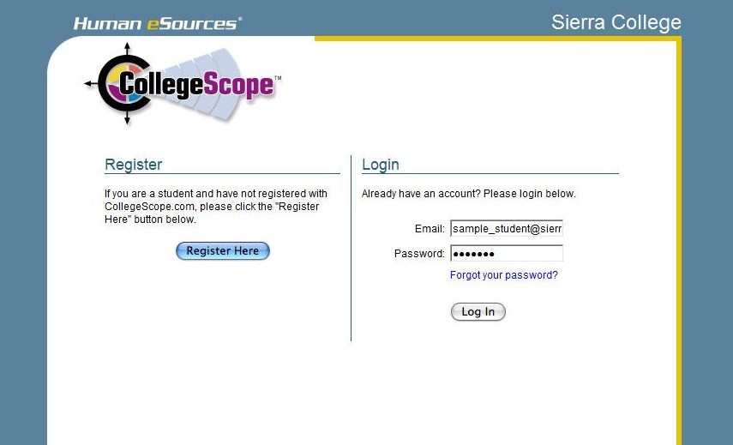
Helping Your Students Log In
Students register only once. They they log in with the email address and the password they created.

Slide 56
Remind students to write down the email address and password they use to create their accounts.

Slide 57
I forgot my email address
You can find the email address that students used to create their account by looking at their portfolio on My Students or All Students in your instructor account.

Slide 58
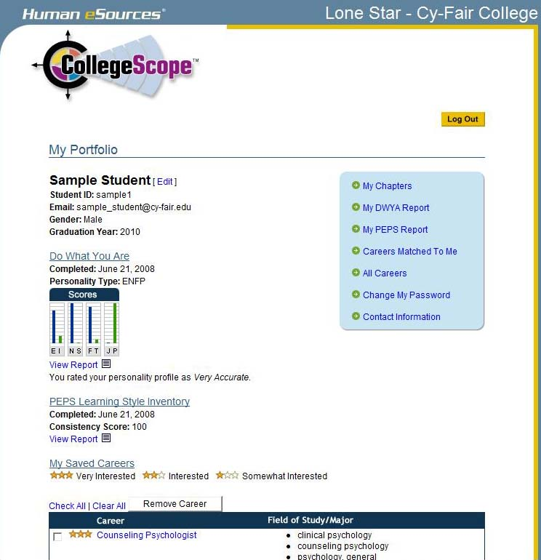

Slide 59
I forgot my password
You can look at the Student Portfolio and reset the password. Tell the student what the new password is. They can reset it when then log into their portfolio.

Slide 61
My Account Disappeared
They tried to log into the instructor account. Make sure that they have /ccs/ in the URL
http://www.collegescope.com/ccs/leeward
Don’t use Google to find CollegeScope. You may end up in a different college account.

Slide 62
When I tried to register, it says that my email already exists.
If the email already exists, they have already registered. Tell students to log in with the email address and password they created when they registered the first time.

Slide 64
When I tried to log in, it says that my email does not exist.
There are several reasons for this:
They are using a different email.
They entered the info incorrectly.
They have not registered.

Slide 65
Contact Customer Service
If you have any problem you cannot resolve. This does not happen very often.
If you need to have a student’s account reset. If a student fails and takes the course again, it can be reset so they can start over.

Slide 66
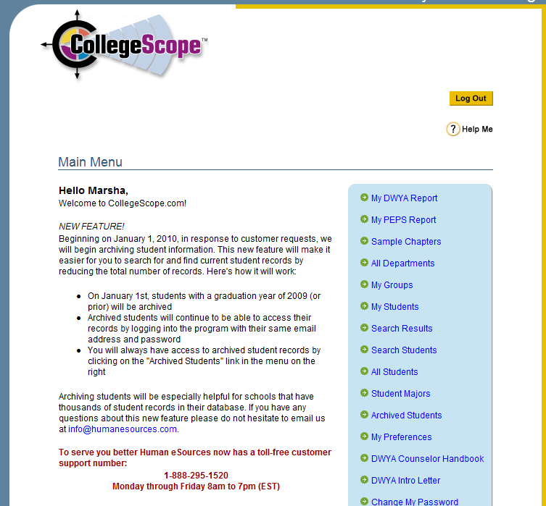

Slide 67
This info is available at the College Success Website
http://www.collegesuccess1.com/
Click on Training Notes and Leeward College for this PowerPoint
Also Common Problems and Easy Solutions
I will also email these items to you

Slide 68
Next Steps
Log into your account and complete the skills checklist
Let me know if you have questions
Next session:
Do What You Are
  PEPS
Questions?

Slide 69
Getting Started
Do What You Are (DWYA)
Productivity Environmental Preference Survey (PEPS)

Slide 70
Exercises for Today
Located at http://www.collegesuccess1.com
Job Jar Activity
Personality Checklist
Talkers and Listeners
J/P exercise

Slide 71

Personality Assessment

Slide 72


Slide 73
Carl Jung 1875-1961
We are born with natural preferences which we develop over a lifetime.
There are no good or bad types.
Each type has their own unique gifts and talents.
Exercise: What is a preference?

Slide 74
Key Theme
Choosing a major
Career choice
Learning Style
Communication
Self-understanding

Slide 75
Job Jar Activity
Use it to introduce career assessments

Slide 76
Administering the DWYA
Find a time when you are not tired or rushed.
There are no right or wrong answers.
Answer quickly giving your first impression. Do not over analyze.
You will have a chance to look at your profile and change it if you think it is not correct.

Slide 77
Administering the DWYA
Answer the questions honestly to get the best results.
Answer the questions how you usually are when you are not stressed.
Do not answer the questions:
  How you want to be
  How you have to be at home, work or school
  How others want you to be

Slide 78
Getting Good Results
Encourage students to give honest answers.
What are some reasons students would not give honest answers?

Slide 79
Administering the DWYA
The test does not measure:
  Intelligence
  Psychological or emotional health

Slide 80

Resources
Click on Do What You Are at:
http://www.collegesuccess1.com
Do What You Are Handbook
Psychometric Report
Also on your faculty menu

Slide 81
Interpreting the Assessment

Slide 82
Use the Personality Checklist
Contains a quick checklist with definitions
Use it to help students understand their results
Available in the Instructor Manual
Training Notes for Leeward College

Slide 83
Begin Self-Assessment
How we interact with the world and where we place our energy
E_____________________________|____________________________I
Extraversion Introversion

Slide 84
Talkers and Listeners
Talker
Listener
What made me a talker?
How can I develop my listening skills?
How can I help listeners talk more?
What made me a listener?
How can I develop my talking skills?
How can I help talkers listen more?

Slide 85
Self-Assessment
The kind of information we naturally notice and remember
S_____________________________|___________________________N
Sensing Intuition

Slide 86
Personality Exercise
Write about the picture for 3 minutes

Slide 87

By Ian Jackson

Slide 88
Self-Assessment
How we make decisions
T_____________________________|___________________________F
Thinking Feeling

Slide 89
Self-Assessment
Whether we prefer to live in a more structured or spontaneous way
J_____________________________|_____________________________P
Judging Perceiving

Slide 90
J and P Exercise:
Where do you stand?
  I can play anytime
  I have to finish my work before I play

Slide 91

The Productivity Environmental Preference Survey (PEPS)
Measures preferences in 20 areas

Slide 92
Administering the PEPS
Give your initial response
No need to over analyze
Answer as though you were learning new or difficult information

Slide 93
Important Considerations
It is not a test
It describes how you prefer to learn new or difficult material
Usually there are 6 or 7 areas out of 20 that are important for an individual

Slide 94
Measures preferences in 20 areas
  Perceptual
    Auditory
    Visual
    Kinesthetic
    Tactile

Slide 95
PEPS
Immediate environment
  Sound
  Heat
  Light
  Design (formal or informal)

Slide 96
PEPS
Emotionality
  Motivation
  Responsibility
  Persistence
  Structure

Slide 97
PEPS
Sociological
  Self oriented
  Peer oriented
  Adult oriented

Slide 98
PEPS
Physical
  Time of day
  Food intake
  Mobility

Slide 99
Perceptual
Auditory (one third)
Visual (one third)
Tactile/Kinesthetic (one third)
Learning disabled as well as gifted prefer tactile/kinesthetic

Slide 100
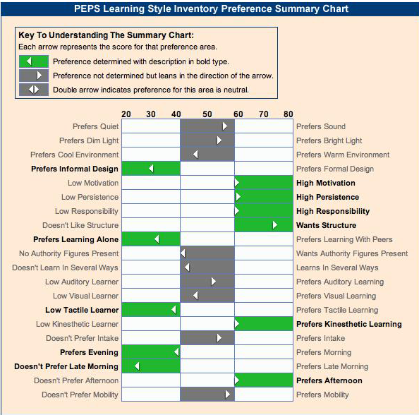

Slide 101
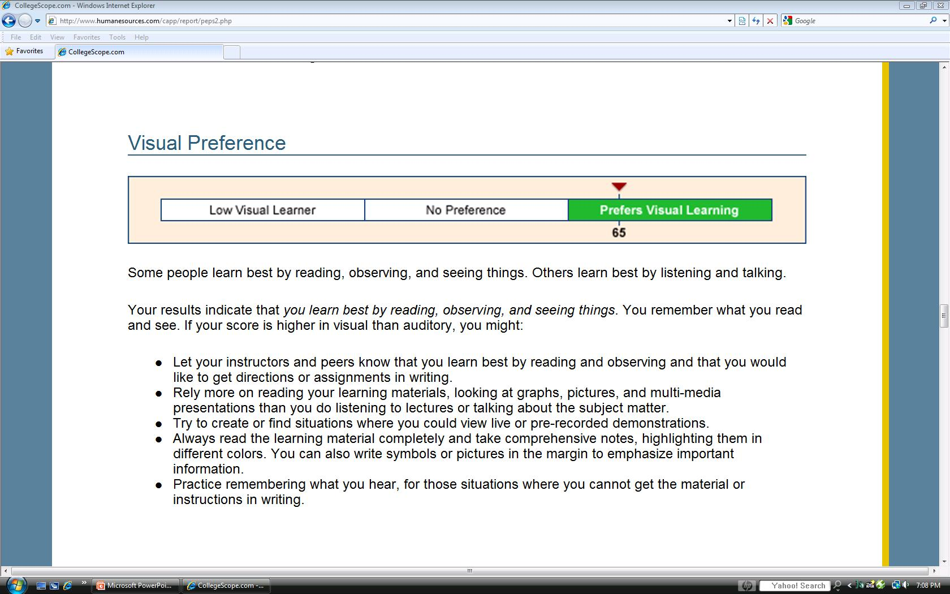
Personalized Learning Strategies

Slide 102
Learning Style Exercise: The Paper Airplane

Slide 103
Questions?

