Slide 1

Improving Retention and Success with CollegeScope

Slide 2
College Success 1
Resources for faculty and students
http://www.collegesuccess1.com/
Training Notes

Slide 3

College Retention
Semester to Semester
5 Year Average at Cuyamaca College
All students 63%
All CollegeScope students 89%
A 26% improvement!

Slide 4
Lone Star College System
College | Persistence rate of all Student Types | Persistence rate of CollegeScope students
LSC – CyFair | 79% | 94%
LSC – Kingwood | 67% | 82%
LSC –Montgomery | 77% | 88%
LSC – North Harris | 81% | 90%
LSC – Tomball | 70% | 82%
System Average | 75% | 87%

Slide 5
Where are you in the technology continuum?
Baby boomer 1946-1964
Generation X 1965-1977
New Millennials 1977-1995
How much technology did you use in college?

Slide 6
New Millennials
Our current college students
Most were born since 1990
Most were born with a computer in the home and were using them by age 5
Cyber generation
The connected generation
82% are online daily
Average 12 hours per week online

Slide 7
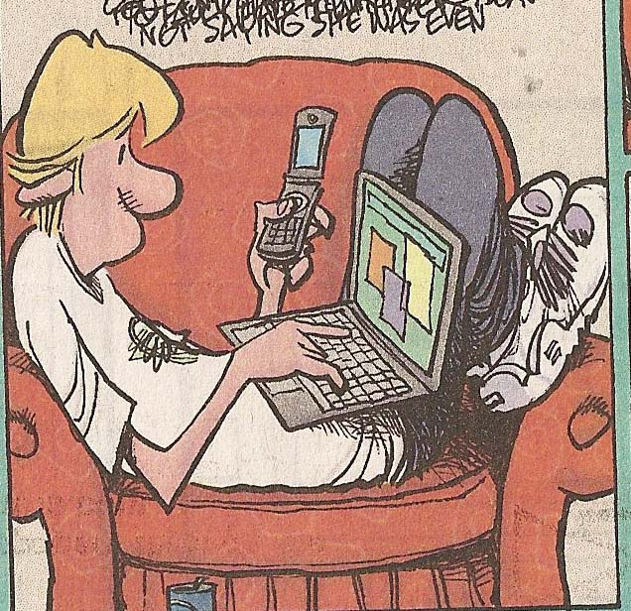
New Millennials or Generation E
18-30 years old
Empowered
Entitled
Electronic
  Leading change from paper to electronic media

Slide 8
Using Technology
Online career and learning style assessment
E-text
Online portfolio
Engaging material for the New Millennial generation

Slide 9
Technology
Most college courses, especially upper division courses, have online components
Working in an online environment is essential for high paying careers
Students are disadvantaged if they do not have access to the Internet and are skilled in using it

Slide 10

Why is the world flat?

Slide 11
Rationale for Using Technology
It prepares students for good paying jobs in flat world
Improves retention and success
New roles for faculty
Your students use it
It captures their attention
Education any time or place

Slide 12
Personalized for each student
Based on personality and learning style
Refers to the student by their name
This is not possible in a printed text

Slide 13
CollegeScope: An Overview
http://www.collegescope.com/cuyamaca
http://www.collegescope.com/cuyamacahs

Slide 14
The Critical Period
The first two weeks is when most students drop.
This is our best opportunity to help students to be successful.

Slide 15
The Critical First 2 Weeks
You will know who has begun the program and who has not started.
How can you help the students who have not begun?
Think
Pair
Share

Slide 16
The first day of class is also critical
Most of your students will attend the first day.
It is an opportunity to impact student success and retention.

Slide 17
What should you do on the first day?

Slide 18
The first day is the most important
Introduce the CollegeScope Student Success Program
Make your expectations clear
  The course syllabus
Get to know your students and help them to meet other students
Do something that motivates students on the first day

Slide 19
Introduce CollegeScope
What is it?
How to log in
Show sample student
  Online portfolio
  Chapters
  Sample journal entries

Slide 20
Logging in to CollegeScope

Slide 21
Log into your account
http://www.collegescope.com/cuyamaca
http://www.collegescope.com/cuyamacahs

Slide 22
How Students Register and Log In
http://www.collegescope.com/ccs/cuyamaca
http://www.collegescope.com/ccs/cuyamacahs

Slide 23
The difference between a faculty and student account
The student account has /ccs/
ccs stands for college and career success

Slide 24
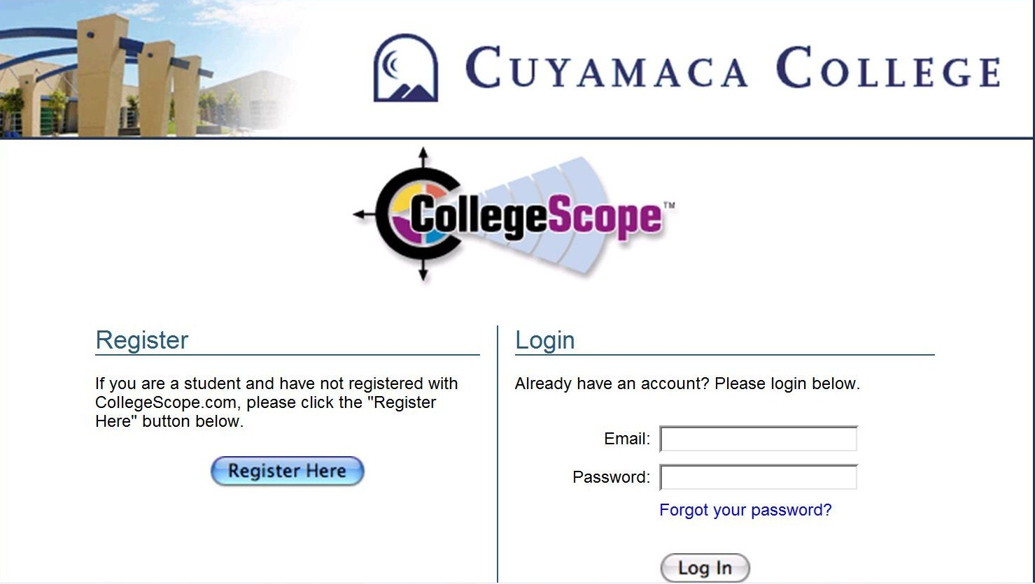

Slide 25
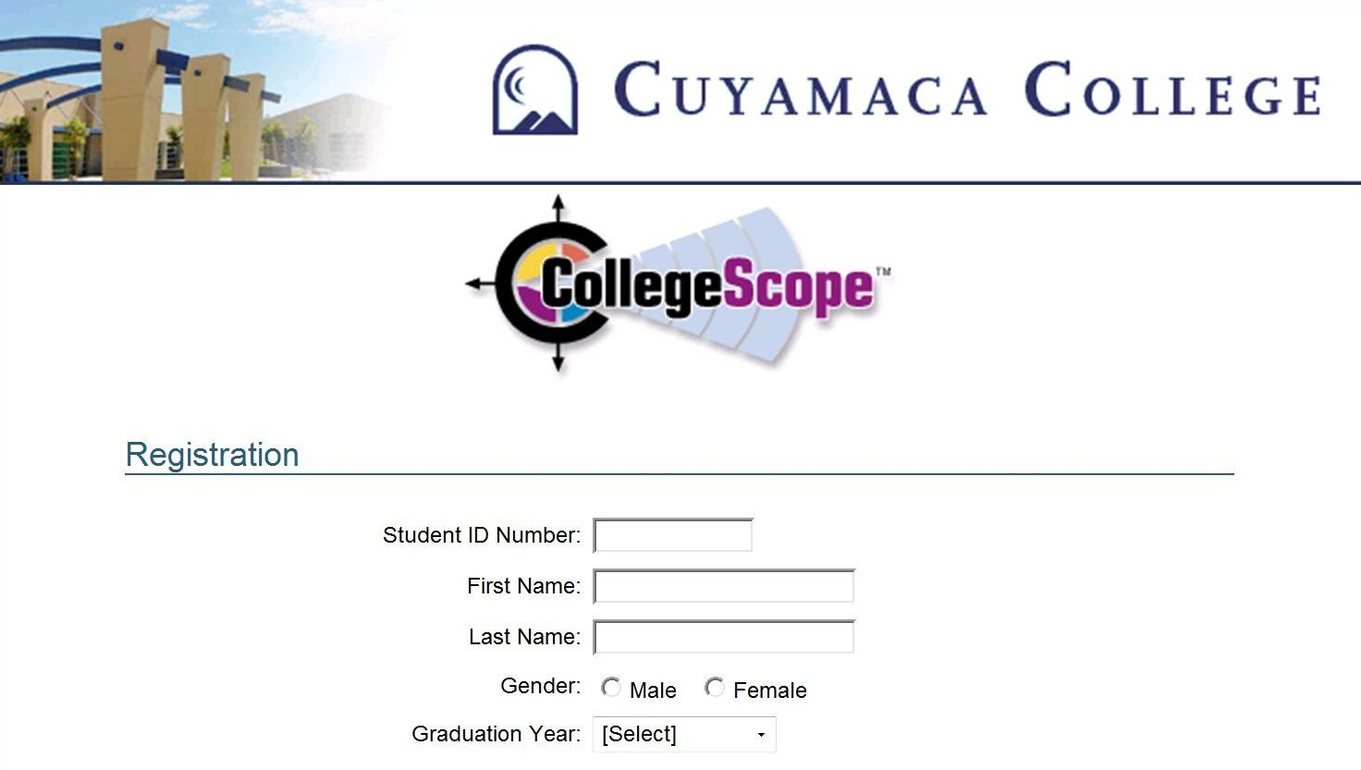

Slide 26
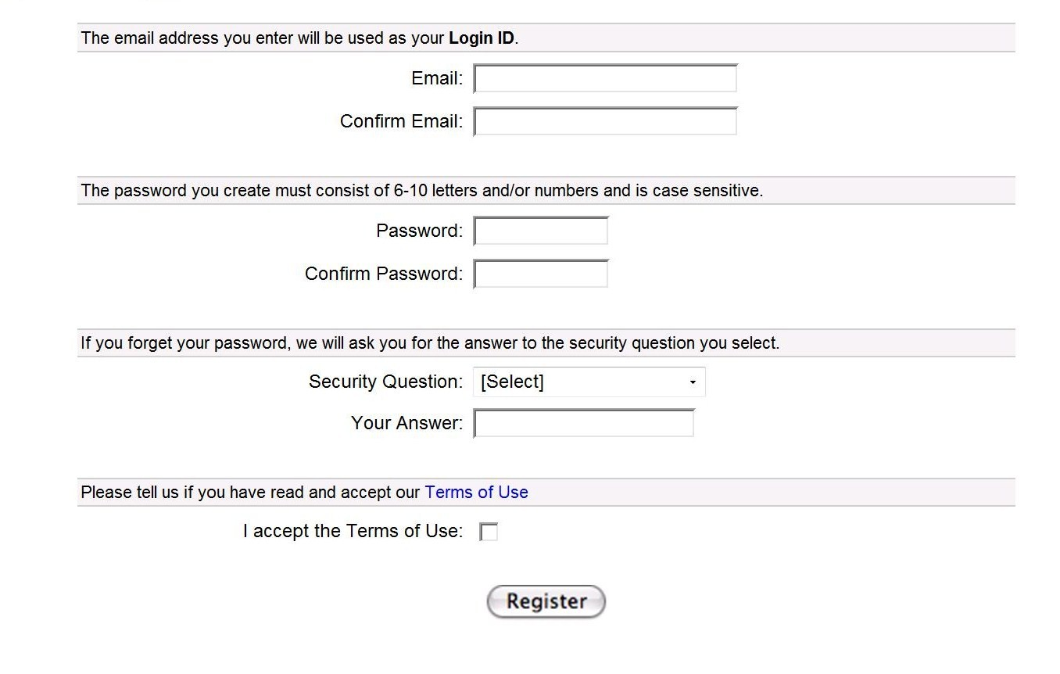

Slide 27


Slide 28
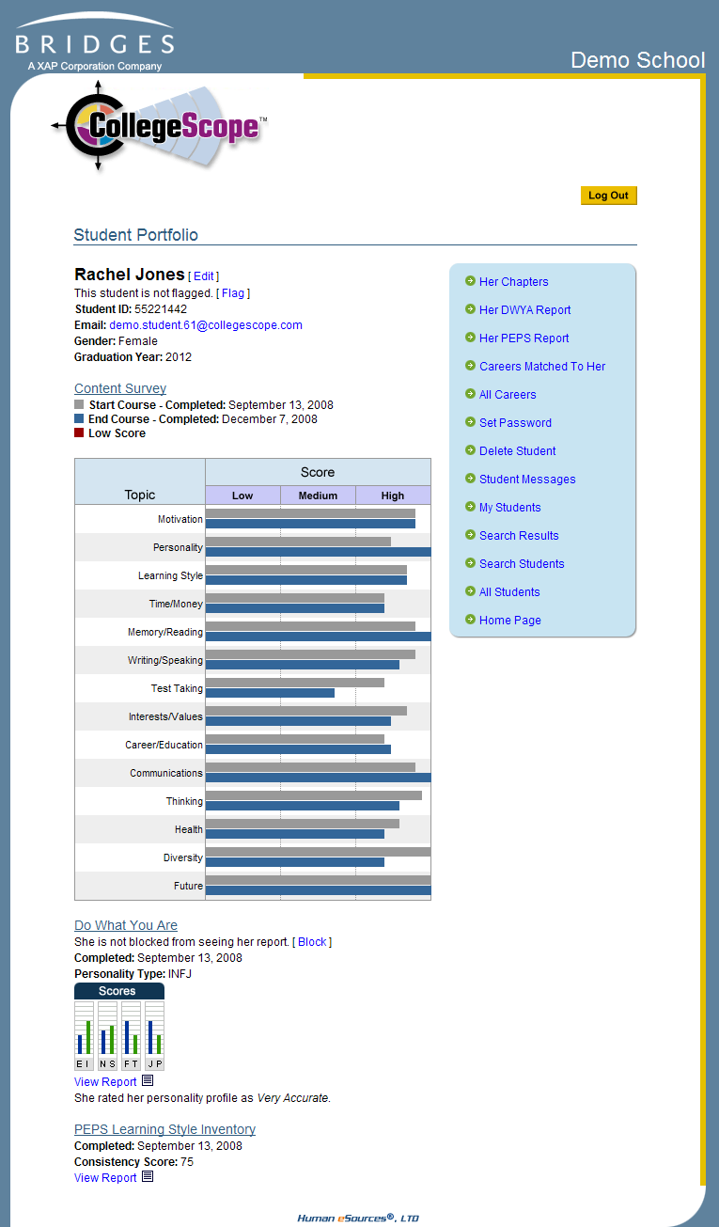
Introducing the Online Portfolio
On the first day, show the students the online portfolio and features.
Let them know that faculty have access.

Slide 29
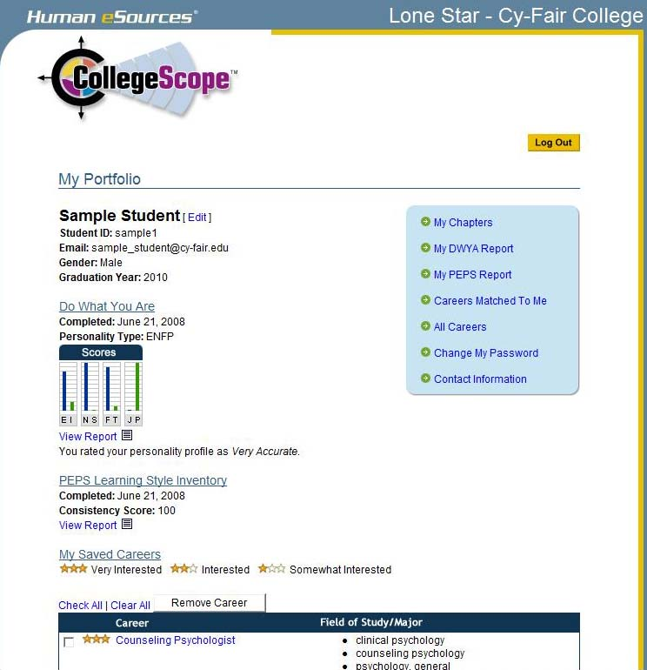

Slide 30
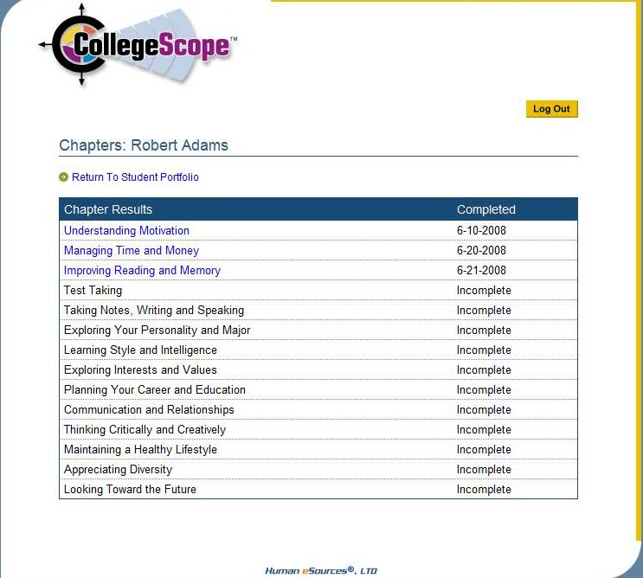
Sample Student

Slide 31
The Electronic Journal
It is an opportunity for students to read and think about how to apply the material in their personal lives.
Make your expectations clear.
Expect a well-developed paragraph for most questions.
Show a sample.

Slide 32
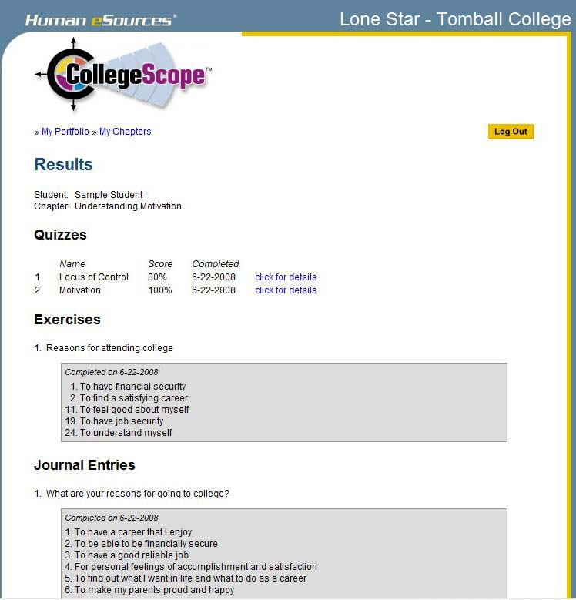

Slide 33
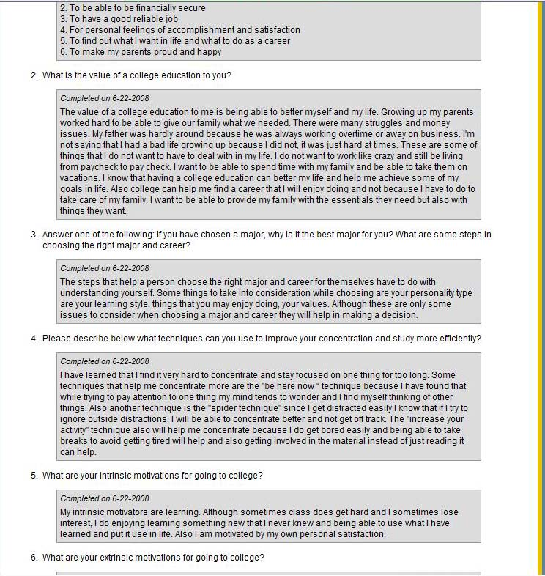

Slide 34
The Electronic Quizzes
This is an interactive feature that helps students with reading comprehension.
Students get immediate feedback.
Students cannot change their answers.
Expect students to do their best.

Slide 35
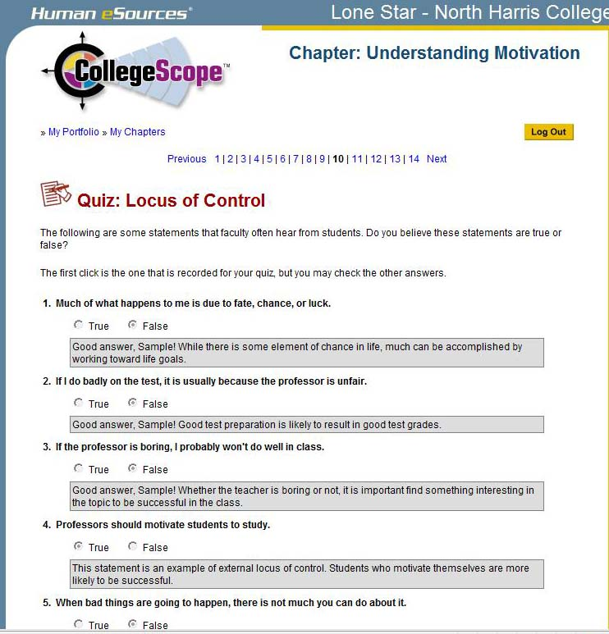

Slide 36
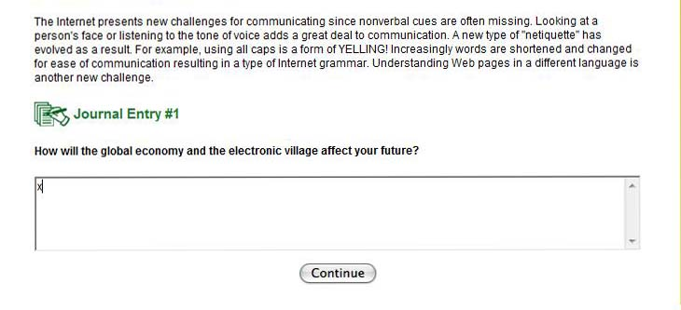
How to Cheat

Slide 37
How you will be caught

Slide 38
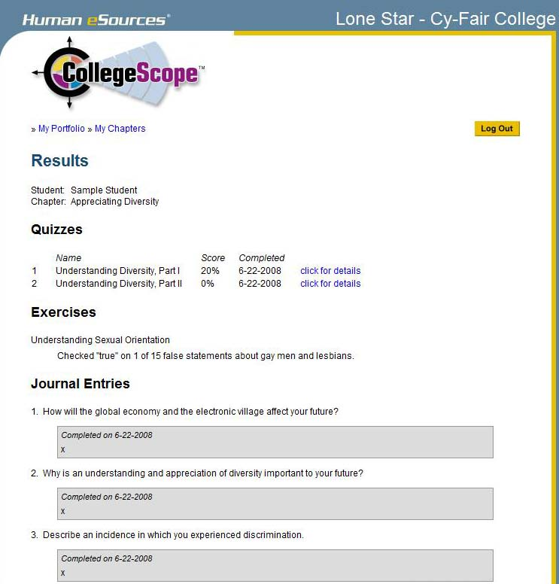

Slide 39
Expect students to read the chapter before coming to class
You can focus on engaging students in learning, discussion and sharing your experiences.
This is a good strategy for other classes too.
Minimizes the need to lecture.
All classes cover the same material in an interactive way.

Slide 40
Review the second day
Review the information on CollegeScope the second day for those who were absent or those who need motivation to get started.
Congratulate those who have started.
Meet with students who have not started CollegeScope.

Slide 41
Common Problems
And Easy Solutions

Slide 42
Helping Your Students Log In
Students register only once. Then they log in with the e-mail address and password they created.

Slide 43
Remind students to write down the email address and password they use to create their accounts.

Slide 44
I forgot my email address
You can find the email address that students used to create their account by looking at their portfolio on My Students or All Students in your instructor account.

Slide 46
I forgot my password
You can look at the Student Portfolio and reset the password. Tell the student what the new password is. They can reset it when then log into their portfolio.

Slide 48
My Account Disappeared
They tried to log into the instructor account. Make sure that they have /ccs/ in the URL
http://www.collegescope.com/ccs/cuyamaca

Slide 49
When I tried to register, it says that my email already exists.
If the email already exists, they have already registered. Tell students to log in with the email address and password they created when they registered the first time.

Slide 50
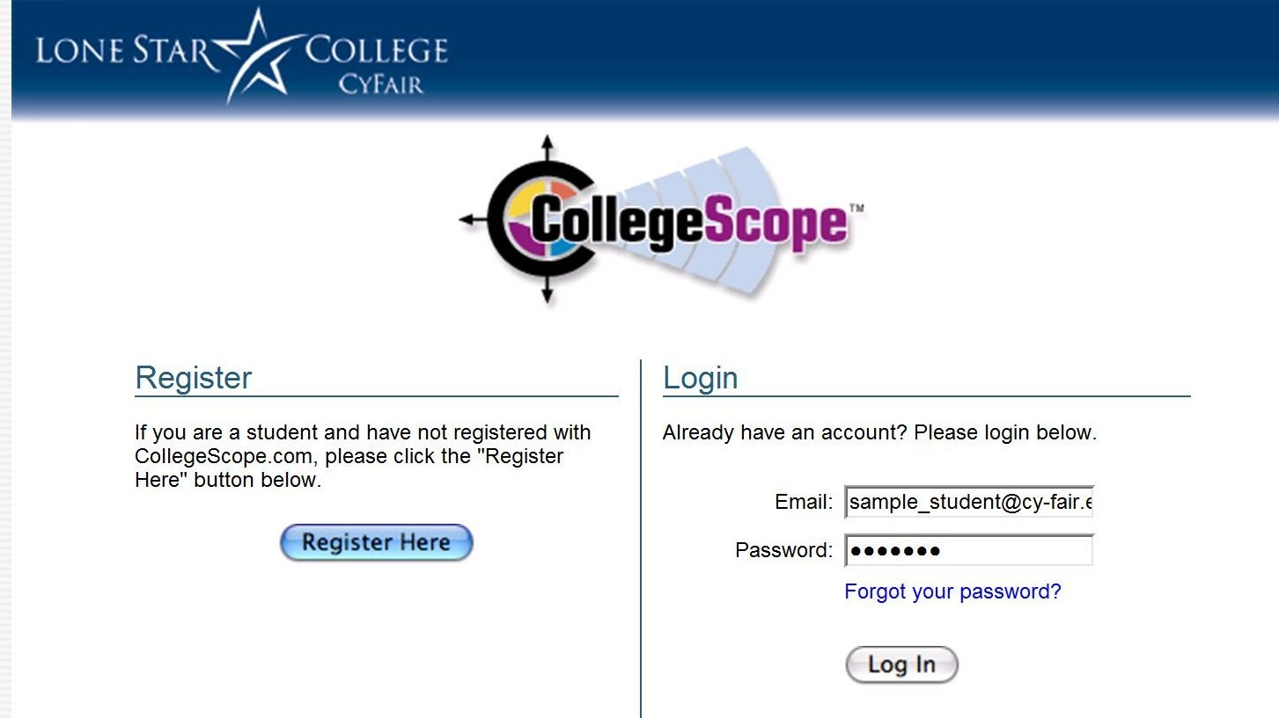

Slide 51
When I tried to log in, it says that my email does not exist.
There are several reasons for this:
They are using a different email.
They entered the info incorrectly.
They have not registered.

Slide 52
Contact Customer Service
If you have any problem you cannot resolve. This does not happen very often.
If you need to have a student’s account reset. If a student fails and takes the course again, it can be reset so they can start over.

Slide 53
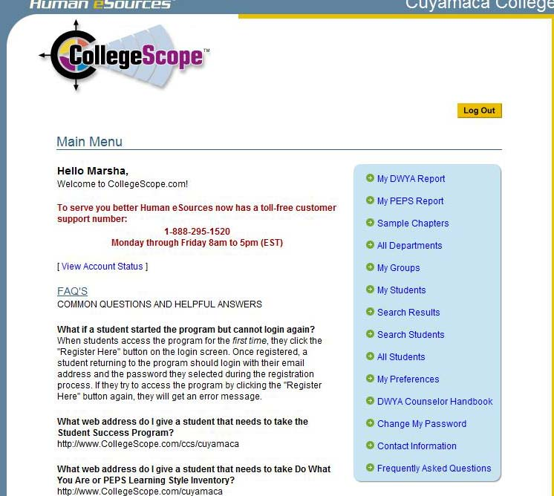

Slide 54
This info is available at the College Success Website
http://www.collegesuccess1.com/
Click on CollegeScope
There is a PowerPoint slide show on how to introduce CollegeScope.

Slide 55
Blackboard Basics
You have an account
Log in with firstname.lastname and use your 6 digit birthdate as the password
Overview
Contact Rhonda Bauerlein for training
  619-660-4013
  Rhonda.Bauerlein@gcccd.edu

Slide 56
What is
Something you learned?
Something you found useful?

Slide 57
Questions?
Discussion
Evaluation

