Slide 1
Exploring Your Multiple Intelligences
Chapter 4

Slide 2
Multiple Intelligences
Developed by Howard Gardner
Defined as the human ability to solve problems or design or compose things valued in at least one culture
Broadens the scope of human potential

Slide 3
MULTIPLE INTELLIGENCES
Verbal/Linguistic
Logical-Mathematical
Musical
Visual/Spatial
Bodily/Kinesthetic
Intrapersonal
Interpersonal
Naturalist
Existential

Slide 4
Three Factors
Heredity
Personal Life History
Cultural and historical background
Key Idea: You can develop your multiple intelligences.

Slide 5
Life History
Crystallizers promote the development of the intelligence.
Paralyzers inhibit the development of the intelligence.
What are some factors that affected your intelligences early in life?

Slide 6
Build on Your Strengths
Musical
Listening to music
Singing or playing an instrument
Recognizing musical patterns
Musical Smart
Careers
Disc Jockey
Music Teacher
Music Retailer
Music Therapist
Singer
Song Writer
Music Critic
Music Lawyer

Slide 7
Build on Your Strengths
Interpersonal
Communication
Social skills
Helping others
Resolve conflicts
People Smart
Careers
Cruise Director
Mediator
Human Resources
Dental Hygienist
Nurse
Psychologist
Social Worker
Marketer
Counselor

Slide 8
Build on Your Strengths
Logical-Mathematical
Math aptitude
Interest in science
Problem solving
Logical thinking
Number Smart
Careers
Engineer
Accountant
Computer Analyst
Physician
Detective
Researcher
Scientist
Economist

Slide 9
Build on Your Strengths
Spatial
Visualization
Navigation
Reading
Writing
Picture Smart
Careers
Architect
Artist
Film animator
Mechanic
Pilot
Webmaster
Interior decorator
Graphic artist
Photographer

Slide 10
Build on Your Strengths
Bodily Kinesthetic
Hand and eye
coordination
Athletics
Dance
Drama
Cooking
Learning by doing
Body Smart
Careers
Athlete
Carpenter
Craftsperson
Mechanic
Jeweler
Computer game designer
Firefighter
Forest ranger
Physical therapist

Slide 11
Build on Your Strengths
Linguistic
Reading
Writing
Vocabulary
Spelling
Good listener
Good memory
Word Smart
Careers
Journalist
Writer
Editor
Attorney
Curator
Newscaster
Politician
Librarian
Comedian

Slide 12
Build on Your Strengths
Intrapersonal
Self-aware
Understand emotions
Independent
Self-motivated
Self Smart
Careers
Career counselor
Wellness counselor
Therapist
Criminologist
Intelligence officer
Entrepreneur
Researcher
Actor
Artist

Slide 13
Build on Your Strengths
Naturalist
Aware of natural surroundings
Preserve the environment
Nature Smart
Careers
Park ranger
Dog trainer
Landscaper
Meteorologist
Veterinarian
Animal health technician
Ecologist
Wilderness guide
Environmental lawyer

Slide 14
Build on Your Strengths
Existential
Questioning
Purpose of life
Religious beliefs
Curiosity Smart
Careers
Counselor
Psychologist
Psychiatrist
Social worker
Ministry
Philosopher
Artist
Scientist
Researcher

Slide 15
Emotional Intelligence
Interpersonal + Intrapersonal
The ability to recognize, control, and evaluate your emotions while realizing how they affect other people

Slide 16
Emotional Intelligence
Two Parts:
Understanding yourself, your goals, intentions, responses and behavior
Understanding others and their feelings

Slide 17
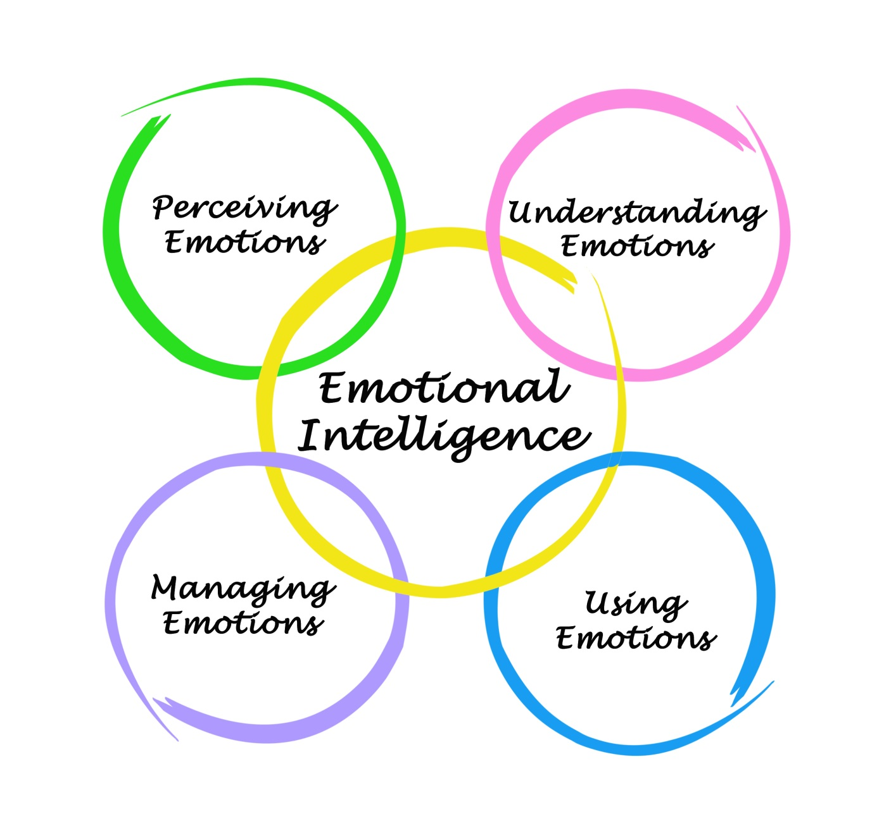
Emotional Intelligence

Slide 18
Emotional Intelligence
Express yourself
Work as part of a team
Concentrate
Remember
Make decisions
Deal with stress
Overcome challenges
Deal with conflict
Empathize with others

Slide 19
How Can You Develop Emotional Intelligence?

Slide 20
Developing Emotional Intelligence
Use empathy.
Think about how your actions affect others.
Be intellectually curious.
Give others credit for their accomplishments.
Work on stress management.
Take a college course on verbal and nonverbal communication.
Take responsibility for your actions.

Slide 21
You have assessed you personal strengths, interests, values and multiple intelligences. Use the results to set some long-term and short-term goals.

Slide 22
What are your lifetime goals?

Slide 23
Successful Goal Setting
Is it achievable?
Is it realistic?
Is it specific and measureable?
Do you want to do it?
Are you motivated to achieve it?
Does the goal match your values?
What steps will you take to begin?
When will you finish this goal?

Slide 24
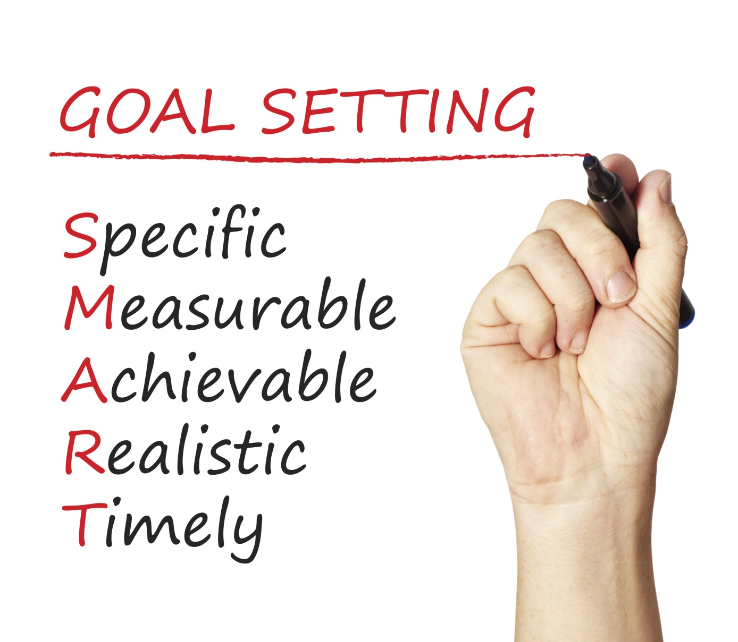
Smart Goals

Slide 25
Class Exercise: My Lifetime Goals

Slide 26
Rules for Brainstorming
Generate as many ideas as possible
No censorship
Choose the best ideas later
Set a time limit
Establish a goal or quota

Slide 27
In 5 minutes, list your lifetime goals. Write anything that comes to mind. Can you list at least 10?

Slide 28
Look over your list and highlight or mark the most important goals.

Slide 29
In 5 minutes, list what you would like to accomplish in the next 5 years. Include your educational and career goals. See if you can come up with 10 items.

Slide 30
Again, highlight or mark your best answers.

Slide 31
What goals would you like to accomplish in the next year?
Consider these goals:
Education
Work
Leisure
Family
Social

Slide 32
Highlight your best ideas. Share with the class one of your most important ideas from this question.

Slide 33
Assignment: Finish My Lifetime Goals

Slide 34
What is the difference between a goal and a fantasy?

Slide 35
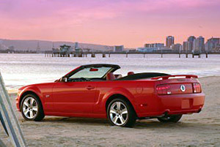
Is this car a goal or a fantasy?

Slide 36
A Goal Requires
ACTION

Slide 37
Turn Your Dreams Into Reality
Dream or visualize
Convert the dream into goals
Convert your goals into tasks
Convert your tasks into steps
Take your first step and then the next

Slide 38
Keys to Success: Create Your Future
We are responsible for what happens in our lives.
We make choices and decisions that create the future.
Our behavior leads to success or
failure.

Slide 39
Create Your Future
“Response-ability”
Our ability to choose responses and make decisions about the future
-Steven Covey
When dealing with a problem, ask how you created it. If you created the problem, you can create the solution.

