Slide 1
Exploring Interests and Values
Chapter 3

Slide 2
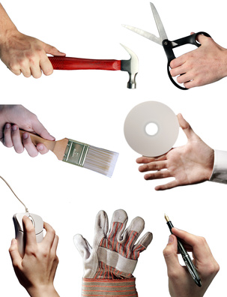
Knowing your interests is helpful in choosing a major and career.

Slide 3
The Interest Profiler*
Place a checkmark next to the items you might like to do.
You do not need to know how to do them or even have the opportunity to do them.
Don’t select items based on income.
You can earn higher income with more education.
For example, if you would like to build a brick walkway, you could work in construction or with more education, become a civil engineer.
*Available in the textbook

Slide 4
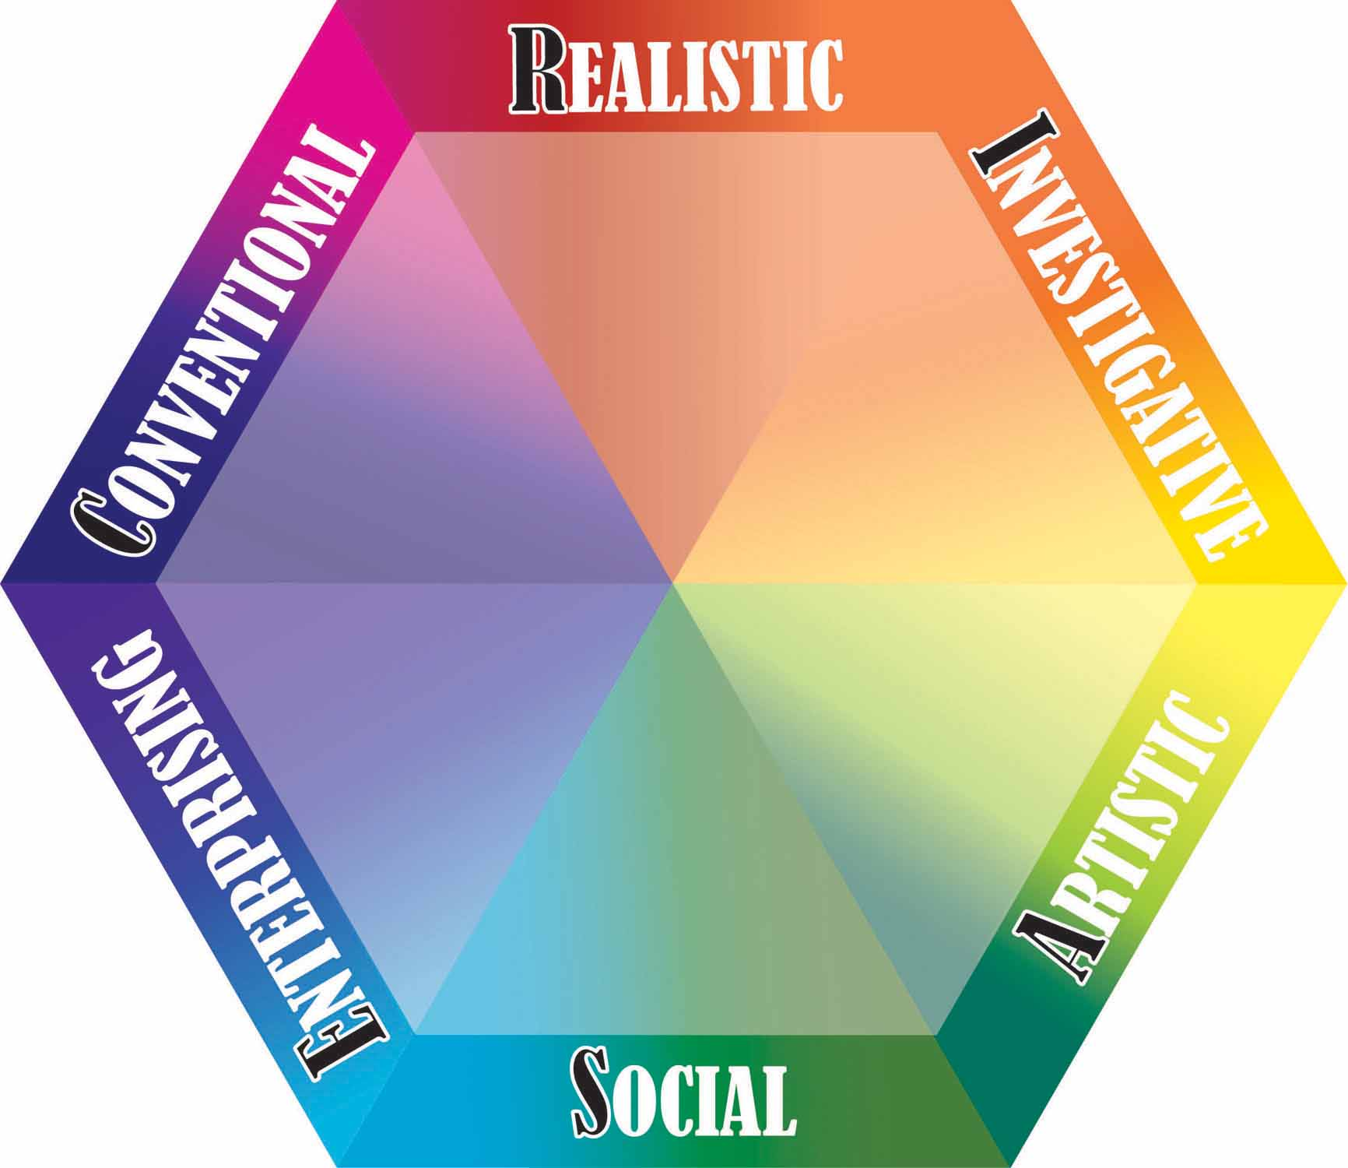
HOLLAND’S HEXAGON

Slide 5

Realistic Persons
Enjoy working with tools, machines, equipment
Often work outdoors
Are active and adventurous
Have good mechanical abilities
Are employed in manufacturing, construction, transportation and engineering

Slide 6
Investigative Persons
Have a strong interest in science
Work with theories, analyze data and solve problems
Are analytical, curious, original and creative
Have good skills in math and science
Are employed in science or lab related work

Slide 7
Artistic Persons
Enjoy visual arts, music, drama or writing
Are creative and value self expression
Work in unstructured and flexible environments
Have artistic talent
Work in museums, theaters, concert halls, advertising

Slide 8
Social Persons
Like to work with people
Enjoy helping, nurturing and caring for others
Have social, communication and teaching skills
Humanistic, idealistic
Work in schools, social services, religious occupations, health care

Slide 9
Enterprising Persons
Like to persuade, lead or supervise
Have skills in selling and communication
Seek positions of leadership, status and power
Employed in business, government, sales and politics

Slide 10
Conventional Persons
Good at organizing and managing details
Like math, accounting, finance
Are efficient and patient
Prefer structure
Work in business, corporations, quality control, and financial institutions

Slide 11
Realistic Persons
Enjoy working with tools, machines, equipment
Often work outdoors
Are active and adventurous
Have good mechanical abilities
Are employed in manufacturing, construction, transportation and engineering

Slide 12
Exercise: What are 20 things you like to do?

Slide 13
Can you list 20 things you like to do in 5 minutes?

Slide 14
Now that you have your list, put a $ next to anything that costs more than $20 each time you do it.

Slide 15
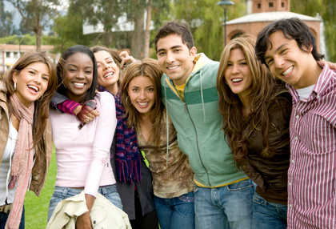
Write P to the left of each item that you do with people.

Slide 16

Write I next to anything that you do by yourself (individually)

Slide 17
Write T next to the items that involve working with things
Cars
Tools
Gardening
Crafts

Slide 18
Write D next to items that involve working with data.
Computers
Math
Budgeting
Organizing

Slide 19
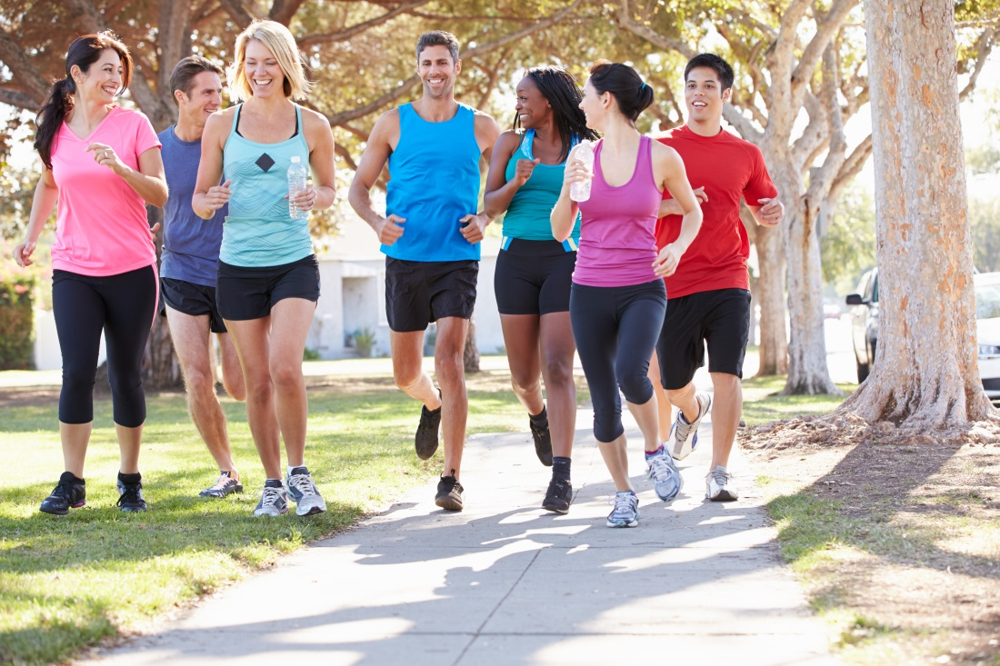
Write A next to items that involve physical activity

Slide 20
Write R next to items that involve risk or adventure
Car racing
Skiing
Motorcycle riding
Skydiving
Rock Climbing

Slide 21
Write MT next to the items you would like to spend more time doing.

Slide 22
Number 1-5 the most important items on your list.
What is your number one interest? Share it with the class.

Slide 23
20 Things You Like to Do
Answer questions at the end of this activity.

Slide 24

What kind of lifestyle do you prefer?

Slide 25
Lifestyle Triangle

Slide 26
Lifestyle
Look at the results of 20 Things You Like to Do.
Do you have a balance between leisure, socializing and work/study?

Slide 27
What Are Your Values?

Slide 28
Values are:
What we think is important
What we feel is right and good

Slide 29
Where do we get our values?

Slide 30
Values come from:
Parents
Friends
Culture
Church
Media
Society

Slide 31
Assignment:
My Personal Coat of Arms
What your like about yourself
Your greatest achievement
Your most prized possession
What you value most in life
A symbol of your personality
Three words to be remembered by

Slide 32
Some samples

Slide 33


Slide 34
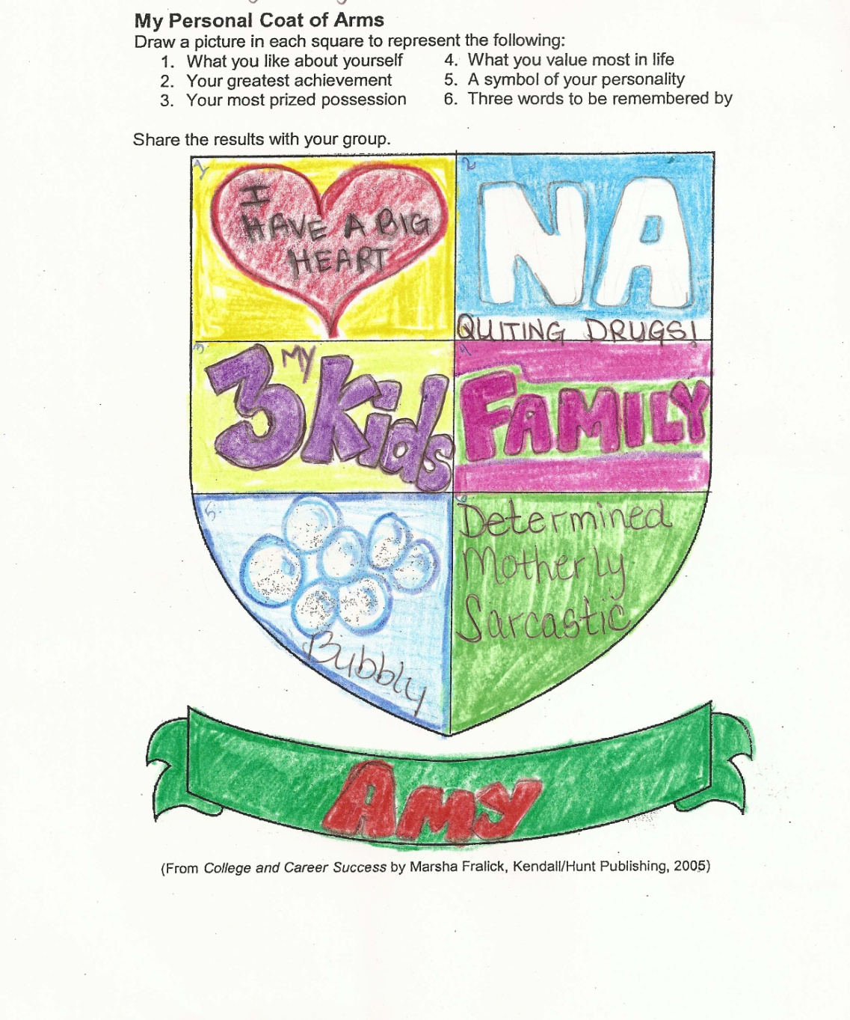

Slide 35


Slide 36
Values and needs are related

Slide 37
Maslow’s Hierarchy of Needs

Slide 38
Maslow’s Hierarchy of Needs
Biological
Tell the truth

Slide 39
Maslow’s Hierarchy of Needs
Safety
Commit to use
Biological
Tell the truth

Slide 40
Maslow’s Hierarchy of Needs
Love and Belonging
Affirmation
Safety
Commit to use
Biological
Tell the truth

Slide 41
Maslow’s Hierarchy of Needs
Self-Esteem
Love and Belonging
Affirmation
Safety
Commit to use
Biological
Tell the truth

Slide 42
Maslow’s Hierarchy of Needs
Self-Actualization
Self-Esteem
Love and Belonging
Affirmation
Safety
Commit to use
Biological
Tell the truth

Slide 43
We Are All Aiming for
Self-Actualization
Feeling secure, loved, respected
Values self and others
Independent
Appreciates and cares for others
Open to new ideas
Feels at one with humankind
Creative, passionate and enjoys life

Slide 44
How are Needs and Values Related?
First we meet basic survival needs
Then focus on wants or desires
Determine what is important (values)
Knowing what we value helps us to make good decisions
Decide on life goals
Accomplish goals

Slide 45
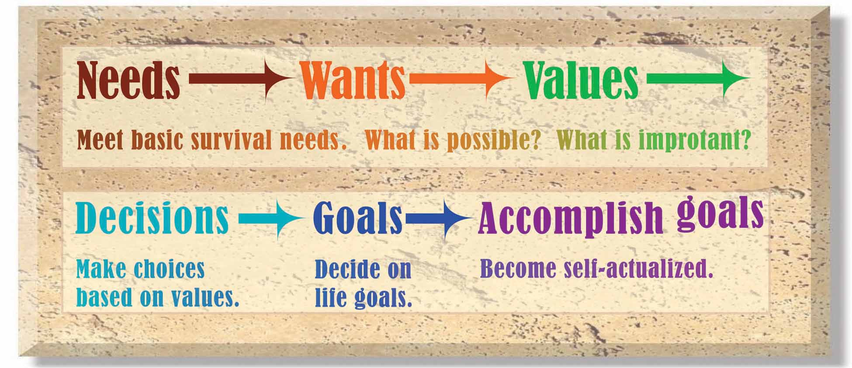

Slide 46
Complete:
Assessing Your Personal Values
Share your highest value with the class
Complete:
Summing Up Values

Slide 47
Keys to Success:
Act on Your Values

Slide 48
Make important decisions based on your values
Should I go to college?
What is my major
What career should I choose?
Who should I marry?

Slide 49
Knowing your values is not enough.

Slide 50
Act on your values

Slide 51
For example, if you value your good health, what actions will you take?

Slide 52

If you value a college education, you can find the motivation needed to be successful.

Slide 53
Group Activity: Values in Action

